Slide 1
Code Mash Conference Sharing
Code Mash Introduction
GIT
Functional Program

Slide 2
CodeMash Introduction
What
CodeMash is a IT conference that educates developers on current practices, methodologies and technology trends in variety of platforms and development languages
When & Where
Every January at Kalahari Resort in Sandusky, Ohio. This is 10th anniversary.
4 day event
2 day Pre-compiler: many workshops
2 day regular sessions

Slide 3
What’s special
Covers many subjects and area
Software and hardware
.Net, Functional program, Javascript, cload, agile methodologies soft skills, big data, Vendor tool introduction.
Schedule is tight.
Topic keeps change
40% new speaker each year
Many regular codemash attendee
Cheap and convenient
KidMash
Free family track for spouses and kids of the attendees
Check Here
http://www.codemash.org/about/

Slide 4
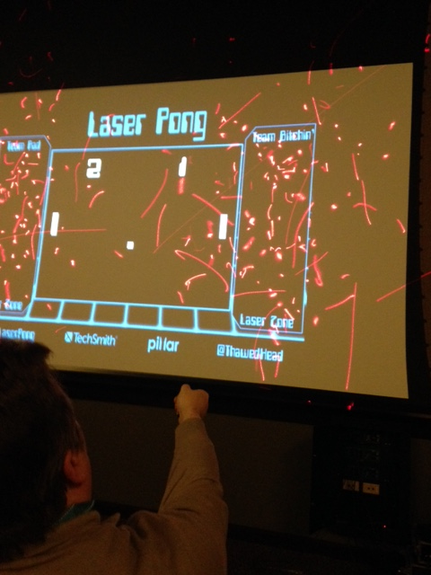
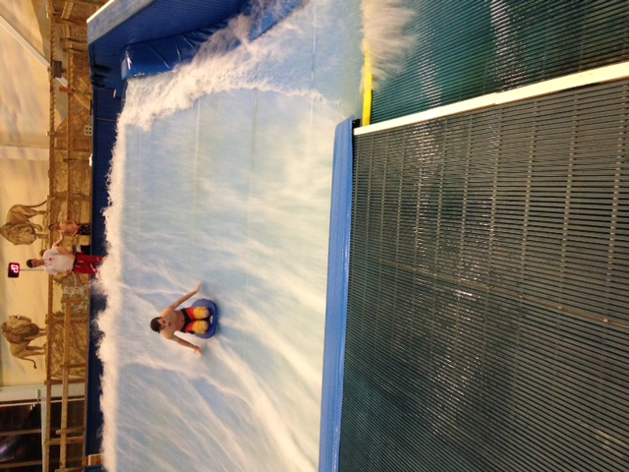
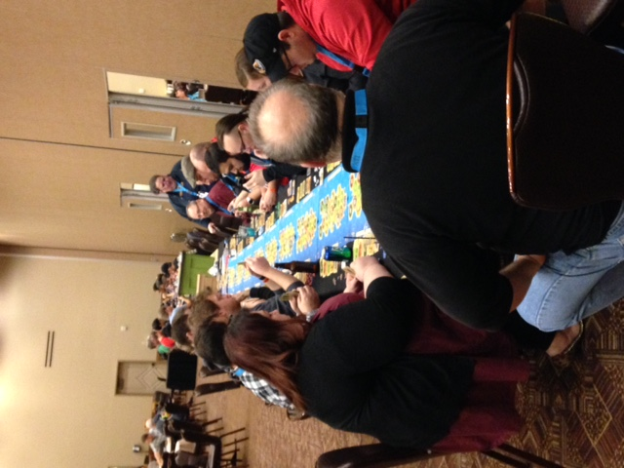
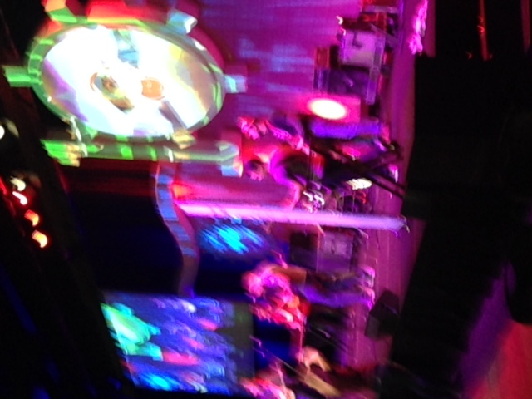
Fun

Slide 5
GIT
Code Mash Introduction
GIT
Functional Program

Slide 6
Commands: Getting Started
First, tell Git who you are:
git config --global user.name “My Name”
git config --global user.email “my@email.address”
Get help:
git <command> -h
git help <command>
Start a new Git repository:
git init

Slide 7
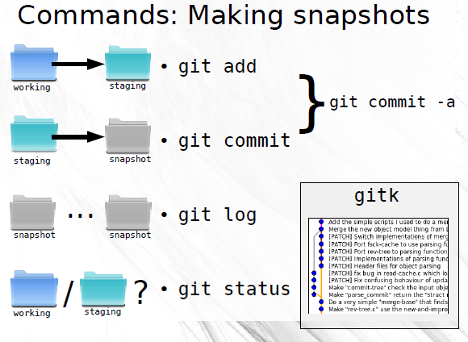

Slide 8
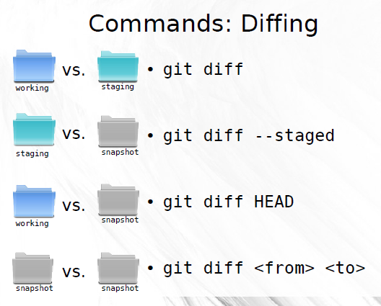

Slide 9
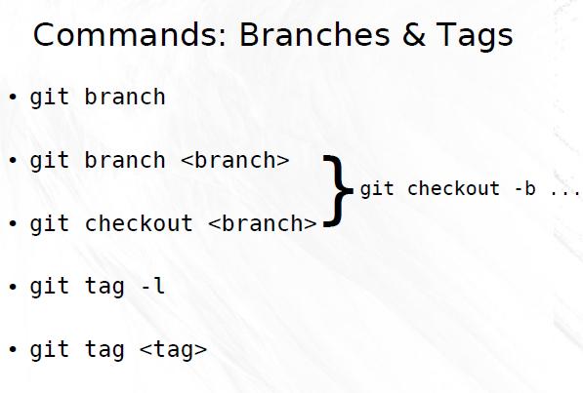

Slide 10
