Slide 1
NLP Assignment1 Review
Elio Desnoulez (19129131)

Slide 2
Assignement Goals
Learn how to predict tags for posts from StackOverflow.
Use multilabel classification approach.

Slide 3
Libraries Used
Numpy — a package for scientific computing.
Pandas — a library providing high-performance, easy-to-use data structures and data analysis tools for the Python
scikit-learn — a tool for data mining and data analysis.
NLTK — a platform to work with natural language.

Slide 4
Text preprocessing
First step : TextPrepare
We needed to lowercase the text
Replace all these characters by spaces : ( ) { } [ ] | @ , ;
Remove these characters : ^ 0-9 a-z ' ' # + _
Remove all the english stopwords downloaded from nltk

Slide 5



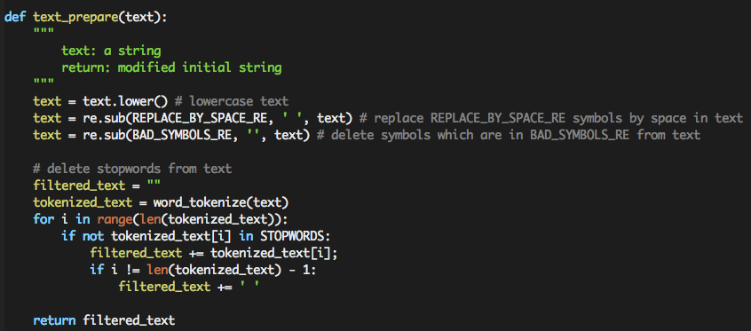
Text preprocessing
Results :
SQL Server - any equivalent of Excel's CHOOSE function? -> sql server equivalent excels choose function
How to free c++ memory vector<int> * arr? -> free c++ memory vectorint arr
"Basic tests are passed." is printed as return of test_text_prepare() function.

Slide 6
Text preprocessing
Second step : WordsTagsCount
We needed to count all words and tags to sort them after and find the most used words / tags.
Create a Bag of words representation

Slide 7
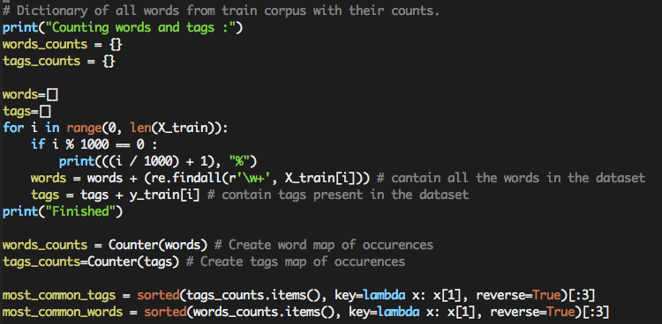
Count Words and Tags
Results :
Most common Tags are javascript, c#, java
Most common Words are using, c, php

Slide 8
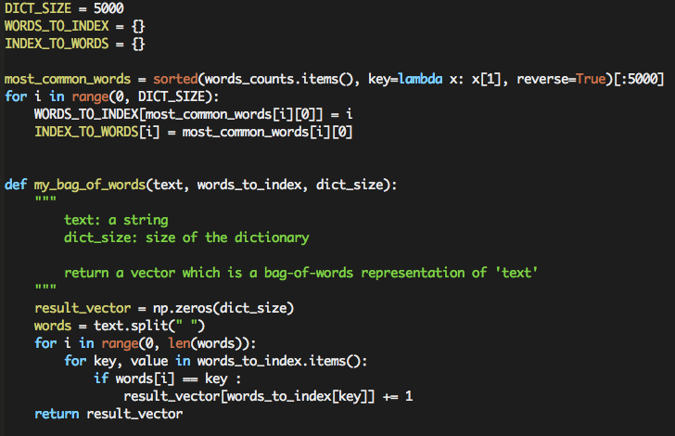
Transforming text to a vector
Results :
words_to_index = {'hi': 0, 'you': 1, 'me': 2, 'are': 3}
examples = ['hi how are you']
answers = [[1, 1, 0, 1]]
"Basic tests are passed." is printed as return of test_my_bag_of_words() function.

Slide 9
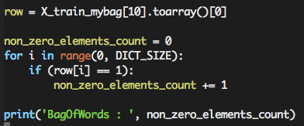

Task 3 : BagOfWords

Slide 10
Encountered problems
I don't know well Python yet (I code usually in Bash, Web, JavaScript, C, C++, Java).
Not much time to do the assignement as I got Distributed Computing courses/project in the same time.
Running the program takes so much time :
i7-4600U CPU @ 2.10GHz
1227.74s user 58.21s system 99% cpu 21:35.73 total -> 22 minutes in local
Xeon(R) CPU E3-1245 V2 @ 3.40GHz
Real 16m56.822s user 16m56.022s sys 0m1.056s -> 17 minutes on server
Maybe with Jupyter I could win some time if I understood it correctly.

