Slide 1
Hidden Markov Model (HMM)
Elio Desnoulez (19129131)

Slide 2
What is the Hidden Markov Model ?
HMM is a statistical Markov model in which the model is assumed to be a Markov process with unobservable states.
Markov Model : a stochastic model used to model randomly changing systems. It is assumed that future states depend only on the current state.
Markov process : a stochastic model describing a sequence of possible events in which the probability of each event depends only on the state attained in the previous event.

Slide 3
Stochastic Model
A stochastic or random process can be defined as a collection of random variables that is indexed by some mathematical set, meaning that each random variable of the stochastic process is uniquely associated with an element in the set.

Slide 4
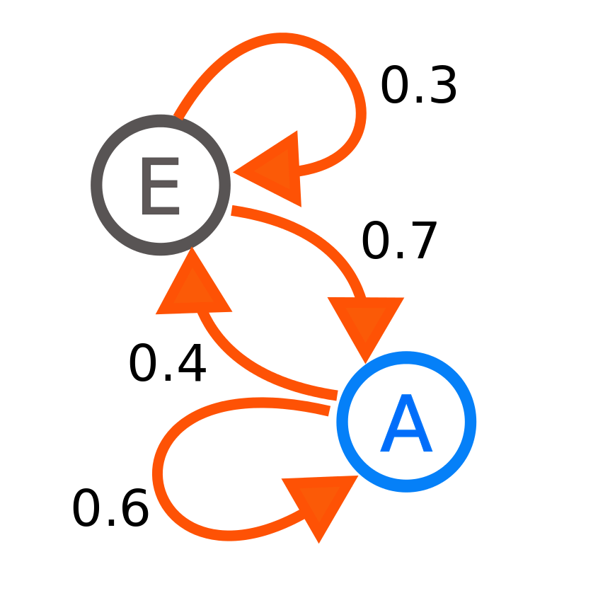
Markov Chain
A diagram representing a two-state Markov process, with the states labelled E and A. Each number represents the probability of the Markov process changing from one state to another state, with the direction indicated by the arrow.
For example, if the Markov process is in state A, then the probability it changes to state E is 0.4, while the probability it remains in state A is 0.6.

Slide 5

The urn problem
In probability and statistics, an urn problem is an idealized exercise in which some objects are represented as colored balls in an urn. One pretends to remove one or more balls from the urn; the goal is to determine the probability of drawing one color or some other properties

Slide 6
Usages and applications
HMMs can be applied in many fields where the goal is to recover a data sequence that is not immediately observable.
Computational finance like stocks predictions.
Speech recognition like Siri (Apple).
Gene prediction to identify the regions of DNA that encode genes.

