Slide 1
NLP Assignment 3 Review
Elio Desnoulez #19129131

Slide 2
Introduction and Goal
Retrieving data from articles from http://scrapsfromtheloft.com/
Selecting only the data from <div class=”post_content”>
Save the retrieved data into local disk with pickle library of Python

Slide 3
Introduction and Goal
Clean the collected data by performing the following tasks :
Make the text all lowercase
Remove the punctuation
Remove numerical values
Remove common non-sensical text like ‘/n’ and ‘\t’
Tokenize the text
Remove the english stop words
Create a document-term matrix using CountVectorizer from sklearn

Slide 4
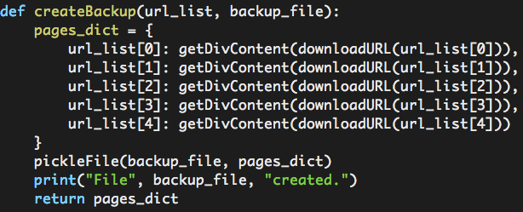
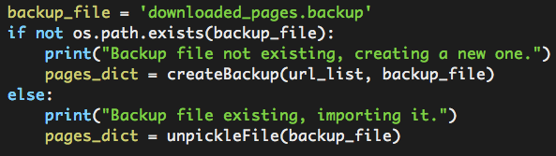
Check if the backup exists
Check if the backup file exists
Creating a backup file with div content data

Slide 5
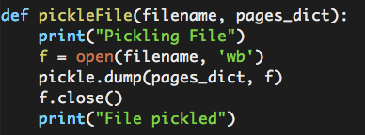
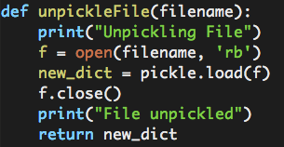
Using Pickle to backup/retrieve data
Dump the dictionary in a file to backup it
Retrieving the dictionary from the backup

Slide 6
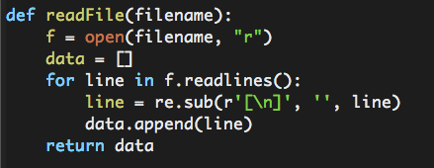
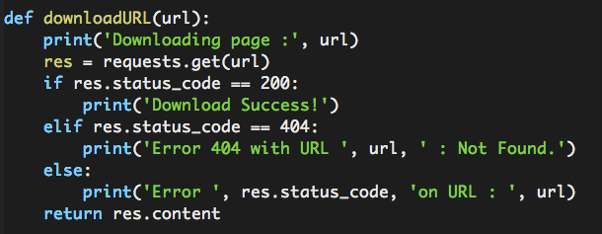
Retrieve data from scrapsfromtheloft site
Get the URL list
Download the page from URL

Slide 7
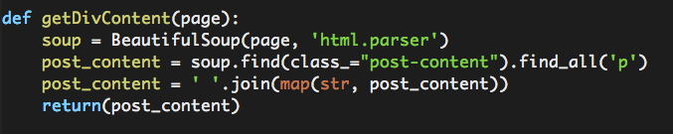
Parse the data from downloaded pages
Get the data from the div class post-content with BeautifulSoup4

Slide 8
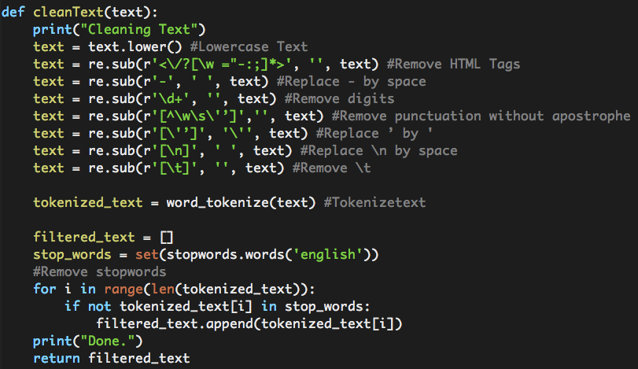
Clean the data retrieved
Cleaning the text, tokenizing it and remove stop words

Slide 9
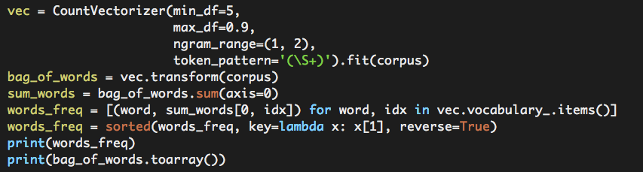
Create a matrix with CountVectorizer
Creating a bag of words representation and a matrix with words frequencies

Slide 10
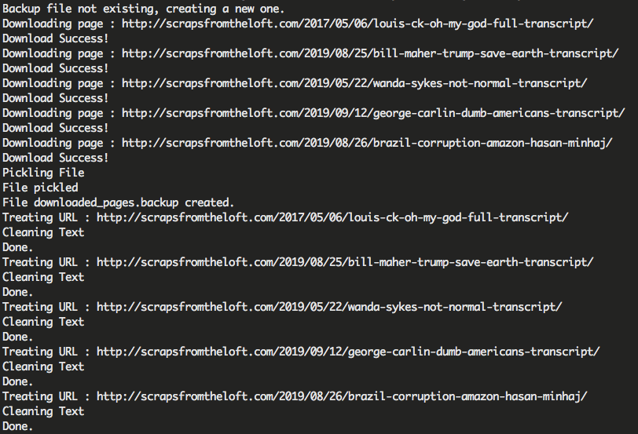
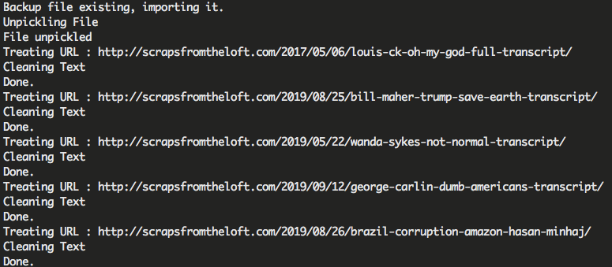
Output of the program
If the backup file is not existing
If the backup file is existing

Slide 11
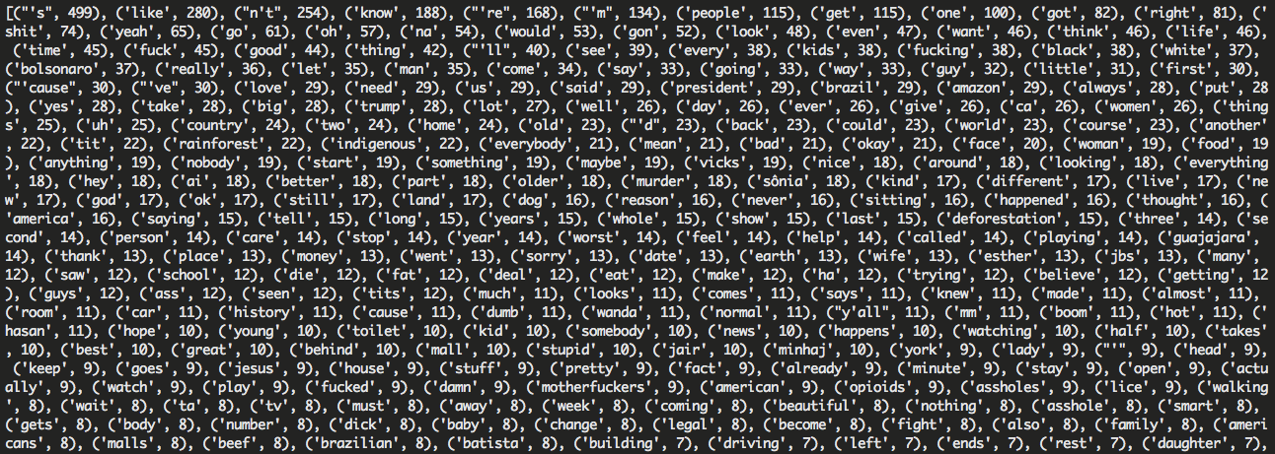
Output of the program
Printing the words occurrences

Slide 12
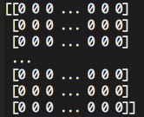
Output of the program
Displaying the array

