Slide 1

Distributed Chat System
Web Services and Cloud Computing — Final Project Team Members: Roniel Abanil, Kanji Earl Guillergan, Alexander Obeja, Joemer Cartagena, Justine Alimpipinig
March 19, 2026

Slide 2
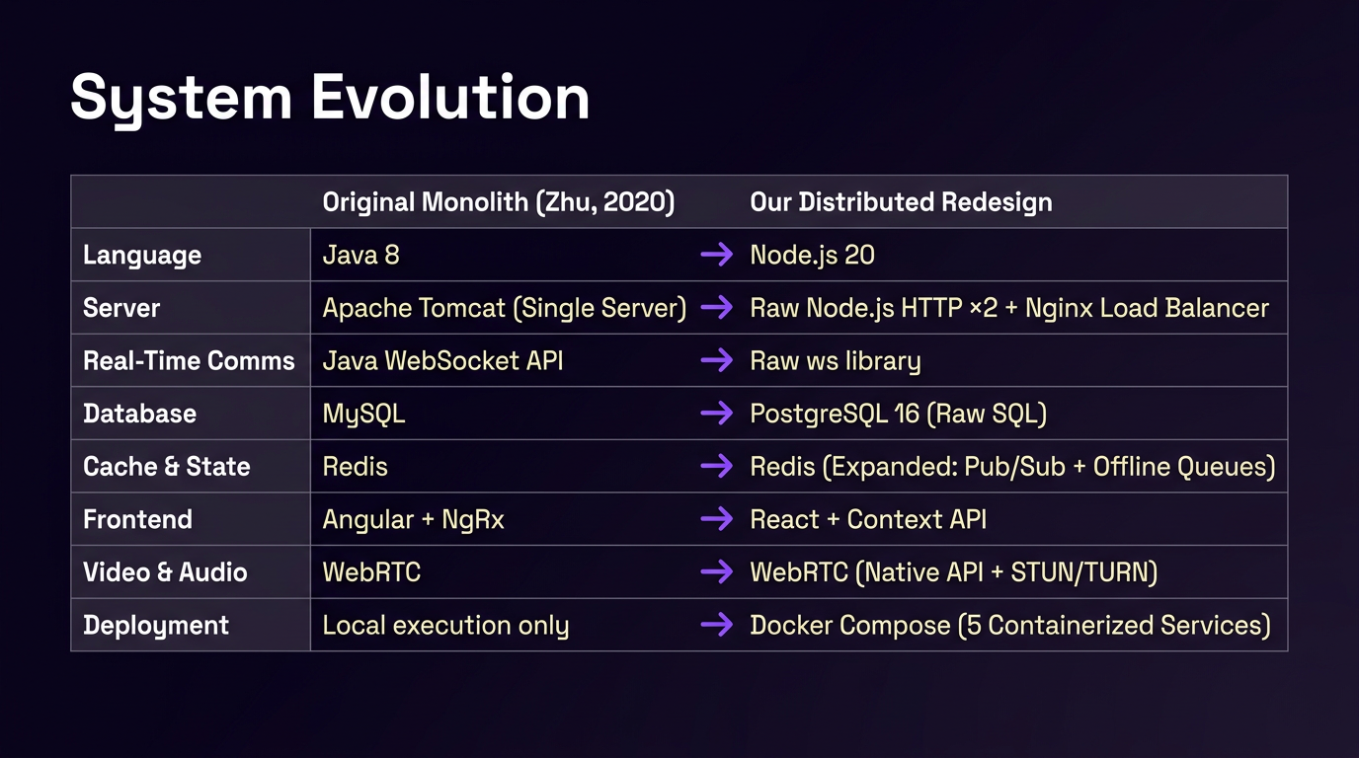

Slide 3





ARCHITECTURE OVERVIEW
LOAD BALANCING
Five core components enable real-time collaboration
Nginx + Sticky Sessions
Distributes incoming traffic across two independent Node.js servers using ip_hash sticky sessions to maintain WebSocket state
STATE SYNCHRONIZATION
Redis Pub/Sub
Operates at the data layer, instantly propagating messages across server instances in real-time
DATA PERSISTENCE
PostgreSQL 16
Unified database securely stores all registered users, dynamic rooms, and chronological message histories
MEDIA STREAMING
WebRTC P2P
Negotiates peer-to-peer pathways, allowing video and audio to flow directly between browsers
SHARED-NOTHING PARADIGM
Stateless Servers
Application servers are completely stateless, guaranteeing horizontal scalability

Slide 4
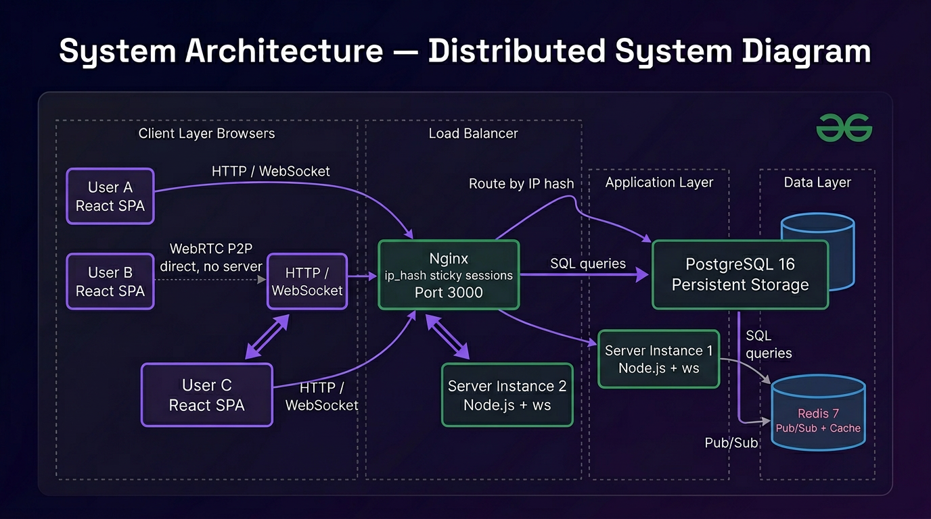
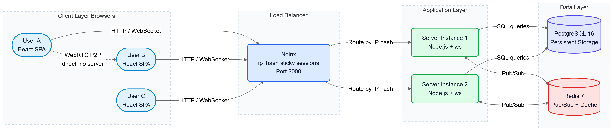

Slide 5
No-Framework Design Philosophy
Standard Framework
Custom Built Solution
Express.js HTTP routing & middleware
Custom 128-line HTTP Router with path parameters & middleware pipelines
Socket.io WebSocket rooms & broadcasting
Raw ws integration with custom room presence & localized broadcasting
Prisma ORM dynamic SQL generation
Raw parameterized SQL queries with bespoke migration runner
Simple-Peer WebRTC wrapper
Native RTCPeerConnection with manual STUN/TURN configuration
Streamlined to 6 runtime dependencies: bcrypt, jsonwebtoken, pg, redis, uuid, ws

Slide 6
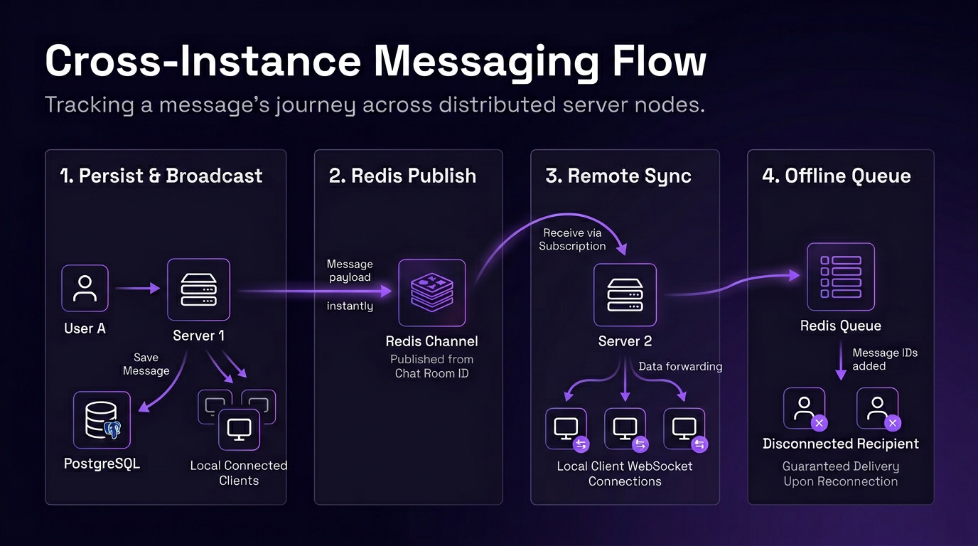

Slide 7
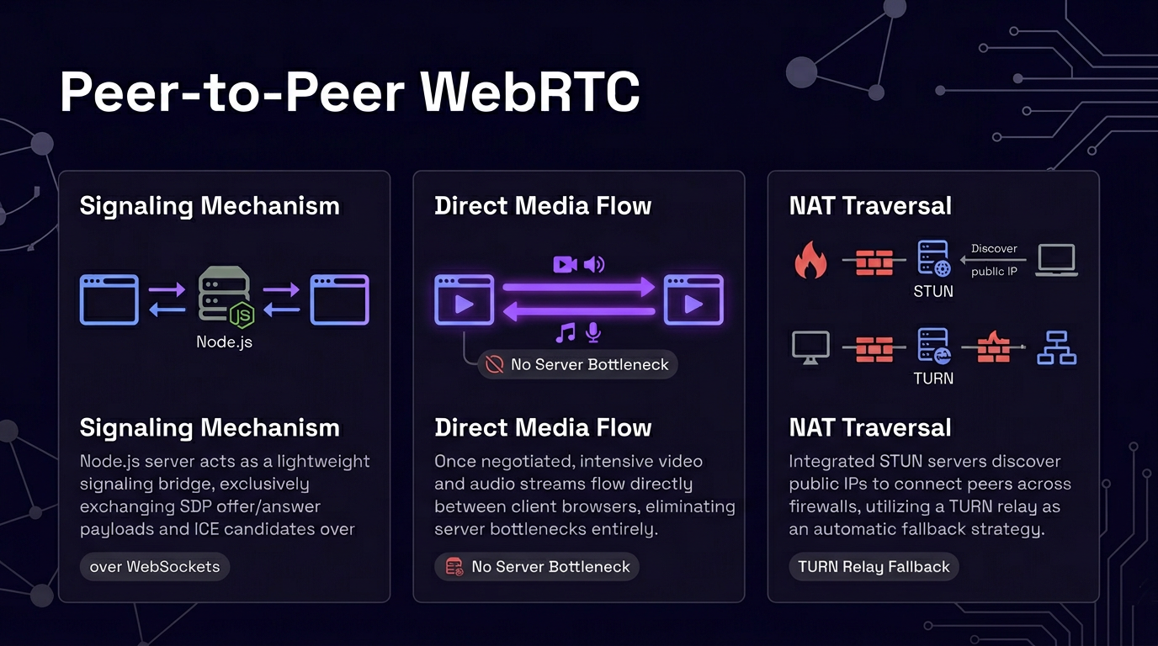

Slide 8
SECURITY
Deployment & Security Standards
Container Orchestration
Authentication
Access Control
A single command initializes all 5 services. Configured health checks enforce strict initialization ordering to prevent race conditions.
Passwords are secured via bcrypt hashing. JSON Web Tokens (JWT) authenticate both REST APIs and critical WebSocket handshakes.
Strict parameterized SQL queries mitigate injection risks. Backend middleware validates room memberships per request, and CORS whitelists block unverified origins.

Slide 9
