Slide 1

Raspberry Pi 101
Some Fun with Pi
By Chuck Duey
September 12th 2018
TM Raspberry Pi Foundation www.raspberrypi.org

Slide 2
Outline:
TM Raspberry Pi Foundation www.raspberrypi.org
Why Raspberry Pi?
What is a Raspberry Pi?
Tips and Tools for the Raspberry Pi
How to install and update your own “Distro”
Tour of the standard Linux Desktop
Raspberry Pi Packages
Raspberry Pi and Internet
  Web Pages, LAMP Stack, Internet API’s and Sockets
Somethings the Raspberry Pi can do with USB hardware
  Wireless router/Access point
  Software Defined Radio
Raspberry Pi Addon Hardware
  Built in interfaces for camera and display
  Hats and bonnets
  Other Addon Boards
Detailed tour of the I/O ports and how to connect.
Hands on exercise with the raspberry Pi and adding circuits. LEDs, and I2C

Slide 3
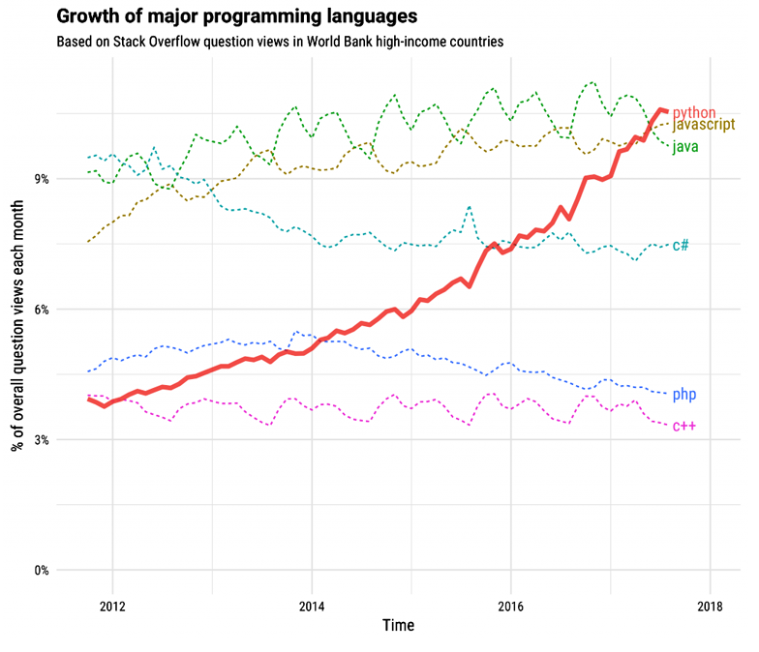
Major Programming Languages

Slide 4
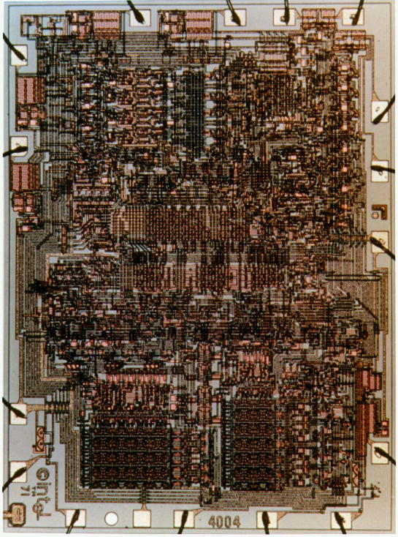
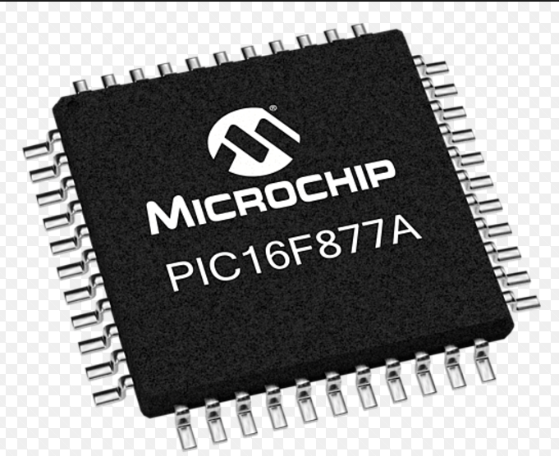
Microchip PIC or other Standalone Microprocessor
Advantages
Targeted size and function. Right for the job.
Low cost.
Support from the manufacturer.
Full custom design. Can make very small.
Disadvantages
Need to build circuitry.
Not much Open-source hardware or software
Need to pay for high level language cross compilers.

Slide 5
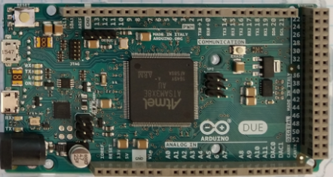
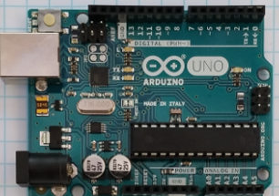
Arduino
Advantages
Many different I/O’s built in.
Very nice IDE. (Integrated Development Environment)
Huge opensource community for both hardware and software.
Many premade shields and hardware addons.
Disadvantages
Size of board is fixed. Cannot easily customize.
Must addon hardware to make IoT device.
Not a platform that can be taken directly to market.

Slide 6
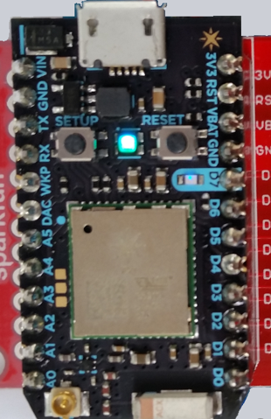
Particle Photon
Advantages
Very small and low power
Uses Arduino like IDE and language.
Is a WiFi device. Very easy to make IoT device.
Full custom design. Can make very small.
Disadvantages
Can only program over the internet.
One processor size and speed 120MHz.
Difficult to connect up dynamically to the internet.
Must have internet connection to start. (use WiFi Hotspot)

Slide 7
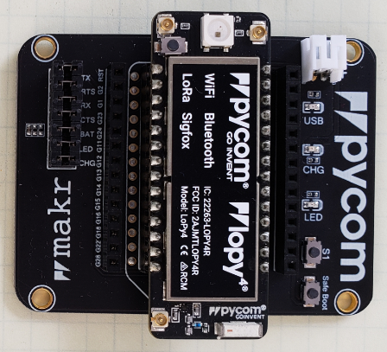
PyCom Boards
Advantages
Very small and low power
Multiple IO 8 X 12 Bit ADC 2x I2C, 2x UART, SPI, GPIO
uPython environment using Atom IDE
Built in AES,DES, and SHA/MD5 Hash
Is Multi standard wireless connections.
Antenna connections for long range
Standalone modules available.
Disadvantages
No Operating system difficult to multi task
One processor size and speed 600MIPS.
Need adapter board to program and connect to I/O.
Difficult to set up dynamic webpages.

Slide 8
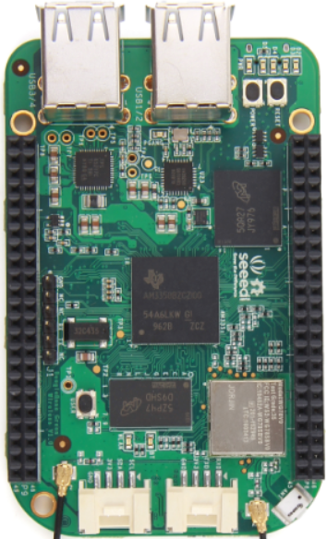
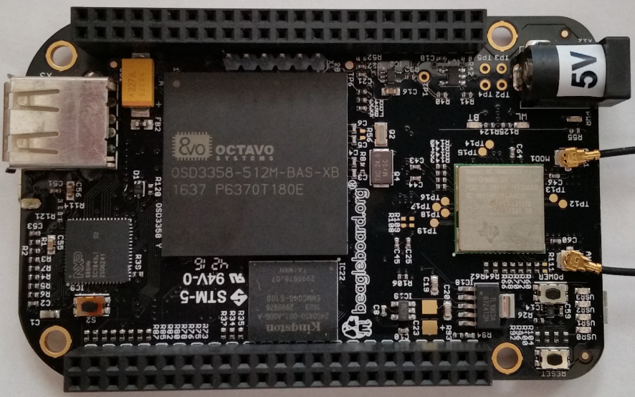
BeagleBone
Advantages
Linux operating system. Can program in many languages and interact with the internet.
Can make Webpages and run full LAMP stack.
Open source software and hardware support.
Fast ARM core processor.
The Black Version has a micro HDMI display.
Analog inputs.
Disadvantages
Display resolution not that good.
Single Core ARM Processors.
Operating system overhead.
Costs more than Raspberry Pi
Community support is not as wide as Raspberry Pi
Operating system and Overlays not stable.

Slide 9
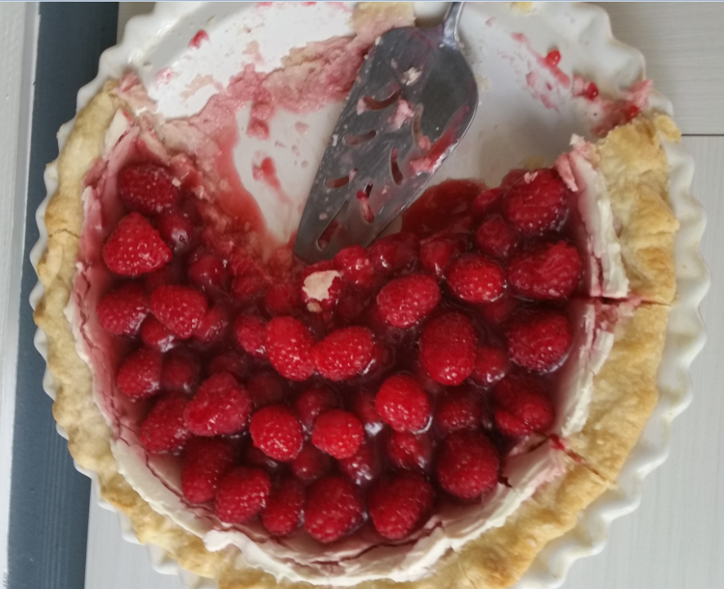
Time to talk about Raspberry Pie

Slide 10
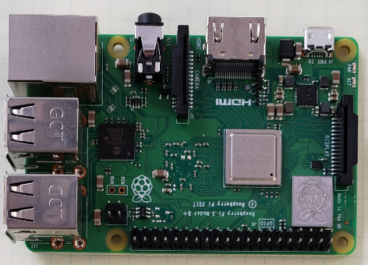
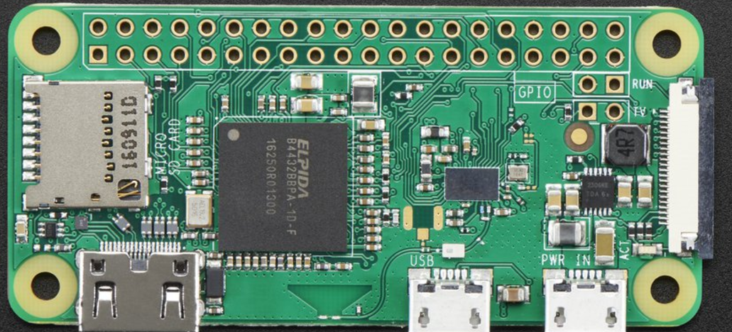
Raspberry Pi
Advantages
Linux operating system. Can program in many languages and interact with the internet.
Can make Webpages and run full LAMP stack.
Massive open source software and hardware support.
Very fast ARM core processor.
Easy to implement GUI’s for interactive programs.
Disadvantages
Need to add on hardware for Analog inputs.
Power hungry when compared to other micro controllers.
Operating system overhead.

Slide 11
Difference between the Raspberry Pi Versions
Model | Zero/W | B | A+ | B+ | Pi 2 | Pi 3 | Pi 3+
CPU | Arm 6 1000MHz | Arm 6 700MHz | Arm 6 700MHz | Arm 6 700MHz | 4xArm 7 900MHz | 4xArm 8 1200MHz | 4xArm 53 1400MHz
RAM | 512MB | 512MB | 256MB | 512MB | 1GB | 1GB | 1GB
USB | 1 | 2 | 1 | 4 | 4 | 4 | 4
Network | None/WiFi | 10/100 | None | 10/100 | 10/100 | 10/100/WiFi | 10/300/WiFi
Video | HDMI | HDMI/NTSC/PAL | HDMI/NTSC/PAL | HDMI/NTSC/PAL | HDMI/NTSC/PAL | HDMI/NTSC/PAL | HDMI/NTSC/PAL
Hardware IO | 25 | 17 | 25 | 25 | 25 | 25 | 25
+5V Current | 120mA | 350mA | 140mA | 250mA | 350mA | 480mA | 600mA
Bluetooth | Yes/W | No | No | No | No | Yes | Yes
SD Card | Micro | Mini | Micro | Micro | Micro | Micro | Micro
Cost | $5/$10* | $30* | $20 | $25 | $35 | $35 | $35

Slide 12
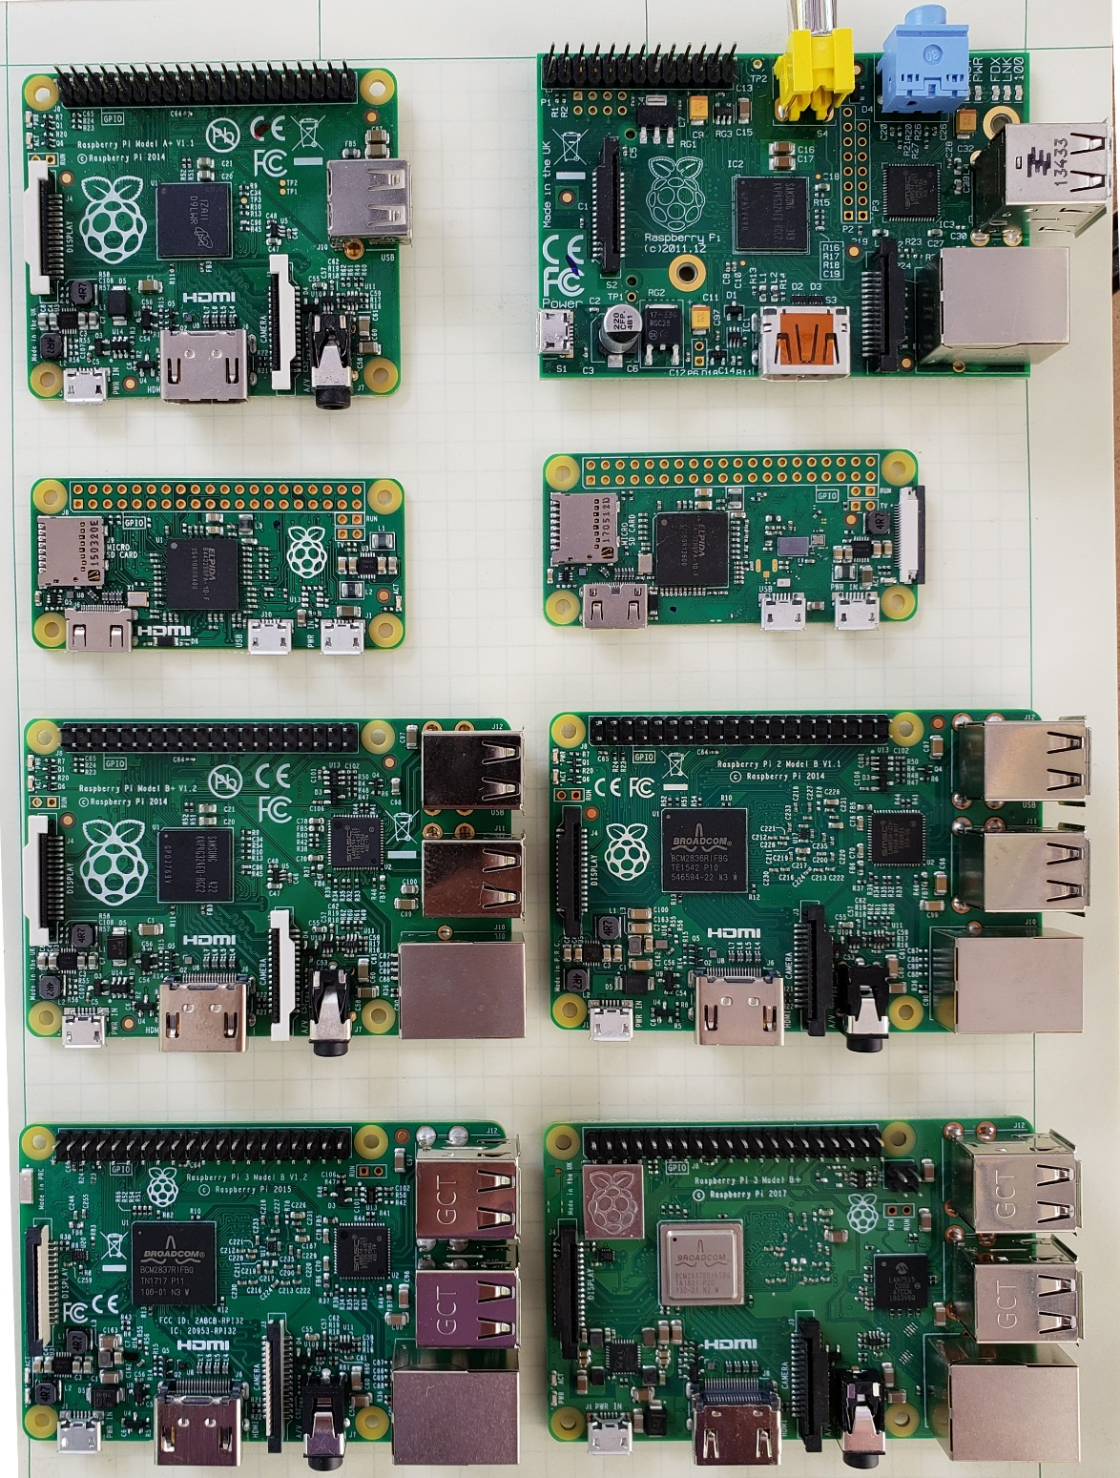
A+
B
Zero
Zero W
B+
Pi2
Pi3
Pi3+

Slide 13

Some Raspberry Pi Resources
TM Raspberry Pi Foundation www.raspberrypi.org
Good Links and web sites:
www.raspberrypi.org —The Foundation’s Website
www.raspberrypi.org/downloads — Various Raspberry Pi Operating Systems
www.adafruit.com — Adafruit very good site for parts and tutorials
learn.adafruit.com/category/raspberry-pi —Many projects and how to’s at Adafruit
www.sparkfun.com —Raspberry Pi parts and many other Hobby parts. (Colorado Co.)
www.mcmelectronics.com —Low priced Raspberry Pi Parts
www.microcenter.com —Online and In Store Raspberry Pi
http://www.instructables.com/howto/Raspberry+Pi/ Lots of good Pi Tutorials
https://github.com/Chuckduey/CSU_Pi_Class.git GitHub page with the code from this class.
My email cduey@msn.com

Slide 14
Important Raspberry Pi Tips
Do Not add or remove hardware while running. Including USB devices. Plugging in a mouse at the last minute can kill the SD card.
Power down the Raspberry Pi using a software command before removing power. SD corruption is very common on uncontrolled power downs.
SD cards are fragile and also wear out. Keep a backup copy of your code. It is best to store it on a network drive.
SD cards come in various speeds and sizes. Class 10 is the fastest. For the Raspberry Pi 32GB is the maximum sized. (SD limitation)
The Raspberry Pi I/O ports are 3.3V. A 5V signal will render the port, and possibly the whole Pi useless.
The Micro SD cards are very easy to pop out accidentally. If it does while it is running, resist the temptation to plug it right back in. Power down first!!!

Slide 15
Useful Tools
Linux or MAC computer with USB and network.
  With a Linux computer, it makes it easy to copy, change and back up Raspberry Pi SD cards using the “dd” command.
  Also the ssh, and ssh –X makes it easy to remote in to work.
Win32 Disk Imager - A perfect tool copying and backing up Raspberry Pi SD cards. Do not do a direct SD to SD copy.
PuTTY - creates a terminal window that can be used to “ssh” to any Linux computer on you network from a windows machine.
VNC/ RealVNC – VNC can display a desktop to another computer Linux or Windows. Very nice for remote work from different platforms.
USB power 2.5A or more - While most computers are limited to 500mA of current on the USB port, it is easy to have more that that draw from a Raspberry Pi with accessories.

Slide 16
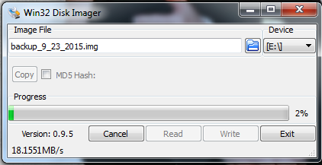
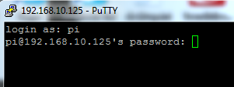
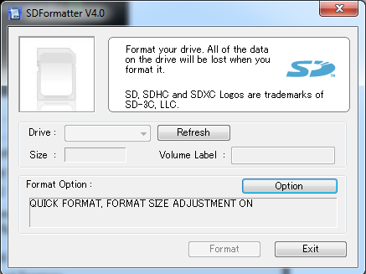
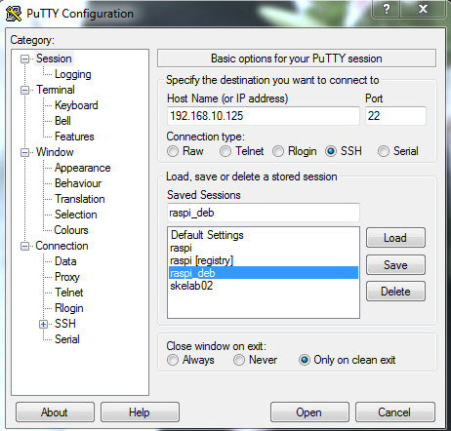
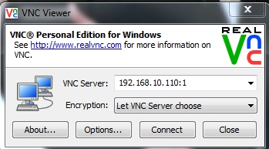
Useful Windows Tools

Slide 17
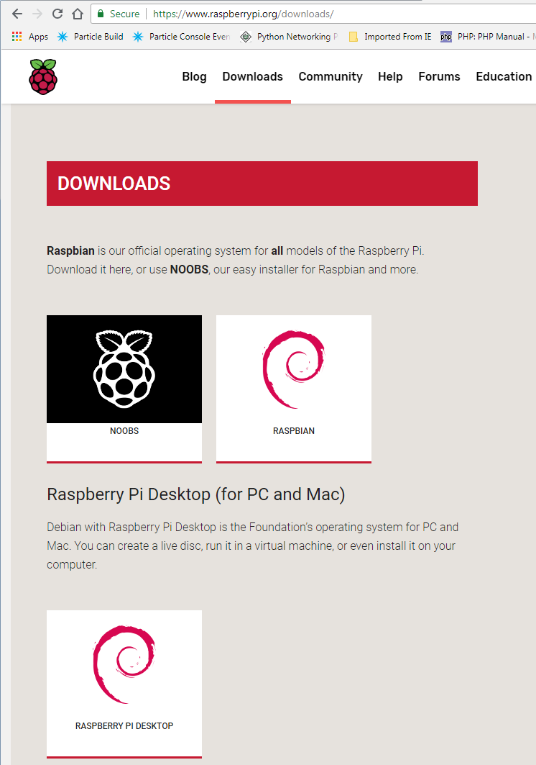
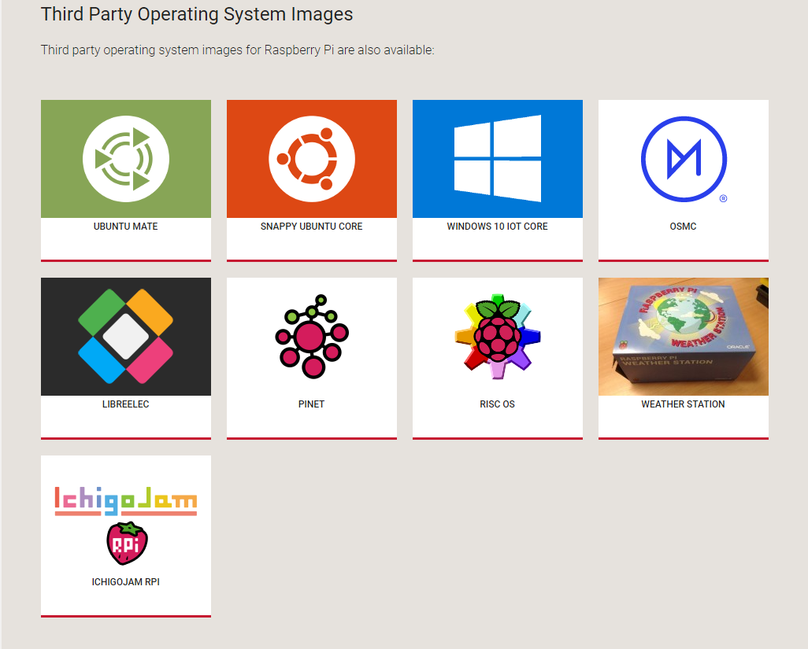
How do you get an OS: NOOBS
www.raspberrypi.org/downloads

Slide 18
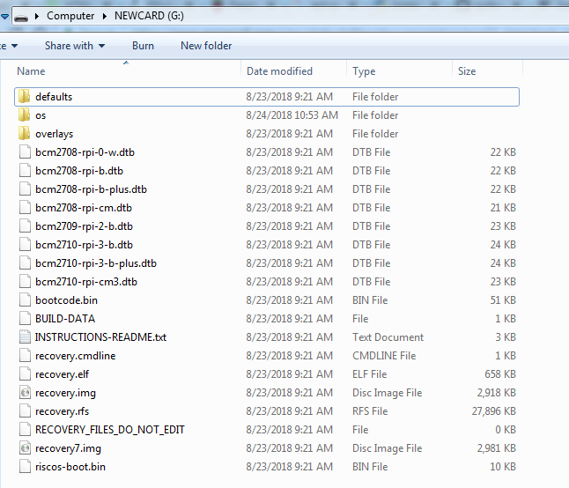
For NOOBS extract files and copy to fresh SDCard 32GB or smaller, and bigger than 4GB

Slide 19
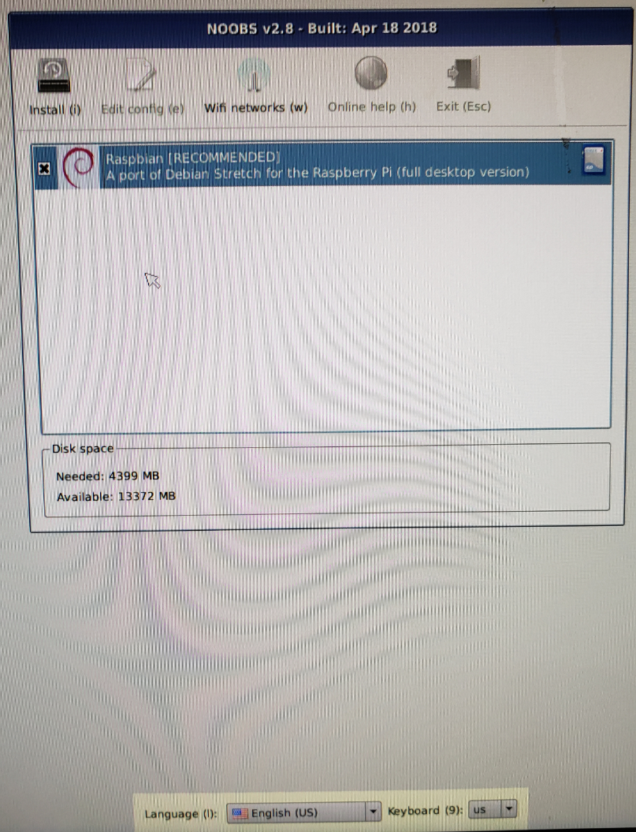
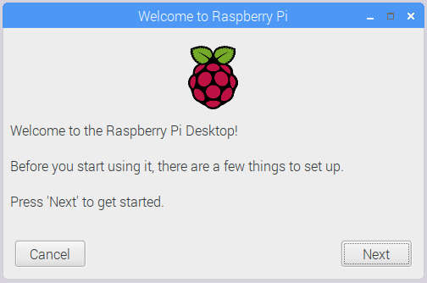
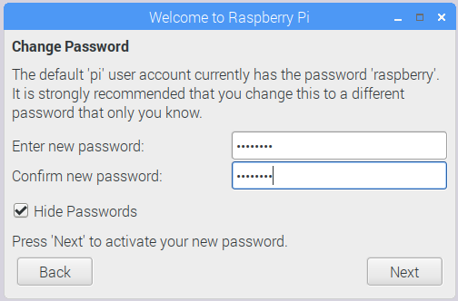
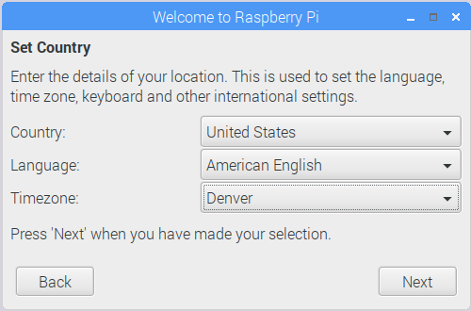
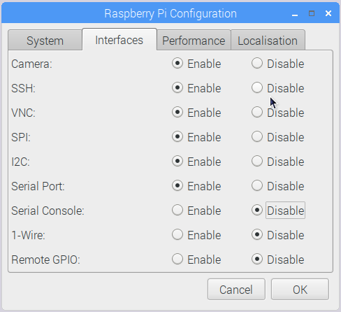
Install Raspian
!
Set US Keyboard!

Slide 20
Hook up your Raspberry Pi
Round up the components. Pi, HDMI cable and display, power supply, power cable, USB mouse and USB keyboard.
Plug in the HDMI to the display and Raspberry Pi.
Plug in USB mouse and keyboard.
Plug in power cable on Raspberry Pi end, and then plug in power.
Watch HDMI display and make sure it is booting.
If it is not booting un plug power and check the SD card.
Do not Plug in or remove hardware components while the Pi is powered! It can cause flash corruption.

Slide 21
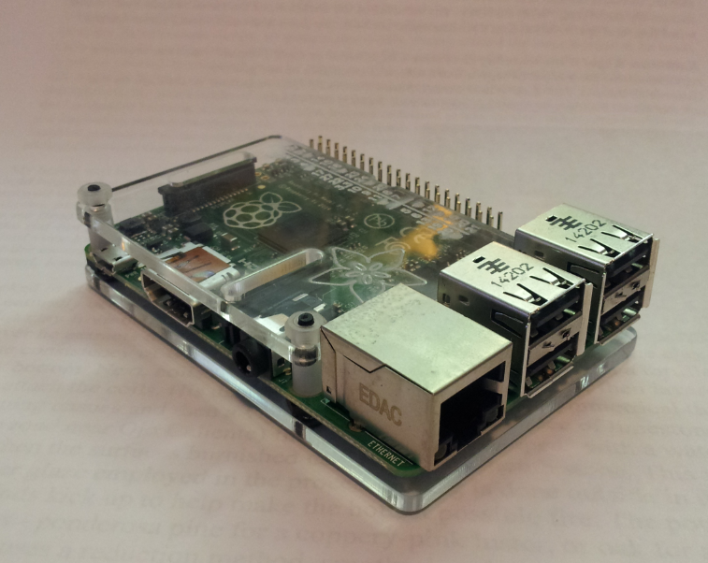
Hooks ups for your Raspberry Pi
10/100 Network
3. Power
1. HDMI
2. USB
Audio/Analog Video

Slide 22
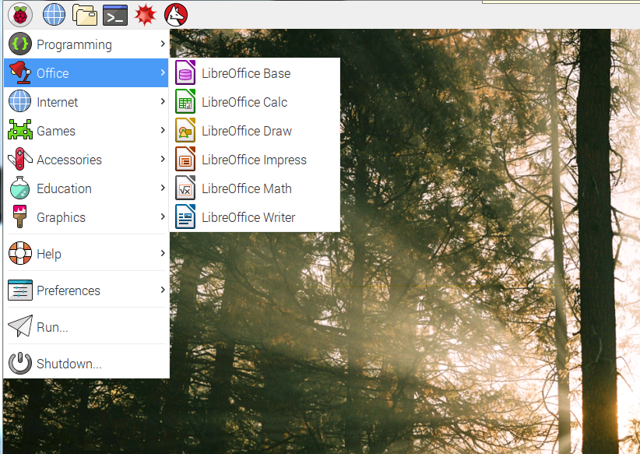
Raspberry Pi Raspian Jessie

Slide 23
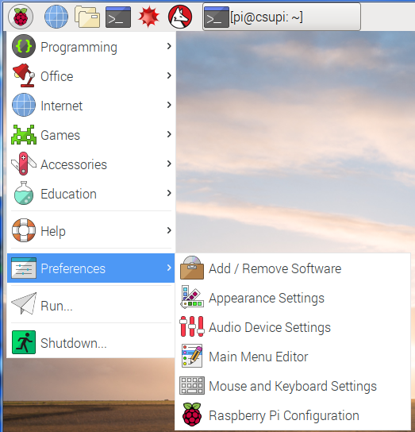
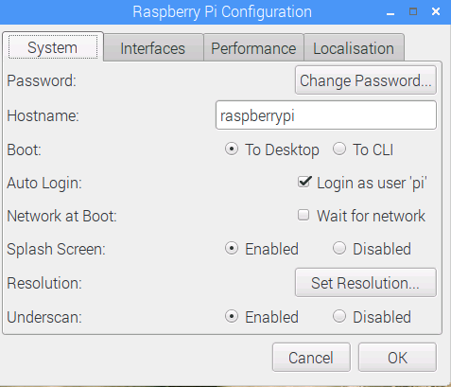
New Raspi-Config

Slide 24
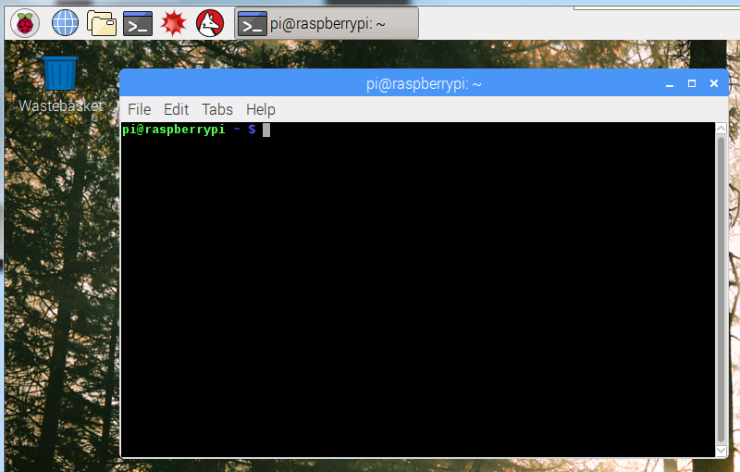
Terminal Window
Click here once

Slide 25
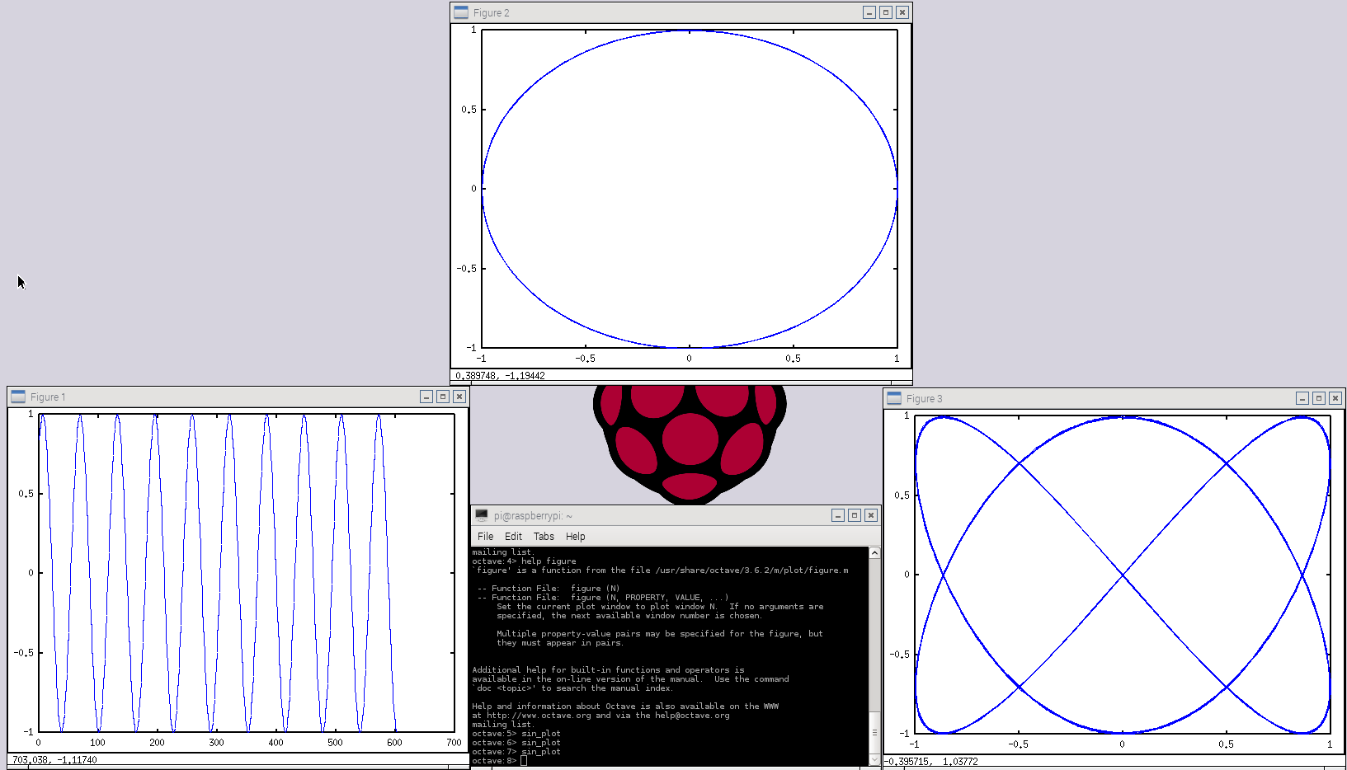
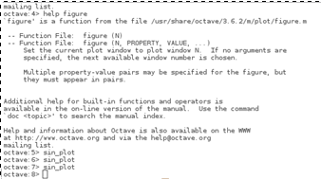
Fun with Octave > sin_plot
Type “exit” When done.

Slide 26
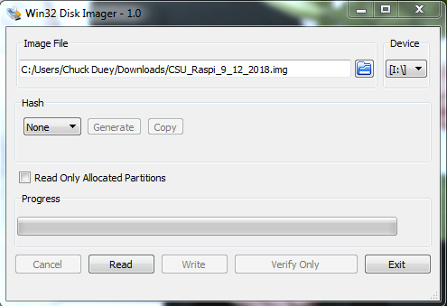
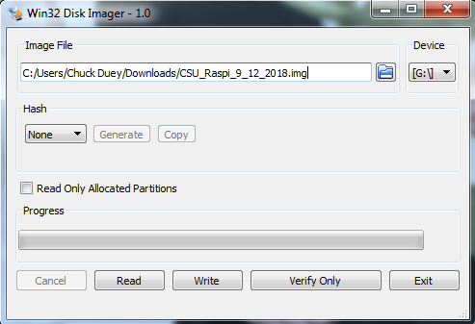
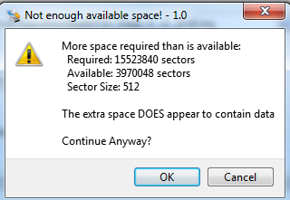
Quick Word on SD Cards
They are not all the same.
Backup your files!!!! SD Cards will get corrupted.
When you copy an image, actual SD card size can vary by more than a GB. To burn to a new card the image size or bigger is needed! Both Windows and Linux copies will have this problem
If Linux dd is used, make sure to copy the root image. /dev/sdX not /dev/sdX0,1..

Slide 27

Matlab® and Raspberry Pi
>> rpi = raspi(‘Address',‘User',‘Password');
>> mcp3208 = spidev(rpi, 'CE0');
>> for i=1:8
[v(i),t(i)] = DAC_Read(mcp3208,i);
end
>> t
t = 66.4532 65.7501 67.1563 66.5411 67.0684 67.1563 67.5958 67.7716
>> scanI2CBus(rpi,'i2c-1')
ans = 1×4 cell array
'0x20' '0x39' '0x3E' '0x68'
Matlab only runs on PC, or other Intel/AMD computers.
Matlab can connect and run commands that controls hardware.
The Student version of Matlab comes with all the controls, many tool boxes and Simulink.
The Student version can ONLY be used by students to meet course requirements and perform research at degree granting institutions.

Slide 28
Terminal window commands
ls = list files in directory ls –l = List long ls –a = List all
cd (dir name) = change directory
df –h = Show file systems sizes and usage
nano (file) = Simple intuitive text editor
vi (file) = Simple powerful non-intuitive test editor.
cat (file) = output the contents of a file
less (file) = output a file one page at a time
apt-get install (package) = get an package to install
apt-get update = update packages
apt-cache show (key word) = show available packages
sudo = next command execute as root
ifconfig = show the ip interface connections

Slide 29
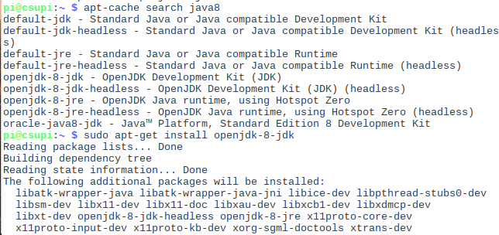
Ways to get applications and software packages
apt-cache search [package]
sudo apt-get install [package] octave, mysql, git, python-pip…
pip install ‘Some Application’
sudo easy_install –U [Python Package] spidev, Rpi.GPIO
git clone git://[package site] git.osmocom.org/rtl-sdr-git
Download “tgz” file. tar –xzf package.tgz

Slide 30
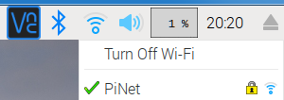

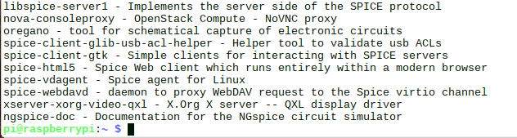
Connect to internet and download package
Verify Connection to Wireless
Open a web page to www.google.com
Open a terminal and “apt-cache search spice”
sudo apt-get install oregano
<- install oregano spice simulation program ->

Slide 31
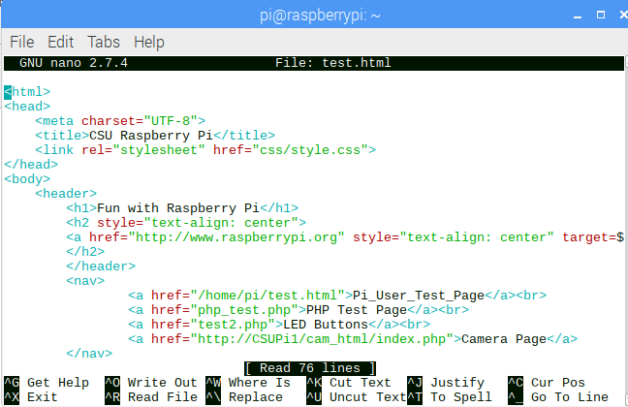
Web Pages
It is very easy to set up a Raspberry Pi to serve Web Pages
Open a web browser and go to “localhost” click on the “Pi_User_Test_Page” link
Now in a terminal window edit the test.html file in your home directory using nano.
~$ nano test.html

Slide 32
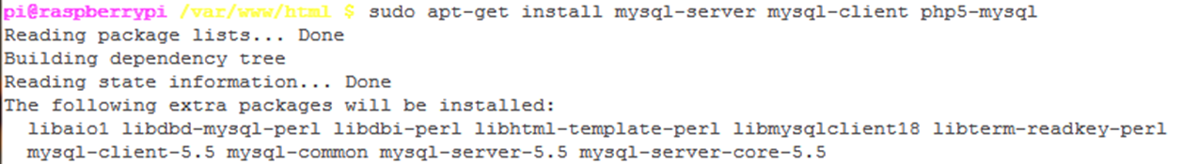
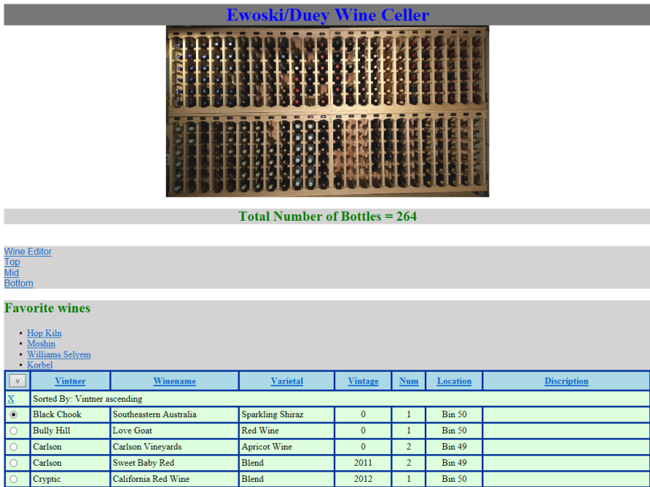
Full LAMP Stack (Linux Apache MySQL PHP)

Slide 33
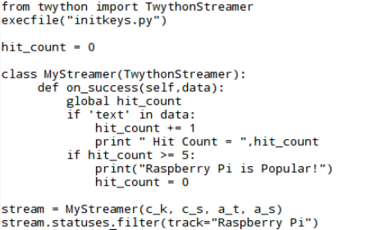
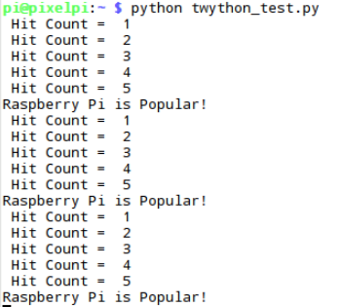
Twython Package for Raspberry Pi

Slide 34

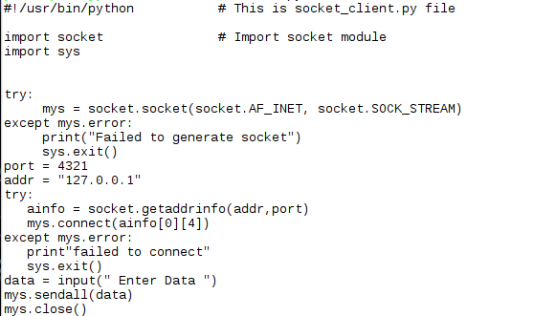
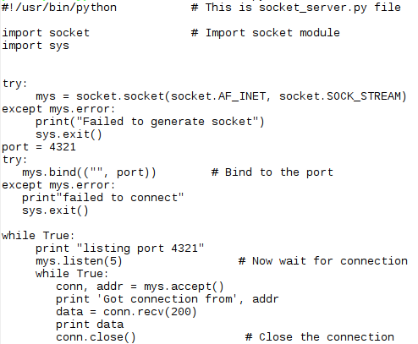


Communicating Via Sockets

Slide 35
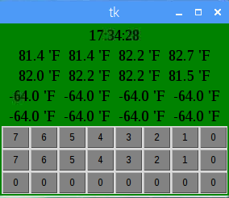
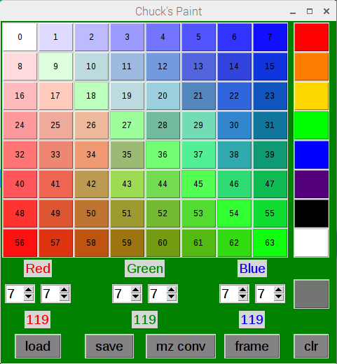
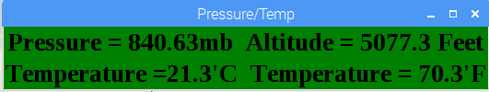

GUI’s via Python Tkinter, Pygame, Qt, GTK+ and Wx Widgets

Slide 36
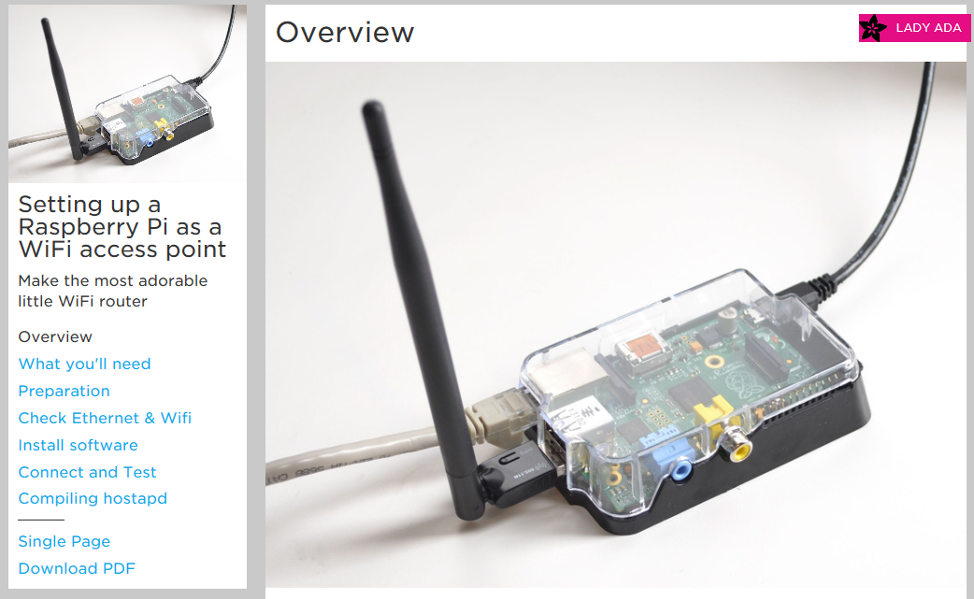
Raspberry Pi as Wireless Access Point
https://learn.adafruit.com/setting-up-a-raspberry-pi-as-a-wifi-access-point?view=all

Slide 37

Raspberry Pi SDR (Software Defined Radio)
HA7ILM Multimode Raspberry Pi SDR: git clone https://github.com/ha7ilm/qtcsdr

Slide 38

GNURadio Example

Slide 39

SDR Radio listening to Aircraft
Aircraft TCAS – Listen to aircraft squawking near by

Slide 40

One more SDR Example
Receiving NOAA Satellite Data
http://www.instructables.com/id/Raspberry-Pi-NOAA-Weather-Satellite-Receiver/

Slide 41



Addon Hardware
Pi Camera – uses built in port.

Slide 42

Camera and Web Page
Open Web browser to home page and click “Camera_Page”
https://elinux.org/RPi-Cam-Web-Interface

Slide 43

New Touch Screen from RPi Foundation

Slide 44

SmartiPi With Camera

Slide 45

Pi Hats – Hardware for the Raspberry Pi

Slide 46





Other Addon Boards
Cirrus Logic Audio Card
Gertboard
Adafruit Proto Bonnet
Pimoroni DAC Bonnet
Adafruit OLED Bonnet

Slide 47




Franken Chiller Brewery Control

Slide 48

Raspberry Pi I/O*
UART/Serial – 2 Wire interface 3.3V
  Good for GPS, RS-232 Monitor, and many others.
  Baud rates up to 115200 bps
SPI Serial 4 Wire interface. (MOSI, MISO, SCLK, CE) 3.3V
  2 Chip Selects built in. Easy connections to many serial sensors.
  Speeds can be between 8KHz to 125MHz
  This can be used to run an LCD Screen
I²C Serial 2 Wire Interface. (SDA, SDL) 3.3V
  Multiple devices with 7 bit address. Up to 127 - 11
  Much slower 400Kbps For Raspberry Pi.
  Great for touch screen sensors.
* From www.raspberrypi.org/forums

Slide 49


GPIO Pin out*
All Others Extra pins
Note: GPIO pins are 3.3V Only
A 5V input will cause damage to the Raspberry Pi!!!
Pi A and B Pin Out
*From http://pi.gadgetoid.com/pinout

Slide 50




Now For Fun and Games with the Pi

Slide 51


Weather station
Open terminal window and type: python MiniWeatherStation.py
Note: Hit the first few characters and hit <tab>

Slide 52
Text display – Scroll you own messages
Open terminal window and type: cat MiniWeatherStation.py
Now do you own, type: python
Copy and center click:
>>> from sense_hat import SenseHat
>>> sense = SenseHat()
>>> sense.clear()
>>> sense.show_message(“Your Message”, text_colour=[255, 0, 0])
When done.
>>> exit()

Slide 53


Accelerometer.
Type: python accel.py
Type: python chuck_maze.py
Use default maze

Slide 54

Pi Sense Hat – Chuck Paint
> python chuck_paint.py

Slide 55

Sense Hat – Chuck Maze

Slide 56

One more Compass
Type: python compass.py
Use a magnet or turn the Pi and see it track the magnetic field.

Slide 57
GitHub – Great Collaboration Tool
For opensource projects it is Free.
Size limit is 1GB, and no file bigger than 100MB.
You can start a Repository and control who can change it.
Changes can be made and tracked.
Branches of code and Tags can be generated.
Private Repos and Closed Repos can be made, but require a monthly fee.
It is a great way to have an opensource project with collaboration.

Slide 58
Thanks !!!
Have Fun With
Raspberry Pi
Code is available at https://github.com/Chuckduey/CSU_Pi_Class.git

