Slide 1

Radhe Institute of Engineering & Technology
Upleta
Mini Project
Presented By :
Chudasama Yash R. (169700307006)
Guided By :
Rojiwadiya Anurag Sir (HOD)
Karmur Kishan Sir

Slide 2
Problem Definition
CY Library Management System is a Library Management System, which maintains the daily work of library.

Slide 3
Index
Introduction
Purposes / Objectives
Tools & Technology
Modules
Users
Screen shots
System Design
Use case Diagram
Activity Diagram
Future Enhancement
Conclusion
References

Slide 4
Introduction
Library Management System is a computerized system, which helps librarian to manage library daily activity in electronic format.
It reduces the risk of paper work such as file lost, file damaged and time consuming.
It helps user to manage transaction or record more effectively and efficiently.

Slide 5
Purposes / Objectives
Improvement in control and performance.
Save cost.
Save time.
Efficient access to library.

Slide 6
Tools & Technology
Tools:
Operating System : Windows XP or higher
Back-end : Microsoft Access
Tools : Microsoft Visual Studio 2012
Front-end : VB.NET
Technology:
Processor : Pentium IV or higher
Memory : 1GB RAM & 40GB Hard Drive

Slide 7
Modules
Login
Add User
User List
Add Student
Student List
Search Student
Add Faculty
Faculty List
Search Faculty
Add Book
Search Book
Issue Book
Return Book
Reports
Notices
Logout

Slide 8
Screen Shots

Slide 9
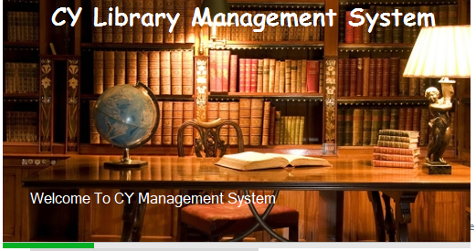
Software Loading

Slide 10
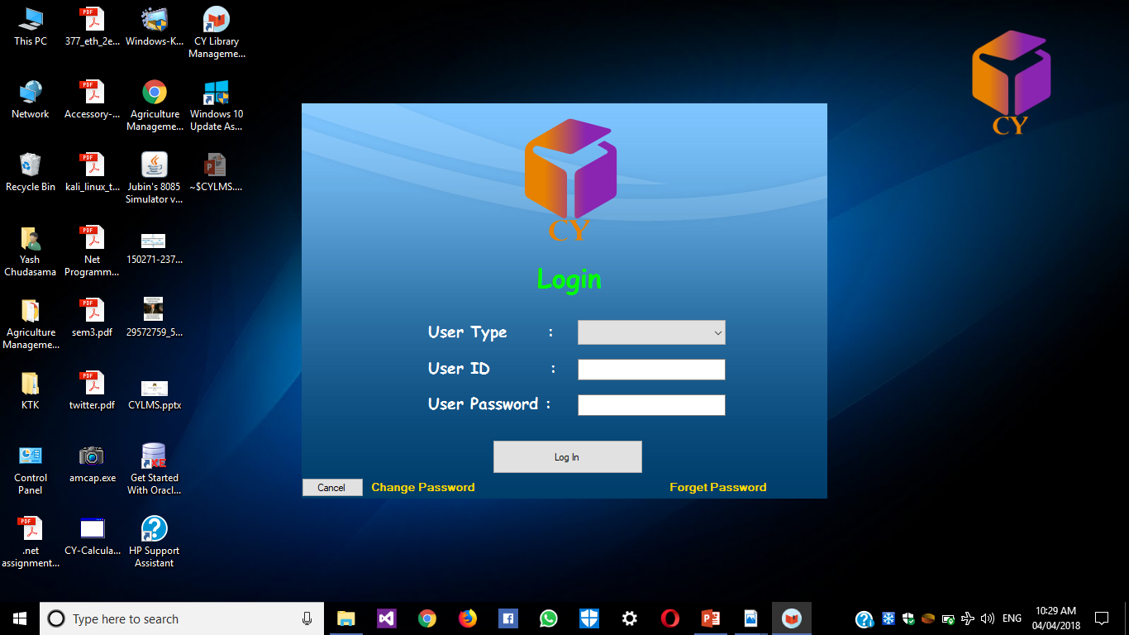
Log In Form

Slide 11
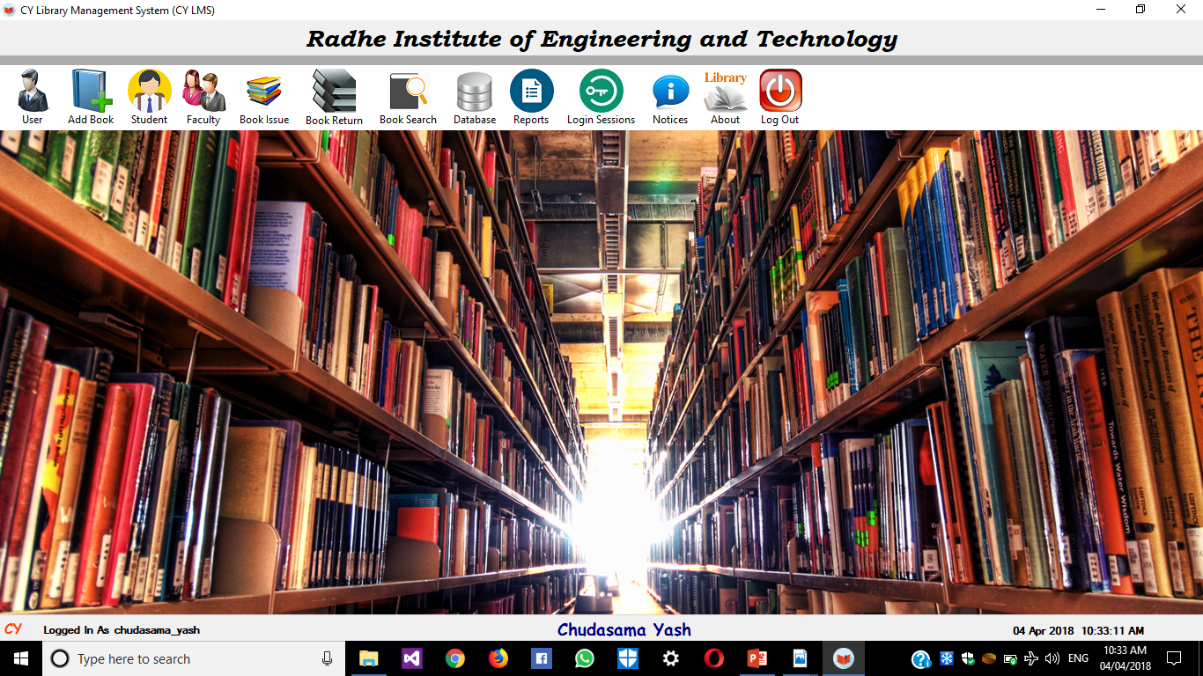
Main Form

Slide 12
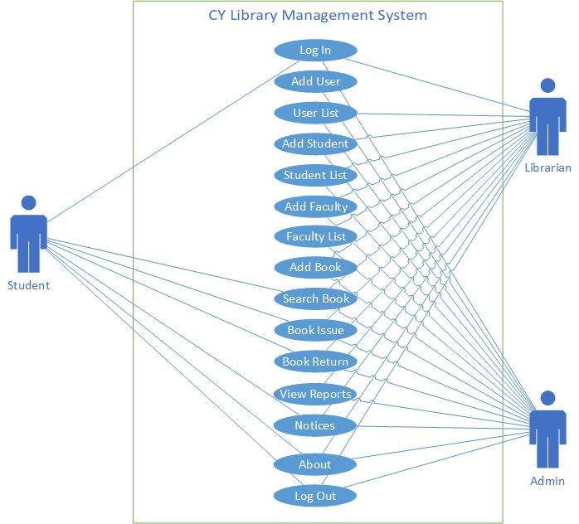
Use case diagram

Slide 13
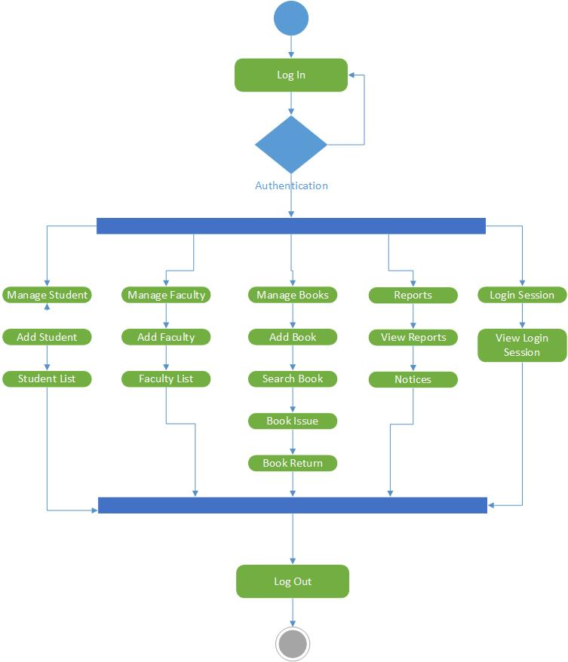
Activity diagram

Slide 14
Future Enhancement
We are modify our system with Biometrics system by using barcode scanner and make our system faster and more smoother then now.
We will trying to add ‘BUY’ and ‘Donation’ modules in our system.

Slide 15
Conclusion
Our project is based on library management. It provides facility to librarian to add book, issue book, return book, search book etc. Using this application, student can easily search for a book. This application makes library work faster. This application increases work efficiency

Slide 16
References
www.microsoft.com
www.stackover.com
www.youtube.com
www.nptel.in
www.iitm.com
www.iitd.com

