Slide 2
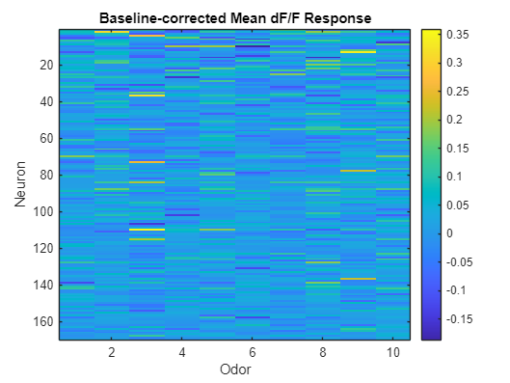
Aim 1: Odor tuning
Mouse 1 170 neurons, 10 odors, 8 trials for each odor.

Slide 3
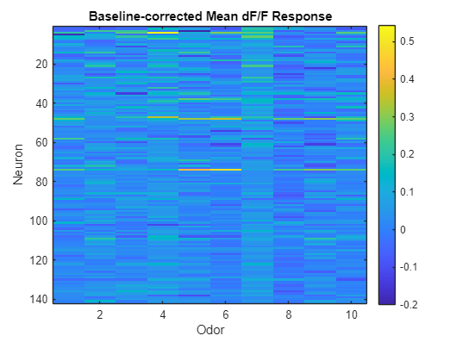
Aim 1: Odor tuning
Mouse 2 142 neurons

Slide 4
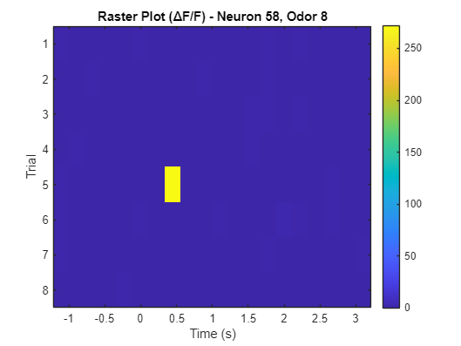
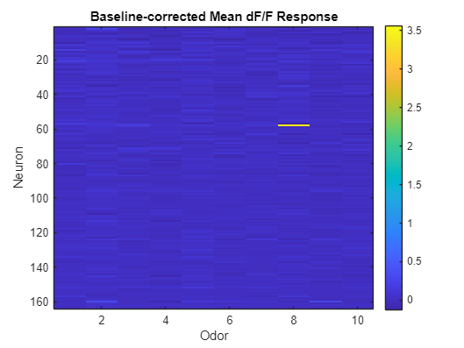
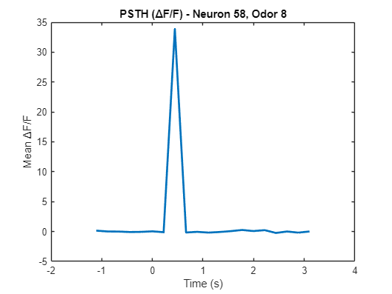
Aim 1: Odor tuning
Mouse 3 164 neurons

Slide 5
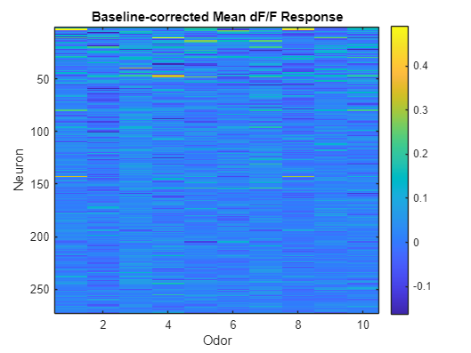
Aim 1: Odor tuning
Mouse 4 273 neurons

