Slide 1

HSIL Hackathon 2026
Taiwan Hub · 全球健康創新黑客松
Building High-Value Health Systems: Leveraging AI
Harvard T.H. Chan School of Public Health × National Taiwan University
April 10–11, 2026 · NTU School of Public Health
1 / 10

Slide 2
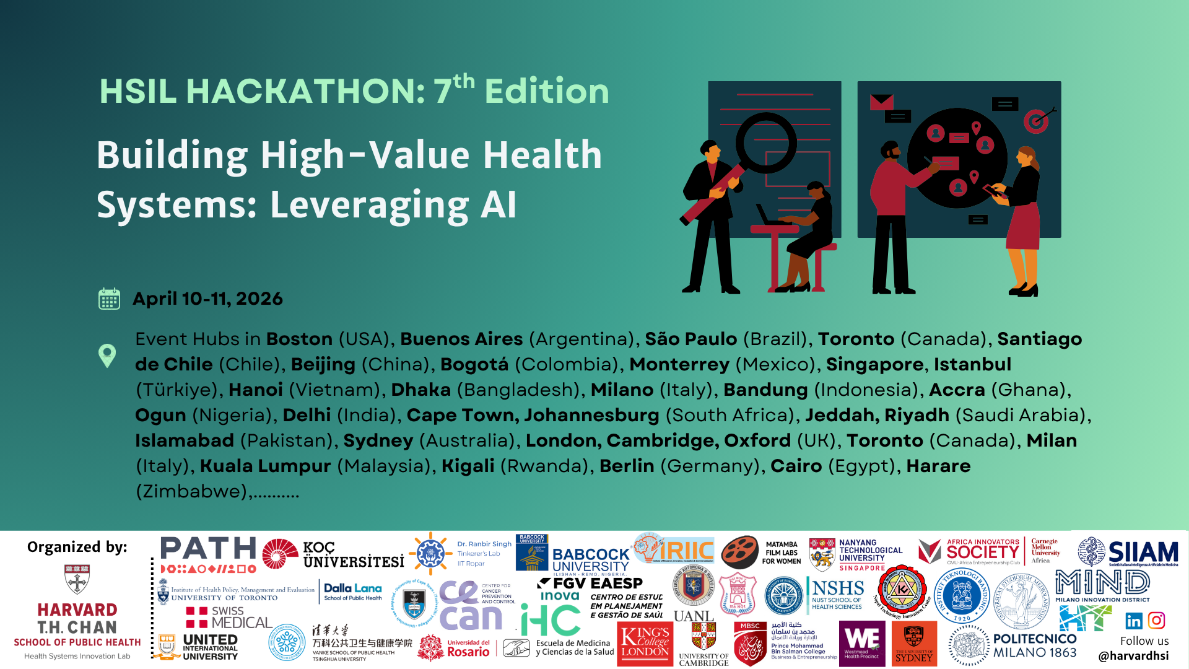
What is HSIL Hackathon?
Annual health innovation hackathon by Harvard HSIL
Now in its 7th edition — 30+ cities worldwide
2026 is Taiwan's FIRST time participating
Co-organized with National Taiwan University (NTU)
Theme: Leveraging AI for high-value health systems
2 / 10

Slide 3
Quick Facts
📅 Dates
📍 Location
April 10–11, 2026 (Fri & Sat)
NTU School of Public Health
⏱ Duration
👥 Team Size
2-Day Hackathon
3–5 members per team
🎤 Deliverable
💰 Cost
3-min pitch + 2-min Q&A
Completely FREE (meals included)
🗣 Language
📝 Registration
Primarily Mandarin Chinese
Deadline: March 31, 2026
3 / 10

Slide 4
Why Join?
🆓 Completely Free
💻 No Coding Required
No registration fee — meals & materials provided
All backgrounds welcome; deliverable is a pitch, not code
🎓 Harvard Bootcamp
🌍 Global Demo Day
Top 2 teams get invited to HSIL Harvard Bootcamp
Present at Harvard Demo Day on June 19, 2026
🤝 Cross-Disciplinary
🏥 Real Health Challenges
Network with students from medicine, CS, business & more
Solve actual healthcare problems with AI-driven solutions
4 / 10

Slide 5
Challenge Themes
運用 AI 打造高價值醫療體系 — Building High-Value Health Systems: Leveraging AI
📊 EHR Data Analysis
🤖 AI Diagnostic Tools
💬 Clinical Chatbots
👨‍⚕️ Medical Workforce Optimization
❤️ Cardiovascular Disease
🎗 Cancer Care
🧠 Mental Health Services
🛡 Disease Prevention & Surveillance
5 / 10

Slide 6
Event Timeline
Now → Mar 31
Registration Open
Online via Airtable form
Early April
Acceptance & Pre-Event
Team confirmation + preparation materials
Apr 10 (Day 1)
Opening · Team Formation · Brainstorm
8:00 AM – 5:30 PM at NTU
Apr 11 (Day 2)
Solution Refinement · Pitch · Awards
8:30 AM – 5:00 PM at NTU
May–June
Post-Event: Refinement & Harvard Demo
June 19 Demo Day at Harvard
6 / 10

Slide 7
Judging Criteria
Each criterion scored 1–5 pts · Total: 30 points
5 pts
Innovation 創新性
5 pts
Feasibility 可行性
5 pts
Health Impact 健康影響力
Novel and creative approach to the problem
Realistic implementation within constraints
Meaningful contribution to health outcomes
5 pts
Scalability 可擴展性
5 pts
Presentation 簡報品質
5 pts
AI Integration AI應用
Potential to scale across populations
Clear, compelling 3-minute pitch delivery
Effective use of AI technologies
7 / 10

Slide 8
Our Website — Tech Stack
Built with modern web technologies to deliver a polished event experience
⚛️ Framework
🎨 Styling
✨ Animations
React 18 + TypeScript
Vite 5 (blazing-fast builds)
Tailwind CSS 3
shadcn/ui + Radix UI
Framer Motion
Scroll-triggered reveals
📱 Responsive
🔧 Dev Tools
🌐 Features
Mobile-first design
Adaptive navigation
ESLint · Vitest
React Testing Library
Live countdown timer
Bilingual (中文 / English)
8 / 10

Slide 9
Website Features
Hero Section
About & Quick Facts
Themes
Animated entrance with live countdown
timer to registration deadline
Event overview, 6-card fact grid,
5-step process timeline
8 AI-health challenge categories
with dark-mode card design
Schedule
Judging & FAQ
CTA & Footer
Color-coded vertical timeline
from registration to Harvard Demo
6 scored criteria + 8 accordion
FAQ items for participants
Prominent register button with glow
effect + social media links
9 / 10

Slide 10
準備好改變世界了嗎？
Ready to Change the World?
📝 Register by March 31, 2026
📍 NTU School of Public Health · April 10–11
📸 Instagram: @hsilhackathon.taiwan
Thank you! · 謝謝！
10 / 10

