Slide 1



DATA SCIENCE CASE STUDY
Loan Offer Propensity Model
Chuene Mosomane
1
Notes:
1

Slide 2






AGENDA
What we'll cover
Business Problem
Data & EDA findings
The bank wants to offer their customers a product - loan. It wants to identify which customers to approach, and if there is any bias in the data.
We have three tables:
customers
loans
transactions
What the three source actually looks like.
Propensity Modelling
Feature engineering
I engineered financial features to check the financial-health KPIs behind the model, in plain terms:
Net cash flow, balance volatility, low balance frequency
Balance to income ratio, burn rate.
I develop a 2 levels-framework - customer and loan levels
Then build a classification model to predict the probability of a which customers will take up a loan.
The customers idenfied are stored in a CSV file
-
Model & fairness results
MLOps: pipeline, monitoring, next steps
I performed feature selection to rank discriminant features.
Then train and evaluate a Logistic regression with 85/15 split.
Lastly generate a fairness report: approval by age and gender
The solution is written in PySpark and runs in production.
Monitoring for key metrics is done in Grafana dashboards
Recomendations: This solution is used by the marketing team for promotional intervension.
Chuene Mosomane
2
2
Notes:
2

Slide 3
BUSINESS PROBLEM
Which customers should we approach with a loan offer?
Objective
Why it matters
Targeted offers convert better than blanket campaigns and cost less to run
Use exploratory analytics, visualization, and machine learning on customer, transaction, and loan data to identify clients we should proactively approach with a loan offer.
Getting this wrong at scale means either missed revenue or reputational/regulatory risk
A model that can't explain *why* it flags someone, it is a liability in a regulated lending context
3
Chuene Mosomane
3
Notes:
3

Slide 4
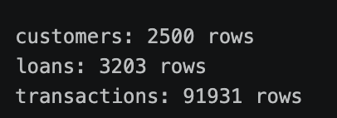




Three tables, one customer ID to join them
THE DATA
Customers
Transactions
Loans
• Gender
• Date
• Date applied
• Age
• Amount (+in / -out)
• Amount requested
• Income
• Balance after transaction
• Outcome: TakeUp / Declined
One row per client
Many rows per client, over time
One row per historical application
Joined on customer ID into two working tables: a customer-level view (for EDA and segmentation) and a loan-application-level view (for modelling — see slide 6).
Chuene Mosomane
4
4
Notes:
4

Slide 5
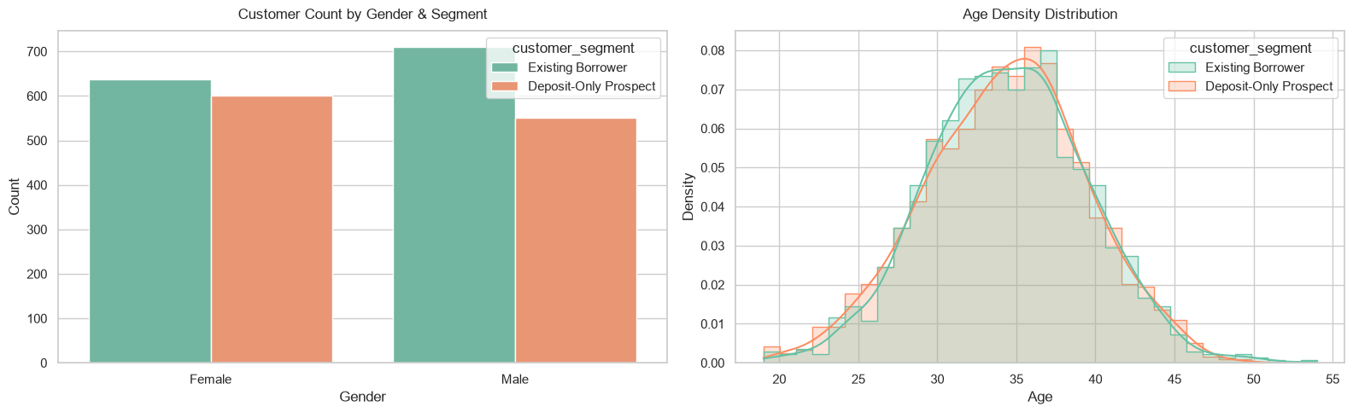
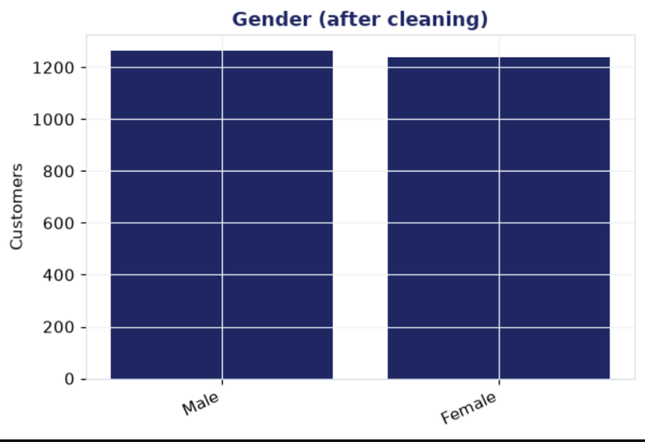
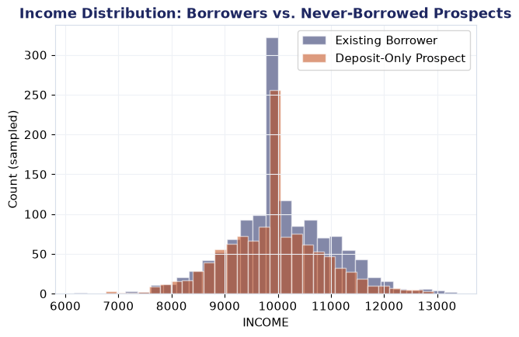
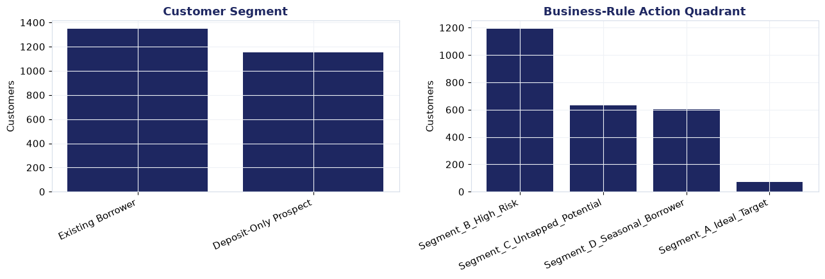
What are the Demographics?
Our customers consists of a fair distribution of male and female who earns ~R10000 and mostly are youth as age peaks around 35 years.
5

Slide 6
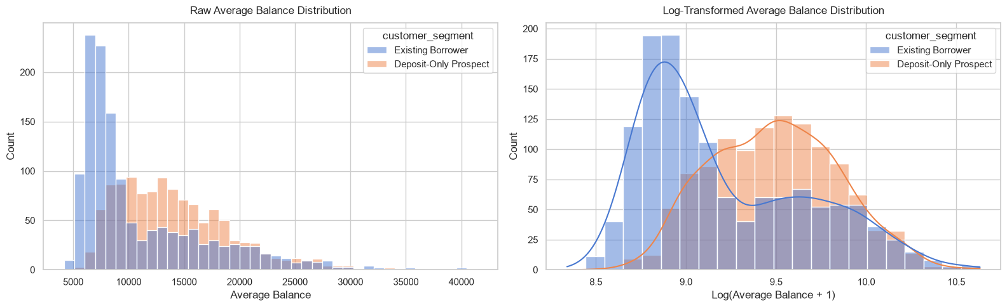
What is the disposable cash our customers have?
We see that most of existing borrower customers have disposable cash of ~R8000 and only around 10% of our customers have higher disposable cash ~R25000
When we zoom in, we further see that the deposit-only prospect customers have the same disposable cash as the exististing borrowers customers at the tail.
6

Slide 7
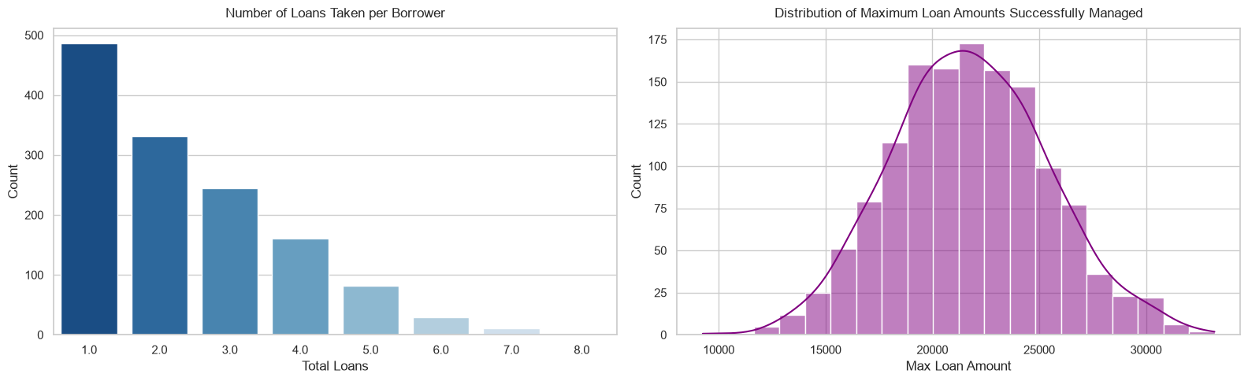
Does our customers take loans and how much?
Most customers take up a single loan of around R21000.
I shall use this feature because it has a normal distribution shape, to engineer KPI features
7

Slide 8
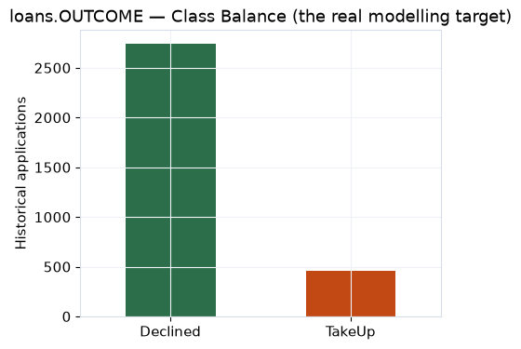
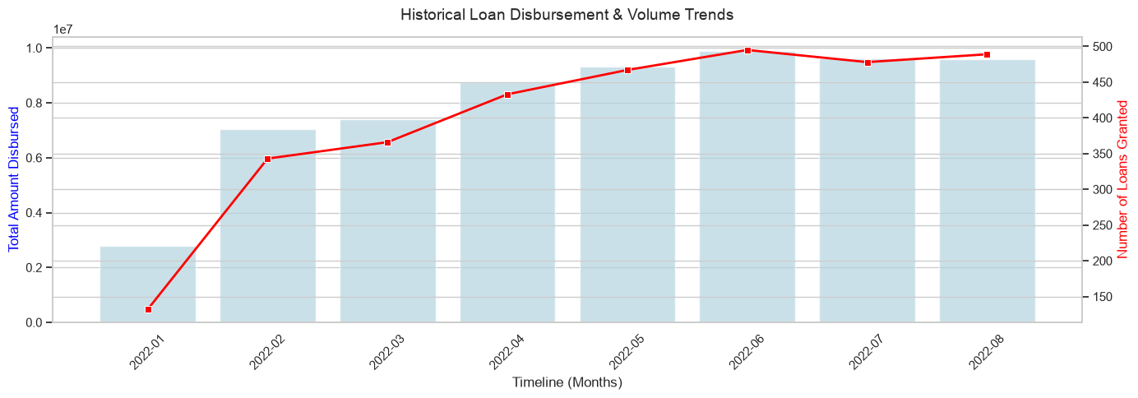
How many customers take-up a loan and what impact does it have on business?
Even though it looks like there is less number of people taking up the loan but there is a increase on the number of loans that are granted.
8

Slide 9

KPIs behind the model
FEATURE ENGINEERING
Net cash flow
Balance volatility
Burn rate
Average monthly inflow minus outflow — a steady positive gap signals capacity to repay.
Std. dev. of balance vs. its average — a shaky balance suggests higher near-term risk.
How fast balance drops after it peaks each month (a proxy for “just got paid”) — currency lost per day.
Low-balance frequency
Credit capacity
Lifecycle segment
Count of near-zero balance events — threshold set from the data's own 10th percentile, not a guessed round number.
Largest amount ever successfully taken up, relative to income — a proven, not assumed, borrowing ceiling.
Age × income quadrant (tertile cut-offs from the data) — young/low-income vs. mid-age/high-income vs. senior, etc.
Chuene Mosomane
8
9
Notes:
8

Slide 10
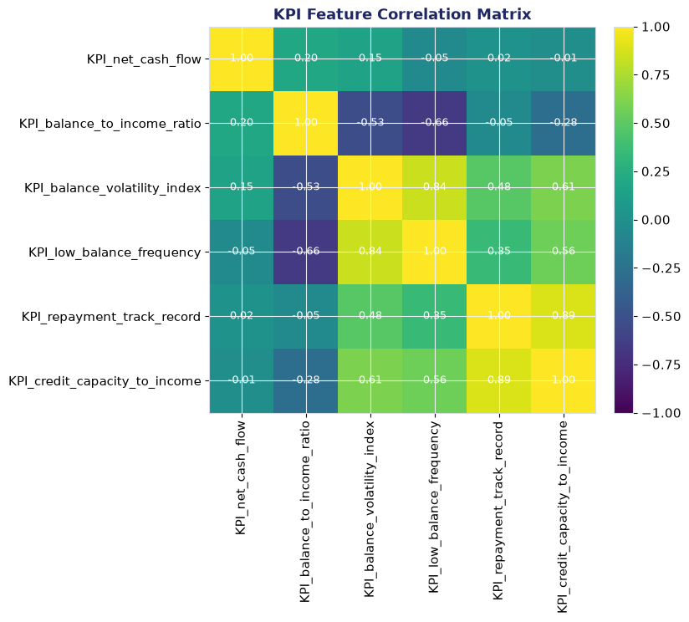
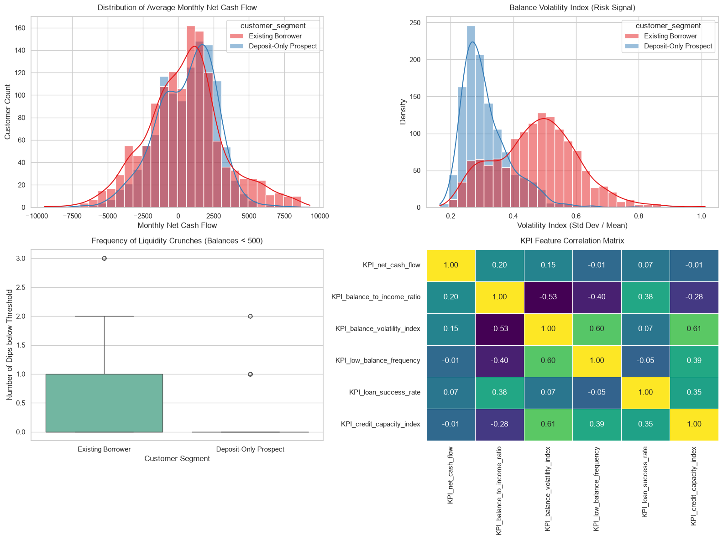
Dealing with Colinearity !
10

Slide 11
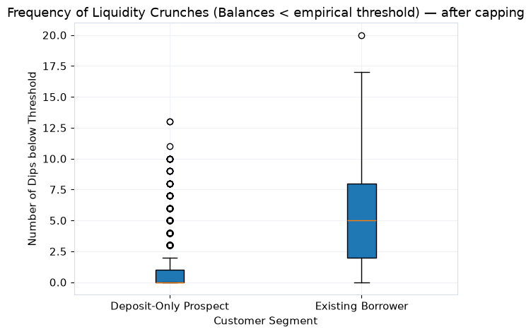
How often does the balance go to negative status?
11

Slide 12
What is cash flow and balance volatility?
Even though our customers have a positive cash flow, the majority of our customers - existing borrower, their balance is more volatile.
12

Slide 13
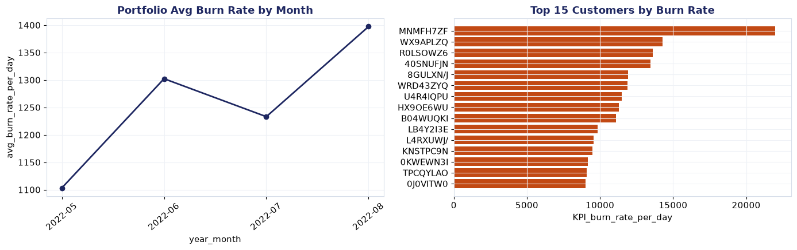
What is the burn rate of our customers
13

Slide 14
Customer Segmentation
Now we know enough about our customers and we procceed to segment them into risk using KPI’s
14

Slide 15
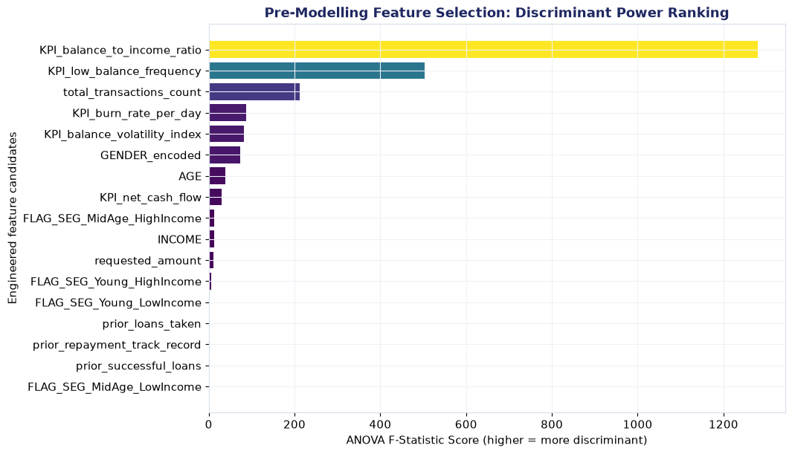
Feature Selection
15

Slide 16
MODELLING
Model & evaluation approach
Headline results
Methodology
Algorithm:
Logistic Regression — interpretable coefficients matter more and therefore we choose it as a baseline
90%
ROC-AUC (test set)
Class imbalance:
Inverse-frequency row weighting (Spark ML's equivalent of scikit-learn's class_weight='balanced')
86%
AUC without GENDER
Split:
Stratified 80/20 train/test, split independently per class to preserve the outcome ratio in both halves
Grain:
85/15
Train / test size
One row per historical loan application — not per customer
Chuene Mosomane
9
16
Notes:
9

Slide 17
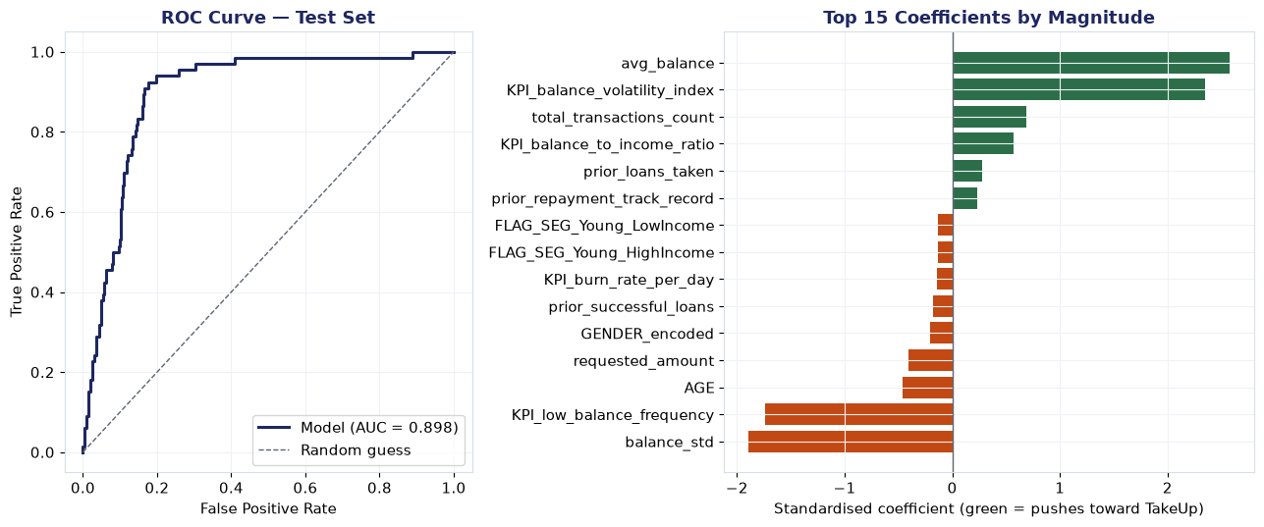
Model Results
17

Slide 18
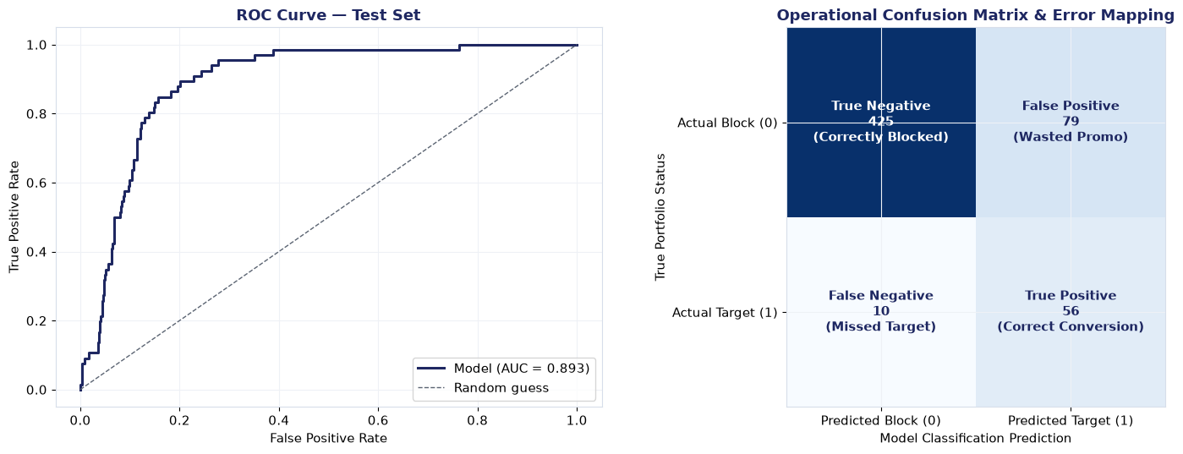
How often are we correct?
18

Slide 19
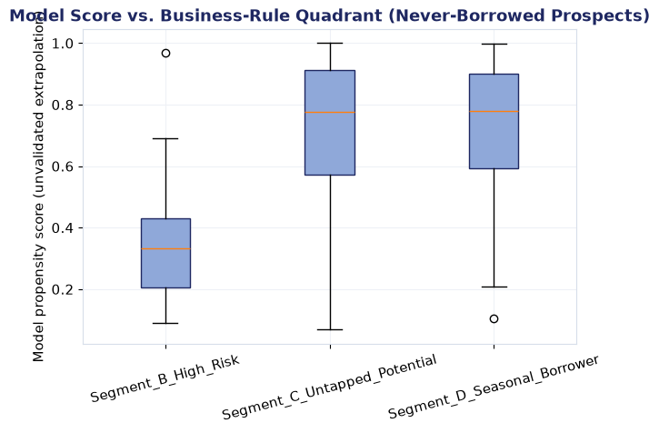
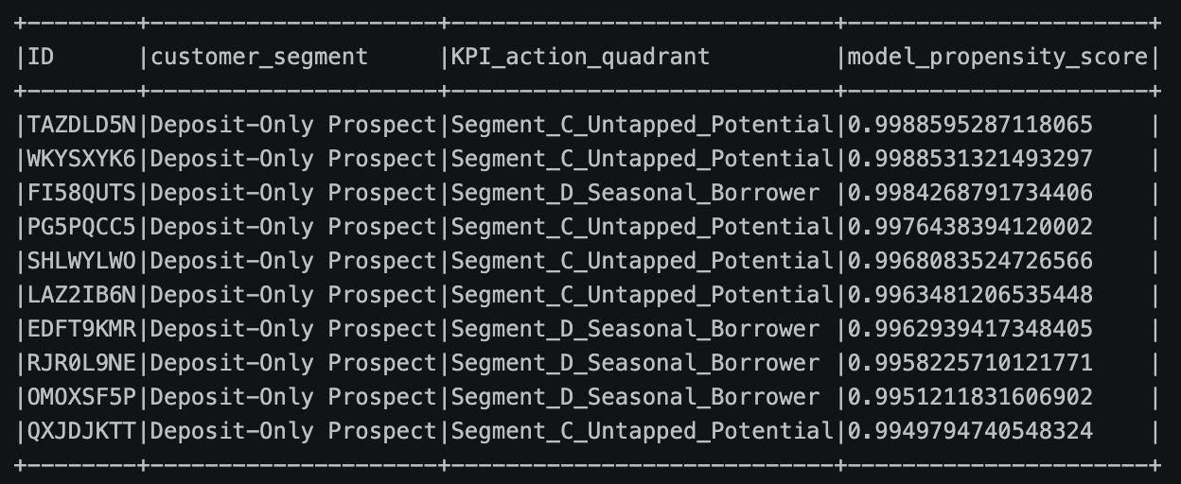
Identified List
Our model have identified 1152 customers who we can approach with a loan and have high chance of accepting.
19

Slide 20
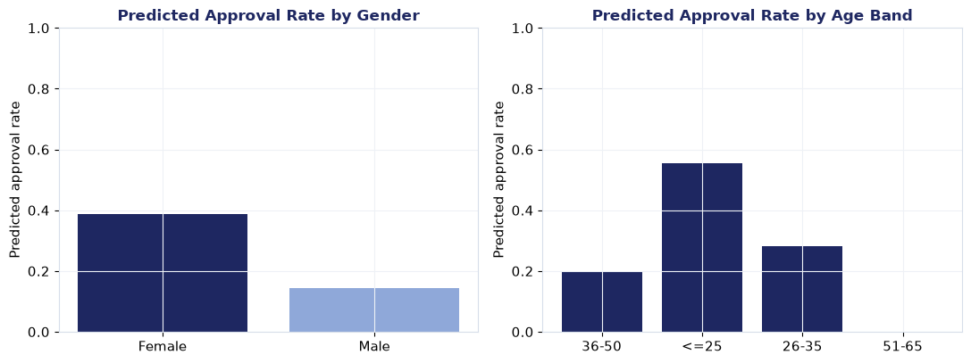
Is there Bias in the Data?
20

Slide 21

Fairness Report
1. Disparate impact
2. Does gender earn its place?
disparate_impact_ratio_gender: 0.35
'Gender’ adds little to no measurable predictive power here;
excluding it from the live model costs little and removes a protected characteristic.
Chuene Mosomane
10
21
Notes:
10

Slide 22


ENGINEERING
How this runs end to end
→
→
→
→
→
Raw data
Clean + EDA
Feature engineering
Train + evaluate
Artifacts
Monitor
GitHub : https://github.com/Chuene100/Loan-Propensity-Model
Chuene Mosomane
11
22
Notes:
11

Slide 23
MONITORING
What we watch once this is live
Prediction volume & latency
Score distribution
Every /score call is counted and timed — catches a serving outage or a slow-down before a downstream team notices.
A histogram of propensity scores over time — a sudden shift (everyone scoring high, or low) is often the first sign something upstream changed.
Feature drift (PSI)
Fairness over time
Population Stability Index compares today's feature distributions to training — <0.10 stable, 0.10–0.25 monitor, >0.25 consider retraining.
The disparate-impact check from slide 10 isn't a one-off — re-run on a schedule so a shift in approval-rate gaps gets caught, not just checked once at launch.
Prometheus + Grafana
The serving app exposes a /metrics endpoint. Grafana connets via a provisioned Prometheus data source, with a starter dashboard covering request volume, latency, error rate, and score distribution.
Chuene Mosomane
12
23
Notes:
12

Slide 24
WHERE WE GO FROM HERE
Recommendations & next steps
1
Run on the full historical dataset
2
Pilot on a small, monitored segment
Decide the serving path: batch scoring vs real-time endpoint
3
4
Schedule fairness & drift re-checks
Chuene Mosomane
14
24
Notes:
14

Slide 25
Discussion
Questions!!!
• Chuene Mosomane • Path Integral (Pty) Ltd
25
Notes:
15

