Slide 1


Department of Computer Science
The Grove School of Engineering
CSC I2400
Formal Language Theory
Lesson 12 Context Free Language
Prof. Stephen Lucci
Office: North Academic Center R - 8/210 B
Phone: (212) 650-6156
Fax: (212) 650-6248
E-mail: lucci@cs.ccny.cuny.edu

Slide 2

CSC I2400 Formal Language Theory
Fall Semester 2010
Lesson 12 Context Free Languages
Simplification of Context Free Grammars
If L is a non-empty Context Free Language(CFL) then it can be generated
by a Context Free Grammar(CFG) with the following properties:
No useless productions : each variable and each terminal of G appears in the
derivation of some word in L.
No unit productions : These are no productions of the form A→ B where A and B
are non-terminals
No ε- productions : if ε ∈ L, these need be no productions of the form A → ε .
Chomsky Normal Form(CNF) : If ε ∈ L, then we can have every production of
the form : A→ BC, A→ a.
where A,B,C are arbitrary variables, a is an arbitrary terminal
α
Prof. Stephen Lucci
Computer Science, CCNY

Slide 3
CSC I2400 Formal Language Theory
Fall Semester 2010
Lesson 12 Context Free Languages
Greibach Normal Form : Every production of G can have the form A → aα, α is
a string of variables (possible empty).
CGF’S Removing Useless Productions
Let G=<V,T,P,S> be a grammar.
A symbol X is said to be useful if there is a derivation
S α x β ω for some α, β ∈ (N + T)* ω ∈ T*
Otherwise X is said to be useless.
There are two aspects to usefulness:
First : some terminal string must be derivable from X.
i.e. α x β ω
Second: X must occur in some string derivable from S.
i.e. S α x β
Prof. Stephen Lucci
Computer Science, CCNY

Slide 4
CSC I2400 Formal Language Theory
Fall Semester 2010
Lesson 12 Context Free Languages
Lemma 1 : Given a CFG G = <V,T,P,S> with L(G) ≠ Ø, We can effectively find an
equivalent CFG G′ = <V′,T′,P′,S′> such that for each A in V′ there is
some ω ∈ T* for which A ω.
// Algorithm to ensure that all variables X in V′ derive something.
begin
1) OLD V ←
2) NEW ← {A|A → ω for some ω in T* }
3) while OLDV ≠ NEWV do
begin
4) OLDV ← NEWV ;
5) NEWV ← OLDV ∪ {A|A → α for some α in (T ∪ OLDV)* }
end;
6) V′ ← NEWV
end
Example: G : S → AC | BS | B
A → aA | aF
B → CF | b
C → cC | D
D → aD | BD | C
E → aA | BSA
F → bB | b
Prof. Stephen Lucci
Computer Science, CCNY

Slide 5

CSC I2400 Formal Language Theory
Fall Semester 2010
Lesson 12 Context Free Languages
Appling lemma 1 to this grammar :
1) OLDV ← Ø
2) NEW ← {B, F}
while OLDV ≠ NEWV
4) OLDV ← {B, F}
5) NEWV ←{B, F} ∪ {A, S}
4) OLDV ← {A, B, F, S}
5) NEWV ← {A, B, F, S} ∪ {E}
4) OLDV ← {A, B, E, F, S}
5) NEWV ← {A, B, E, F, S} ∪ Ø
V′= NEWV = {A, B, E, F, S}
However, lemma 1 alone does not ensure that every non-terminal is useful.
For example .E⇒ aA ⇒ aaF ⇒ aab so lemma 1 would find non-terminal E useful.
However, note that there is no derivation starting with S that yields E , i.e. S E.
B⇒ b
// first time in while loop
// second time
G′ : S → BS | B
A → aA | aF
B → b
E → aA | BSA
F → bB | b
// we note that every
non-terminal yields
something!
e.g. A⇒ aF ⇒ ab
B⇒ b
// third time
// we exit the while loop
Prof. Stephen Lucci
Computer Science, CCNY

Slide 6
CSC I2400 Formal Language Theory
Fall Semester 2010
Lesson 12 Context Free Languages
Hence, we require lemma Z as well :
Lemma 2: Given a CFG G=<V, T, P, S>, we can effectively find an equivalent CFG
G′=<V′, T′, P′, S′> such that for each X in V′∪ T′, there exist α and β
in (V′∪ T′)* for which S α x β
// iterative algorithm
Place S in V′
If A is placed in V′ and A → α₁ | α₂ | … |α_{n} then add all variables of α₁,α₂ … α_{n} to
V′ and all terminals of α₁,α₂ … α_{n} to T′ P′ is the set of productions of P containing
only symbols of V′∪T′.
Let us apply lemma 2 to our previous example:
Lemma1 had yielded:
G : S → BS | B
A → aA | aF
B → b
E → aA | BSA
F → bB | b
Prof. Stephen Lucci
Computer Science, CCNY

Slide 7
CSC I2400 Formal Language Theory
Fall Semester 2010
Lesson 12 Context Free Languages
We place S ∈ V′′ we have S→BS | B hence B ∈ V′′ V′′= {B, S}
Next we have B → b ∴ b ∈ T′′ done!
∴ G′′= S → BS | B
B → b
L(G′′) = L(G) = b*
and every nonterminal of G′′ appears in some derivation (and is thereby useful).
We note that the order of application of our two lemmas is important, i.e. lemma 1
first and then lemma 2.
Consider G: S → a | AB
A → b
Lemma 1 will remove variables that do not derive anything.
NEW V ← {S,A}
V′ = {S,A}
G′ = S → a
A → b
Prof. Stephen Lucci
Computer Science, CCNY

Slide 8
CSC I2400 Formal Language Theory
Fall Semester 2010
Lesson 12 Context Free Languages
then lemma 2 would remove A → b //why?
Hence : G′′ = S → a remains
If lemma 2 is applied first :
Exercise: Give an algorithm to remove unit productions. Example: S → a
A → a | b
Removing ε-productions
We will convert a CFG with ε-productions to a CFG with the same or almost the
same language. // why might the two languages not be entirely identical?
S ∈ V′
S → a | AB
∴ V′ = {A,B,S}
T′ = {a}
then A → b so add b to T′
G′ : S → a|AB and A b
Next lemma 1 applied
new V ← S,A
then
G′′ = S → a
A → b
Prof. Stephen Lucci
Computer Science, CCNY

Slide 9
CSC I2400 Formal Language Theory
Fall Semester 2010
Lesson 12 Context Free Languages
A non-terminal yields ε if one can derive ε from that non-terminal, either directly.
i.e. A → ε or indirectly: A→ BC ⇒ ε
Every non-terminal that is the left side of an ε-production, yields ε. Place a check make above each occurrence of each of these non-terminals in all the productions both on the left sides and right sides.
Next, look for an unchecked non-terminal on the left side of a production whose right side consists exclusively of checked non-terminals, this non-terminal is then checked in all of its occurrences.
We stop only after use see that these is no production remaining whose left side is unchecked and whose right side consists exclusively of checked non-terminals. A it has been checked.
Example
S→ eSe 5) D → BDh
S→ CD 6) D → ε
C → fCg 7) B → hB
C → ε 8) B → f
Prof. Stephen Lucci
Computer Science, CCNY

Slide 10
CSC I2400 Formal Language Theory
Fall Semester 2010
Lesson 12 Context Free Languages
No more checking is possible: we may conclude that S,C,D yield ∈ but B does not.
Let G₀ be a grammar with ε-productions.
Phase 1 is the procedure just described above.
Phase 2 we construct a grammar G₁ from G₀
Suppose a production(with one or more ε-yielding non-terminals on the right)
B → … C₁ … C₂ … C_{p} ...
Where C₁,C₂, … C_{p} are not necessarily distinct.
We add to the list each production that can be formed by picking a non-empty
subset of {C₁,C₂,…C_{P}} and deleting just those occurrences that are members of
the subset. At most 2^{P-1} new productions will result.
Example : suppose one of the productions of G₀ is : B → C E b C D and suppose
that C and D yield ε , but E does not. Then add the seven (2³⁻¹) new productions
below: B→ EbCD | CEbD | CEbC | CEb | EbC | EbD | Eb
Prof. Stephen Lucci
Computer Science, CCNY

Slide 11
CSC I2400 Formal Language Theory
Fall Semester 2010
Lesson 12 Context Free Languages
Note: G₁ will have an ε -production for each ε -yielding non-terminal.
Example: Suppose H is an ε -yielding non-terminal but H→ ε is not a rule
in G_{o} then we would have: H → CB where C,B ARE e-yield then we would
add the productions: H → C | B | ε
Finally in phase 3 we construct grammar G₂ from G₁. the set of productions of G₂
is the set of rules from G₁ that are not ε -rules.
Phase 1 applied to our previous example resulted in :
G₀ :
S→ eSe 5) D → BDh
S→ CD 6) D → ε
C → fCg 7) B → hB
C → ε 8) B → f
Prof. Stephen Lucci
Computer Science, CCNY

Slide 12
CSC I2400 Formal Language Theory
Fall Semester 2010
Lesson 12 Context Free Languages
Phase 2 augments these rules to yield:
G₁ :
Phase 3 would delete rules (2c)(4) and (6) yielding:
G₂ :
Practice – Produce parse trees for the strings e f f g g f h f h h e and e e e e
Chomsky Normal Form
Every non-empty CFG may be converted to an equivalent CFG in which all rules are of the form : A → BC A→ a // CNF
Example: Find a Chomsky Normal Form grammar for L={a^{n}b^{n} | n≥1}.
First, obtain a CFG for L: G(1)(2) S → a S b | a b
(1)(1a) S→ eSe | ee (5) (5a) D → BDh | B
(2)(2a)(2b) S→ CD | D | C | ε (7) D → ε
(3)(3a) C → fCg | fg (8) B → f
(1)(1a) S→ eSe | ee (5) (5a) D → BDh | Bh
(2)(2a)(2b) S→ CD | D | (7) B → hB
(3)(3a) C → fCg | fg (8) B → f
Prof. Stephen Lucci
Computer Science, CCNY

Slide 13
CSC I2400 Formal Language Theory
Fall Semester 2010
Lesson 12 Context Free Languages
We observe two types of difficulties with three rules.
Rule 1) has mixed terminals and non-terminals
Rule 1) is also too long
Rule 2) has too many terminal symbols
We will introduce new non-terminal symbols C_{a} and C_{b} which will derive terminals a and b respectively.
Our Grammar now appears as :
G1 : (1) S → CaSCb
(2) S → CaCb
(3) Ca → a
(4) Cb → b Rules 2,3 and 4 are fine.
Rule 1) however has a RHS that is too long.
we will need to “break it up” so to speak yielding :
Prof. Stephen Lucci
Computer Science, CCNY

Slide 14
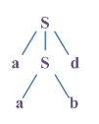
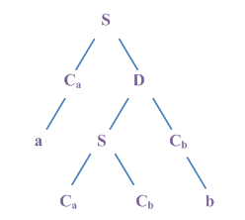
CSC I2400 Formal Language Theory
Fall Semester 2010
Lesson 12 Context Free Languages
G₂ : (1) S → C_{a}D
(1a) D → SC_{b}^{b}
(2) S → C_{a} C_{b}^{b}
(3) C_{a} → _{a}
(4) C_{b} → b
Each rule in G₂ has the “proper form”
aabb ∈ L(G) aabb ∈ L(G₂)
Note that the derivation tree is always a binary tree when the CFG is in CNF.
Question : Suppose a CFG has a rule of the form A → RHS
Where |RHS| = 8. How would you convert this rule into CNF?
// CNF grammar equivalent to G.
Prof. Stephen Lucci
Computer Science, CCNY

Slide 15

CSC I2400 Formal Language Theory
Fall Semester 2010
Lesson 12 Context Free Languages
Pumping Lemma for CFL’S
Let L be any CFL. Then these is a constant n, depending only on L, such that q, z is in L and |z| ≥ n then we may write z=uvwxy s.t.
1) | vx| ≥ 1
2) |vwx| ≤ n, and
3) uv^{i}wx^{i}y ∈ L ∀ i ≥ 0
Proof: Let G be a Chomsky Normal Form grammar generating L-{ ε }.
If z ∈ L(G) and z is long, then any parse tree for z must contain a long path.
If a parse tree of a word generated by a CNF grammar has no path of length greater than i then the word is of length no greater than 2^{i-1}.
Basis Step : i = 1
length ≤ 2^{i-1} = 2⁰ = 1
Prof. Stephen Lucci
Computer Science, CCNY

Slide 16
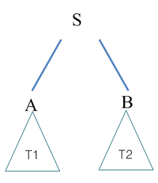
CSC I2400 Formal Language Theory
Fall Semester 2010
Lesson 12 Context Free Languages
Inductive Step i > 1
Let the grammar G have K variables and let n= 2^{k}. If z ∈ L(G) and |z| ≥ n then
Since |z| > 2^{k-1}, any parse tree for z must have a path of length at least k+2 vertices,
only the last of which is labeled with a terminal.
Hence, these must be some variable that appears twice on the path.
Let P be a path that is as long as longer than any path in the tree. There must be
two vertices v₁,v₂ on the path s.t.
No paths of length greater than i-1 in either tree. Then the trees generate words of length ≤ 2^{i-2}.
Then the entire tree generates a word whose length < n^{i-1}.
Prof. Stephen Lucci
Computer Science, CCNY

Slide 17
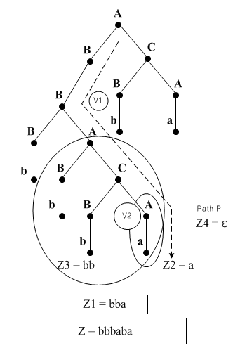
CSC I2400 Formal Language Theory
Fall Semester 2010
Lesson 12 Context Free Languages
v₁,v₂ both have the same label (say A)
v₁,v₂ is closer to the root than v₂ .
The portion of the path from v₁ ,to the leaf is of length at most k+1.
Start Symbol
Z_{i} = z₃z₂z₄ where z₃=bb, z₄=ε
G : A→ Bc | a
B → BA | b
C → BA
Z₃ and Z₄ cannot both be ε since first production is A → BC
Prof. Stephen Lucci
Computer Science, CCNY

Slide 18
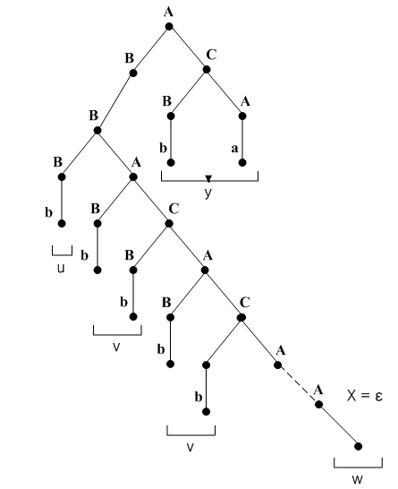
CSC I2400 Formal Language Theory
Fall Semester 2010
Lesson 12 Context Free Languages
We know that A z₃ A z₄ and A z₂ where | z₃ z₂ z₄ | 2^{k} = n
It follows that A z₃^{i} z₂ z₄^{i} ∀i ≥ 0
The derivation of uv^{i}wx^{i}y
u = b
v = bb
w = a
x = ε
y =ba
Prof. Stephen Lucci
Computer Science, CCNY

Slide 19
CSC I2400 Formal Language Theory
Fall Semester 2010
Lesson 12 Context Free Languages
L = {1^{p} | p prime is not context free}
Assume L is context free and let n be the constant of the pumping lemma.
Let |z| n then z may be written as:
z = uvwxy = 1^{p} with
|vx| ≥ 1
|vwx| ≤ n, and
uviwxiy ∈ L ∀ ≥ 0
i.e. 1ª(1^{b})^{k}1^{c}(1^{d})^{k}1e ∈ L, ∀k ≥ 0
v x
b + d > 0
a + b + c + d + e = p
∴ a + c + e + (b + d)k is prime ∀k ≥ 0
Let x = a + c + e
y = b + d
x + ky + is prime ∀ ≥ 0
Let k = x + y + 1 :
x + ky = x + (x + y + 1)y
= x + xy + y² +y
= x (y + 1) + y (y+1)
= (x + y) (y + 1) done !
Not prime x, y > 0
Prof. Stephen Lucci
Computer Science, CCNY

Slide 20
CSC I2400 Formal Language Theory
Fall Semester 2010
Lesson 12 Context Free Languages
The language L ={a^{n}b^{n}c^{n} | n ≥ 1} is not context free. To prove this result we shall consider a sufficiently long string z, in L.
Let z= a^{n}b^{n}c^{n} where n is the constant in the pumping lemma. We know that z maybe written as uvwxy.
Now, since | vwx | ≤ n there are five cases
1) vwx lies entirely within a substring uv²wx²y will contain too many a’s
// |v x| ≥ 1
2) vwx consists entirely of b’s
3) vwx consists entirely of c’s similar to case above.
4) v contains a’s (and perhaps b’s)
x contains b’s // c’s not possible
letting i=2 once more uv²wx²y will have too few c’s (*and perhaps some syntax problems)
5) v contains b’s (and perh*-see above).
Hence L is not context free!
Prof. Stephen Lucci
Computer Science, CCNY

Slide 21
CSC I2400 Formal Language Theory
Fall Semester 2010
Lesson 12 Context Free Languages
Pumping Lemma for CFL’s
Let L be a CFL. Then these is a constant n, depending only on L, such that if z is in L and |z| ≥ n, then we may write z= uvwxy s.t
1) | vx| ≥ 1
2) |vwx| ≤ n, and
3) uv^{i}wx^{i}y ∈ L ∀ i ≥ 0
The language L = {a^{i}b^{j}a^{i}b^{j} | i,j ≥ 0} is not context free
Let n be the number specified by the pumping lemma and z = a^{n}b^{n}a^{n}b^{n}.
Assume these is a decomposition uvwxy of z that satisfies the conditions of the
pumping lemma.
Condition ii) requires the length of vwx to be at most n. ⇒ that vwx is a string
containing only one type of terminal or the concatenate of two such strings.
i.e. i) vwx ∈ a* or vwx ∈ b* or ii) vwx ∈ a*b* or vwx ∈ b*a*
∴ Pumping v and x increases the number of a’s or b’s in only one of the substring in Z.
∴ L is not context free.
Prof. Stephen Lucci
Computer Science, CCNY

Slide 22
CSC I2400 Formal Language Theory
Fall Semester 2010
Lesson 12 Context Free Languages
Closure Properties for CFL’s
Regular Languages are closed under : union, intersection, closure, concatenation,
complementation, reversal, difference, homomorphism, inverse homomorphism.
CFL’s are closed under : union, concatenation and closure.
Proof - Let L₁,L₂ be CFL’s generated by the CFG’s G₁=(V₁,T₁,P₁,S₁) and
G₂=(V₂,T₂,P₂,S₂) We may assume w log that V₁ ∩ V₂ = Ø Also assume that S₃, S₄,
and S₅ are not in V₁ or V₂
For L₁ ∪ L₂
G₃=(V₁ ∪ V₂ ∪ { S₃ }, T₁ ∪ T₂ , P₃, S₃) where P₃ = P₁ ∪ P₂ Plus the production
S → S₁ | S₂ if ω was in L₁ - a derivation would begin S₃ ⇒ S₁ ω
Similarly every word in L₂ has a derivation that begins S3 ⇒ S₁ ω
hence L₁ ∪ L₂ ⊆ L(G₃) conversely let ω ∈ L(G₃)
then the derivation S ω begins with either S3⇒ S₁ ω or either S3⇒S₂ ω
G₃
G₂
G₃
G₃
G₃
G₃
G₃
Prof. Stephen Lucci
Computer Science, CCNY

Slide 23
CSC I2400 Formal Language Theory
Fall Semester 2010
Lesson 12 Context Free Languages
However V₁ ∩ V₂ = Ø Only symbols of G₁ may appears in the derivation.
S₁ ω hence only productions of P₁ are used thus S₁ ω and ω ∈ L₁
Similarly, we would have ω ∈ L₂
∴ L (G3) ⊆ V₁ ∪ V₂
∴ L (G3) = V₁ ∪ V₂
For concatenation :
Let G₄ = (V₁ ∪ V₂ ∪{S₄}, T₁ ∪ T₂, P₄ S₄) where P₄ = P₁ ∪ P₂ plus the
production S₄→ S₁S₂
For Closure
Let G₅ = (V₁ ∪ {S₅}, T₁, P₅ S₅) where P₅ is P₁ plus S₅→ S₁S₅ | ε
The class of CFL’s is not closed under intersection
Let L₁ = a^{j}b^{j}c^{k} =j,k ≥ 0 both CFL’s
L₂ = a^{l}b^{m}c^{n} =l,m ≥ 0
then L₁ ∩ L₂ = a^{n}b^{n}c^{n} n ≥ 0 which is not context free.
G₃
G₃
Prof. Stephen Lucci
Computer Science, CCNY

Slide 24
CSC I2400 Formal Language Theory
Fall Semester 2010
Lesson 12 Context Free Languages
Decision Properties for CFL’s
For regular languages, it is decidable whether:
1. L₁ = L₂
2. L₂ = Ø
3. L₁ is finite, L₁ is infinite.
4. L₁ ∩ L₂ = Ø
5. L₁ ⊆ L₂
6. G is ambiguous.
For Context Free Languages : it is decidable if a CFL
1) L₁ = Ø
2) L₁ is finite, L₁ is infinite.
3) membership CYK algorithm
Is a CFL empty
L1 = Ø iff every production of G1 is useless .
Prof. Stephen Lucci
Computer Science, CCNY

Slide 25
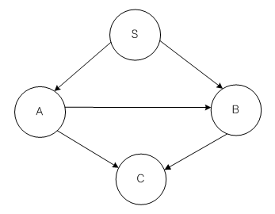
CSC I2400 Formal Language Theory
Fall Semester 2010
Lesson 12 Context Free Languages
Is L1 finite? Infinite?
Consider the grammar S → AB
A → BC | a
B → CC | b
C → a
Suppose G has no cycles: Define the rank of a variable A to be the longest path in
the graph beginning at A.
If A has rank r, then no terminal string derived from A has length greater then 2^{r}
In fact the longest string in L
Rank C=0
Rank B=1
Rank A=2
Rank S=3
S ⇒ AB ⇒ BCB ⇒ CCCB ⇒ CCCC ⇒ a⁵ has length 5
Prof. Stephen Lucci
Computer Science, CCNY

Slide 26
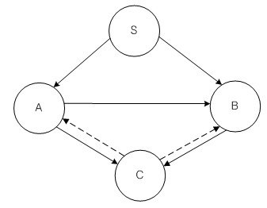
CSC I2400 Formal Language Theory
Fall Semester 2010
Lesson 12 Context Free Languages
If we add production C → AB
Now, the graph G has cycles
Now, the graph G has cycles
S⇒ a^{i}a(ba)^{i}b ∀i
∴L is infinite
S Ab, A a
A ⇒ BC
⇒ CCC
⇒ CABC
C a
BC ba
A aAba
Undecidable CFL Problems
Is a given CFG G ambiguous?
Is a given CFL inherently ambiguous?
Is the intersection of two CFL’s empty?
Are two CFL’s the same?
Prof. Stephen Lucci
Computer Science, CCNY

Slide 27
CSC I2400 Formal Language Theory
Fall Semester 2010
Lesson 12 Context Free Languages
Cocke-Younger-Kasami Algorithm (CYK)
The membership problem for CFL’s
Given a CFG G= <V,T,P,S> and a string X in T*, is x ∈ L(G) ?
How would you answer this question if G were in Greibach Normal Form?
(every rule is of the form A →ab, with α a string of variables – possibly empty).
CYK algorithm – based on dynamic programming
To solve a problem of size n, we first solve every sub-problem as opposed to divided
and conquer where some sub problems are solved.
Recall the Ri^{k}j algorithm for finding the regular expression equivalent to a DFA.
Given a string x of length n ≥ 1, and a grammar G in CNF, determine for each i and j and for each variable A whether A x_{ij} where x_{ij} is the substring of x of length j beginning at position i.
Prof. Stephen Lucci
Computer Science, CCNY

Slide 28
CSC I2400 Formal Language Theory
Fall Semester 2010
Lesson 12 Context Free Languages
Some notation
Let X = X₁X₂X₃X₄
= a a b b then X = X₁₄
X₁₁ = a
X₃₁ = b
X₁₂ = ?
X₂₂ = ?
X₃₂ = ?
X₂₃ = ?
X₃₃ = ?
By induction :
When j=1, A X_{ij} iff A X_{ij} is a production rule, since X_{ij} is a string of length one.
By Induction :
When j=1, a
Prof. Stephen Lucci
Computer Science, CCNY

Slide 29
CSC I2400 Formal Language Theory
Fall Semester 2010
Lesson 12 Context Free Languages
J > 1, A X_{ij} iff these is some production A→BC and some K 1 ≤ K < j
s.t. B derives the first K symbols of X_{ij}
and C derives the last j-k symbols of X_{ij.}
i.e. B X_{ik} and C X_{i+k}, j-k
j = n, We may determine if S X_{in}
(recall X_{in} = X)
∴ X ∈ L(G) iff S X_{in}
Let V_{ij} be the set of variables A s.t.
A X_{ij}
We may assume 1 ≤ i ≤ n-1j+1 as there is no string of length > n-i+1
beginning at position i.
Prof. Stephen Lucci
Computer Science, CCNY

Slide 30
CSC I2400 Formal Language Theory
Fall Semester 2010
Lesson 12 Context Free Languages
//CYK Algorithm
begin
1) for i ← 1 to n do
2) V_{i1} = {A | A → a is a production and the i^{th} symbol of x is ‘a’}.
3) for j ← 2 to n do
4) for i ← 1 to n-j+1 do
begin
5) V_{ij} ← Ø
6) for K ← 1 to j-1 do
7) V_{ij} ← V_{i}j {A|A → BC}
is a production, B is in V_{ik}
and a production, B is in V_{ik} and C is in V_{i+k}, j+k}
end
end
// Verify that t(n)=Θ(n³)
Prof. Stephen Lucci
Computer Science, CCNY

Slide 31
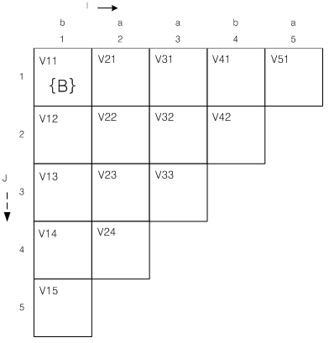
CSC I2400 Formal Language Theory
Fall Semester 2010
Lesson 12 Context Free Languages
Consider the CFG: (1)(2) S→ AB | BC
(3)(4) A→ BA | a
(5)(6) B→ CC | b
(7)(8) C→ AB | a
and the input string X=baaba
We construct the following table :
Consider the top row
V11 is that set of non-terminal capable of yielding x11=‘b’
Scan the Right Hand Side of each rule. If RHS=‘b’ of any rule, then the variable on the left goes into this box
The RHS of rule 6 is ‘b’ hence we know that B→b so place B in V11
Prof. Stephen Lucci
Computer Science, CCNY
Notes:
Hat B

Slide 32
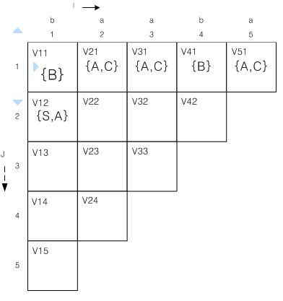
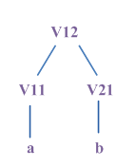
CSC I2400 Formal Language Theory
Fall Semester 2010
Lesson 12 Context Free Languages
Fill in the rest of the first row
Next we fill in row2 (i.e. j=2).
V12 is that set of non-terminals capable of yielding X12=‘ba’
We need to fill in the parse tree below.
V12 → V11V21
Where V11 is responsible for the first half of X12 and V21 for the second.
Observe that V11 and V21 have already been calculated.
We consider the following templates
V12 → V11 V21
? → BA
? → BC
Prof. Stephen Lucci
Computer Science, CCNY

Slide 33
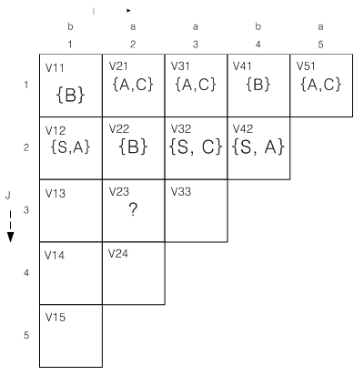
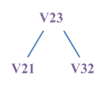
CSC I2400 Formal Language Theory
Fall Semester 2010
Lesson 12 Context Free Languages
i.e. the left non-terminal on the rightle
Find a RHS of some rule that matches these.
Observe A→ BA(rule3) and S→BC(rule2) Place S and A in V12. Fill in row2.
Next we consider the third row. We are computing possible derivation for all substring of length 3.
Perusing line 6 of the algorithm,
We conclude that k may equal 1 or 2.
We will concentrate on box V23, i.e. all non-terminals capable of yielding X23=‘aab’.
When K=1 our parse tree has the form: V23
i.e. the left non-terminal on the right (i.e. V21) must define X21=‘a’ and the right non-terminal on the right(V32) must derive j-k=2 symbols, i.e. X32=‘ab’
Prof. Stephen Lucci
Computer Science, CCNY

Slide 34
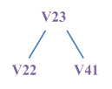
CSC I2400 Formal Language Theory
Fall Semester 2010
Lesson 12 Context Free Languages
Template to consider
V23 → V21 V32
? → A S // V21={A,C}
? → A C V32={S,C}
? → C S
? → C C
? → A S
CC matches the RHS of rule 5.
Place the LHS of rule 5. i.e. ‘B’ in V23.
We must also consider possible parse trees when K=2.
V22={B}
V41={B}
The only template is : V23 → V22V41
? → BB
No RHS of our grammar matches ‘BB hence K=2 adds nothing to V23.
Prof. Stephen Lucci
Computer Science, CCNY

Slide 35
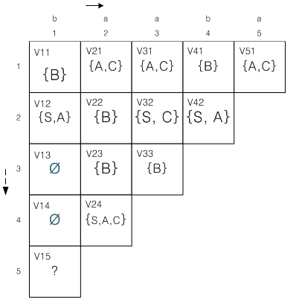
CSC I2400 Formal Language Theory
Fall Semester 2010
Lesson 12 Context Free Languages
No RHS of our grammar matches ‘BB’ hence K=2 adds nothing to V23.
Let us fill in the 4th row. Recall in doing so, one lets K assume the values 1,2 and 3.
We will calculate V15.
Note if S→ V15 then X=X15=baaba∈ L(G)
V15 = ? K = 1 to j-1 i.e. K=1,2,3,4
K=1
V15 → V12V24 // V11={B}
? → B S V24={S,A,C}
? → B A
? → B C
BA matches RHS of rule 3 BC matches RHS of rule 2
∴ add LHS of this rule rule 2: S →BC
i.e. A to V15 add S to V15
rule 3: A →BA
Prof. Stephen Lucci
Computer Science, CCNY

Slide 36
CSC I2400 Formal Language Theory
Fall Semester 2010
Lesson 12 Context Free Languages
K=2
V15 → V12 V33 // V12={S,A}
? → S B V33={B}
? → A B
AB matches RHS of rule 7
i.e. C → AB
add C to V15
K=3
V15 → V13 V42 // V13=Ø
? → Ø V42={S,A}
No matches
V15={S,A,C}
K=4
V15 → V14 V51 // V14=Ø
? → Ø V51={A,C}
No matches either.
V15={S,A,C}
So, YES! X=BAABA ∈ L(G)
K=2
V15 → V12V33 // V12={S,A}
? → S B V33={B}
? → A B
AB matches RHS of rule 7
i.e. C → AB
add C to V15
Prof. Stephen Lucci
Computer Science, CCNY

Slide 37
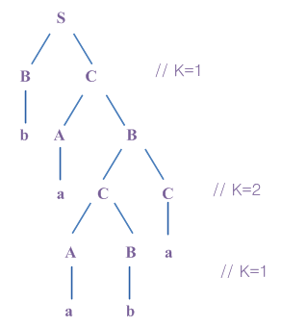
CSC I2400 Formal Language Theory
Fall Semester 2010
Lesson 12 Context Free Languages
If we keep track of which values of K succeeded for each variable, we will be able
to produce a parse tree for the string X.
The CYK is a bottom-up parsing algorithm.
We build smaller trees for substring first and “hope” that S will yield the
respective roots of sub-trees required at the last step.
Prof. Stephen Lucci
Computer Science, CCNY

Slide 38
Final Exam is waiting for you
Merry Christmas
&
Happy new year !!

