Slide 1


Department of Computer Science
The Grove School of Engineering
CSC I2400
Formal Language Theory
Lesson 9 Grammars
Prof. Stephen Lucci
Office: North Academic Center R - 8/210 B
Phone: (212) 650-6156
Fax: (212) 650-6248
E-mail: lucci@cs.ccny.cuny.edu

Slide 2

CSC I2400 Formal Language Theory
Fall Semester 2010
Lesson 9 Grammars
Heretofore we have dealt with two types of devices for language processing:
- Transducer
- Acceptors
Next, we discuss the role of grammars:
A Grammars G = < N, T, S, R> where :
N is a set of nonterminals – “ intermediate constructs” that may yield words in the languages.
T is the actual set of words in the language
S ∈ N is the start symbol (sometimes sentence)
R is the set of replacement rules ( or P for production rules).
Prof. Stephen Lucci
Computer Science, CCNY

Slide 3
CSC I2400 Formal Language Theory
Fall Semester 2010
Lesson 9 Grammars
Example(from English)
“ They are failing students.”
T is the set of words in the English language to simplify matters we restrict our attention to the four words above – i.e. They, are, ….
N corresponds to the set of nonterminals e.g. <Noun Phrase>, <Verb Phrase>, … Note – we will employ capital letters for nonterminals – and in an English grammars – brackets as well
S is the nonterminal < Sentence >
R – The set of replacement rules will include the following :
1> <Sentence> → < Subject > < Predicate >
2> <Subject> → <Noun Phrase>
3> <Noun Phrase> → <Pronoun >
4> <Pronoun> → They
Prof. Stephen Lucci
Computer Science, CCNY

Slide 4
CSC I2400 Formal Language Theory
Fall Semester 2010
Lesson 9 Grammars
5> <Predicate> → < Verb Phrase > < Direct Object >
6> <Verb Phrase > → <Auxiliary Verb > < Main Verb>
7> <Auxiliary Verb> → are
8> <Main Verb> → failing
9> <Direct Object > → students
We may demonstrate the action of our grammar (for a miniscule portion of the English Language) in two ways : 1) Derivation
2) Parse Tree
A derivation for “ They are failing students. ”
Double arrow
<Sentence > ⇒ < Subject > < Predicate >
(1) Rule used
⇒ < Noun Phrase > < Predicate >
(2) Rule used
⇒ < Pronoun > < Predicate >
(3) Rule used
⇒ They < Predicate > // sentential form
(4) Rule used
Prof. Stephen Lucci
Computer Science, CCNY

Slide 5
CSC I2400 Formal Language Theory
Fall Semester 2010
Lesson 9 Grammars
⇒ They < Verb Phrase > < Direct Object >
(5) Rule used
⇒ They are <Auxiliary Verb > <Main Verb> <Direct Object>
(6) Rule used
⇒ They are < Main Verb > < Direct Object>
(7) Rule used
⇒ They are failing < Direct Object >
(8) Rule used
⇒ They are failing students.
(9) Rule used
//Can you produce a rightmost derivation for this sentence
//Observe, that whenever a choice occurred, we replaced the leftmost nonterminal
//This is referred to as a leftmost derivation.
Prof. Stephen Lucci
Computer Science, CCNY

Slide 6
CSC I2400 Formal Language Theory
Fall Semester 2010
Lesson 9 Grammars
Note, that many other derivations exist
Alternately we way show the action of a grammar by producing a parse tree (or derivation tree) for the “Target string”.
A parse tree for “ they are failing students”
< Sentence >
<Subject> <Predicate>
<Noun Phrase> <Verb Phrase> < Direct Object>
<Pronoun> <Auxiliary Verb> <Main Verb>
They are failing students
Prof. Stephen Lucci
Computer Science, CCNY

Slide 7
CSC I2400 Formal Language Theory
Fall Semester 2010
Lesson 9 Grammars
Note : Many different derivations correspond to the parse tree but only one
leftmost derivation (or equivalently – rightmost derivation)
The meaning corresponding to (semantics) of the above parse (syntax) tree is that
teaches are busy doing what they do. Can you extend our grammar to provide a
2nd mean in computer Science we deal with Formal Languages rather than natural
languages such as English, French.
The grammars we employ fall into four categories :
- Regular Grammars
- Context Free Grammars
- Context Sensitive Grammars
- Phrase Structure Grammars
Prof. Stephen Lucci
Computer Science, CCNY

Slide 8
CSC I2400 Formal Language Theory
Fall Semester 2010
Lesson 9 Grammars
Regular Grammars
every rule is of the form:
A → a | a A // right linear
or
A → a | Aa // left linear
Note that in formal grammars we forego the brackets.
Examples
Consider E = a * b
i.e. L(E) = { b, ab, aab, … }
It may prove helpful to first consider an FA M s.t. L(m) = L(E).
Prof. Stephen Lucci
Computer Science, CCNY

Slide 9
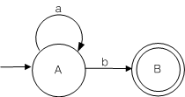


CSC I2400 Formal Language Theory
Fall Semester 2010
Lesson 9 Grammars
E = a * b
M :
where L(m) = L(a *b)
In Converting from an FA to a regular grammar –
we employ the following two rules
1) Q_{i}, Q_{j} and a arbitrary in G:
include the rule : Q_{i} → aQ_{j}
2) Q_{i}, a arbitrary Q_{j} ∈ F in G
we would have : Q_{i} → aQ_{j} | a
or
Q_{i} → aQ_{j}
Q_{j} → ε
Prof. Stephen Lucci
Computer Science, CCNY

Slide 10
CSC I2400 Formal Language Theory
Fall Semester 2010
Lesson 9 Grammars
Hence in our example we obtain the grammar
G: (1)(2)(3) A → a A | b B | b which may simplified to the equivalent grammar :
G′ : (1)(2) A → aA | b // why?
Def : Two grammars G and G′ are said to be equivalent, written G G′
if L(G) = L(G′), i.e. the two grammars generate the same set of strings.
if you extended the grammar for the English sentence extended “they are failing students” then you obtained an alternate meaning for this sentence. i.e. the sentence could be characterizing students who are having trouble with their studies.
Def: if a string(or sentence) in some language has two distinct parse trees(or equivalently, two distinct leftmost derivations, (rightmost derivations) then that sentence is said to be ambiguous.
Prof. Stephen Lucci
Computer Science, CCNY

Slide 11
CSC I2400 Formal Language Theory
Fall Semester 2010
Lesson 9 Grammars
Def: if a grammar G generates a string ω via two distinct parse trees then G is said to be an ambiguous grammar.
Def: if a language L cannot be generated by any grammar that is unambiguous, then L is said to be inherently ambiguous.
Example: Consider the regular grammar:
G : A → aA | a B | a , B → aB | a
We observe that the string ω = aaa is ambiguous. Two distinct parse trees are:
A A
a A a A
VS.
a A a B
a a
Prof. Stephen Lucci
Computer Science, CCNY

Slide 12
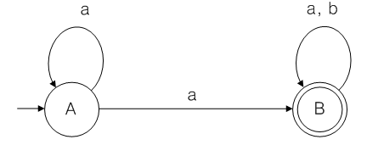
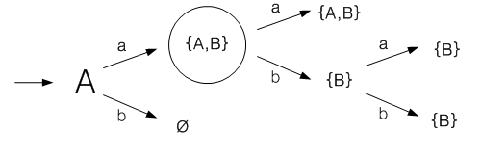
CSC I2400 Formal Language Theory
Fall Semester 2010
Lesson 9 Grammars
Hence G is an ambiguous grammar.
An FA ^{M} equivalent to G is :
We note that M is nondeterministic.
Reachable sets :
Prof. Stephen Lucci
Computer Science, CCNY

Slide 13
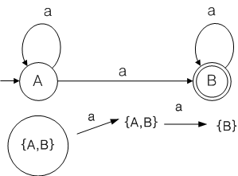
CSC I2400 Formal Language Theory
Fall Semester 2010
Lesson 9 Grammars
We define the notion of the leavable set for the string ω as the set of all states that one may have been in previously, given that one is now in an accept state and ω has been processed.
i.e. Y(ω) = { p | p ∈ Q and δ (p,w) = r with r ∈ F }
If ∃ an element of both the set of reachable and leavable sets with cardinality ≥ 2, then ∃ an ambiguous string in L and hence the regular grammar G is ambiguous.
Prove that there do not exist any inherently ambiguous regular languages.
Find a regular grammar for xy(xx)⁴y . Is this grammar ambiguous?
Prof. Stephen Lucci
Computer Science, CCNY

Slide 14
CSC I2400 Formal Language Theory
Fall Semester 2010
Lesson 9 Grammars
Regular Languages are:
Recognizable by finite automata
Denoted by regular expressions
Generated by regular grammars
May be expressed as the union of some of the equivalence classes of a right-invariant equivalence relation of finite index.
To prove that certain languages are not regular we can use:
The pumping lemma for regular sets
The Myhill-Nerode Theorem.
Context Free Language(CFL’s) may be generated by context Free grammars(CFG)
In a CFG every production rule has the form: N → (N + T)*
Prof. Stephen Lucci
Computer Science, CCNY

Slide 15
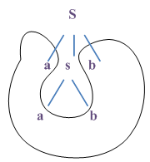

CSC I2400 Formal Language Theory
Fall Semester 2010
Lesson 9 Grammars
Example
L₁ = { a^{n} b^{n} | n ≥ 1} aabb ∈ L(G)
i.e. L₁ = { ab, aabb, … }
G₁ : S → aSb | ab
L₂ = { b^{m}c^{n} d^{n}e^{m} | m, n n ≥ 1 } i.e. L₂ = { bcde, bbcdee, bccdde, … }
G2 : S → bSe | bTe , T → cSd | cd
Parse Tree For bbccddee
Prof. Stephen Lucci
Computer Science, CCNY

Slide 16
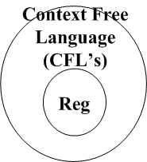
CSC I2400 Formal Language Theory
Fall Semester 2010
Lesson 9 Grammars
L₃ = { w {a, b}* | |w| is even }
S will occur in a sentential form when an even number of terminals has been
generated. An O records the presence of an odd number of terminals.
G3:
(1)(2)(3) S → aO | bO | ε
(4)(5) O → aS | bS
S ⇒ aO ⇒ abS ⇒ ab
even # terminals (1) odd# (5) even # (3)
The relation between CFL’s and regular languages is shown below:
Prof. Stephen Lucci
Computer Science, CCNY

Slide 17
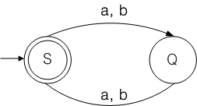
CSC I2400 Formal Language Theory
Fall Semester 2010
Lesson 9 Grammars
We note that every regular language is C.F. but not every CFL is regular.
Can you prove this???
The production rules for G₃ are context free. Hence L₃ must be context free.
However it is possible that CFG production rules are being used to define a regular language.
Example : Obtain grammar G′₃ from the following FA:
Verify that G′₃ G₃
What can you now conclude about L3?
Prof. Stephen Lucci
Computer Science, CCNY

Slide 18
CSC I2400 Formal Language Theory
Fall Semester 2010
Lesson 9 Grammars
Practice problems
Find CFG’s for the following CFL’s :
L₄ = { wcw^{R} | w ∈ {0, 1}*}
L₅ = {ww^{R} | w ∈ {0, 1}*}
L₆ = { w ∈ {a, b}* | n_{a}(w) = 2*n_{b}(w) }
We showed earlier that it is decidable whether or not a regular language is ambiguous. We also demonstrated that there do not exist any inherently ambiguous regular language.
Later in this course, we will prove that the ambiguity question for context free language is undecidable.
Now, We will show the existence of an inherently ambiguous context free language, i.e. a CFL for which no unambiguous grammar may be found.
Prof. Stephen Lucci
Computer Science, CCNY

Slide 19
CSC I2400 Formal Language Theory
Fall Semester 2010
Lesson 9 Grammars
Ambiguity in CFL’s
Context Free Grammar for (simplified) expression in a programming language.
Operators : +, *
Identifiers : letters a, b, digits 0, 1
Every identifiers must begin with an a or b followed by any string in {a,b,0,1}*
Non-Terminals E - for expression (also start’s symbol)
I - identifiers
Where I = (a+b)(a+b+0+1)*
1. E → I // single identifier
2. E → E + E
3. E → E * E Inductive case
4. E → (E)
Prof. Stephen Lucci
Computer Science, CCNY

Slide 20
CSC I2400 Formal Language Theory
Fall Semester 2010
Lesson 9 Grammars
5. I → a
6. I → b Basis
7. I → Ia
8. I → Ib Inductive case
9. I → I0
10. I → I1
Recursive inference vs derivation
Concatenating strings together known to be in L
String inferred | Language of | Production used | String(s) used
a | I | 5 | -
b | I | 6 | -
Bo | I | 9 | (ii)
boo | I | 9 | (iii)
v) a | E | 1 | (i)
vi) boo | E | 1 | (iv)
vii) a+boo | E | 2 | (v),(vi)
Any identifier is an expression
Prof. Stephen Lucci
Computer Science, CCNY

Slide 21
CSC I2400 Formal Language Theory
Fall Semester 2010
Lesson 9 Grammars
Vs
Derivation
E ⇒ E + E ⇒ I + E ⇒ I + I
(2) (1) (1)
⇒ a + I ⇒ a + Io ⇒ a +Ioo ⇒ a + boo
(5) (9) (9) (6)
Prof. Stephen Lucci
Computer Science, CCNY

Slide 22
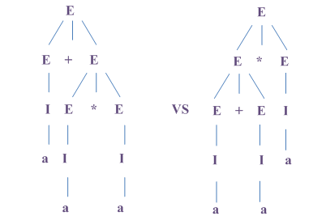
CSC I2400 Formal Language Theory
Fall Semester 2010
Lesson 9 Grammars
Ambiguous Grammars
Sentential form : E + E * E has two distinct derivations.
Hence the expression grammar is ambiguous
Different
meanings
Prof. Stephen Lucci
Computer Science, CCNY

Slide 23
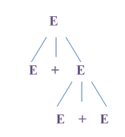
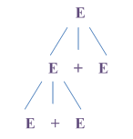
CSC I2400 Formal Language Theory
Fall Semester 2010
Lesson 9 Grammars
Causes for ambiguity in this case
Operator precedence not respected
left * first ← We need to enforce this
On the right * first
Grouping from the left or right
Both +, * are associative
We insist on this
Grouping
From right
Grouping
From left
Prof. Stephen Lucci
Computer Science, CCNY

Slide 24
CSC I2400 Formal Language Theory
Fall Semester 2010
Lesson 9 Grammars
Removing Ambiguity
Factor – expression that cannot be broken apart by any adjacent operator, either
* or +
In this language - identifiers
any parenthesized expression
Term - expression that cannot be broken apart by + operator
A term is a product of one or more factors
ex) term a * b
place a₁ + to it’s left, we got
a₁ * a * b which is grouped as ( a₁ * a ) * b
a₁ + to it’s left, we got
a₁ + ( a * b )
Prof. Stephen Lucci
Computer Science, CCNY

Slide 25
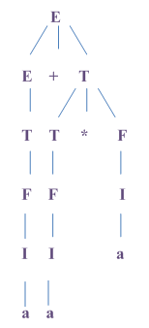
CSC I2400 Formal Language Theory
Fall Semester 2010
Lesson 9 Grammars
Expression : any possible expression
sum of one or more terms
An unambiguous expression grammar
I → a | b | Ia | Ib | I0 | I1
F → I | (E)
T → F | T * F
E → T | E + T
The only parse tree for a + a * a
Hence the expression language is not ambiguous
Prof. Stephen Lucci
Computer Science, CCNY

Slide 26
CSC I2400 Formal Language Theory
Fall Semester 2010
Lesson 9 Grammars
Inherent Ambiguity - There are inherently ambiguous context free languages.
L = { a^{n}b^{n}c^{m}d^{m} | m ≥ 1 , n ≥ 1 }
∪
{ a^{n}b^{m}c^{m}d^{n} | n ≥ 1 , m ≥ 1 }
L = those strings in a + b + c + d +
where n_{a}(w) = n_{b}(w) and n_{c}(w) = n_{d}(w)
or n_{a}(w) = n_{d}(w) and n_{b}(w) = n_{c}(w)
S → AB | C
A → aAb | ab
B → cBd | cd
C → aCd | aDd
D → bDc | bc
Two Parse trees for a b c d
Prof. Stephen Lucci
Computer Science, CCNY

Slide 27
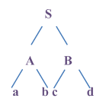
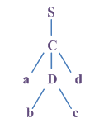
CSC I2400 Formal Language Theory
Fall Semester 2010
Lesson 9 Grammars
Context Sensitive Languages (CSL) are
Generated by Context Sensitive Grammars (CSG)
Recognized by Linear Bounded Automata (LBA)
(A LBA is a Turing Machine in which the amount of tape that may be used is
a linear function of the size of the input).
No grammar may be found for this language which removes the ambiguity
Hence L is inherently ambiguous
Prof. Stephen Lucci
Computer Science, CCNY

Slide 28
CSC I2400 Formal Language Theory
Fall Semester 2010
Lesson 9 Grammars
Production rules in a CSG :
α Aβ γBΔ A,B ∈ N α,β, γ, Δ ∈ ( N + T )*
With | α Aβ | ≤ | γBΔ | //the rules are non contracting.
Consider L = { a^{n}b^{n}c^{n} | n ≥ 1 } i.e. L = { abc, aabbcc, … }
L is a Context Sensitive Language that is not context free ( We will prove thus fact
once we encounter our second pumping lemma.)
L = { a^{n}b^{n}c^{n} | n ≥ 1 }
1) S → aSBC
2) S → aBC
3) CB → BC
4) ab → ab
5) bB → bb
6) bC → bc
7) cC → cc
Our target string w = a^{n}b^{n}c^{n}
Prof. Stephen Lucci
Computer Science, CCNY

Slide 29
CSC I2400 Formal Language Theory
Fall Semester 2010
Lesson 9 Grammars
First, we employ rule 1) n-1 times yielding :
a^{n-1} S(BC)^{n-1} then ⇒ a^{n}(BC)^{n}
(2)once
Then we must move the B’s left past the C’s employ rule 3 repeatedly to yield
a^{n}B^{n}C^{n} ⇒ a^{n}b^{n-1}C^{n}
(4)once
⇒ a^{n}b^{n}C^{n}
(4) n-1 times
⇒ a^{n}b^{n}cC^{n-1}
(6) once
⇒ a^{n}b^{n}C^{n}
(7) n-1 times
When n=2 our target string w=aabbcc
S ⇒ aSBC ⇒ aaBCBC
(1) (2)
⇒ aaBBCC
(3)
⇒ aabBCC
(4)
⇒ aabbCC
(5)
⇒ aabbcC
(6)
⇒ aabbcc
(7)
Prof. Stephen Lucci
Computer Science, CCNY

Slide 30
CSC I2400 Formal Language Theory
Fall Semester 2010
Lesson 9 Grammars
Def: A language L is said to be Turing Decidable(recursive) if an algorithm exists so that whenever w∈ L, the algorithm responds YES and whenever w∈ L, the algorithm responds NO.
Def: A language L is said to be Turing Acceptable ( recursively enumerable ) if whenever w∈ L, a procedure responds YES.
Question : If L is Turing Acceptable (recursively enumerable) and w∈ L,
then what happens??
So whenever L is Turing Decidable (recursive) we can solve the membership question (i.e. we can answer whether or not a string w lies in L).
Problem : Prove that every context sensitive language is Turing Decidable
(recursive).
Hint : The rules in a CSG are non-contracting.
Prof. Stephen Lucci
Computer Science, CCNY

Slide 31
CSC I2400 Formal Language Theory
Fall Semester 2010
Lesson 9 Grammars
The following grammar is phrase structure (i.e. there are no restrictions on the
format of the rules).
(1)(2) S → FA | FBA
(3)FB → FOEBO
(4)(5)EB → O | XBY
(6)OX → XO
(7)YO → OY
(8)FX → FOW
(9)YA → ZOA
(10)WO → OW
(11)OZ → ZO
(12)WBZ → EB
(13)F → ε
(14)A → ε
// IF rule 1 used then we are generating the empty string(need rules 13,14 as well)
// if rule 2, then 3 we have FOEBOA we can erase A & F
And use rule 4 to obtain a 3rd ‘O’ from EB yielding 000.
Prof. Stephen Lucci
Computer Science, CCNY

Slide 32
CSC I2400 Formal Language Theory
Fall Semester 2010
Lesson 9 Grammars
If rule 2, then 3 yielding FOEBOA we can then employ rule 5 FOXBYOA using
rules 6 & 7 send x′ legf FXOBOYA and Y right then rules 8 & 9 will add a 0 on left
FOWOBOZOA and right rule 10 moves w right FOOWBZOOA rule 11 moves Z
left then WBZ → EB in rule 12 then EB → O producing odd #
or EB → XBY to start cycle again
We end by erasing F and A with rules 13 & 14.
L(G) = G ∪ Ooo(oo)* Hence L is actually regular and a regular grammar would have sufficed!
Btw : Notice that rules 4 and 12 are contracting rules, and hence in general
(but not in the case here) it will not be possible to solve the membership
question.
i.e. Phase structure languages are in general not recursive.
Prof. Stephen Lucci
Computer Science, CCNY

Slide 33
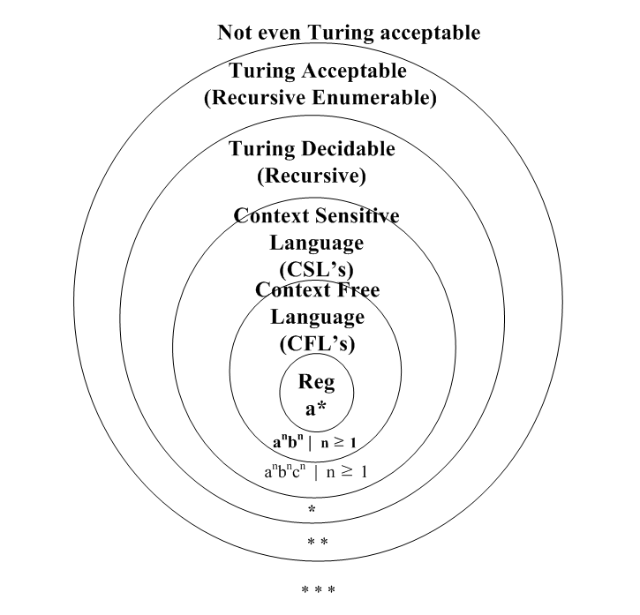
CSC I2400 Formal Language Theory
Fall Semester 2010
Lesson 9 Grammars
Our taxonomy of languages :
We will see examples of languages in *, ** and *** in the next few weeks.
Prof. Stephen Lucci
Computer Science, CCNY

Slide 34

Lesson 10 Pushdown Automata is Next

