Slide 1
THT1 Fall 2021 CSC 342/343 Izidor Gertner
By : Chue Zhang

Slide 2
Objective
Compile and debug code given in Mars MIPS environment, i7 intelx86 processor and GCC.

Slide 3
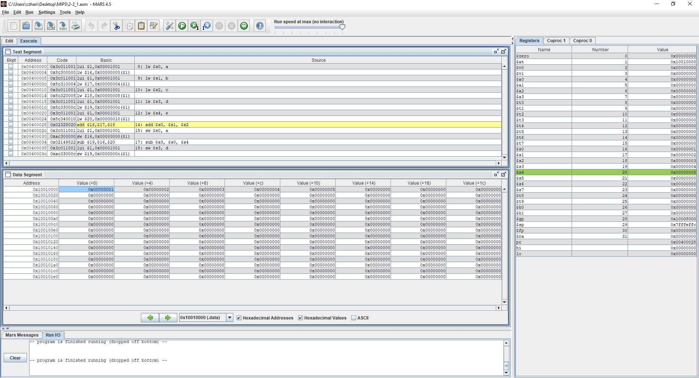

Slide 4
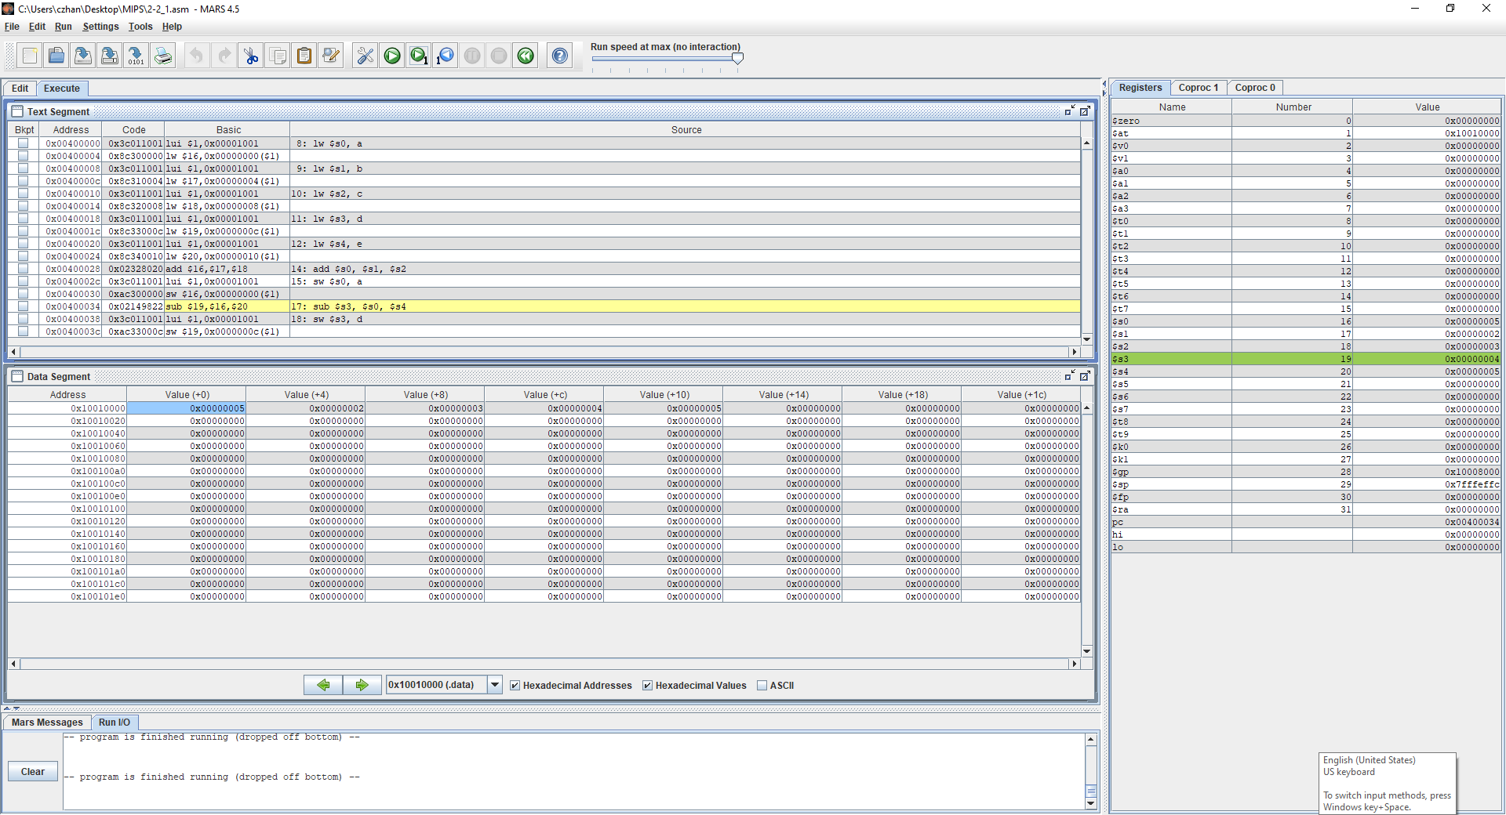

Slide 5
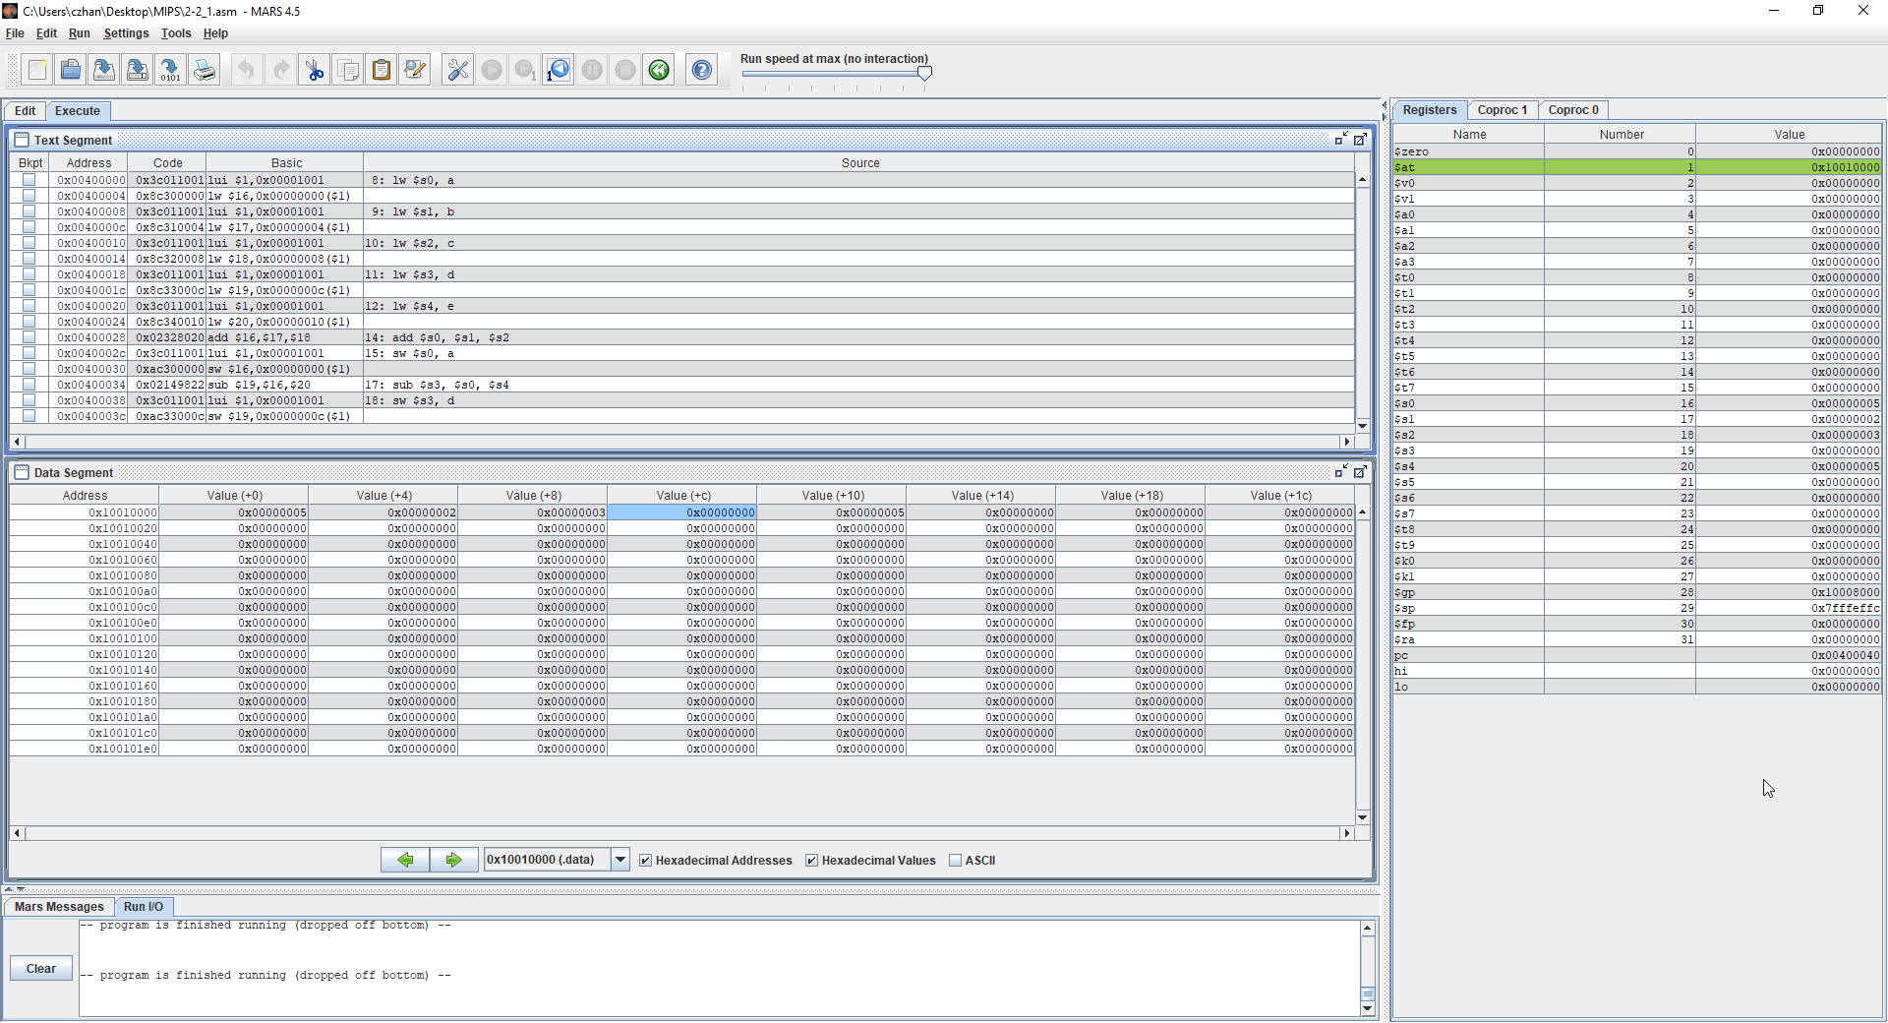

Slide 6
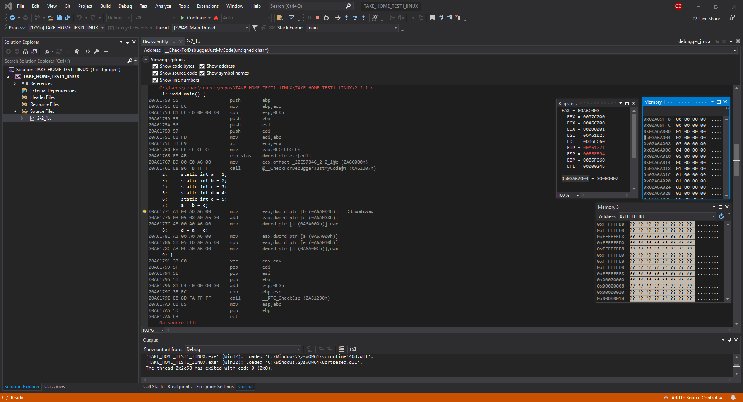

Slide 7
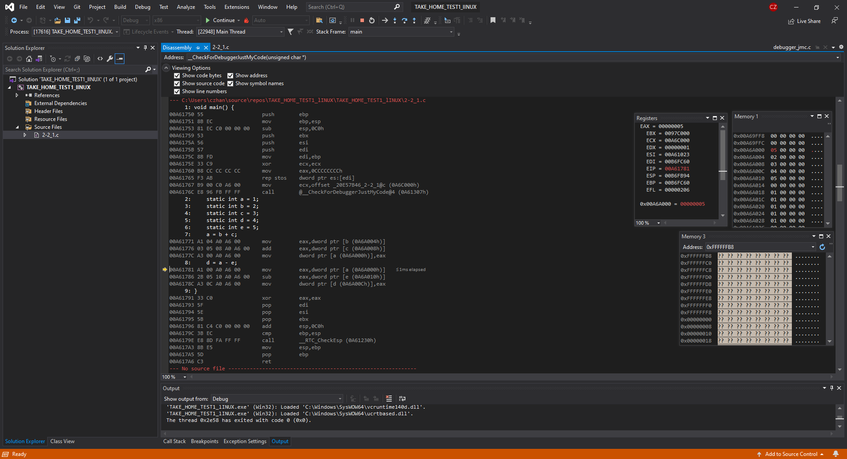

Slide 8
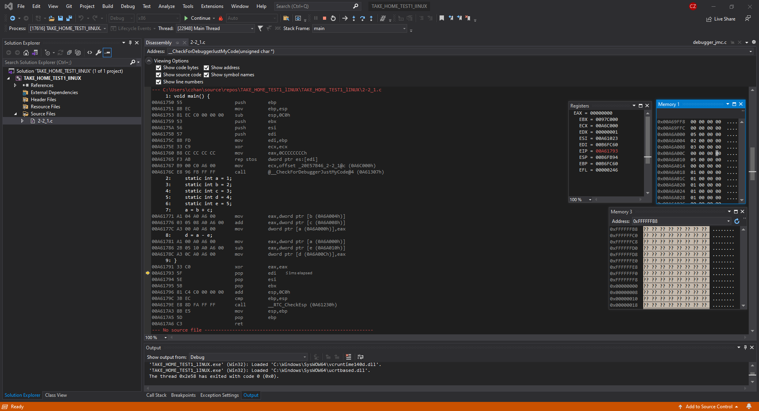

Slide 9
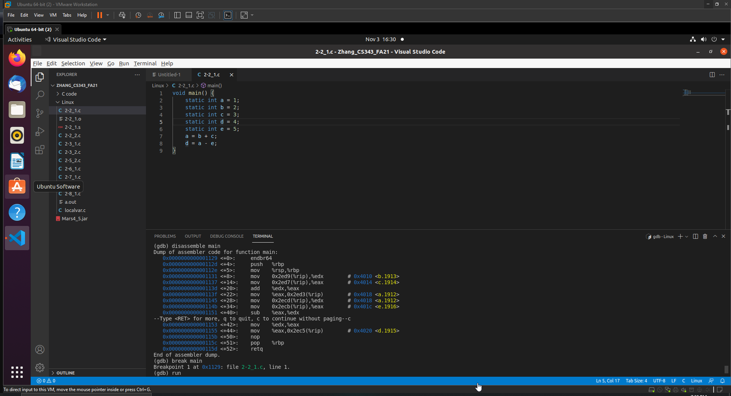

Slide 10
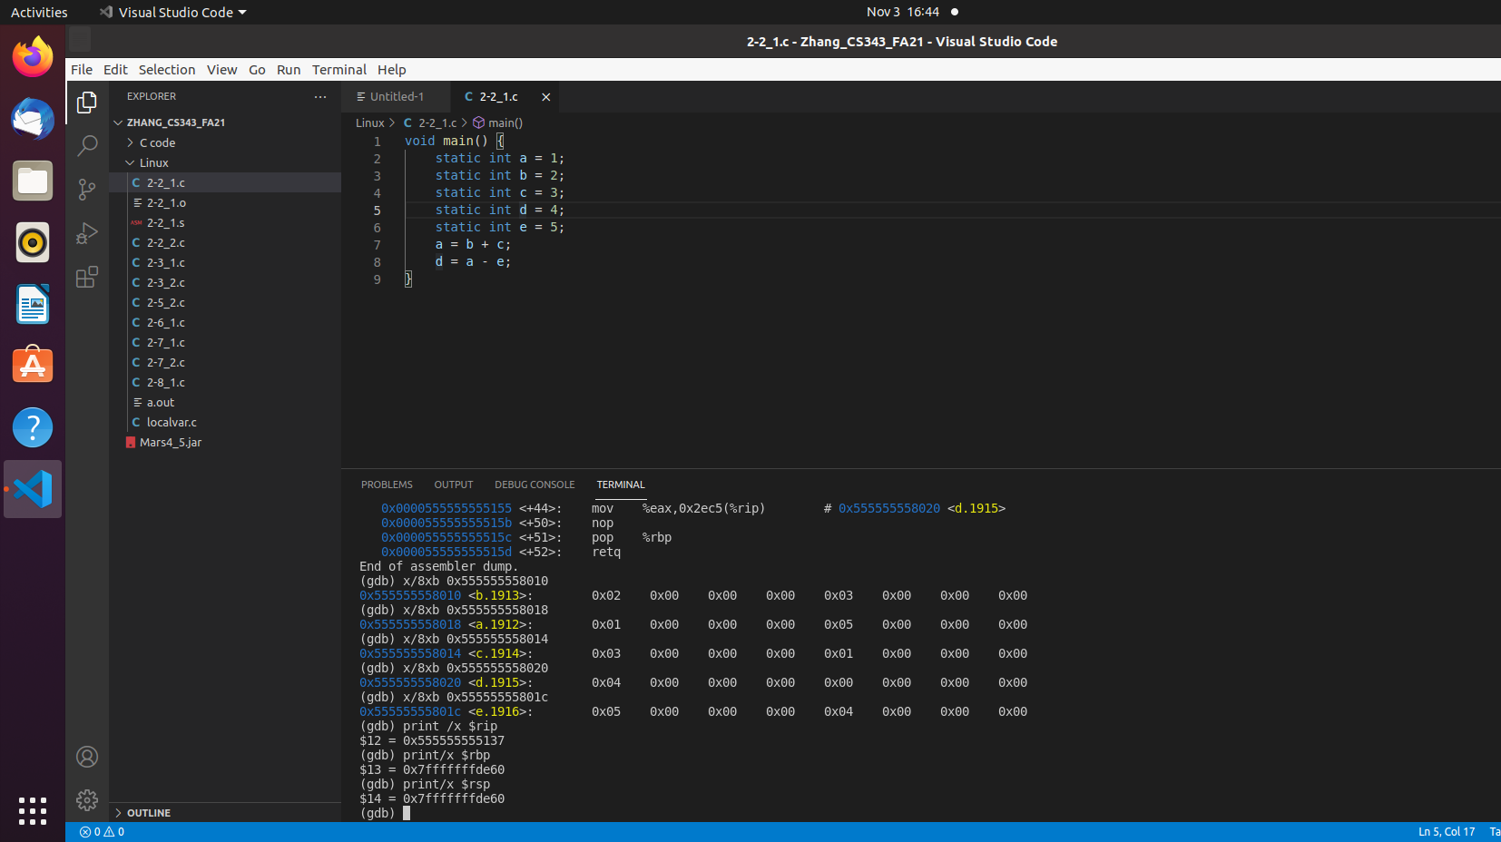

Slide 11
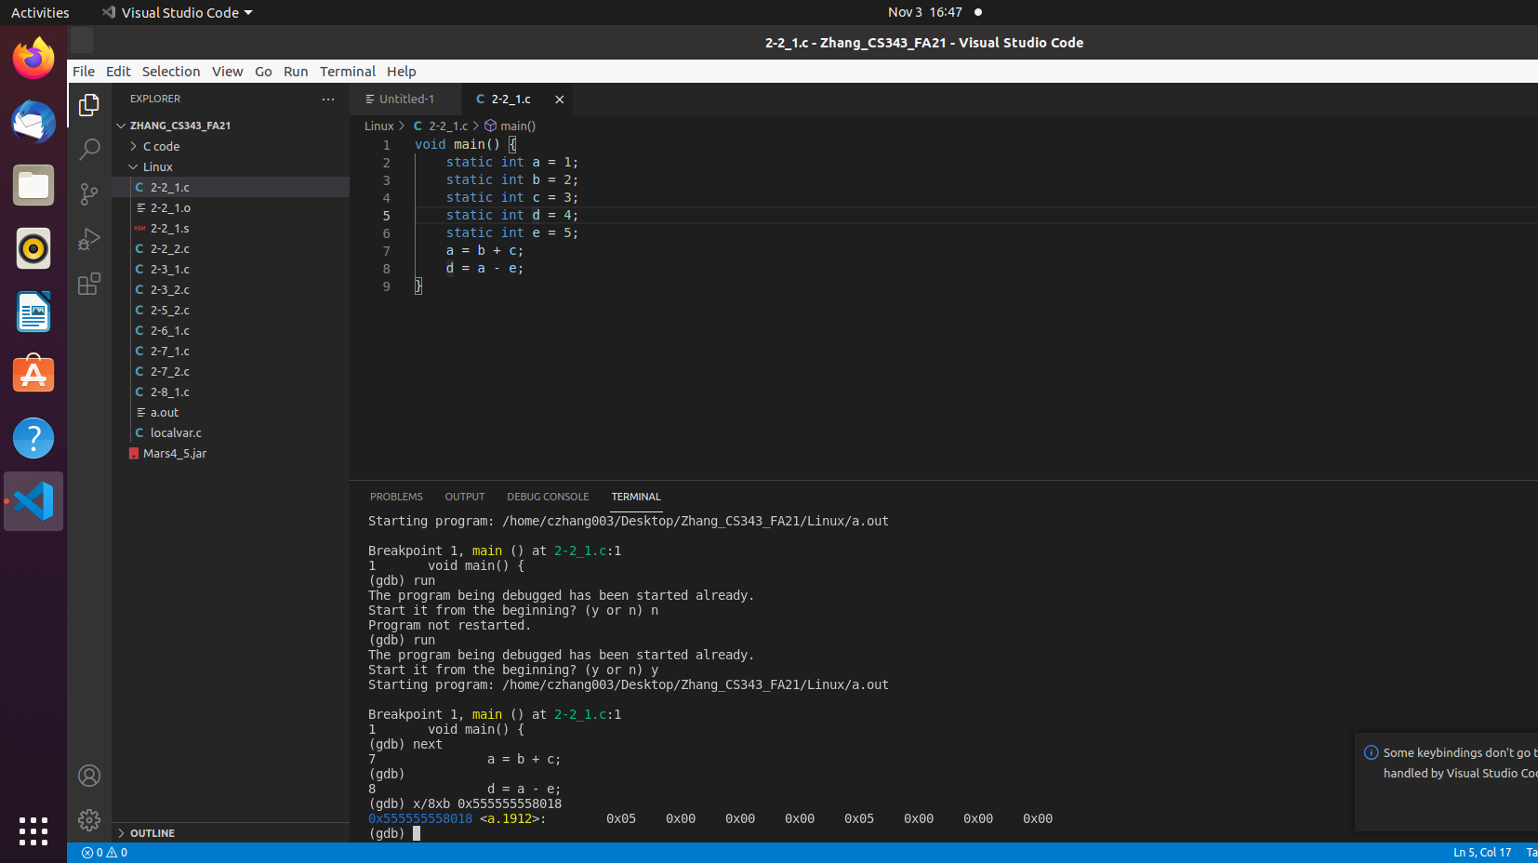

Slide 12
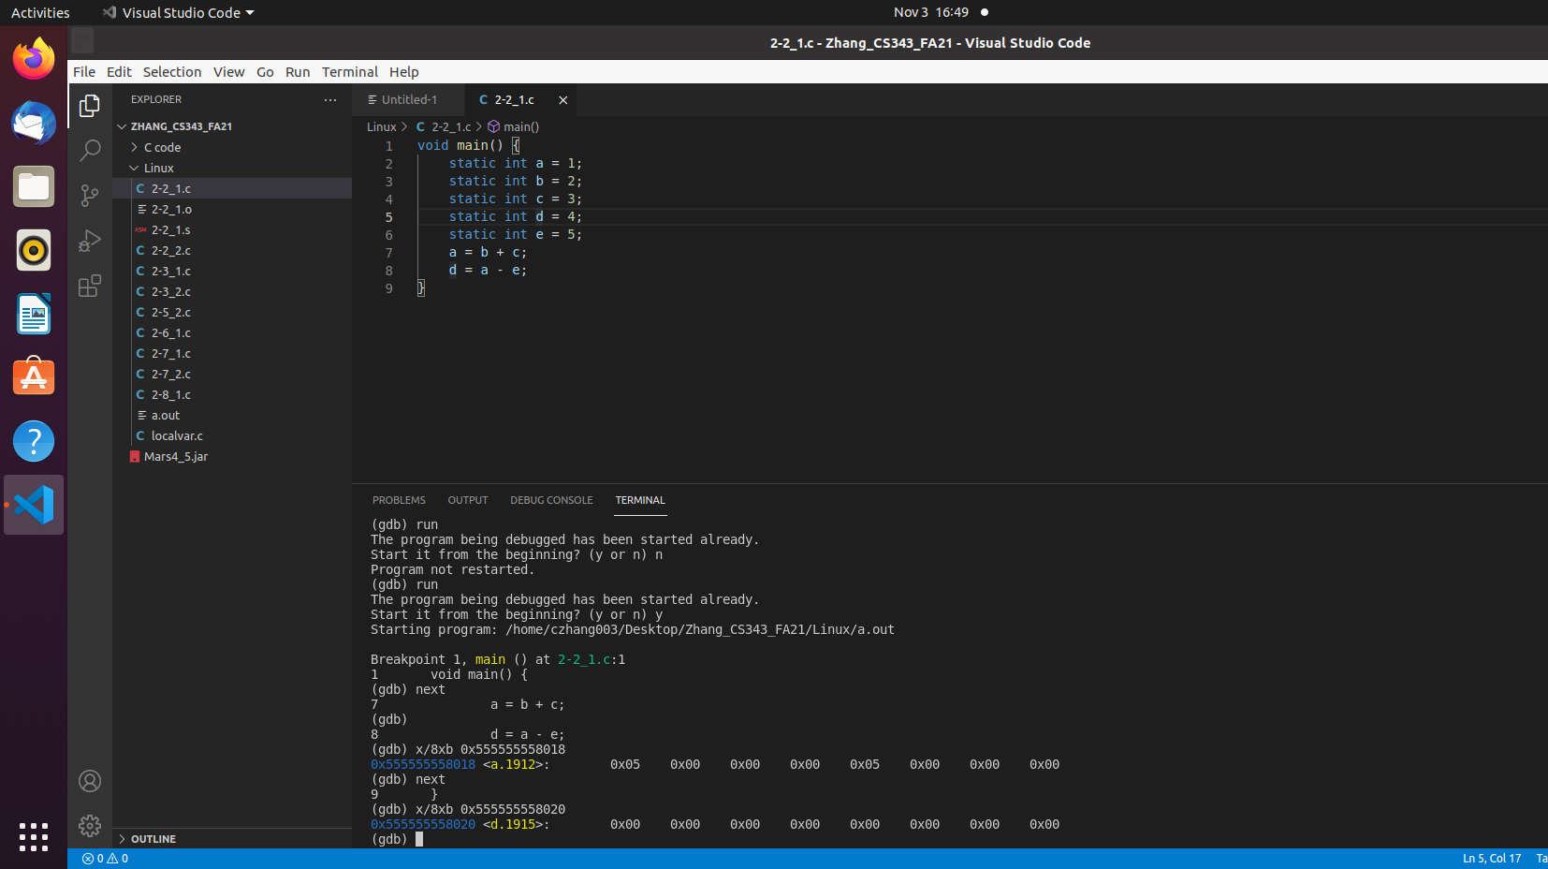

Slide 13
Conclusion
Little endian is GCC and Intelx86 because they read least significant bit first
Big endian is MIPS because it reads most significant bit first

