Slide 1
Probability and Statistics Review
Le Song
Introduction to Computational Data Analysis
(Machine Learning)
CSE/ISYE 6740, Fall 2019

Slide 2

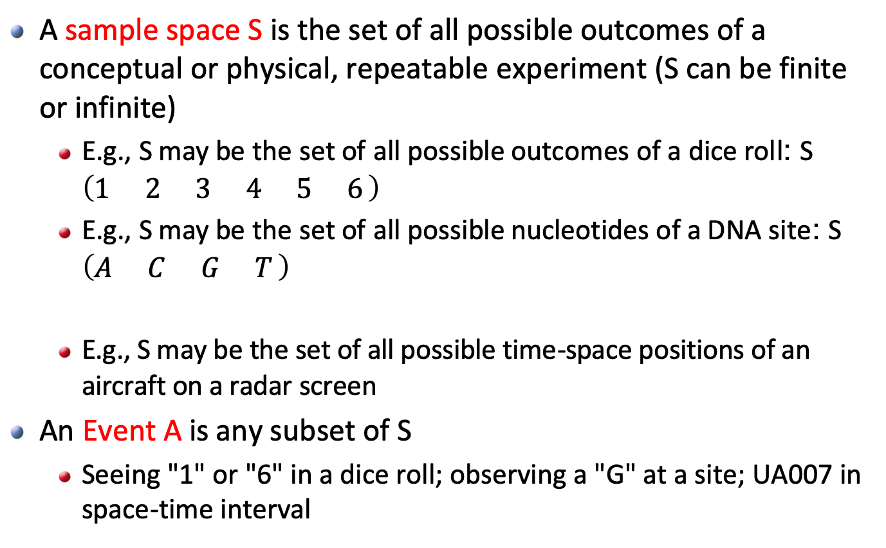
Basic Probability Concepts
A sample space S is the set of all possible outcomes of a conceptual or physical, repeatable experiment (S can be finite or infinite)
E.g., S may be the set of all possible outcomes of a dice roll: S $\left(\begin{matrix}1 & 2 & 3 & 4 & 5 & 6\end{matrix}\right)$
E.g., S may be the set of all possible nucleotides of a DNA site: S $\left(\begin{matrix}A & C & G & T\end{matrix}\right)$
E.g., S may be the set of all possible time-space positions of an aircraft on a radar screen
An Event A is any subset of S
Seeing "1" or "6" in a dice roll; observing a "G" at a site; UA007 in space-time interval

Slide 3
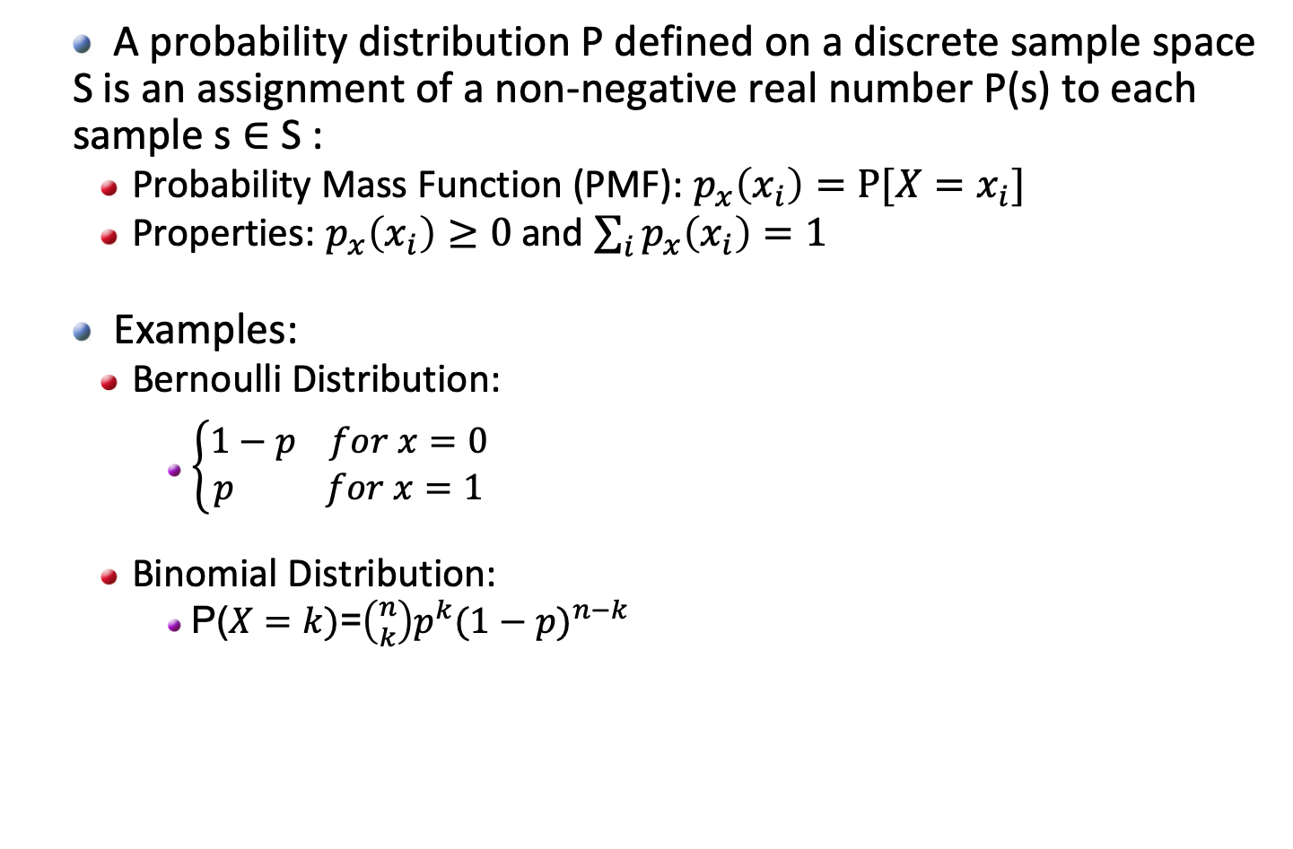
Discrete Prob. Distribution
A probability distribution P defined on a discrete sample space S is an assignment of a non-negative real number P(s) to each sample s $∈$ S :
Probability Mass Function (PMF): $p_{x}\left(x_{i}\right)=P⁡[X=x_{i}]$
Properties: $p_{x}\left(x_{i}\right)≥0$and $\sum_{i}{p_{x}\left(x_{i}\right)=1}$
Examples:
Bernoulli Distribution:
$\left\{\begin{aligned}1−p for x=0 \\ p for x=1\end{aligned}\right.$
Binomial Distribution:
P($X=k)$=$\left({n \atop k}\right)p^{k}{(1−p)}^{n−k}$

Slide 4
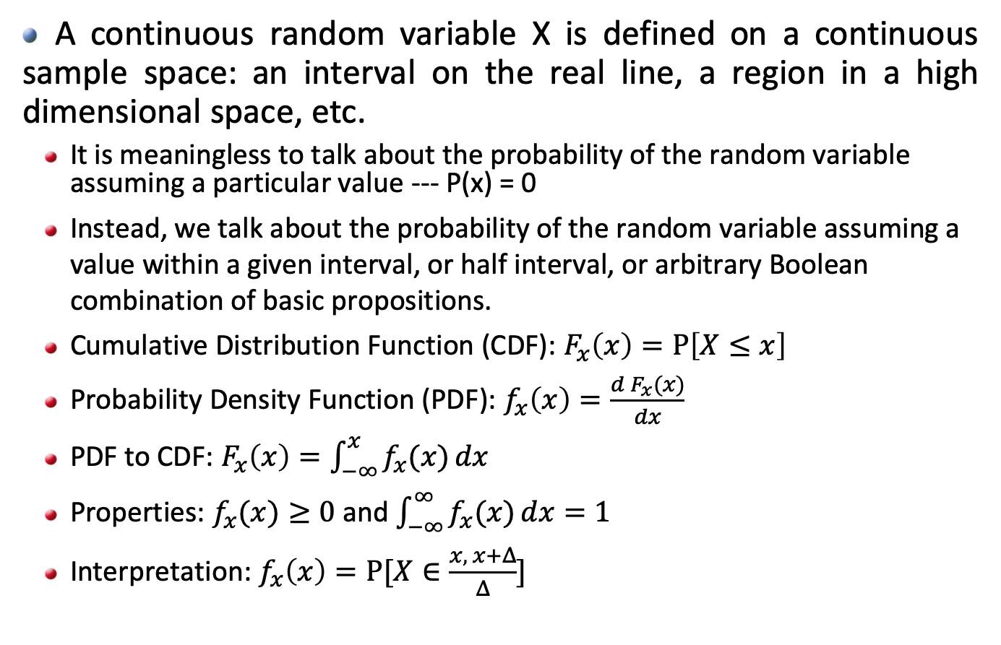
Continuous Prob. Distribution
A continuous random variable X is defined on a continuous sample space: an interval on the real line, a region in a high dimensional space, etc.
It is meaningless to talk about the probability of the random variable assuming a particular value --- P(x) = 0
Instead, we talk about the probability of the random variable assuming a value within a given interval, or half interval, or arbitrary Boolean combination of basic propositions.
Cumulative Distribution Function (CDF): $F_{x}\left(x\right)=P\left[X≤x\right]$
Probability Density Function (PDF): $f_{x}\left(x\right)=\frac{d F_{x}(x)}{dx}$
PDF to CDF: $F_{x}\left(x\right)=\int_{−∞}^{x}{f_{x}(x)}dx$
Properties: $f_{x}(x)≥0$ and $\int_{−∞}^{∞}{f_{x}(x)}dx=1$
Interpretation: $f_{x}\left(x\right)=P⁡[X∈\frac{x, x+Δ}{Δ}]$

Slide 5
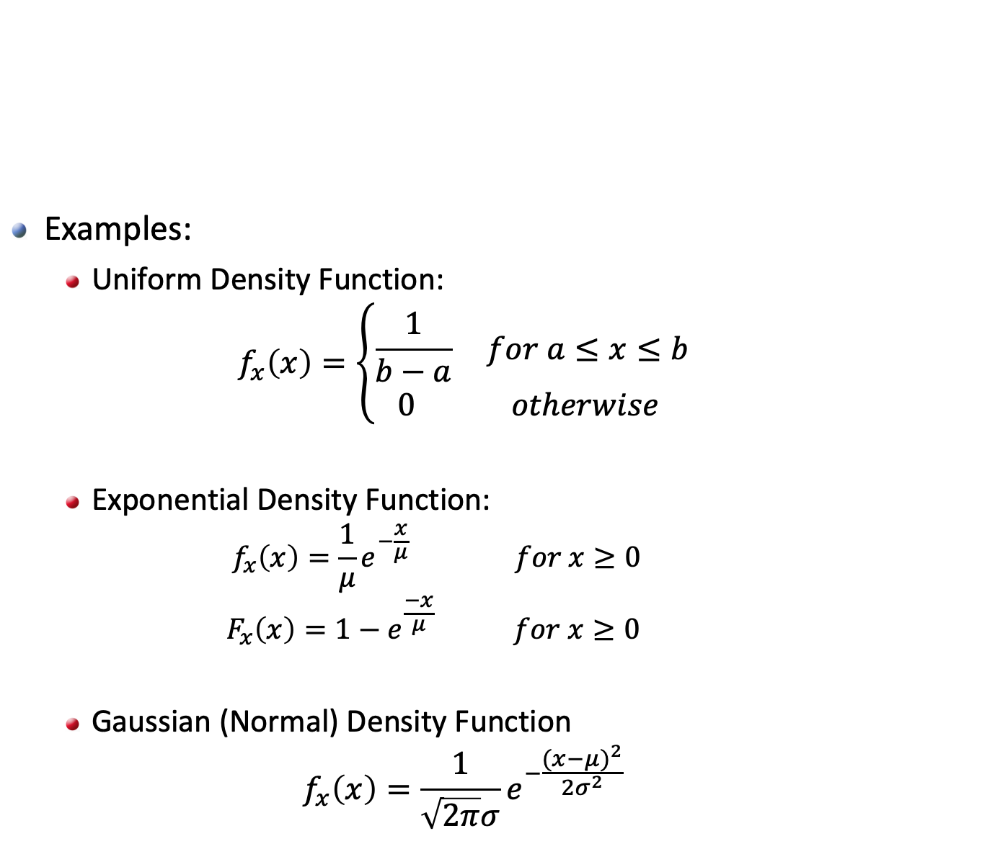
Continuous Prob. Distribution
Examples:
Uniform Density Function:
$$f_{x}\left(x\right)=\left\{\begin{aligned}\frac{1}{b−a} for a≤x≤b \\ 0 otherwise \end{aligned}\right.$$
Exponential Density Function:
$$f_{x}\left(x\right)=\frac{1}{μ}e^{−\frac{x}{μ}} for x≥0$$
$$F_{x}\left(x\right)=1−e^{\frac{−x}{μ}} for x≥0$$
Gaussian (Normal) Density Function
$$f_{x}\left(x\right)=\frac{1}{\sqrt{2π}σ}e^{−\frac{{(x−μ)}^{2}}{2σ^{2}}}$$

Slide 6
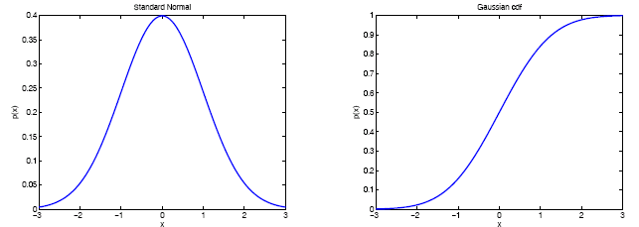
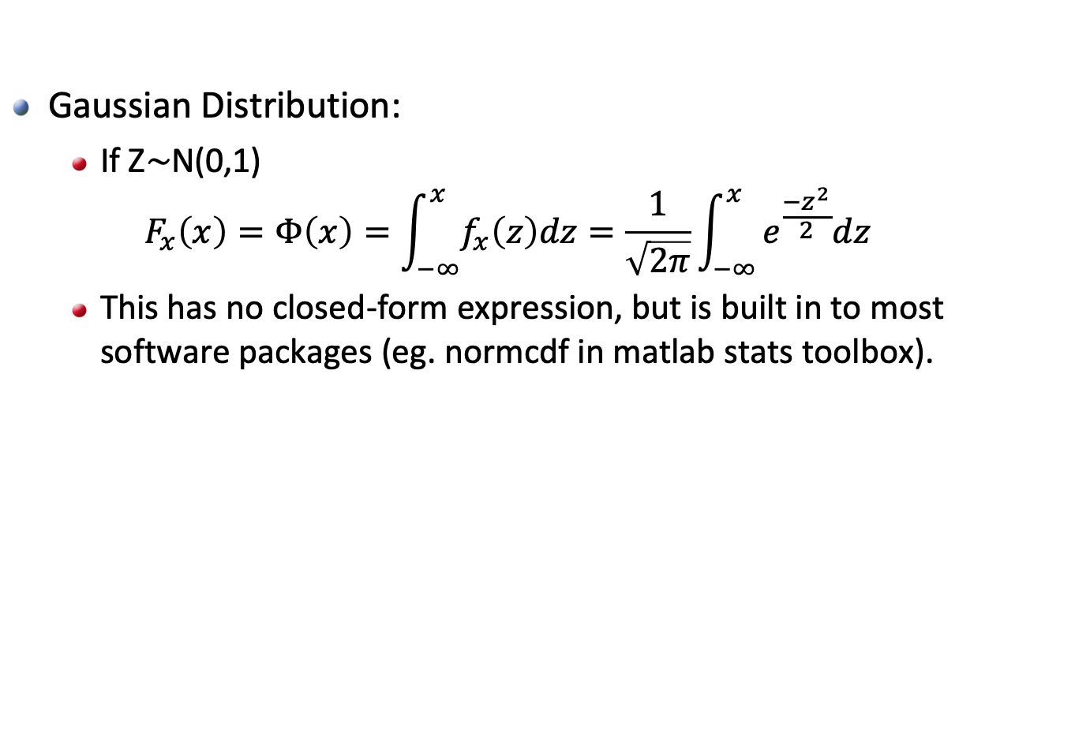
Continuous Prob. Distribution
Gaussian Distribution:
If Z$\sim$N(0,1)
$$F_{x}\left(x\right)=Φ\left(x\right)=\int_{−∞}^{x}{f_{x}\left(z\right)dz}=\frac{1}{\sqrt{2π}}\int_{−∞}^{x}{e^{\frac{−z^{2}}{2}}dz}$$
This has no closed-form expression, but is built in to most software packages (eg. normcdf in matlab stats toolbox).

Slide 7
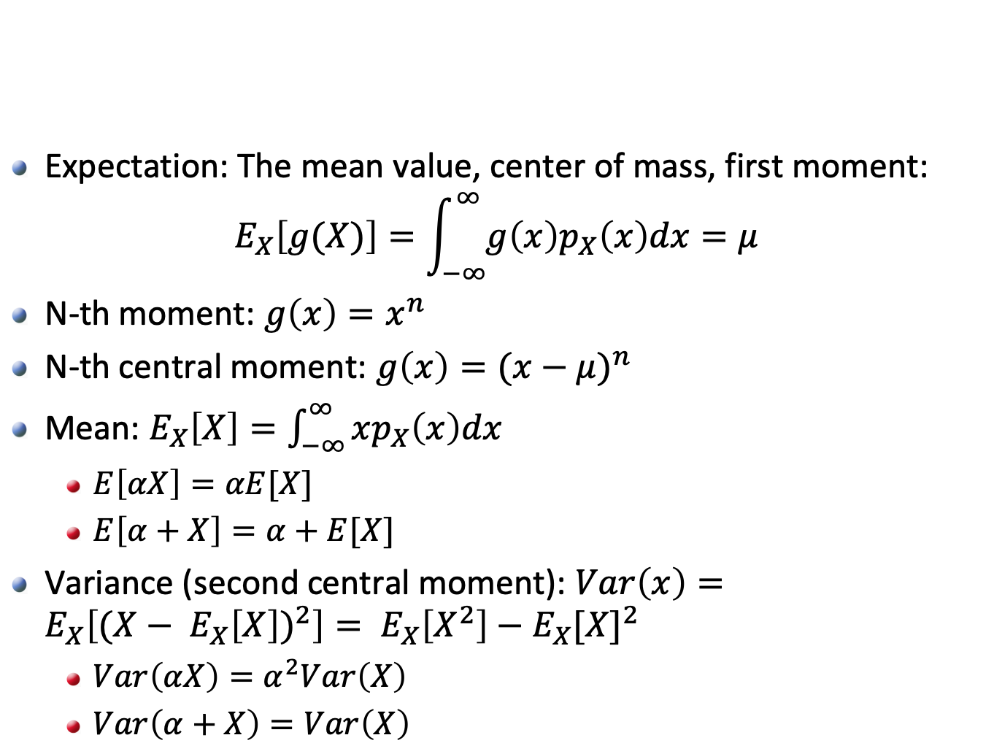
Characterizations
Expectation: The mean value, center of mass, first moment:
$$E_{X}\left[g(X)\right]=\int_{−∞}^{∞}{g\left(x\right)p_{X}\left(x\right)dx=μ}$$
N-th moment: $g\left(x\right)=x^{n}$
N-th central moment: $g\left(x\right)=({x−μ)}^{n}$
Mean: $E_{X}\left[X\right]=\int_{−∞}^{∞}{xp_{X}\left(x\right)dx}$
$E\left[αX\right]=αE[X]$
$E\left[α+X\right]=α+E[X]$
Variance (second central moment): $Var\left(x\right)=E_{X}\left[{(X− E_{X}\left[X\right])}^{2}\right]= E_{X}\left[X^{2}\right]−E_{X}{[X]}^{2}$
$Var\left(αX\right)=α^{2}Var\left(X\right)$
$Var\left(α+X\right)=Var\left(X\right)$

Slide 8
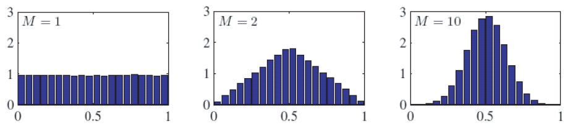
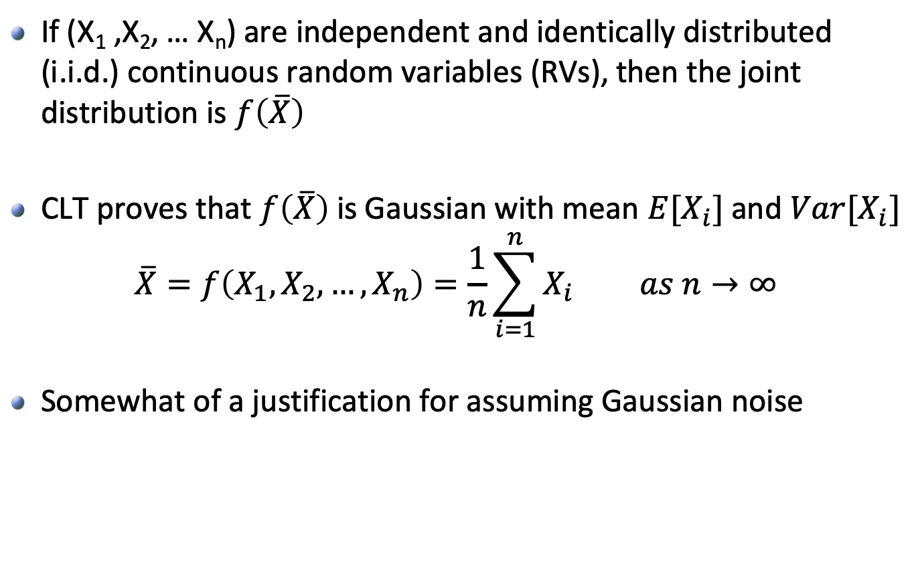
Central Limit Theorem (CLT)
If (X₁ ,X₂, … X_{n}) are independent and identically distributed (i.i.d.) continuous random variables (RVs), then the joint distribution is $f\left(\overline{X}\right)$
CLT proves that $f\left(\overline{X}\right)$ is Gaussian with mean $E[X_{i}]$ and $Var[X_{i}]$
$$\overline{X}=f\left(X_{1},X_{2},…,X_{n}\right)=\frac{1}{n}\sum_{i=1}^{n}{X_{i} as n→∞}$$
Somewhat of a justification for assuming Gaussian noise

Slide 9
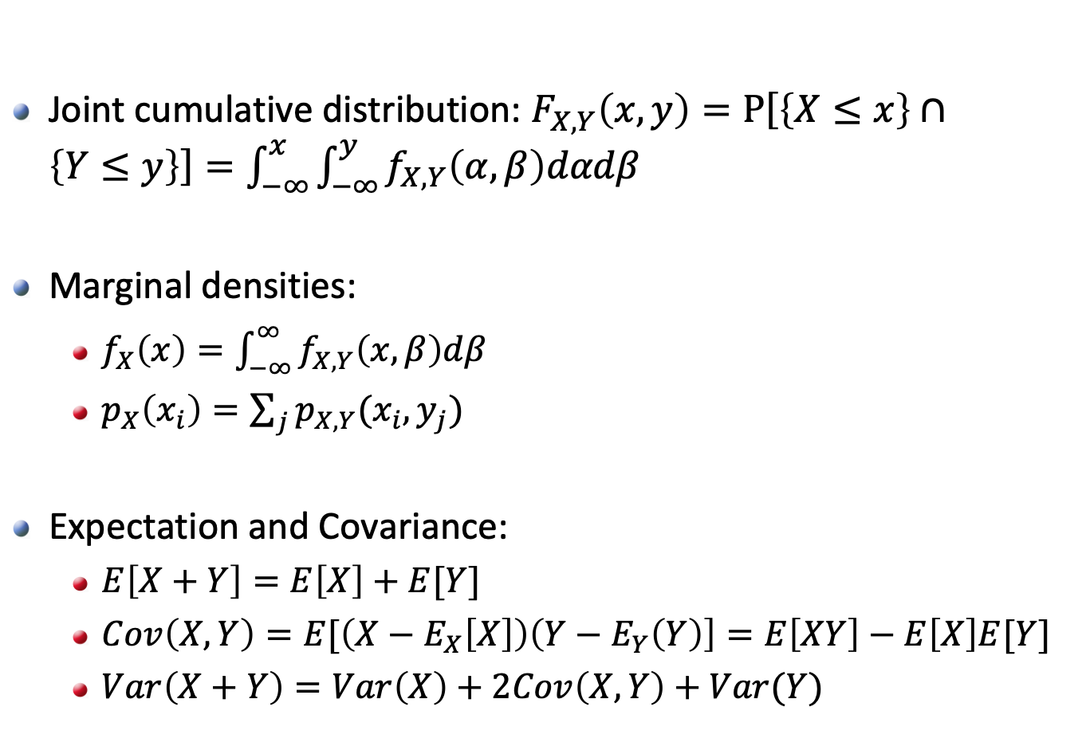
Joint RVs and Marginal Densities
Joint cumulative distribution: $F_{X,Y}\left(x,y\right)=P\left[\left\{X≤x\right\}∩\left\{Y≤y\right\}\right]=\int_{−∞}^{x}{\int_{−∞}^{y}{f_{X,Y}\left(α,β\right)dαdβ}}$
Marginal densities:
$f_{X}\left(x\right)=\int_{−∞}^{∞}{f_{X,Y}\left(x,β\right)dβ}$
$p_{X}\left(x_{i}\right)=\sum_{j}{p_{X,Y}(x_{i},y_{j})}$
Expectation and Covariance:
$E\left[X+Y\right]=E\left[X\right]+E[Y]$
$Cov\left(X,Y\right)=E[\left(X−E_{X}\left[X\right]\right)\left(Y−E_{Y}\left(Y\right)\right]=E\left[XY\right]−E\left[X\right]E[Y]$
$Var\left(X+Y\right)=Var\left(X\right)+2Cov\left(X,Y\right)+Var(Y)$

Slide 10
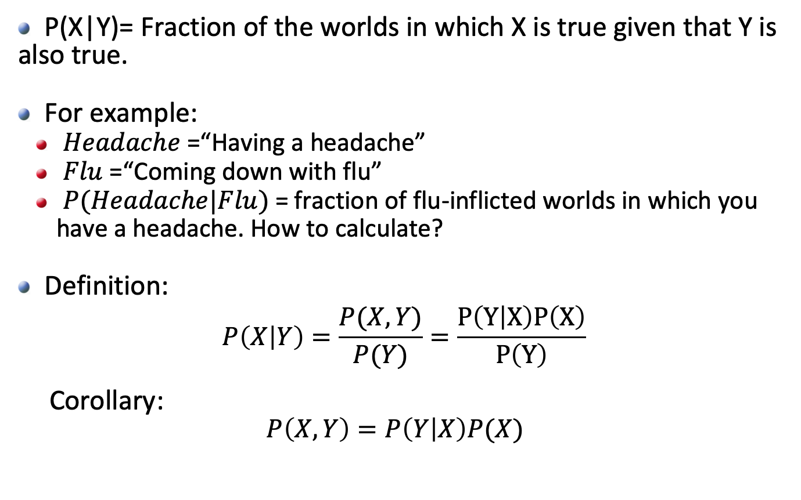
Conditional Probability
P(X|Y)= Fraction of the worlds in which X is true given that Y is also true.
For example:
$Headache$=“Having a headache”
$Flu$=“Coming down with flu”
$P(Headache|Flu)$ = fraction of flu-inflicted worlds in which you have a headache. How to calculate?
Definition:
$$P\left(X | Y\right)=\frac{P(X,Y)}{P(Y)}=\frac{P\left(Y | X\right)P\left(X\right)}{P\left(Y\right)}$$
Corollary:
$$P\left(X,Y\right)=P\left(Y | X\right)P(X)$$
This is called Bayes’ Rule

Slide 11
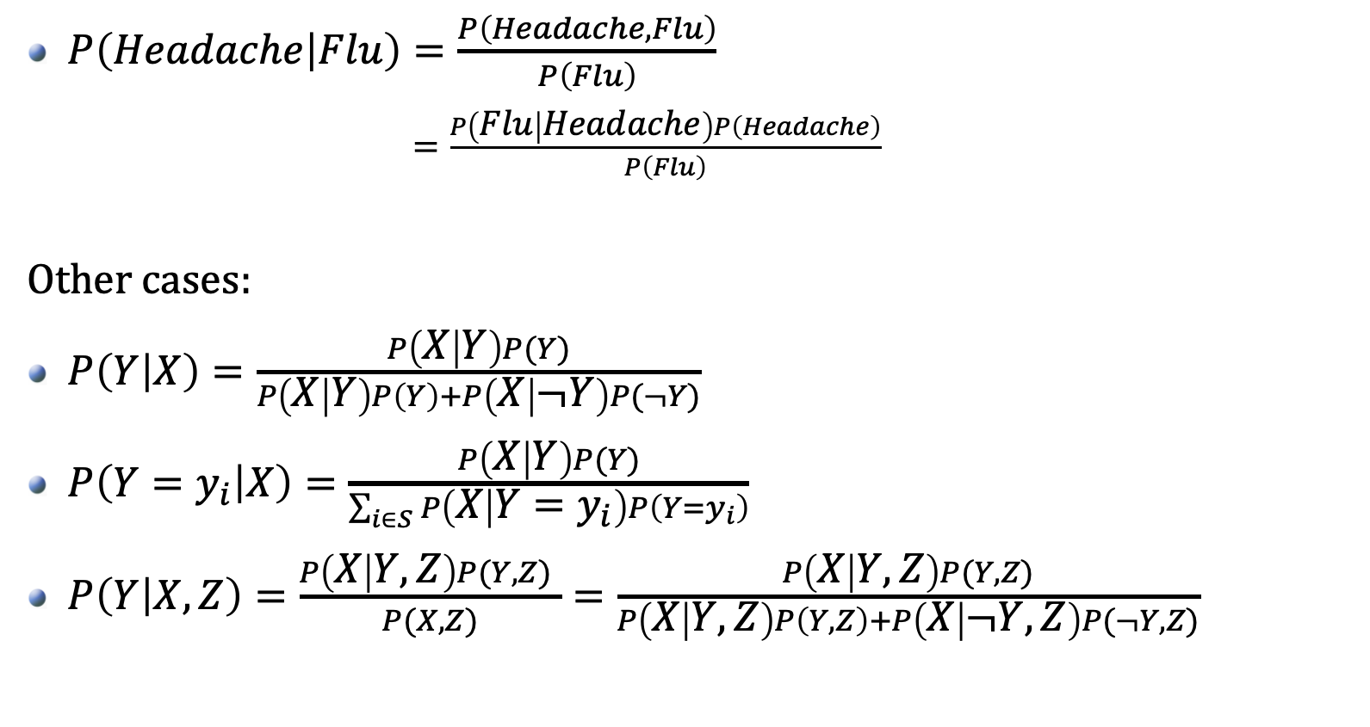
The Bayes Rule
$P\left(Headache | Flu\right)=\frac{P\left(Headache,Flu\right)}{P\left(Flu\right)}$
$=\frac{P\left(Flu | Headache\right)P\left(Headache\right)}{P\left(Flu\right)}$
Other cases:
$P\left(Y | X\right)=\frac{P\left(X | Y\right)P(Y)}{P\left(X | Y\right)P\left(Y\right)+P\left(X | ¬Y\right)P(¬Y)}$
$P\left(Y=y_{i} | X\right)=\frac{P\left(X | Y\right)P(Y)}{\sum_{i∈S}{P\left(X | Y=y_{i}\right)P\left(Y=y_{i}\right)}}$
$P\left(Y | X,Z\right)=\frac{P\left(X | Y,Z\right)P(Y,Z) }{P(X,Z)}=\frac{P\left(X | Y,Z\right)P(Y,Z)}{P\left(X | Y,Z\right)P\left(Y,Z\right)+P\left(X | ¬Y,Z\right)P(¬Y,Z)}$

Slide 12
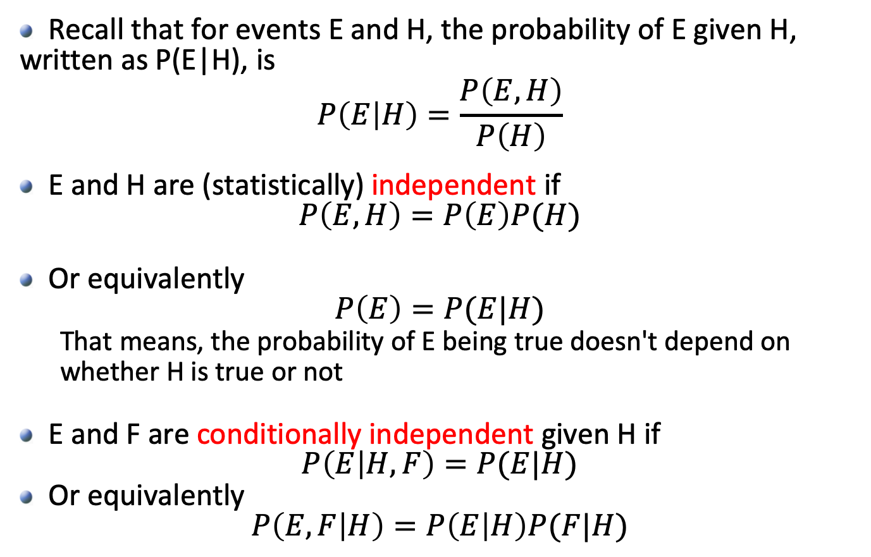
Rules of Independence
Recall that for events E and H, the probability of E given H, written as P(E|H), is
$$P\left(E | H\right)=\frac{P\left(E,H\right)}{P\left(H\right)}$$
E and H are (statistically) independent if
$$P\left(E,H\right)=P\left(E\right)P(H)$$
Or equivalently
$$P\left(E\right)=P(E|H)$$
That means, the probability of E being true doesn't depend on whether H is true or not
E and F are conditionally independent given H if
$$P\left(E | H,F\right)=P(E|H)$$
Or equivalently
$$P\left(E,F | H\right)=P\left(E | H\right)P(F|H)$$

Slide 13
Rules of Independence
Examples:
P(Virus | Drink Beer) = P(Virus)
iff Virus is independent of Drink Beer
P(Flu | Virus;DrinkBeer) = P(Flu|Virus)
iff Flu is independent of Drink Beer, given Virus
P(Headache | Flu;Virus;DrinkBeer) = P(Headache|Flu;DrinkBeer)
iff Headache is independent of Virus, given Flu and Drink Beer
Assume the above independence, we obtain:
P(Headache;Flu;Virus;DrinkBeer)
= P(Headache | Flu;Virus;DrinkBeer) P(Flu | Virus;DrinkBeer)
P(Virus | Drink Beer) P(DrinkBeer)
= P(Headache | Flu;DrinkBeer) P(Flu | Virus) P(Virus) P(DrinkBeer)

Slide 14

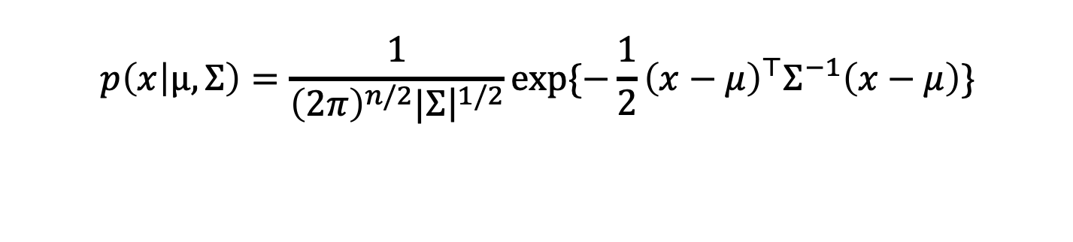


Multivariate Gaussian
Moment Parameterization
Mahalanobis Distance
Tons of applications (Mixture of Gaussian, Kalman filter, …)
$$p\left(x | μ,Σ\right)=\frac{1}{{\left(2π\right)}^{n/2}|{\left.​Σ\right|}^{1/2}}exp⁡\{−\frac{1}{2}{\left(x−μ\right)}^{⊤}Σ^{−1}\left(x−μ\right)\}$$
$$μ=E(X)$$
$$Σ=Cov\left(X\right)=E[\left(X−μ\right){\left(X−μ\right)}^{⊤}]$$
$$∆^{2}={\left(x−μ\right)}^{⊤}Σ^{−1}\left(x−μ\right)$$
Notes:
The Mahalanobis distance is a measure of the distance between a point x and a distribution D which has mean \mu and covariance matrix \Sigma

Slide 15

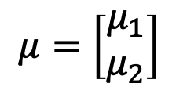




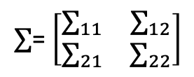

Multivariate Gaussian P(X₁, X₂)
$$P\left(X_{1},X_{2}\right)$$
Joint Gaussian
Marginal Gaussian
Conditional Gaussian
$$μ=\left[\begin{matrix}μ_{1} \\ μ_{2}\end{matrix}\right]$$
$∑$= $\left[\begin{matrix}∑_{11} & ∑_{12} \\ ∑_{21} & ∑_{22}\end{matrix}\right]$
$$μ_{2}^{m}=μ_{2}$$
$$Σ_{2}^{m}=Σ_{2}$$
$$P\left({X_{1}|X}_{2}=x_{2}\right)$$
$$μ_{1|2}=μ_{1}+Σ_{12}Σ_{22}^{−1}\left(x_{2}−μ_{2}\right)$$
$$Σ_{1|2}=Σ_{11}−Σ_{12}Σ_{22}^{−1}Σ_{21}$$

Slide 16
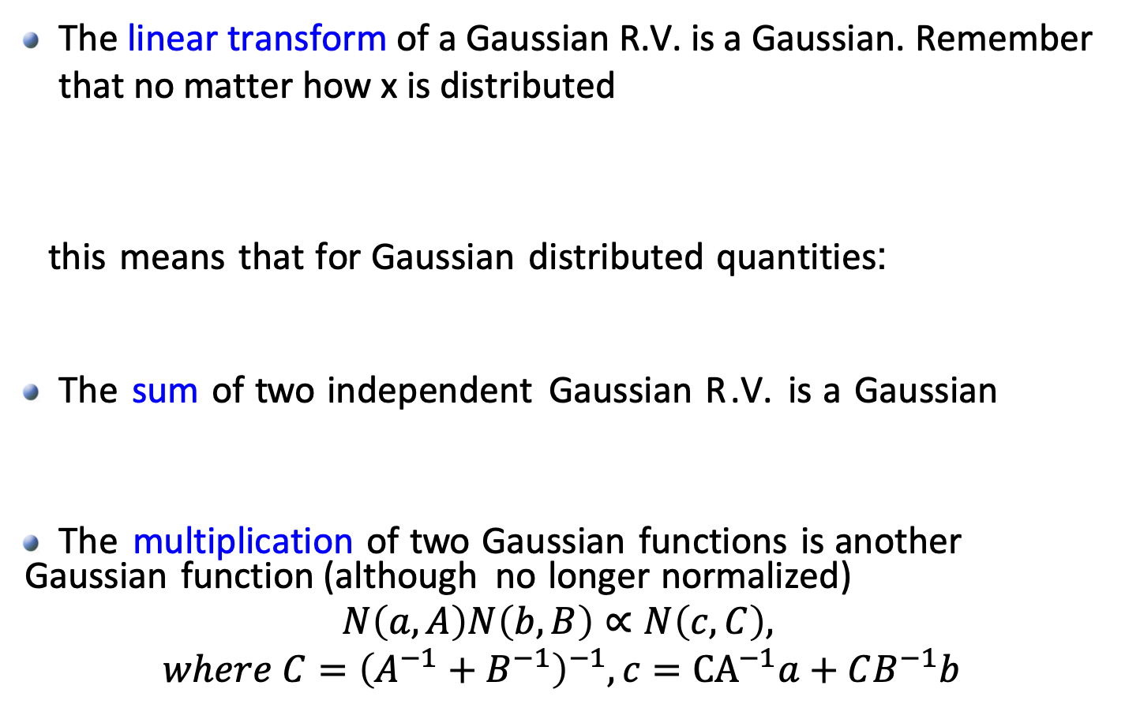


Operations on Gaussian R.V.
The linear transform of a Gaussian R.V. is a Gaussian. Remember that no matter how x is distributed
this means that for Gaussian distributed quantities:
The sum of two independent Gaussian R.V. is a Gaussian
The multiplication of two Gaussian functions is another Gaussian function (although no longer normalized)
$$N\left(a,A\right)N\left(b,B\right)∝N\left(c,C\right),$$
$$where C={\left(A^{−1}+B^{−1}\right)}^{−1}, c={\text{CA}}^{−1}a+CB^{−1}b$$
$$E\left(AX+b\right)=AE\left(X\right)+b$$
$$Cov\left(AX+b\right)=ACov\left(X\right)A^{⊤}$$
$$X∼N\left(μ, Σ\right) → AX+b∼N(Aμ+b, AΣA^{⊤})$$
$$Y=X_{1}+X_{2}, { X}_{1}⊥X_{2} →μ_{y}=μ_{1}+μ_{2}, Σ_{y}=Σ_{1}+Σ_{2}$$

Slide 17
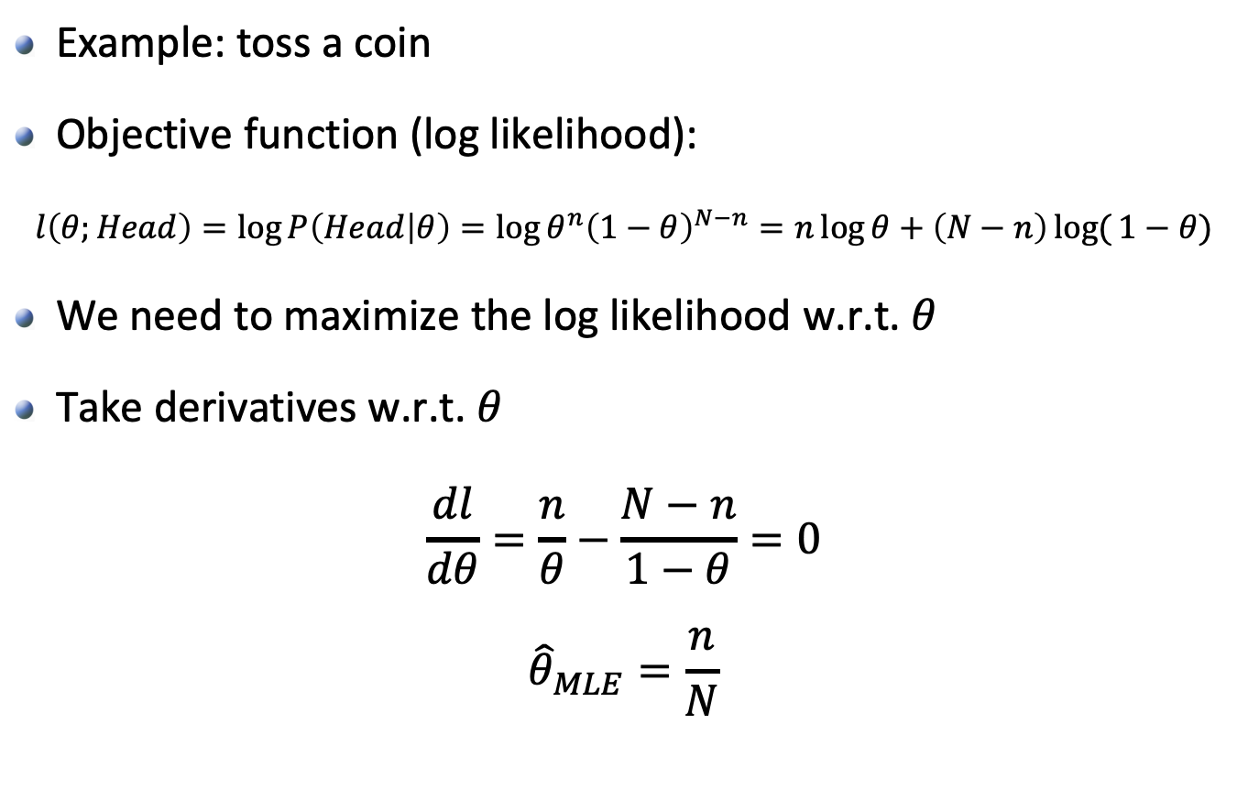
Maximum Likelihood Estimation (MLE)
Example: toss a coin
Objective function (log likelihood):
$$l\left(θ;Head\right)=\log{P\left(Head | θ\right)=\log{θ^{n}{\left(1−θ\right)}^{N−n}=n\log{θ+\left(N−n\right)log({1−θ)}}}}$$
We need to maximize the log likelihood w.r.t. $θ$
Take derivatives w.r.t. $θ$
$$\frac{dl}{dθ}=\frac{n}{θ}−\frac{N−n}{1−θ}=0$$
$${\hat{θ}}_{MLE}=\frac{n}{N}$$

