Slide 1
BioResearch OS
Bala Muhammad Abubakar
Student ID: 312023705021
Self-Reflective Retrieval-Augmented Generation for Biomedical Research
Chukwu John Okike
Student ID: 312023704038
ICLR 2024
PubMedQA
Self-RAG
Next.js 15
Python
Supervisor
Final Year Software Engineering Project | 2025 - 2026
Yuchen Zhang

Slide 2
Presentation Agenda
01
The Problem
02
Solution Overview
Why existing tools fail biomedical researchers
BioResearch OS -- three integrated layers
03
Self-RAG Mechanism
04
Hybrid Retrieval
Adaptive retrieval via reflection tokens
BM25 + Blake2b dense fusion, CPU-only
05
System Architecture
06
Platform & Demo
4-layer hexagonal design
Next.js 15 enterprise workspace + screenshots
07
Engineering
08
Evaluation
3 non-obvious decisions that made it work
PubMedQA results -- honest and complete
09
Competitive Analysis
10
Limitations & Future
vs. PubMed, ChatGPT, Standard RAG
Honest assessment + clear roadmap
BioResearch OS
Final Year Project | 2025-2026

Slide 3
The Problem
Why existing biomedical AI tools fail researchers and clinicians
34M+
19/day
~40%
0%
PubMed Articles
Papers per Specialist
LLM Hallucination Rate
Retrieval Transparency
Impossible to manually keep up
To stay current in one subspecialty
In ungrounded medical answers
No tool exposes its full reasoning chain
The Gap
Standard RAG retrieves unconditionally -- every query gets documents whether they help or not, adding noise. LLMs answer with false confidence and no source attribution. No existing tool exposes its retrieval decision, passage relevance, or grounded evidence chain to the user.
Feature
PubMed Search
ChatGPT / LLMs
Standard RAG
BioResearch OS
Live retrieval
Yes
No
Yes
Yes
Reasoning
No
Yes
No
Yes
Evidence trace
No
No
No
Yes
BioResearch OS
Final Year Project | 2025-2026

Slide 4
Solution: BioResearch OS
Three integrated layers delivering adaptive, transparent biomedical QA
LAYER 1
LAYER 2
LAYER 3
Self-RAG Core
Hybrid Retrieval
Next.js 15 Platform
Adaptive retrieval via reflection tokens Model decides when to retrieve. Critiques every passage. Selects best-supported answer.
BM25 (a=0.35) + Dense Blake2b (b=0.65) CPU-only. Zero GPU required. Full semantic + lexical fusion over 1,000 PubMedQA passages.
6-page enterprise workspace Evidence grounding, confidence scoring, reflection-token transparency in every answer.
PubMedQA Corpus
1,000 Passages
CPU Compatible
Open Source
No Cloud Required
BioResearch OS
Final Year Project | 2025-2026

Slide 5
Self-RAG: How It Works
Asai et al., ICLR 2024 -- adaptive retrieval through learned self-reflection
[Retrieve]
[IsRel]
[IsSup]
[IsUse]
>
>
>
Retrieve or skip?
Passage relevant?
Answer grounded?
Quality 1-5
Critique Score:
score = 0.4 x P(IsRel) + 0.4 x P(FullySup) + 0.2 x (IsUse / 5)
Adaptive Retrieval
Single Unified Model
Best-of-N Selection
Emits [No Retrieve] for simple factual queries -- no unnecessary retrieval noise added
No external rerankers or classifiers -- self-reflection is learned end-to-end in one LM
Multiple candidates generated per retrieved passage -- highest critique score wins
BioResearch OS
Final Year Project | 2025-2026

Slide 6
Hybrid Retrieval Engine
Lexical precision + semantic depth -- zero GPU, zero training required
BM25 (Sparse Lexical)
Dense Semantic
Weight: a = 0.35
Weight: b = 0.65
Robertson & Zaragoza (2009)
Blake2b hash projection
k1 = 1.5, b = 0.75
+
128-dim float vectors
Pre-computed IDF at index build
Cosine similarity scoring
Exact keyword overlap signal
Zero training required
Robust on domain terminology
< 1ms on laptop CPU
Fusion: score = 0.35 x BM25_norm + 0.65 x cosine_sim
CPU-only | < 5s index build | 1,000 passages
BioResearch OS
Final Year Project | 2025-2026

Slide 7
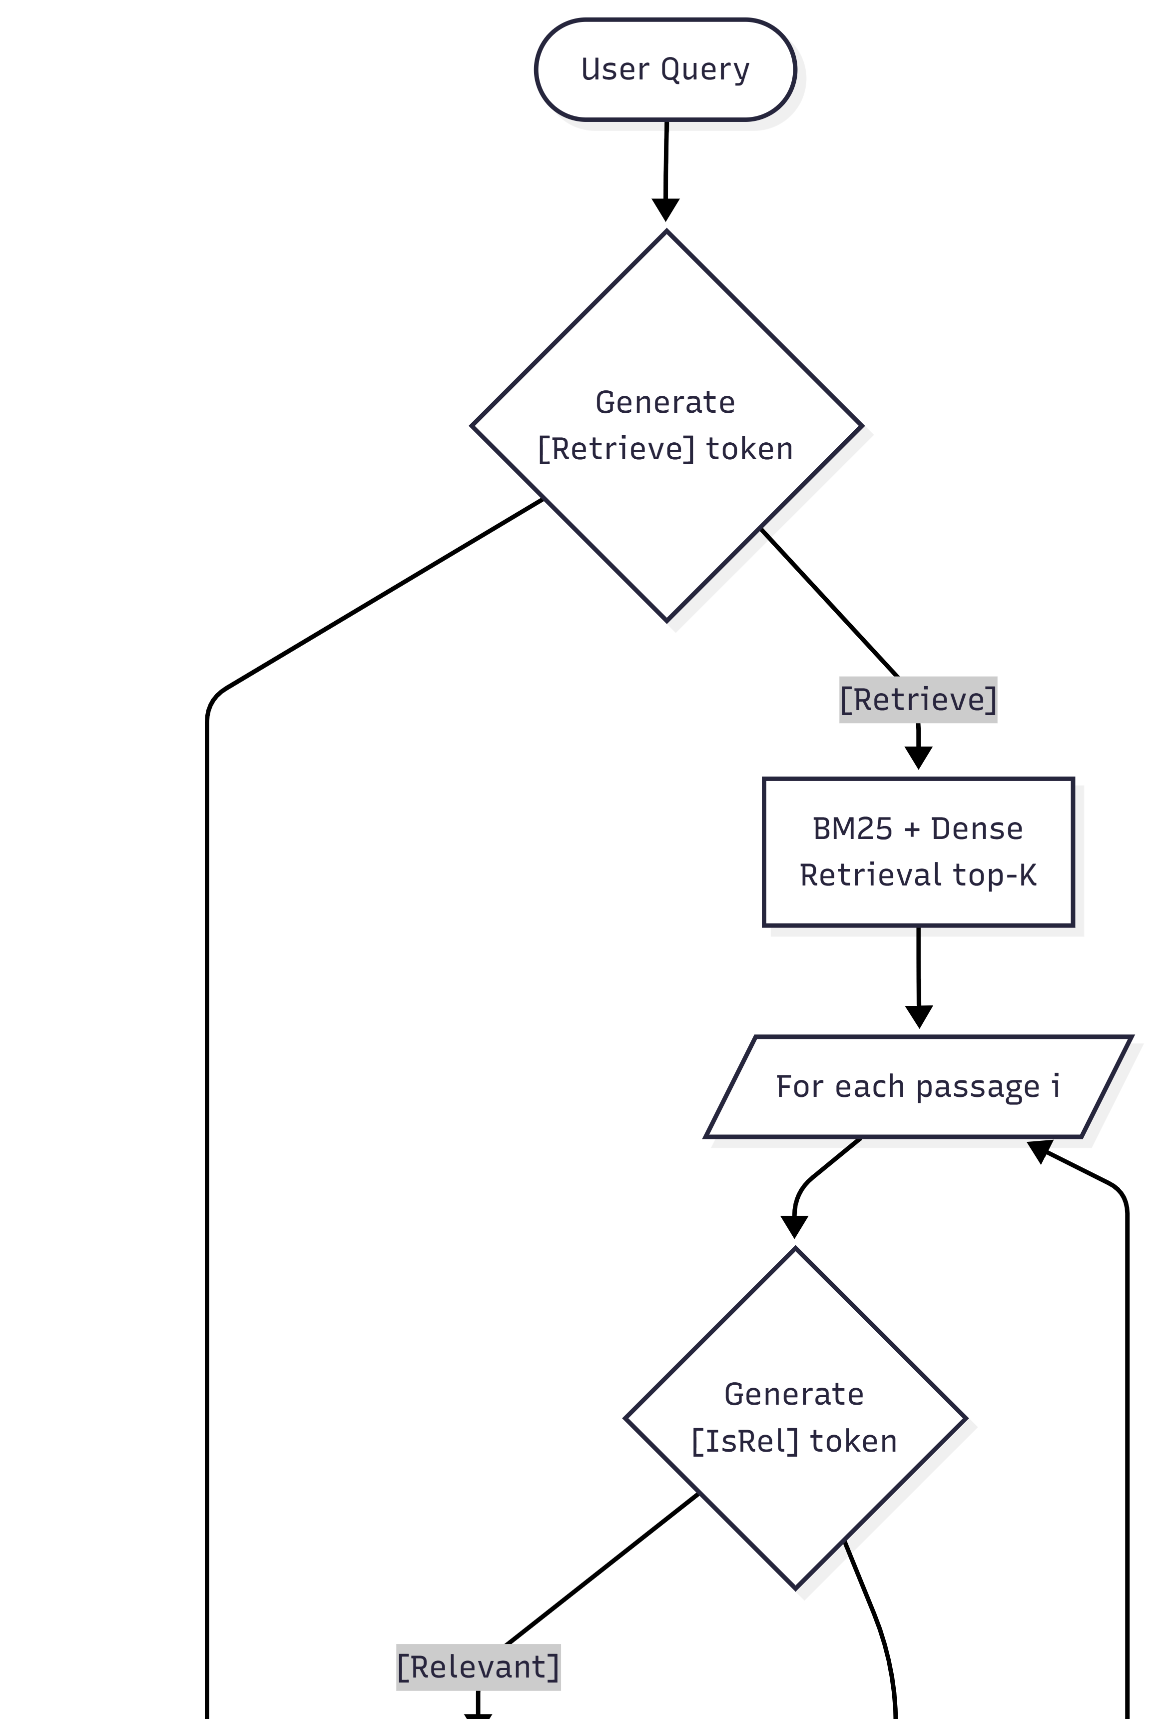
System Architecture
4-layer hexagonal design -- each layer independently testable and replaceable
PRESENTATION
Next.js :3000 | Gradio :7861
4
6-page enterprise UI * Gradio rapid-demo
APPLICATION
REST Bridge :7862 | /api/query
3
stdlib HTTP server * JSON normalisation * CORS
INFRASTRUCTURE
SelfRAGPipeline | Retriever | Backends
2
HeuristicBackend * HuggingFaceBackend * swappable
CORPUS
pubmedqa_index.json | 1,000 passages
1
BM25 stats * Blake2b embeddings * built in <5s
Design principle: each layer depends ONLY on the layer below. Swap HeuristicBackend -> HuggingFaceBackend without touching retrieval, bridge, or UI.
System diagram (generated from architecture spec)
BioResearch OS
Final Year Project | 2025-2026

Slide 8
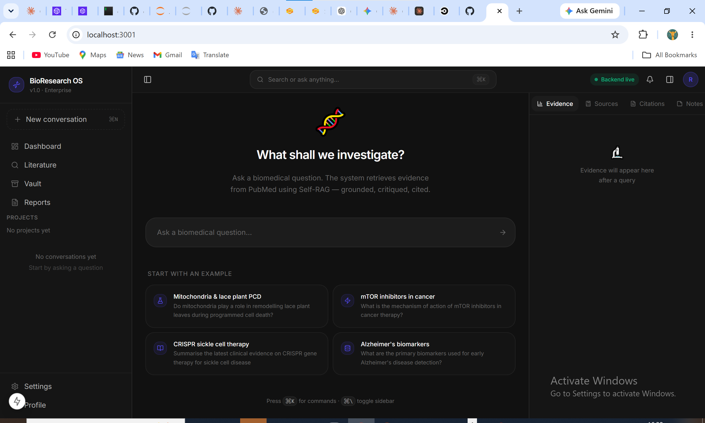
BioResearch OS Platform
Next.js 15 * TypeScript * Tailwind CSS * Framer Motion * Zustand
Research Workspace
Literature Explorer
Knowledge Vault
Conversational Q&A with live retrieval and evidence panels
Search-to-workspace routing and passage browsing
Save & tag evidence passages across all sessions
Analytics Dashboard
Settings
Profile
Session stats, query metrics, retrieval rates
Backend URL, top-K, inference mode toggle
Usage statistics and account info
Live: BioResearch OS -- Research Workspace
BioResearch OS
Final Year Project | 2025-2026

Slide 9
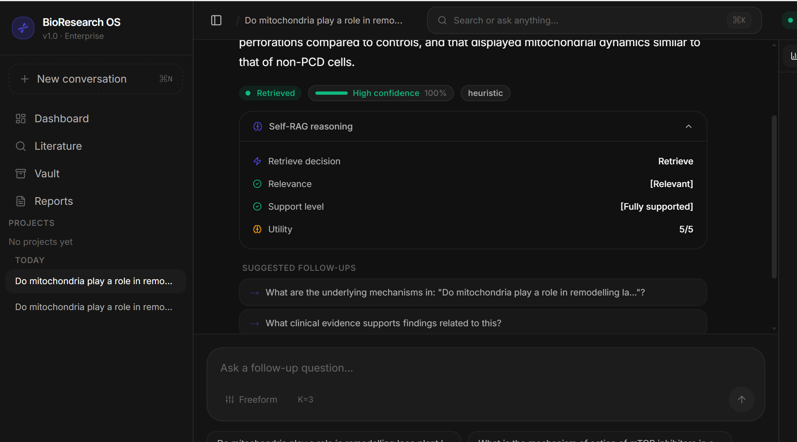
Live Platform Screenshots
BioResearch OS running locally -- real Self-RAG queries with evidence grounding
Home -- Research Workspace with retrieval badge and confidence bar
Expanded reasoning panel -- reflection tokens: IsRel, IsSup, IsUse
BioResearch OS
Final Year Project | 2025-2026

Slide 10
3 Key Engineering Decisions
Non-obvious technical choices -- and why each one mattered
01
REST Bridge (not Gradio API)
Problem:
Gradio 6 returns gr.update() objects through SSE queue -- not JSON-serialisable. Next.js fetch calls failed silently.
Solution:
stdlib BaseHTTPRequestHandler on :7862 calls run_demo() directly -> clean JSON. ~80 lines, zero dependencies. Gradio demo stays intact.
02
Blake2b Hash Projection
Problem:
Dense semantic retrieval normally requires a trained sentence encoder and GPU inference.
Solution:
hashlib.blake2b(token).digest() -> 128-dim float, mean-pooled. Zero training, zero FAISS, <1ms on CPU. Full system runs on a laptop.
03
Full Message Object in Store
Problem:
Updating a streaming placeholder in Zustand required the original message ID -- lost in partial state updates.
Solution:
addMessage() accepts complete Message objects. aiMsgId preserved through stream, enabling placeholder -> final swap with zero duplicates.
BioResearch OS
Final Year Project | 2025-2026

Slide 11
Evaluation Results
PubMedQA * 10-example subset * label-mode accuracy (yes / no / maybe)
0%
20%
<100ms
<1s
Heuristic Label Accuracy
+20 pp
Self-RAG 7B Label Accuracy
Retrieval Latency
Full Pipeline Response
Keyword pattern matching
HF LLaMA-2 on NVIDIA A40
BM25 + Blake2b on CPU
Heuristic backend on laptop
Evaluation Notes
Why label-mode?
PubMedQA was designed around yes/no/maybe labels -- the metric the authors specify.
Why not token F1?
Gold answers are long rationales; Self-RAG emits concise reflection-prefixed output. F1 penalises brevity.
GPU runtime:
HF Self-RAG 7B on NVIDIA A40 (24GB): ~53s/query. Heuristic: <1s on CPU. Same retrieval layer.
BioResearch OS
Final Year Project | 2025-2026

Slide 12
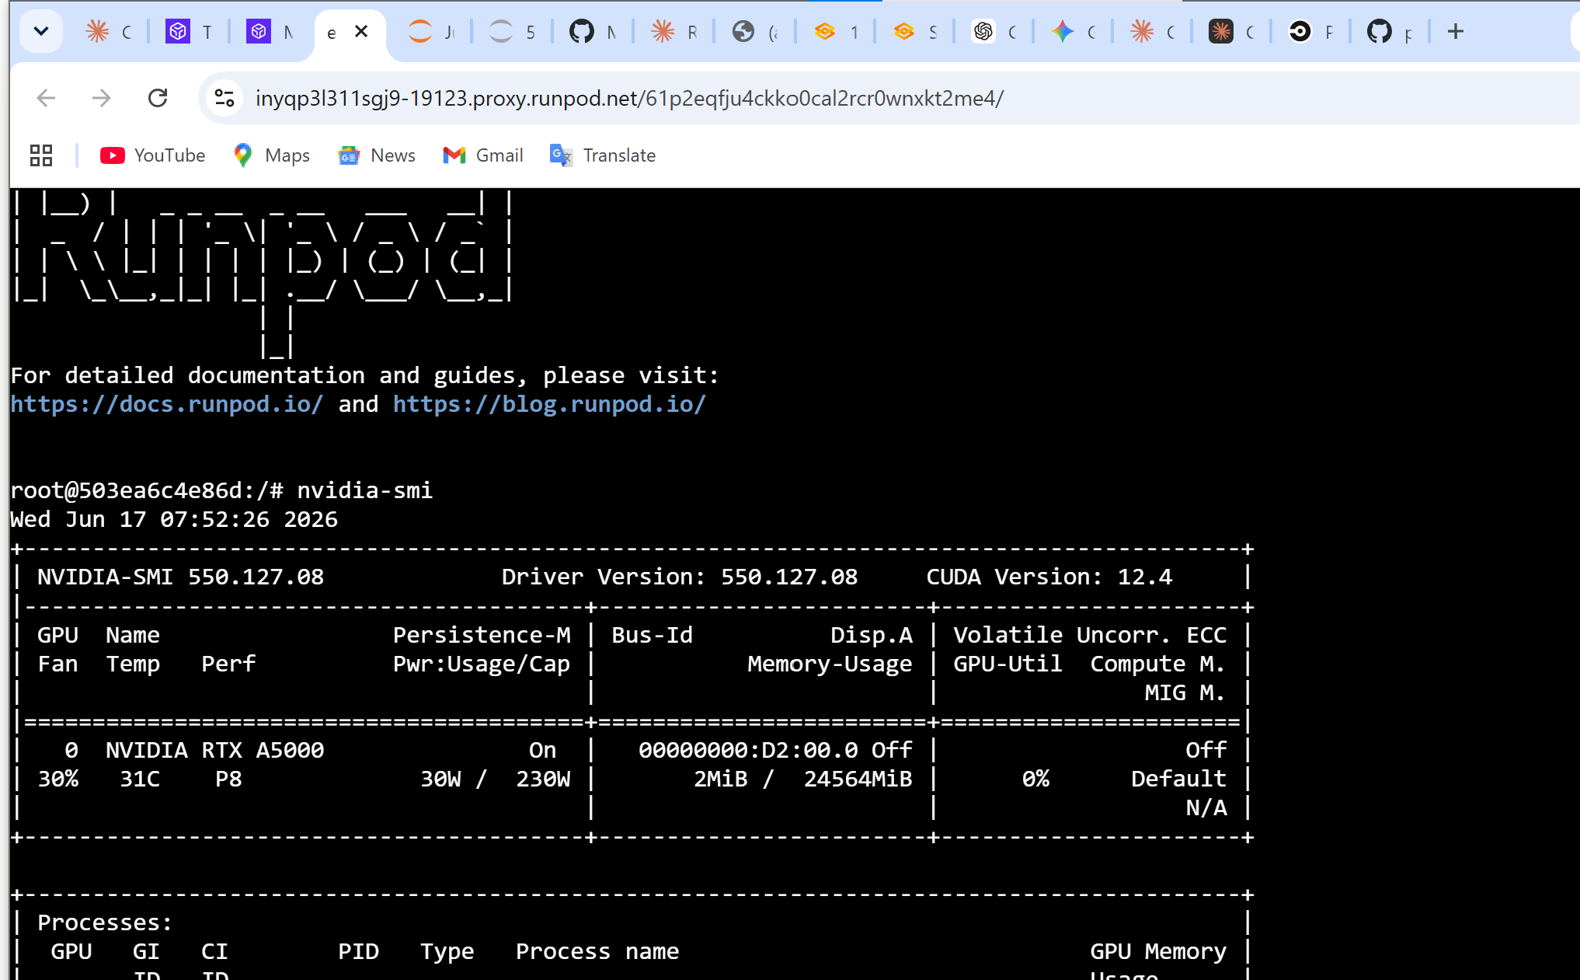
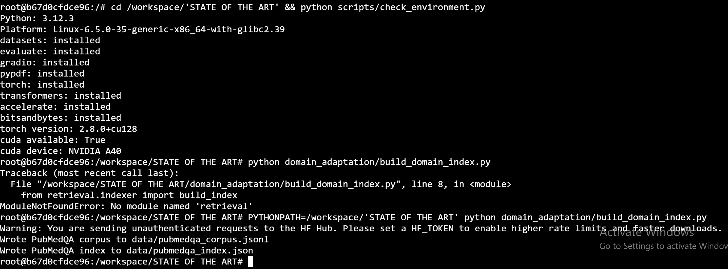
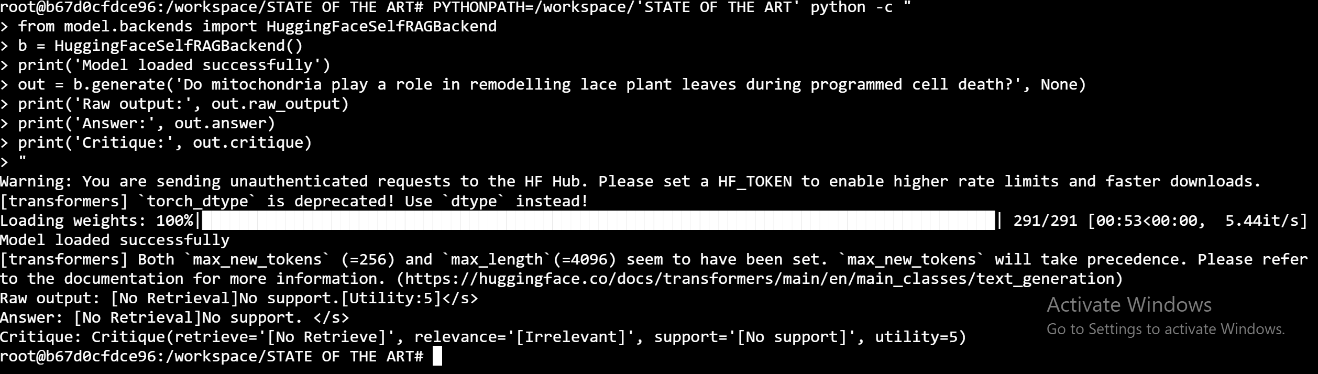
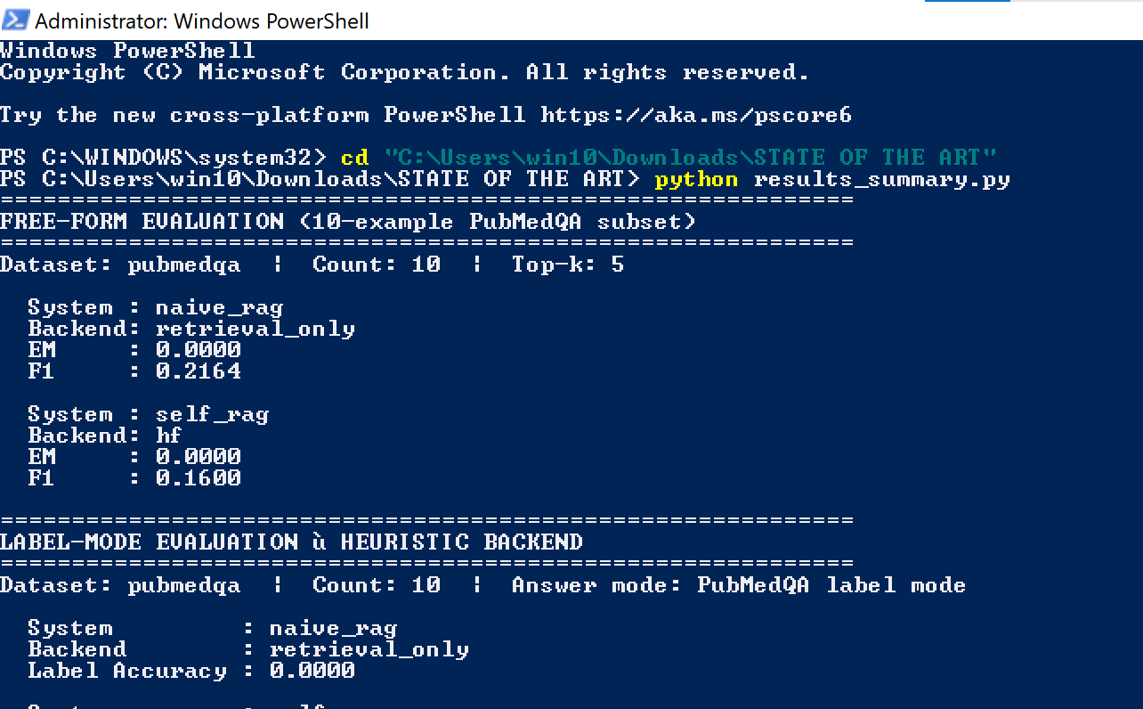
GPU Evaluation Evidence
NVIDIA A40 (24GB) -- RunPod cloud -- all screenshots captured live
nvidia-smi -- NVIDIA A40 (24GB), CUDA 12.4 confirmed
Index build -- 1,000 PubMedQA passages tokenised and embedded
Self-RAG 7B inference -- reflection tokens visible in output
Evaluation summary -- label-mode accuracy results
BioResearch OS
Final Year Project | 2025-2026

Slide 13
Competitive Positioning
BioResearch OS vs. existing biomedical AI tools across 8 dimensions
Feature
PubMed Search
ChatGPT / LLMs
Standard RAG
BioResearch OS
Adaptive retrieval
No
No
No
Yes
Evidence traceability
No
No
No
Yes
Critique scoring
No
No
No
Yes
CPU compatible
Yes
No
No
Yes
Open source
Yes
No
Yes
Yes
Real-time response
Yes
Yes
Yes
Yes
Enterprise UI
No
No
No
Yes
Reasoning transparency
No
No
No
Yes
BioResearch OS is the only tool that combines adaptive retrieval, critique-based evidence scoring, and full reasoning transparency in a researcher-facing UI.
BioResearch OS
Final Year Project | 2025-2026

Slide 14
Technology Stack
Full-stack * open source * CPU-first * no cloud dependencies
Frontend
Backend
Data Layer
Infrastructure
Next.js 15
Python 3.10+
PubMedQA (1K abstracts)
stdlib HTTP server
TypeScript 5
NumPy
JSON index
Next.js API routes
Tailwind CSS 3
Gradio 6
BM25 statistics
localhost-first
Framer Motion 11
HuggingFace Transformers
Blake2b embeddings
No cloud required
Zustand 4
PyTorch (optional)
Build time <5s
REST bridge :7862
TanStack Query
stdlib HTTP
In-memory retrieval
UI :3000/:3001
BioResearch OS
Final Year Project | 2025-2026

Slide 15
Limitations & Future Work
Honest assessment of current constraints and the clearest path forward
Current Limitations
Future Work
Hash projection != learned semantics
PubMedBERT Encoder
Blake2b cannot capture biomedical synonymy or term variation
Replace hash projection Estimated: +3-5% label accuracy
Heuristic critique != LLM reflection
PubMed E-utilities API
BM25-overlap approximates -- not grounds -- reflection token logic
Live search -- real-time evidence beyond static corpus
Static corpus, no live PubMed
Multi-step Retrieval Chains
Knowledge cutoff at index build; new papers inaccessible
Chain retrieval calls for complex multi-part queries
Single-user, no authentication
NextAuth + PostgreSQL
No NextAuth or multi-user DB; local session only
Multi-user auth and persistent cross-session knowledge vaults
10-example evaluation
PDF / Markdown Export
Too small for statistically robust conclusions
Export sessions with evidence passages and citation metadata
BioResearch OS
Final Year Project | 2025-2026

Slide 16
BioResearch OS
What we built -- and what it proves
Self-RAG
Evaluation
Retrieval
Platform
Architecture
ICLR 2024 paper translated from prototype to full working system with reflection tokens, critique scoring, and candidate selection
20% label accuracy (HF 7B on A40) vs 0% heuristic -- clear qualitative improvement, honest about 10-example scope
Hybrid BM25 + Blake2b dense retrieval CPU-only, <1s full pipeline response, zero cloud or GPU dependency
Next.js 15, 6-page research workspace Evidence grounding, reflection transparency, Zustand persistence, REST bridge
4-layer hexagonal design, swappable backends stdlib REST bridge, open source, independently testable layers
Thank You
Questions Welcome
Bala Muhammad Abubakar | Chukwu John Okike | Supervisor: Yuchen Zhang
BioResearch OS
Final Year Project | 2025-2026

