Slide 1

QuickMed
Applying AI to medical diagnostics

Slide 2


The Problem
Medical related tests are expensive including cost of materials for the tests and equipment purchase & maintenance costs.
Medical tests take time to perform delay before receiving results and doctors wasting time to carry out tests.

Slide 3

Case Study

Slide 4
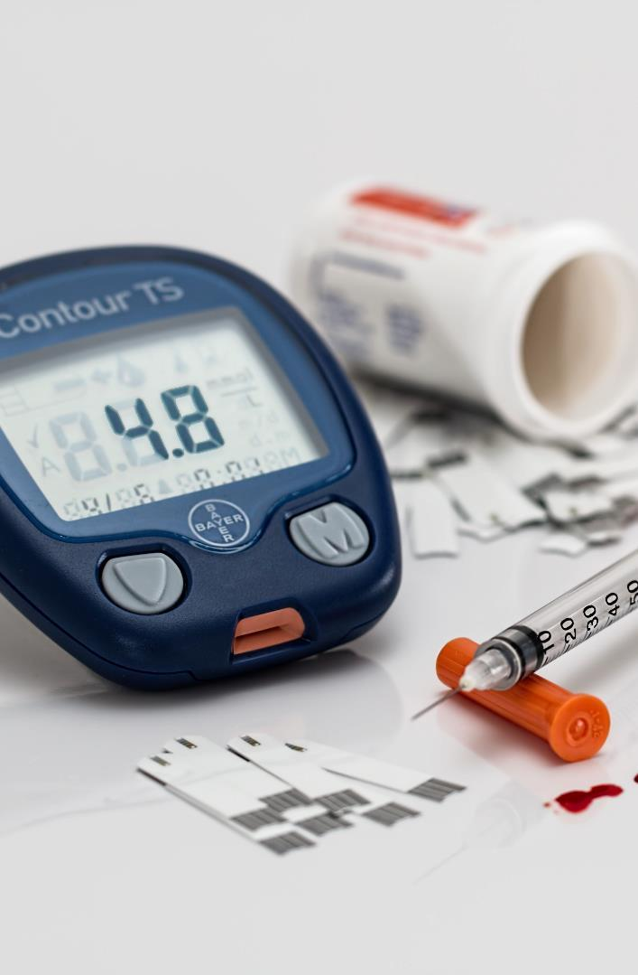

The simple solution to the problem is the implementation of new & modern techniques that will cut down cost of medical tests while increasing speed of getting test results.
The Solution

Slide 5
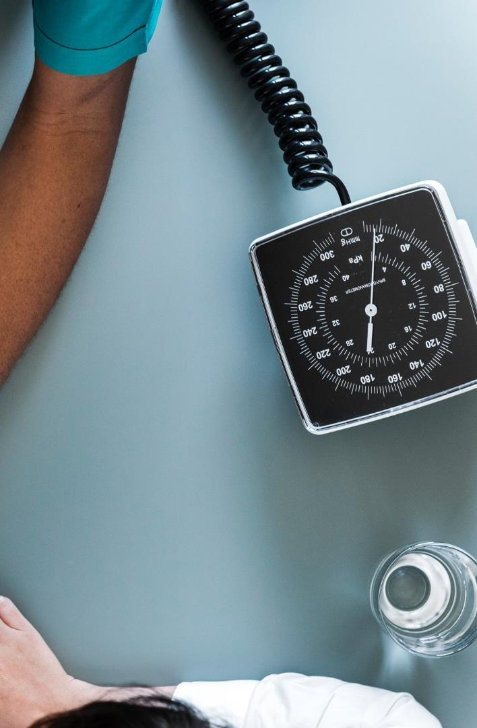

An online platform that uses artificial intelligence to perform real-time diagnostics and medical tests.
This cuts off cost of purchasing & maintaining testing equipment's as modern AI techniques are now used.
The Product

Slide 6

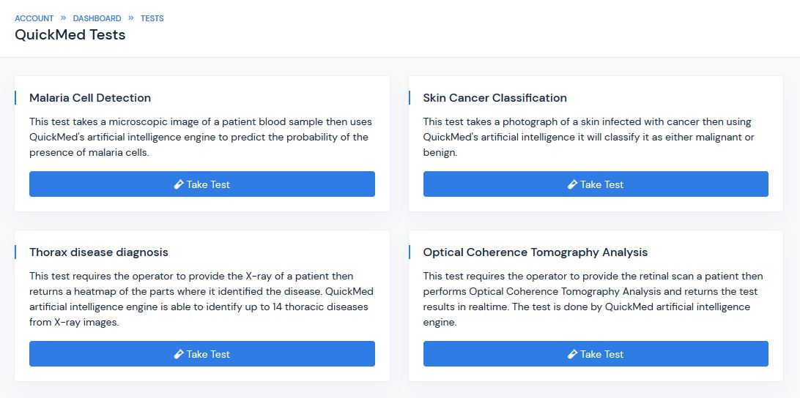
Tests Quickmed is able to perform
Malaria Cell Detection
Skin Cancer Classification
Thorax Disease Identification
Optical Coherence Tomography Analysis

Slide 7

Business Model
How we plan to make money…
We use a PAYU business model where hospitals will be charged based on the amount of tests performed with the platform.

Slide 8
Market Opportunity
Nigeria’s 2019 budget for the ministry of health.
Approximate number of hospitals in Nigeria (Public & Private Included), About 24K as at 2005.
₦366B
50K
10k
Average share of market we should be able to cover which is 20% of the total market.

Slide 9
Funding
Cloud Computational Resources
Computer Equipment's
Funds are needed to get better computer equipment so we are able to train better machine learning models on our side to constantly maintain and manage our platform
Funds are needed to keep our cloud computers that perform our calculations to properly perform the diagnostics for our artificial intelligence engine
Cloud Storage Facilities
Django Platform Hosting
Funds are needed to pay for our AWS cloud storage platform to store patient test records.
Funds are needed for the hosting of the Django platform itself, along with the domain name maintenance.

Slide 10

About Us
QuickMed was created by LordGhostX, Ochuko & Destiny to solve problems associated with costs & running time in medical tests and diagnostics.
QuickMed is focused on using innovative AI and Machine Learning techniques to improve diagnostic accuracy, cut costs, decrease testing time and improve patient safety worldwide.
We’re Setting the Standards in Research & Clinical Care

Slide 11

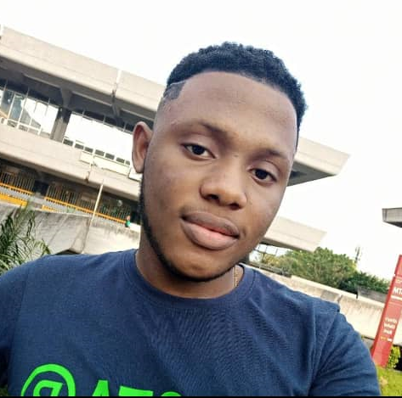

The Team
Solomon
Ochuko
Destiny
Machine & Deep Learning Engineer
Django Backend Developer
Frontend Developer & UI/UX designer

Slide 12


Thank You
www.quickmedai.com

