Slide 1
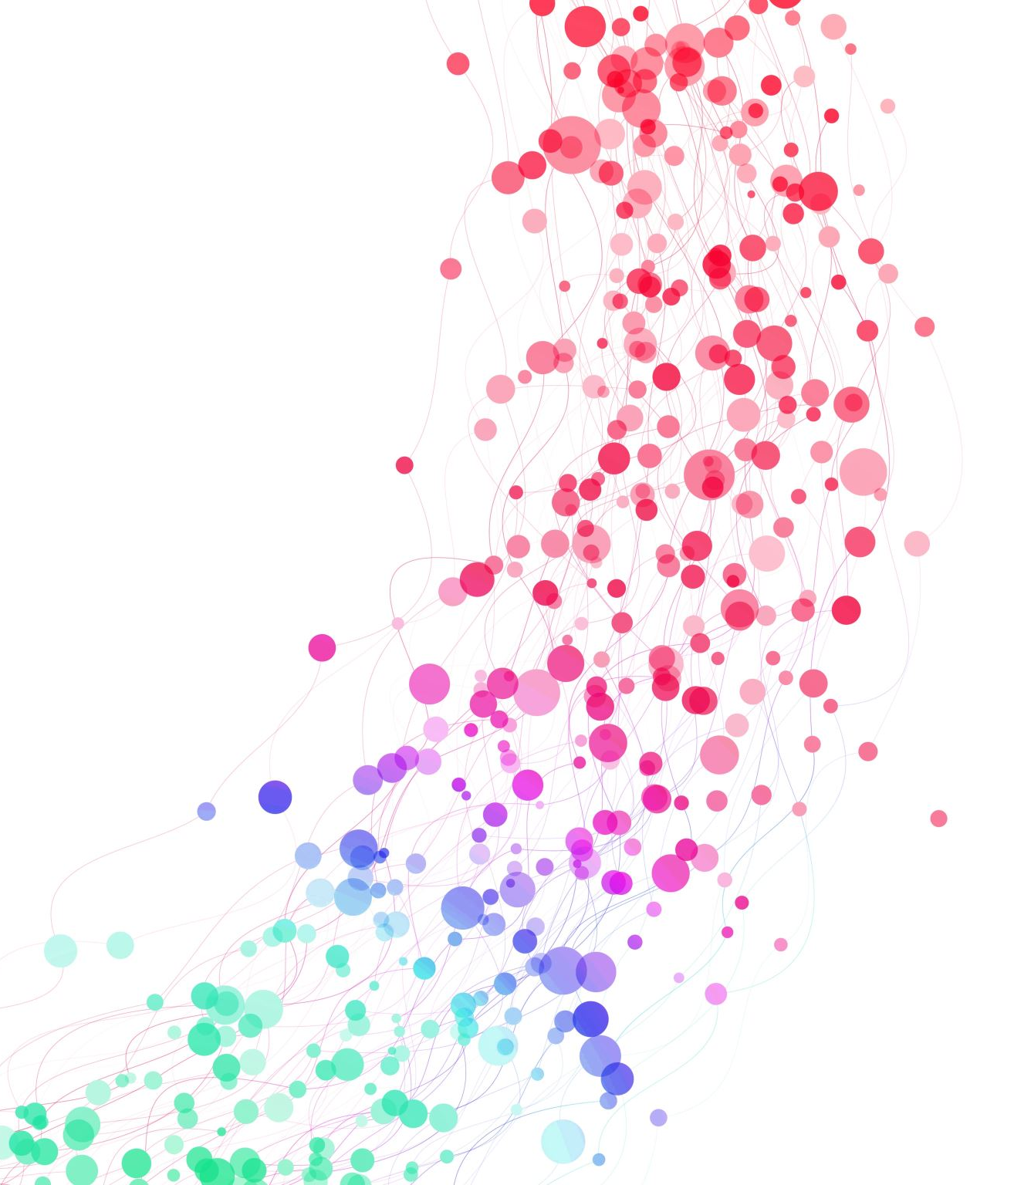
Sales Insights & Revenue Drivers Dashboard
Prepared by:
Chukwudi Ekweani
Tools used:
Power BI, Python
A Data-Driven Exploration of Retail Performance

Slide 2
Executive summary
In this analysis, key drivers of revenue was explored in different aspects of the business such as product price tiers, customer segments and categories.
With the dataset which consist of 5000 transaction records, 257 products and the business operating in two major cities, the goal of this analysis is to discover the factors that drive revenue.
The Power BI dashboards provide insights such as products that drive revenue, customer behaviour, pricing dynamics and monthly trends.
The findings reveal the business’ reliance on high-price products which is the major drivers of revenue for the business.
This insight directly informs the strategic action of diversifying to other product categories to inprove revenue stability.

Slide 3
Dataset and methodology
Dataset includes:
5000 transactions
257 unique products
2 cities (Sydney, Melbourne)
Product pricing, categories, discounts
Customer names and purchase history

Slide 4
Methodology
Dataset was cleaned and transformed using Python
For KPIs (Key Performance Indicators), DAX was built in PowerBI
Design of 3 dashboard pages: Revenue Overview, Customer Insights, Product Analysis.
Tools Used
Python for EDA (Exploratory Data Analysis)
Power BI for dashboarding

Slide 5
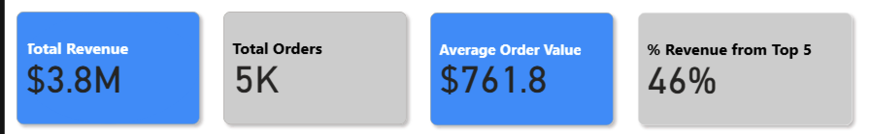
Kpi overview (page 1)
Key Highlights:
Total Revenue: $3.8M
Total Orders: 5,000
Average Order Value (AOV): $761.80
% Revenue from Top 5 Products: 46%
Insight:
The revenue is highly concentrate. Almost half of the revenue is coming from only five of the products being sold, signaling overdepence on these products. This is risky for the business.

Slide 6
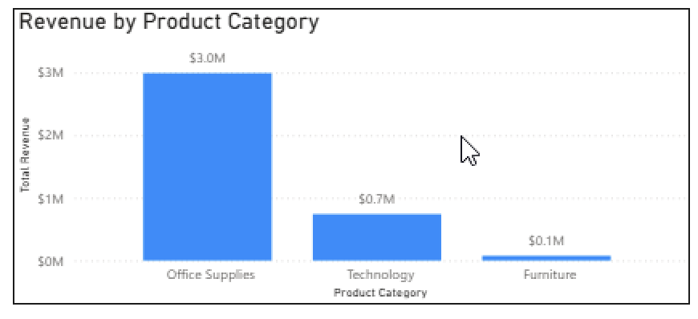
Revenue by category
Insights:
Office supplies are the major revenue drivers with a total revenue of ~$3.0M
Technology contributes about $700k, while furniture contributes about $100k
Business is highly dependent on a singly product category.
Implication:
It is important that the business diversifies to prevent overdependence on a singly product category

Slide 7
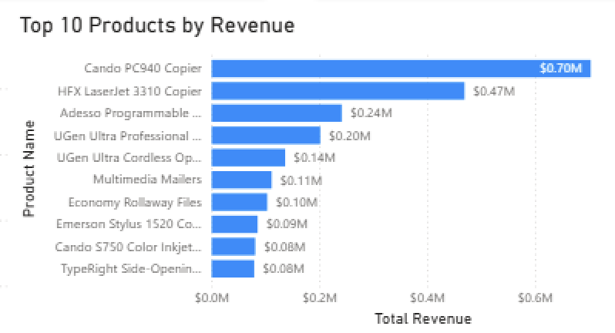
Top product analysis
Insights:
The top products alone contribute to 18.6% of total revenue.
The top 2 product generate over $1.2M combined.
Implication:
Secure supply, pricing strategy and promotion of top item is important to maintain the revenue these products pull.

Slide 8
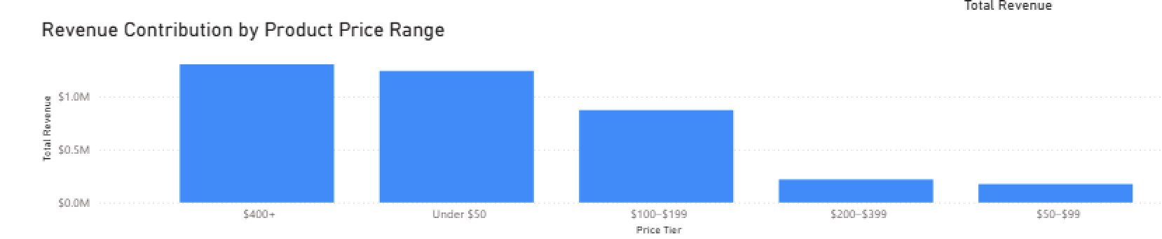
Revenue by price range
Insights:
High-priced products generate the most revenue.
Low-priced products though sells a lot but generate less revenue.
Mid-tier products (i.e. in the range of $100 to $399) show strong revenue by product.
Implication:
There is an opportunity to promote mid-tier product and use the low-priced products and bundles.

Slide 9
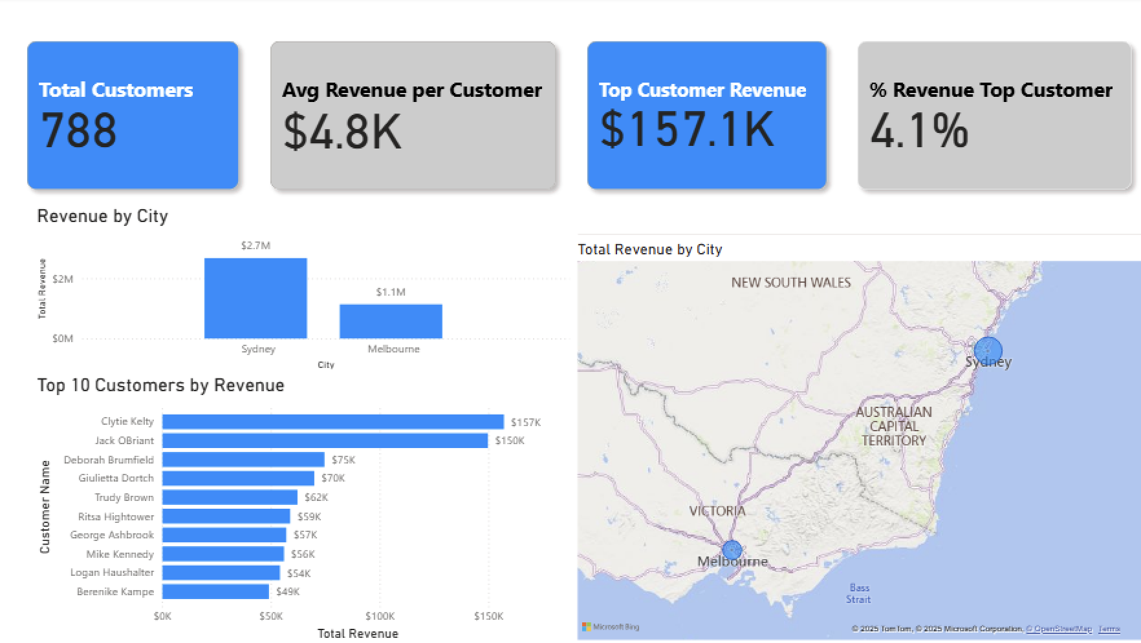
Customer insights
Findings:
Sydney contributes significantly more revenue that Melbourne
The total number of customers is 788
The average revenue per customer is $4.8k
Implication:
Focus on customer loyalty, segmentation and retention strategies.

Slide 10
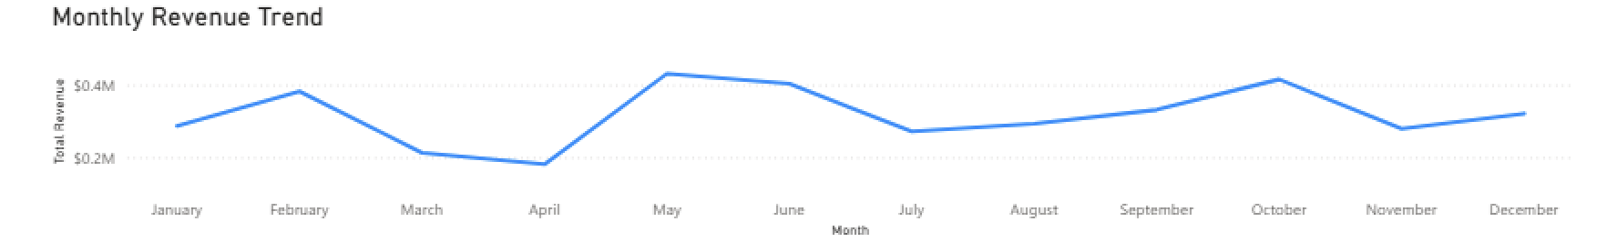
Monthly trend analysis
Insights:
Revenue shows spikes around mid-year
This seasonal peaks indicates the perfect time to begin targeted promotions
Implication:
Improve inventory planning during peak periods.

Slide 11

Business recemmendation
Strengthen high-value product strategy
- Secure supplier contracts
- Offer warranties, service bundles
Expand mid-tier product ranges
- Highest growth opportunity with moderate pricing
Reduce category dependency
- Invest in Technology and Fruniture product expansion
4. Develop customer-based initiatives
- Loyalty programs
- Segmented promotions (Sydney-focused)
5. Leverage seasonal demand
-Mid-year promotional campaingns

Slide 12

Conclusion
The analysis discovered high dependency on high-quality products, categories and cities. With proper strategies such as diversivying product categories, price-tiers, promotions in certain locations, and targeting high-value customers, the business can stabilize revenue and unlock new growth opportunities.

