Slide 1

Demand Forecasting
Milestone 2 - Business Analytics Model Communication
Presented By Chukwudi Emmanuel Ekweani
Learner ID: 141451

Slide 2

Introduction
I refined the dataset used to strengthen the forecasting model. The new dataset contains daily sales, inventory, pricing, and promotion data to give clearer insights into how demand behavior is in real life.
We explore data insights and apply time series forecasting using the SARIMAX model. We also worked with linear regression and random forest.
The final goal is to provide actionable strategies to improve the stocking of products.

Slide 3

Business Problem
Retail stores always face the challenge of predicting what customers need part-time.
Overstocking leads to waste, while understocking leads to lost sales and tarnishes the image of the company.
We aim to build a reliable forecasting model for better stock planning.

Slide 4
Why We Updated the Dataset
The initial dataset lacked a direct 'demand' column needed for modeling.
The dataset was updated so that it contains valuable metrics that would be used for model training
This allowed us to clearly define our forecasting target.

Slide 5

Modeling Approach
We selected the SARIMAX model for its ability to handle time series data with variables that are not affected by other variables within the model (i.e., exogenous variables).
Exogenous variables used are: price, discount, holidays, weather, seasonality, and competitor pricing.
We first trained a baseline model, then performed parameter tuning to train a tuned version.

Slide 6
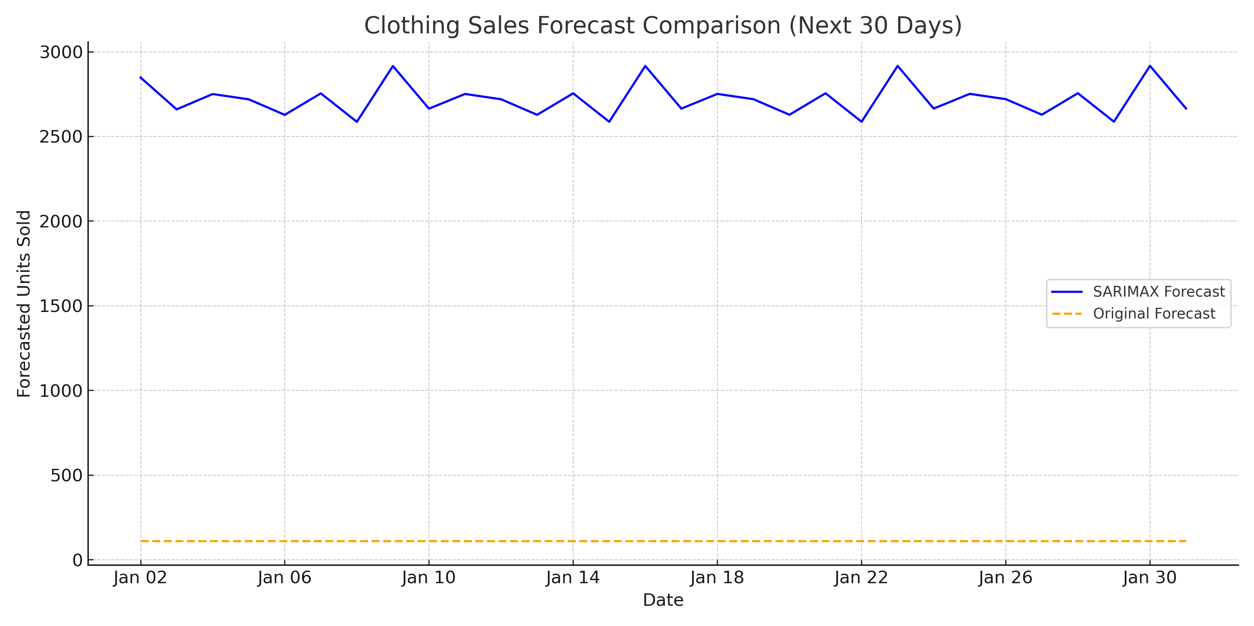
Exploratory Data Insights

Slide 7
Forecast Comparison: SARIMAX vs Original
Initial parameters: order=(1,1,1), seasonal_order=(1,1,1,7).
MAE: ~672.9, RMSE: ~777.5
Original Forecast MAE: ~2356, RMSE: ~2462
SARIMAX outperformed the datasets' forecast by far making it suitable for ineventory optimization and forecasting of demand.

Slide 8
Tuned SARIMAX Model Results
Best parameters: order=(1,1,1), seasonal_order=(0,1,1,7).
MAE: ~672.43, RMSE: ~775.9 — slight improvement over baseline.
Confirms our initial model was already quite effective.

Slide 9
Why We Tuned the Model
To further reduce forecasting error and validate our assumptions.
We used grid search to test multiple combinations of seasonal and ARIMA parameters.
Evaluation was based on AIC (Akaike Information Criterion).

Slide 10
Forecast Comparison: SARIMAX vs Original

Slide 11
Business Value
Reliable forecasting helps optimize inventory and reduce waste.
Informs promotional timing and regional stock distribution.
Supports long-term planning with data-driven insights.

Slide 12
Forecast Comparison: SARIMAX vs Original Forecast
This slide compares the SARIMAX model's forecast with the original demand forecast from the dataset using the last 30 days of actual sales data.
• Original Forecast MAE: ~2,356, RMSE: ~2,462
• SARIMAX Forecast MAE: ~672.6, RMSE: ~776.5
The SARIMAX model significantly outperforms the original method in predictive accuracy, making it more reliable for inventory decisions.

Slide 13
R² scores for SARIMAX models (last 30 days):
• Baseline: -0.1201
• Tuned: -0.1173
Negative R² means the model performed worse than a constant average prediction.
Despite this, SARIMAX had strong MAE and RMSE and is still recommended for trend-aware forecasting.
Model Evaluation: R² for SARIMAX Models

Slide 14

Linear Regression Model
• R²: 0.25 | MAE: ~16.4 | RMSE: ~20.7
Linear Regression helps explain key sales drivers: Inventory, Seasonality, Price.
Recommended for understanding variable impact and business strategy decisions.

Slide 15
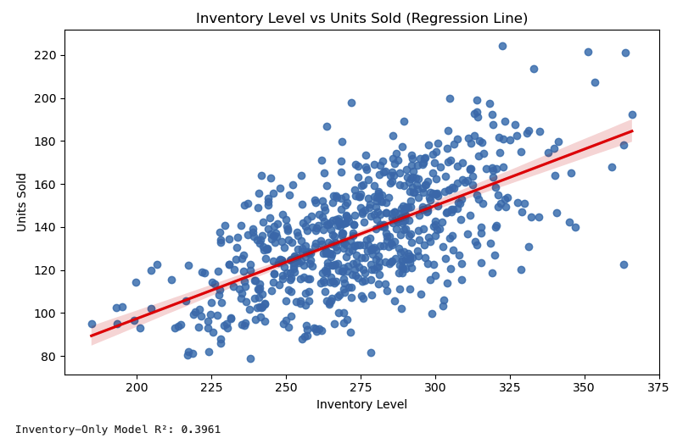
Inventory Level as a Predictor
Simple linear regression (Inventory → Units Sold)
R² Score: 0.40
Inventory level alone explains ~40% of sales variability.
Helps identify understocking or overstocking risks.

Slide 16
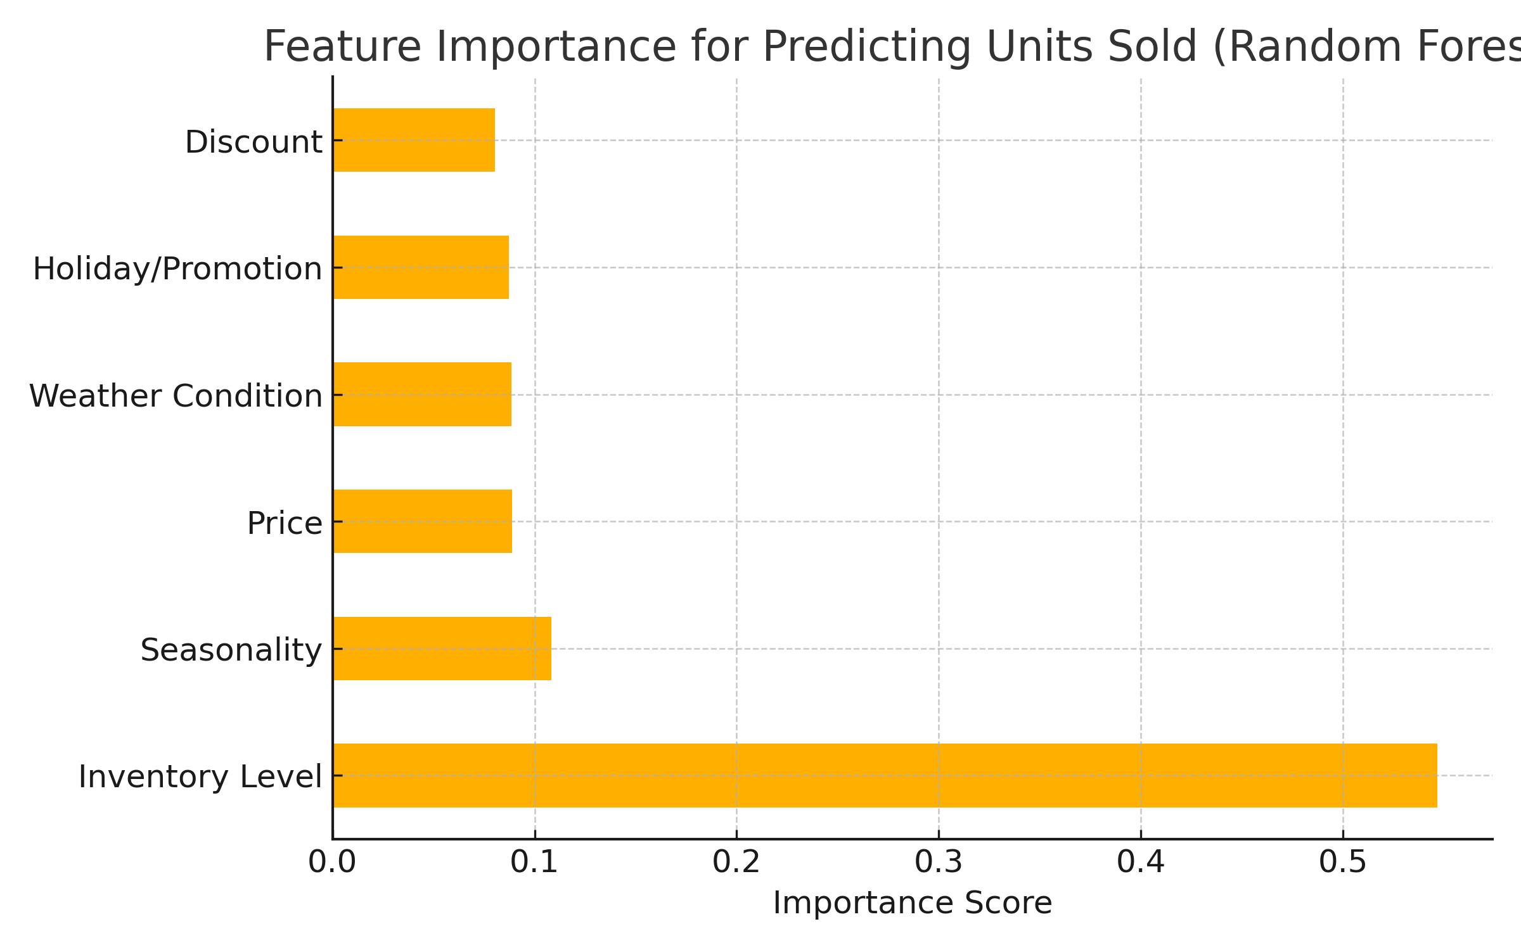
Feature Importance: Random Forest Model

Slide 17

Final Summary and Recommendation
This project explored multiple data-driven approaches to forecast Clothing sales and analyze drivers of demand:
SARIMAX outperformed the original forecast and other models in predictive accuracy (MAE ~672).
Linear Regression provided the most interpretable model for understanding key sales influencers like Inventory, Seasonality, and Price.
Inventory Level was the strongest sales predictor across all models.
Random Forest offered insight into feature importance but underperformed in accuracy.
Recommendation: Use SARIMAX for regular forecasting, and Linear Regression for internal strategy decisions.
Deploy SARIMAX model weekly to update forecasts.
Incorporate real-time weather and holiday data for accuracy.

