Slide 1
Setup for Git & Github Tutorial Using GitKraken, a Git GUI Client
Jaeyeong Yang
Computational Clinical Science Laboratory
Seoul National University

Slide 2
Install Git
Windows
With an official executable file
https://git-scm.com/
MacOS
With X-code command line tools:
Run xcode-select --install in the Terminal.app
With Homebrew (the package manager for macOS):
Install Homebrew: https://brew.sh/
Run brew install git in the Terminal.app
With an official executable file
https://git-scm.com/
Linux
(For Devian-based) sudo apt install git
(For Redhat-based) sudo yum install git
http://happygitwithr.com/install-git.html

Slide 3
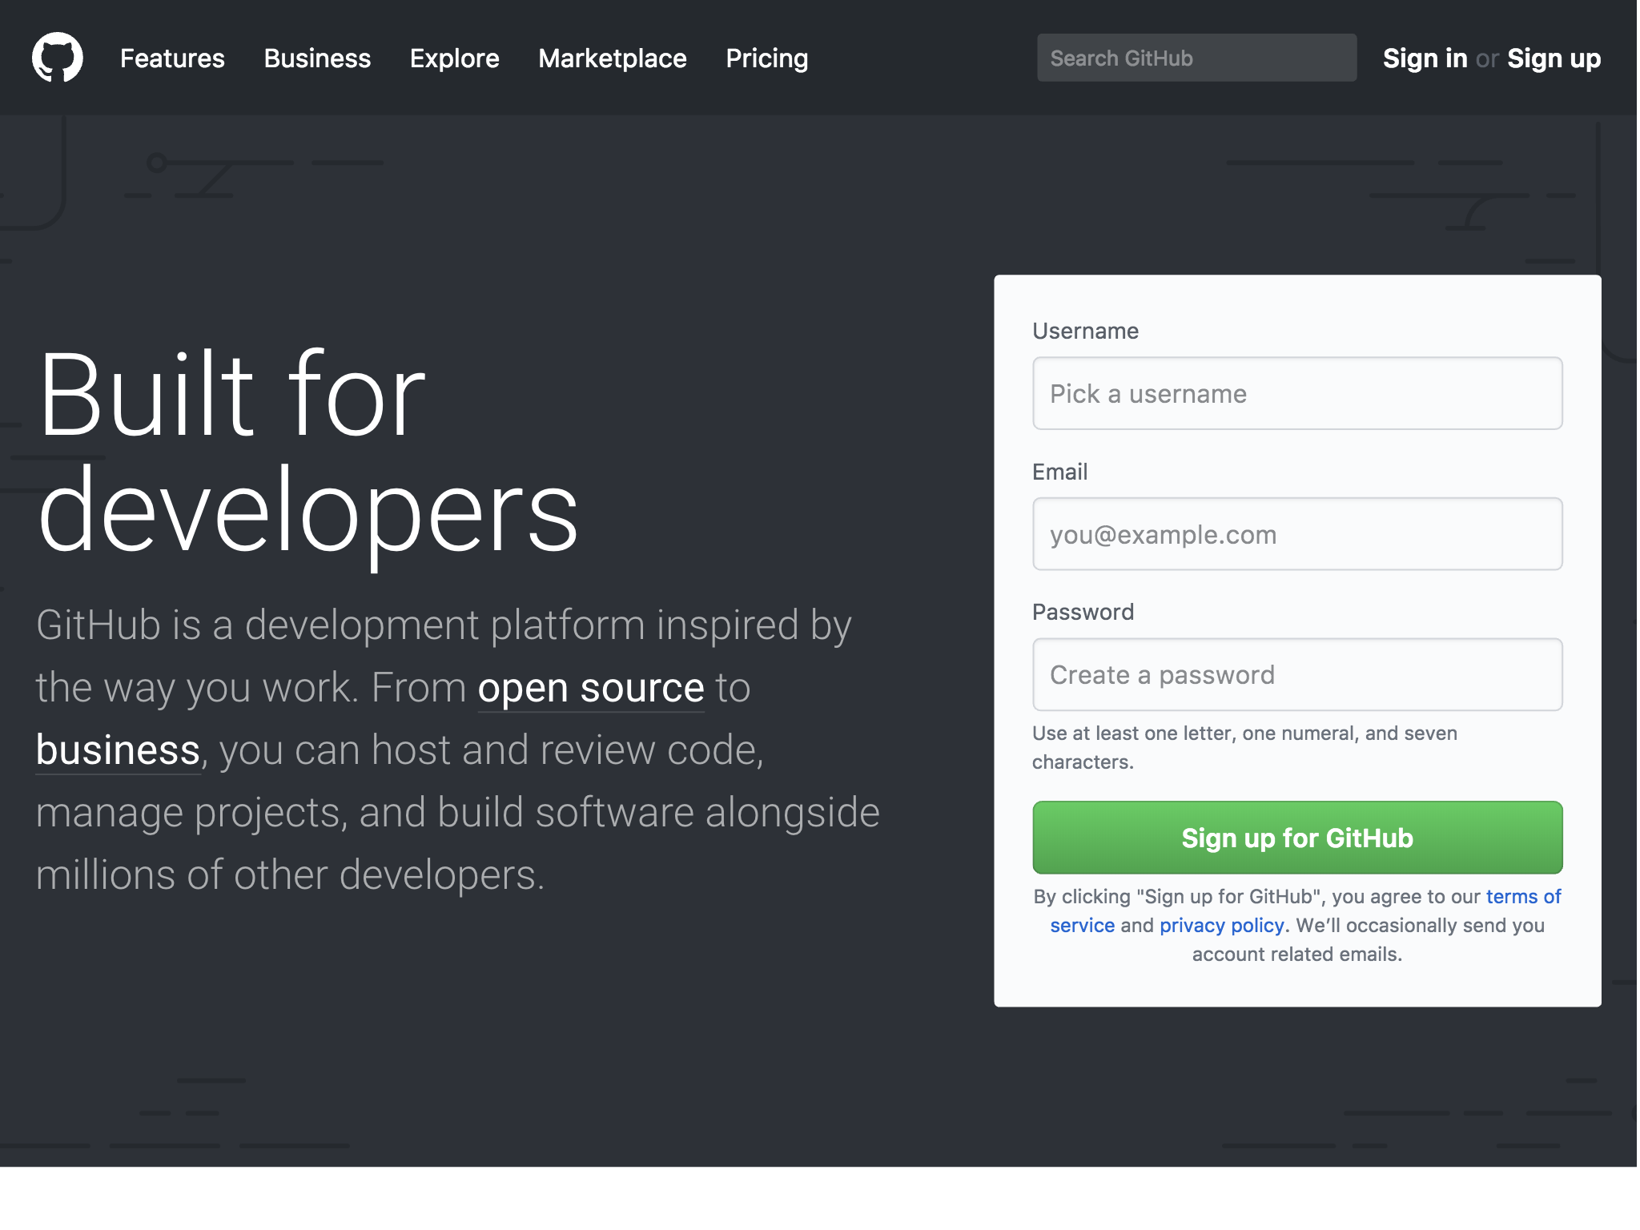
Register a Github account
https://github.com

Slide 4
Register a Github account
Username Guidelines: http://happygitwithr.com/github-acct.html
Incorporate your actual name
Reuse your username from other contexts (e.g., Slack, Twitter)
Pick a username you will be comfortable revealing to your future boss.
Shorter is better than longer
Be as unique as possible in as few characters as possible
Make it timeless.
Don’t highlight your current univ., employer, or place of residence.
Avoid words laden with special meaning in programming
for, NA, NaN, while
Even if your username seems not good, don’t worry. You can change it later. 😉

Slide 5
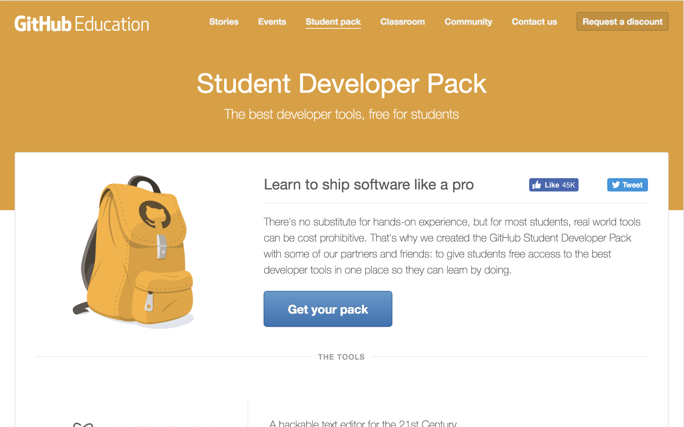
Get the Student Developer Pack
https://education.github.com/pack

Slide 6
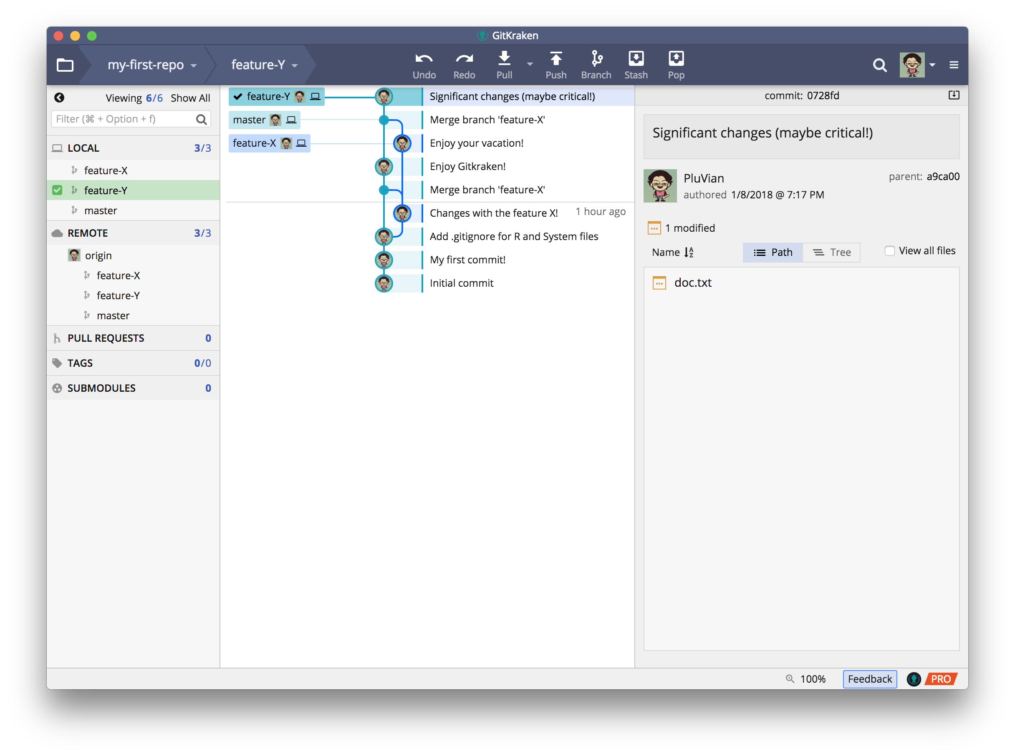

Install GitKraken
https://www.gitkraken.com/
Free for non-commercial Use
You should use Pro version (with a paid plan) for private repos
With Github Student Developer Pack, you can use it free for a year!

