Slide 1
Introduction to C++
Object Oriented Programming with C++
Lecture 1
Nadeera Ahangama
Senior Lecturer, NSBM

Slide 2
Topic & Structure of the lesson
C++ Programming
Writing a Simple Program

Slide 3
Learning Outcomes
You should be able to:
Define the mechanism and its common features about C++ programming
Write a simple C++ program

Slide 4
Key Terms
You should be able to use the following terms correctly in your assignments and exams:
Programming
Object oriented programming
Variable
Operator

Slide 5
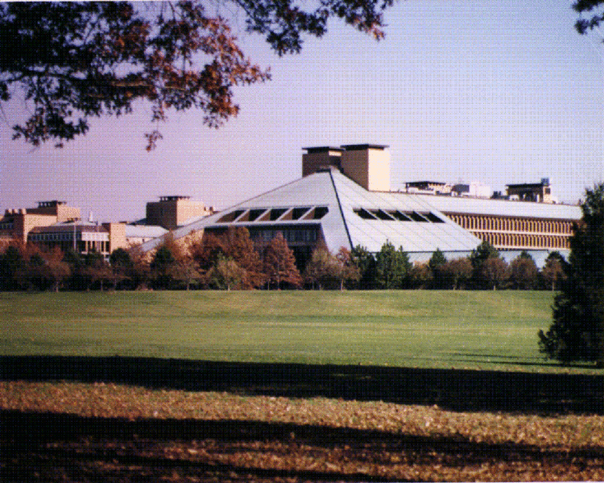
History of C++
Developed by Bjarne Stroustrup starting in 1979 at Bell Labs, C++ was originally named C with Classes, adding object oriented features, such as classes, and other enhancements to the C programming language.
The language was renamed C++ in 1983, involving the increment operator.
It is regarded as an intermediate-level language, as it comprises both high-level and low-level language features.

Slide 6

Bjarne Stroustrup

Slide 7
Turbo C++
Turbo C++ is a C++ compiler and integrated development environment and computer language originally from Borland.
Most recently it was distributed by Embarcadero Technologies, which acquired all of Borland's compiler tools with the purchase of its CodeGear division in 2008.

Slide 8
Typical C++ Environment
Editor
Disk
Program is created in
the editor and stored
on disk.
Phases of C++ Programs:
Edit
Preprocess
Compile
Link
Load
Execute
Preprocessor
Disk
Preprocessor program
processes the code.
Compiler
Compiler creates object code and stores it on disk.
Disk
Linker
Linker links the object code with the libraries, creates a.out and stores it on disk
Disk
Primary
Memory
Loader
Loader puts program
in memory.
Disk
.
.
.
.
.
.
Primary
Memory
CPU
CPU takes each
instruction and
executes it, possibly
storing new data
values as the program
executes.
.
.
.
.
.
.

Slide 9
About C++
Facilitates structured and disciplined approach to computer program design
Object Oriented Programming (OOP)
- Model real-world objects with software counterparts
Meaningful software units, i.e.: date object, time object
More understandable, better organised and easier to maintain than procedural programming
Favor modularity for software reuse
Libraries

Slide 10
Object Oriented Programming
Attributes (state) – properties of objects
i.e.: Size, shape, colour, weight, etc.
Behaviors (operation) – actions
i.e.: A ball rolls, bounces, inflates and deflates
Inheritance
New classes of objects absorb characteristics from existing classes
Object
Encapsulate data and functions
Information hiding (communicate across well-defined interfaces)

Slide 11
Writing a Simple Program
Comments
Document programs
Improves program readability
Ignored by compiler
Single-line comment, begin with //
Paragraph comment, begin with /* and end with */

Slide 12
Writing a Simple Program
Preprocessor directives
Preprocessor directives are lines included in the code of our programs that are not program statements but directives for the preprocessor
Processed by preprocessor before compiling
Begin with #
Example: #define, #undef, #include, #ifndef, #endif etc…
#include <iostream.h>

Slide 13
Writing a Simple Program
Standard output stream object
std::cout -- “Connected” to screen
<<
Stream insertion operator
Value to right (right operand) inserted into output stream
Namespace
std:: specifies using name that belongs to “namespace”
All the elements of the standard C++ library are declared within what is called a namespace, the namespace with the name std.
In order to access its functionality we declare with this expression that we will be using these entities.

Slide 14
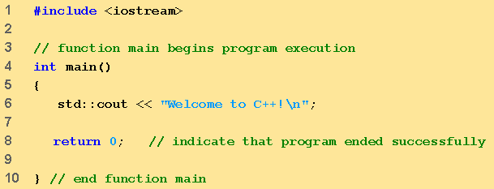
Writing a Simple Program
Small Example that looks big:
Preprocessor directive to include input/output stream header file <iostream>
Function main returns an integer value
Function main appears exactly once in every C++ program
Left brace { begins function body
Keyword return means exit function; and return the calling function with value 0
Corresponding right brace } ends function body
Name cout belongs to namespace std
Statement end with a semicolon
Single-line comment

Slide 15
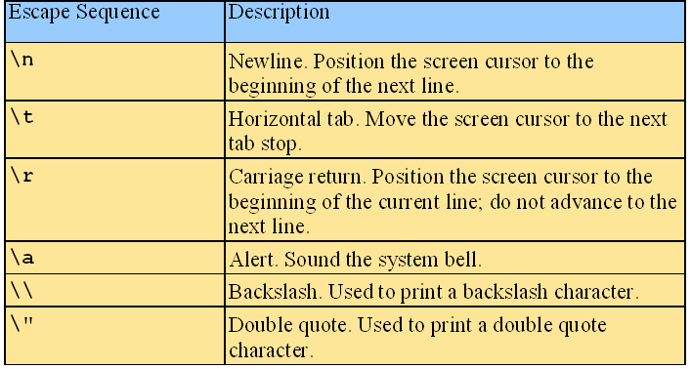
Writing a Simple Program
Escape Characters
“\” indicates “special” character output

Slide 16
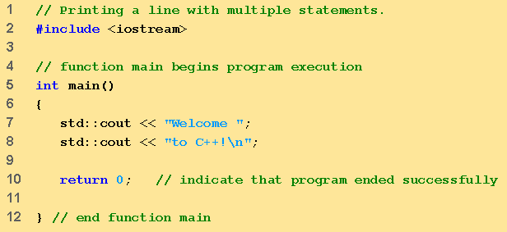
Example two:
Writing a Simple Program
Multiple stream insertion statements produce one line of output

Slide 17
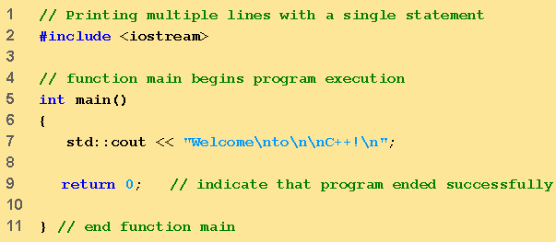

Writing a Simple Program
Example three
Using newline characters to print on multiple lines

Slide 18
Variables (1)
Location in memory where value can be stored
Common data types
int – integer numbers
char – characters
double – floating point numbers
Declare variables with name and data type before use
int integer1;
int integer2;
int sum;

Slide 19
Variables (2)
Can declare several variables of same type in one declaration
Comma-separated list
int integer1, integer2, sum;
Variable name as valid identifier
Series of characters (letters, digits, underscores)
Cannot begin with digit
Case sensitive
Keywords cannot be used as identifiers or variable names

Slide 20
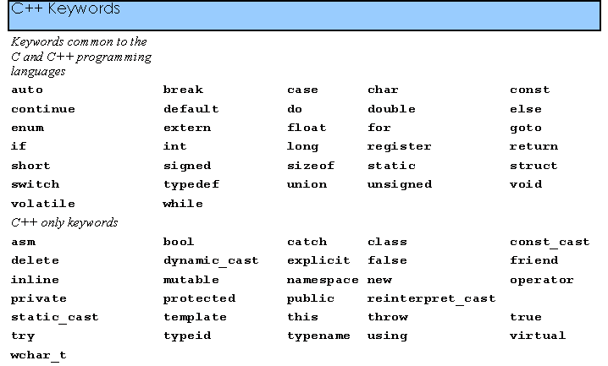
Writing a Simple Program
C++ keywords

Slide 21
Writing a Simple Program
Input stream object
>> (stream extraction operator)
Used with std::cin
Waits for user to input value, then press Enter (Return) key
Store value in variable as right operator and convert value to variable data type
= (assignment operator)
Assigns value to variable
Binary operator (two operands)
Example: sum = variable1 + variable2

Slide 22
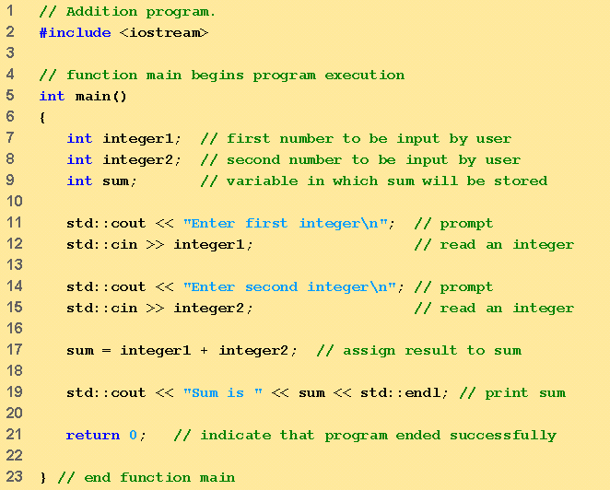
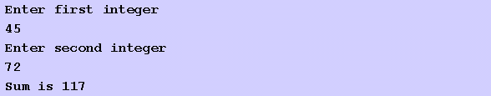
Writing a Simple Program
Declare integer variables
Example (4)
Use stream extraction operator with standard input stream to obtain user input
Stream manipulator std::endl outputs a newline, then flushes output buffer
Concatenating, chaining or cascading stream insertion operations

Slide 23
Writing a Simple Program
Memory Concepts
Variable name corresponds to actual location in computer’s memory
Every variable has name, type, size and value
When new value placed into variable, overwrites previous value
std::cin>>integer1
- Assume user entered 45
std::cin>>integer2
- Assume user entered 72
sum = integer1 + integer2
integer1
45
integer1
45
integer1
45
72
integer2
integer2
72
sum
117

Slide 24
Fundamental Data Types
Name | Description | Size* | Range*
char | Character or small integer. | 1byte | signed: -128 to 127 unsigned: 0 to 255
short int (short) | Short Integer. | 2bytes | signed: -32768 to 32767 unsigned: 0 to 65535
int | Integer. | 4bytes | signed: -2147483648 to 2147483647 unsigned: 0 to 4294967295
long int (long) | Long integer. | 4bytes | signed: -2147483648 to 2147483647 unsigned: 0 to 4294967295
bool | Boolean value. It can take one of two values: true or false. | 1byte | true or false
float | Floating point number. | 4bytes | +/- 3.4e +/- 38 (~7 digits)
double | Double precision floating point number. | 8bytes | +/- 1.7e +/- 308 (~15 digits)

Slide 25
Writing a Simple Program
Arithmetic and Precedence
Arithmetic operators: - +, -, * (multiply), / (division) and % (modulus)
Example: 7/5 evaluates to 1 and 7%5 evaluates to 2
Rules of operator precedence
What do you call the underlined concept??

Slide 26
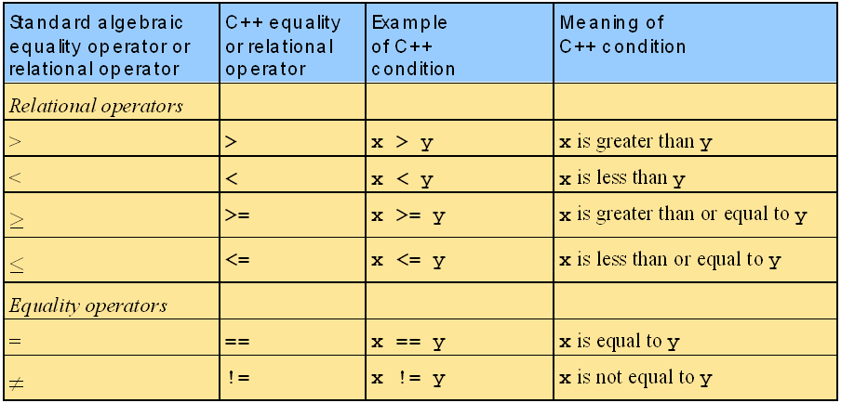
Equality and Relational Operators

Slide 27
using Statement
Eliminate use of std::prefix
Write cout instead of std::cout
At the beginning of the file, using statement is used
using std::cout;
using std::cin;
Or
is replaced by using namespace std;

Slide 28
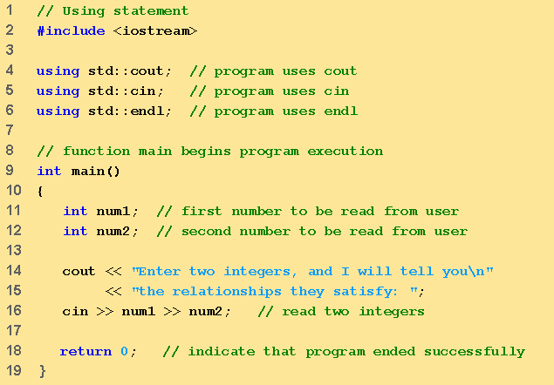
Writing a Simple Program
Example (5)
using statements eliminate need for std::prefix
Or
Three lines can be replaced by using namespace std;

Slide 29
An Example with a Class
#include <iostream>
using namespace std;
class HelloWorld
{
public:
void display();
};
void HelloWorld::display()
{
cout<<"Programming Fun\n";
}
void main()
{
HelloWorld objHello;
objHello.display();
}
Scope resolution operator (::)
Ties the function to the class and allows every instantiated class object to use the function name

Slide 30
Follow Up Learning
Reading:
Deitel – Chapter 1
Farrell – Chapter 1, Chapter 2 (pg. 36 – pg.40)

Slide 31
Summary of Main Teaching Points
C++ is an object oriented language that has its own set of syntax
The main task of the program is written in the main function

Slide 32
Question and Answer Session
Q & A

Slide 33
Then Let me give YOU one!
Use the preprocessor directives to include the iostream and conio header files.
Create a class called Student that will hold two public fields: one that holds credit hours and another that holds the grade point average.
Create the main function and within it declare a Student object identified as stuOne. Also within the main function, write the statements that prompt for and allow entry of the Student’s data. Add the statements that display the data just entered.

Slide 34
Resources
Juan Soulie 2008, C++ language tutorial:preprocessor directives, [Online], Available: http://www.cplusplus.com/doc/tutorial/preprocessor.html [Accessed 25th Sep 2008]

Slide 35
Next Session
Control Structures

