Slide 1
Topics & Structure of the lesson
BOOLEAN ALGEBRA
  Boolean Algebra
  Logic circuits

Slide 2
Logic Gates
The NOT gate
A
B
0
1
A
B
1
0

Slide 3
Logic Gates
The AND gate
A
B C
A
0
0 0
C
0
1 0
B
1
0 0
1
1 1

Slide 4
Logic Gates
The NAND gate
A
C
B
A
A
B C
C
0
0 1
B
0
1 1
1
0 1
1
1 0

Slide 5
Logic Gates
The OR gate
A
B C
A
0
0 0
C
0
1 1
B
1
0 1
1
1 1

Slide 6
Logic Gates
The NOR gate
A
C
B
A
B C
A
0
0 1
C
0
1 0
B
1
0 0
1
1 0

Slide 7
Logic Gates
The XOR gate
A
B C
A
0
0 0
C
0
1 1
B
1
0 1
1
1 0

Slide 8
Boolean Algebra
Developed by Reverend George Boole in the last century (well before computers)
based on true and false ideas or 1’s and 0’s
can be used to represent the output of a logic circuit as a function of its inputs.
can simplify the design of a circuit.

Slide 9
Boolean Algebra
Output as a function of input ?
Multiplier
A
A * B
B
What is the output if the inputs are A=2 & B=6
Output = A * B = 2 * 6 = 12

Slide 10
Boolean Algebra
Need some new operators for boolean algebra
  Invert (NOT)
  AND • (often omitted)
  OR +
  XOR +

Slide 11
Boolean Algebra
The NOT gate
A
A
0
1
A
A
1
0

Slide 12
Boolean Algebra
The AND gate
A
B A•B
A
0
0 0
A • B
0
1 0
B
1
0 0
1
1 1

Slide 13
Boolean Algebra
The NAND gate
A
B A • B
A
0
0 1
A • B
0
1 1
B
1
0 1
1
1 0

Slide 14
Boolean Algebra
The OR gate
A
B A+B
A
0
0 0
A + B
0
1 1
B
1
0 1
1
1 1

Slide 15
Boolean Algebra
The NOR gate
A
B A+B
A
0
0 1
A + B
0
1 0
B
1
0 0
1
1 0

Slide 16
Boolean Algebra
The XOR gate
A
B A + B
A
0
0 0
A + B
0
1 1
B
1
0 1
1
1 0

Slide 17
Boolean Algebra
Combinational Logic
A
A
A • B
B
A B A A • B
0 0 1 0
0 1 1 1
1 0 0 0
1 1 0 0

Slide 18
Boolean Algebra
Combinational Logic
A
A
A + B
B
A B A B A + B
0 0 1 1 1
0 1 1 0 1
1 0 0 1 1
1 1 0 0 0
B
A + B = A • B

Slide 19
Boolean Algebra
Combinational Logic
A
A
A • B
B
A B A B A • B
0 0 1 1 1
0 1 1 0 0
1 0 0 1 0
1 1 0 0 0
B
A • B = A + B

Slide 20
Boolean Algebra
Combinational Logic
A • B
A
(A• B) + (A • B)
B
A • B
(A • B) + (A • B) = A + B

Slide 21
Boolean Algebra
Circuit to Equation
A
B
Output
C
D

Slide 22
Boolean Algebra
Circuit to Equation
A
B
Output
C
D
Output = (A + B)

Slide 23
Boolean Algebra
Circuit to Equation
A
Output
B
C
D
Output = (A + B) + (A • C)

Slide 24
Boolean Algebra
Circuit to Equation
A
Output
B
C
D
Output = (A + B) + (A • C) + (C • D) • B

Slide 25
Boolean Algebra
Equation to Circuit
  Output = A•B + C
A
B
Output
C

Slide 26
Boolean Algebra
Table to Circuits(1)
  Sum of Products
A B C Out
0 0 0 0
0 0 1 1
0 1 0 0
0 1 1 1
1 0 0 0
1 0 1 0
1 1 0 1
1 1 1 0
A•B•C
A•B•C
A•B•C
Out = A•B•C + A•B•C + A•B•C

Slide 27
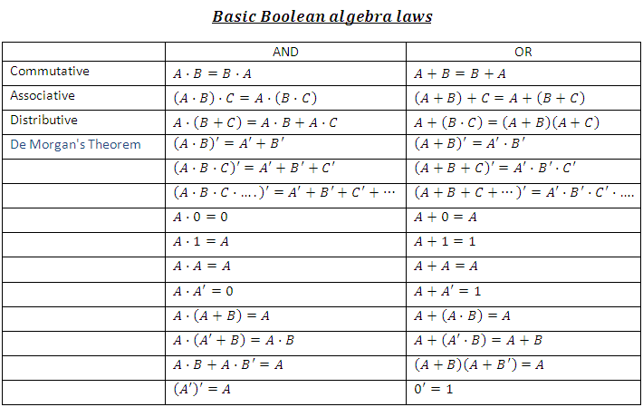
Identity Law
Null Law
Idempton Law
Inverse Law
Slide <number> of 11

Slide 28
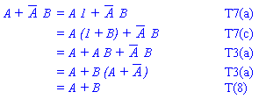
XZ + Z(X'+ XY)
Slide <number> of 11

