Slide 1
Control Structures
Object Oriented Programming with C++
Lecture 2
Nadeera Ahangama, Senior Lecturer, NSBM

Slide 2
Topic & Structure of the lesson
Control Strctures
Selection Structure
Repetition Structure

Slide 3
Learning Outcomes
You should be able to:
Identify and examine various control structures in procedural programming

Slide 4
Key Terms
You should be able to use the following terms correctly in your assignments and exams:
Flowchart
if/else
switch
for
while
do/while

Slide 5
Three Types of Control Structure
Sequence Structure
Programs executed sequentially by default
Selection structures
if, if/else, switch
Repetition structures
while, do/while, for

Slide 6
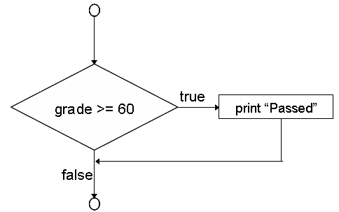
Selection Structure
if Selection Structure
Choose among alternative courses of action
Condition
if (grade >= 60)
cout << “Passed”;
If the condition is true, Print statement executed, program continues to next statement
If the condition is false, Print statement ignored, program continues

Slide 7
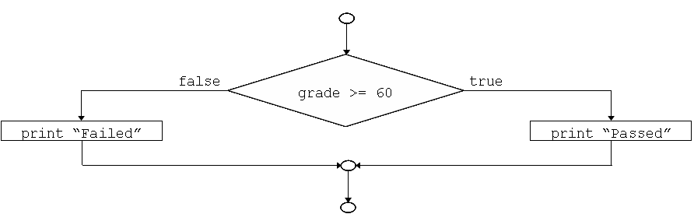
Selection Structure
if/else Selection Structure
Different actions if conditions true or false
if (grade >= 60)
cout << “Passed”;
else
cout << “Failed”;
Similar expression can be written in ternary conditional operator (? :)
- Three arguments (condition, value if true, value if false)
CODE:
cout << (grade >= 60 ? “Passed” : “Failed”);
Condition
Value if true
Value if false

Slide 8
Selection Structure
Nested if/else Selection Structure
One inside another, test for multiple cases
Once condition met, other statements skipped
if (grade >= 90) // 90 and above
cout << “A”;
else if (grade >= 80) // 80 - 89
cout << “B”;
else if (grade >= 70) // 70 - 79
cout << “C”;
else if (grade >=60) // 60 - 69
cout << “D”;
else
cout << “E”; // less than 60

Slide 9
Selection Structure
Compound statement
Set of statements within a pair of braces
Block – set of statements within braces
if (grade >= 60)
cout << “Passed”;
else
{
cout << “Failed”;
cout << “You must take this course again.\n”;
}
Without braces
cout << “You must take this course again.\n”;
always executed

Slide 10
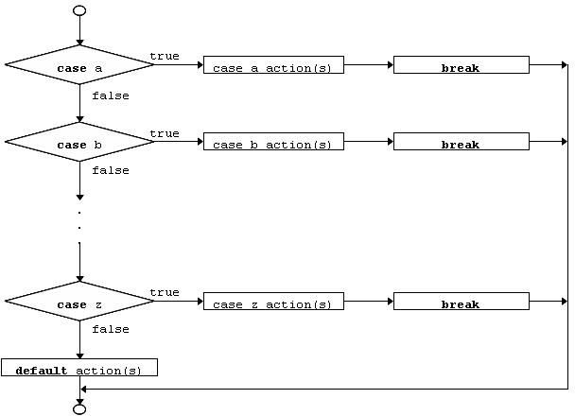
Selection Structure
Switch Multiple Selection Structure
Test variable for multiple values
Series of case labels and optional default case
switch (variable)
{
case value1: // taken if variable == value1
statements
breaks; // necessary to exit switch
case value2:
case value3: // taken if variable == value2
statements or == value3
breaks;
default: // taken if variable matches
statements no other cases
breaks;
}

Slide 11
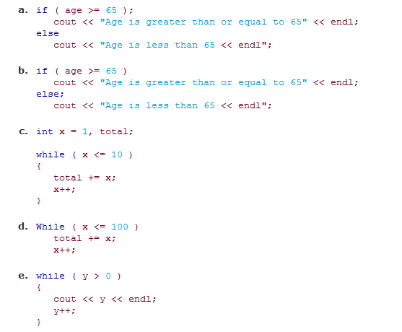
Identify Errors (if any)

Slide 12
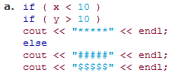
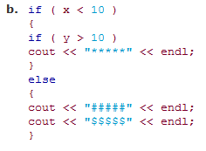
Dangling-else problem
State the output of each when x=9 and y=11.
And
x=11 and y=9.
Notes:
Note that the compiler ignores the indentation in a C++ program. The C++ compiler always associates an else with the previous if unless told to do otherwise by the placement of braces {}. On first glance, the programmer may not be sure which if and else match, so this is referred to as the "dangling-else" problem. We eliminated the indentation from the following code to make the problem more challenging. [Hint: Apply indentation conventions you have learned.]

Slide 13

Review Exercise
A program that determines the winner of a sales contest inputs the number of units sold by each salesperson. The salesperson who sells the most units wins the contest. Write a C++ program that uses a while statement to determine and print the largest number of 10 numbers input by the user.

Slide 14
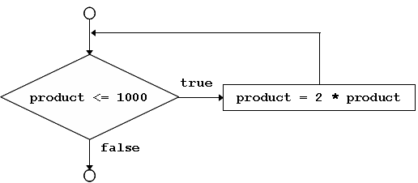
Repetition Structure
While Repetition Structure
Action repeated while condition(s) remains true
while loop repeated until condition becomes false
int product = 2;
while (product <= 1000)
product = 2 * product;

Slide 15
Repetition Structure
Requirement of Repetition Structure
1) Name of control variable/loop counter
2) Initial value of control variable
3) Condition to test for final value
4) Increment/decrement to modify control variable when looping

Slide 16
Repetition Structure
Formulation of While Repetition Structure
The condition in the while structure consist of:
1
Value of the variable to be compared
2
Equality or Relational operators
3
Sentinel Value indicates end of data
Initially, the value of the variable need to be initialised first
Is good to know the number of repetition, if not a sentinel value like -1 is used or EOF (end of file)

Slide 17
Repetition Structure
Break Statement
Immediate exit from while, for, do/while and switch
Program continues with first statement after structure
Common uses
- Escape early from a loop
- Skip the remainder of switch

Slide 18
Repetition Structure
Continue Statement
Continue statement used in while, for, do/while
Skips remainder of loop body
Proceeds with next iteration of loop
while and do/while structure
Loop-continuation test evaluated immediately after the continue statement
for structure
Increment expression executed
Next, loop-continuation test evaluated

Slide 19
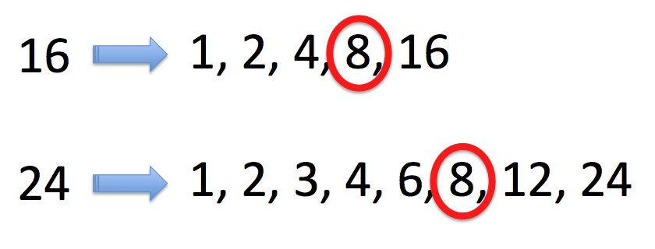
Review Exercise
Write a C program to find the largest factor of a given number (other than itself of course!)

Slide 20
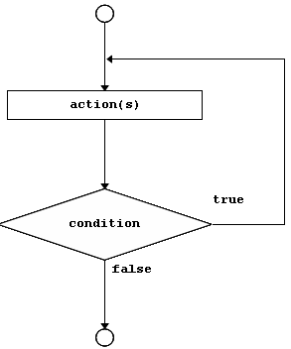
Repetition Structure
Example of Do/While Repetition Structure
Make loop continuation test at end, and not beginning
Loop body executes at least once
do
{
statement;
} while (condition);

Slide 21
Assignment Operator
Assignment expression abbreviations
variable
Variable operator expression
c = c + 3;
c += 3;
equivalent to
can be written in either way
Other assignment operators
d -= 4 (d = d – 4)
e *= 5 (e = e * 5)
f /= 3 (f = f / 3)
g %= 9 (g = g % 3)

Slide 22
Increment and Decrement Operators
Increment operator (++) similar to c += 1
Decrement operator (--) similar to c -= 1
Preincrement
- when the operator is used before the variable (++c, --c)
- variable is changed, then the expression is executed
Postincrement
- when the operator is used after the variable (c++, c--)
- execute the expression first, then variable is changed

Slide 23
Tell me the output
int y, x=10;
cout<< x << y ; //A
y = x++;
cout<< x << y ; //B
int y, x=10;
cout<< x << y ; //A
y = ++x;
cout<< x << y ; //B
Last one
int x=10;
cout << x++;
cout << ++x;

Slide 24
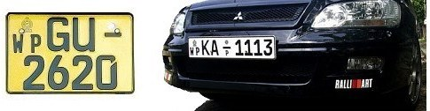
Lucky number in the license plate
Write a C++ program that would take the last four digits of a license plate number as an integer. Calculate and display the lucky number for the license plate.
Example: 2+6+2+0=10 → 1+0=1

Slide 25
Repetition Structure
for Repetition Structure
General format when using for loops:
for (initialisation; LoopContinuationTest; increment)
Example:
Prints integers from one to ten
for( int counter = 1; counter <= 10; counter++)
cout << counter << endl;
No semicolon after last statement

Slide 26
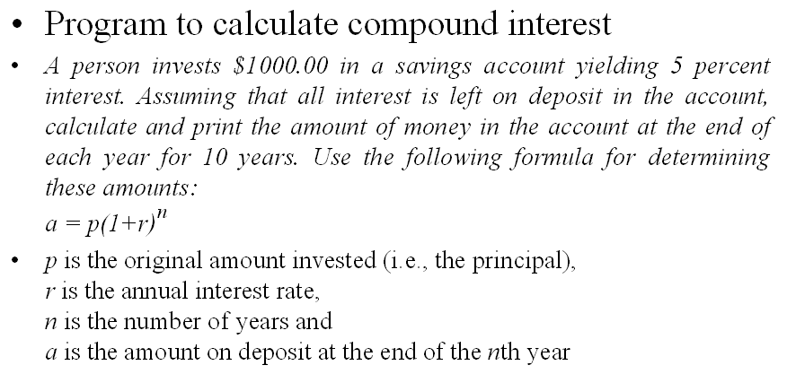
Repetition Structure
Problem Statement Using for Loop

Slide 27
Try This
The moon’s gravity is about 17 percent that of Earth’s. Write a program that displays a table that shows Earth pounds and their equivalent moon weight. Have the table run from 1 to 100 pounds. Output a newline every 25 pounds.
A year on Jupiter (the time it takes for Jupiter to make one full circuit around the Sun) takes about 12 Earth years. Write a program that converts Jovian years to Earth years. Have the user specify the number of Jovian years. Allow fractional years.

Slide 28
Follow Up Learning
Reading:
Deitel – Chapter 2
Farrell – Chapter 2

Slide 29
Summary of Main Teaching Points
Procedural programming is practiced to organize action tasks in a structured way
Control structure consist of sequence, selection and repetition structures

Slide 30
Question and Answer Session
Q & A

Slide 31
Next Session
Functions

