Slide 1
Definitions
Active – the function is being performed
  Active low – active when the output is 0.
  Active high – active when the output is 1.
Enabled – active circuit can perform its function
  Low-level enabled
    circuit performs its function when Enable = 0.
  High-level enabled
    circuit performs its function when Enable = 1.

Slide 2
Decoders

Slide 3
Decoder
A decoder selects 1 of 2^{N} output lines by decoding a binary value on the N input lines.
(similar to a 1-to-2^{N} Demultiplexer)

Slide 4
Decoder: N-to-2^{N}
w
0
y
0
N
inputs
2
N
w
n
–
1
outputs
Enable
y
2
n
–
1
En
Active-high or active-low
Active-high or active-low

Slide 5
Decoder: 2-to-4
x
D₀
x
y
D
0
D
1
D
2
D
3
y
0
0
1
0
0
0
D₁
0
1
0
1
0
0
1
0
0
0
1
0
1
1
0
0
0
1
D₂
D₃
active-high output

Slide 6
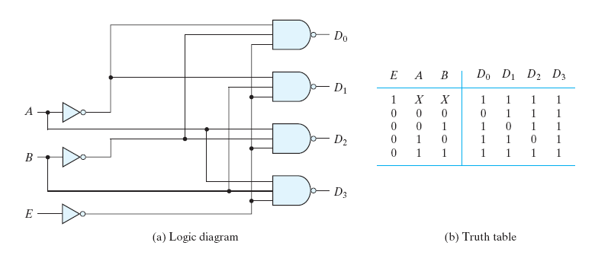
Decoder: 2-to-4 with Enable
0
active-low output

Slide 7
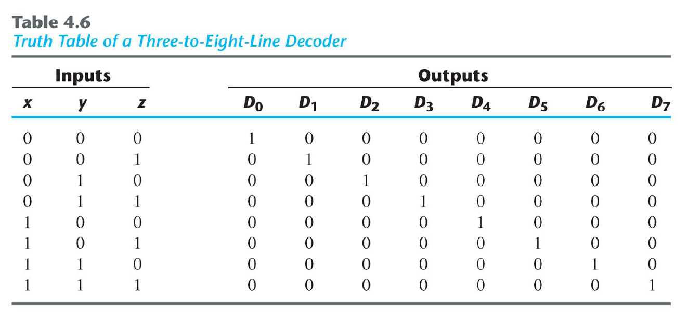
Decoder: 3-to-8

Slide 8
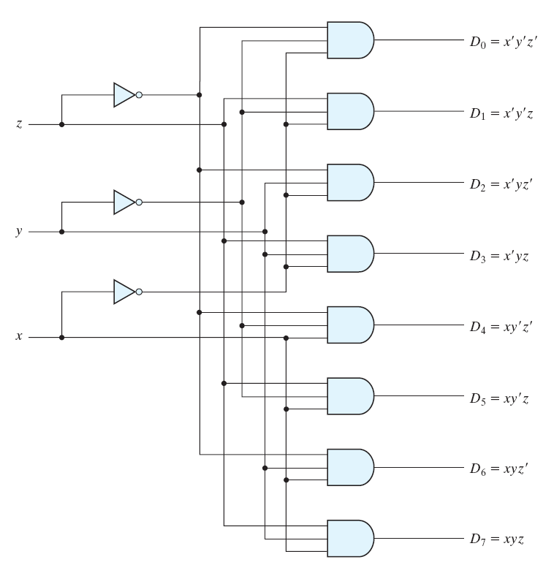
Decoder: 3-to-8

Slide 9
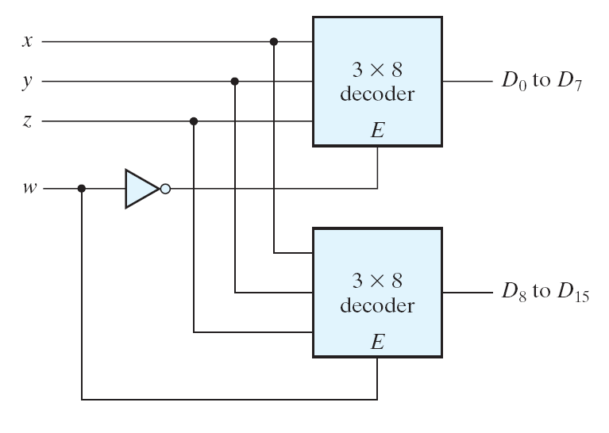
Decoder: 4-to-16

Slide 10
Decoders: Designing Logic Circuits
Each row in a Truth Table corresponds to a minterm
Each minterm can be mapped to a decoder output
For each row in the Truth Table, where the output of the function is one (F = 1),
  Sum (“OR”) the corresponding outputs of the decoder to realize the logic function

Slide 11
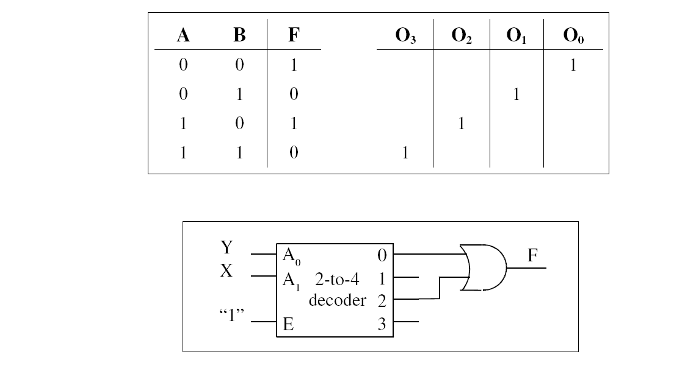
Decoders: Designing Logic Circuits
F = Σm(0,2)

Slide 12
Decoders: Designing Logic Circuits
Exercise:
Design a circuit, using a 3-to-8 Decoder to realize the Boolean expression given below.
F_{X,Y,Z} = Σm(1,2,5,7)

Slide 13
Decoders: Designing Logic Circuits
Exercise:
Design a circuit, using 2-to-4 Decoders to realize the Boolean expression given below.
F_{X,Y,Z} = Σm(1,2,5,7)

Slide 14
Decoders: Designing Logic Circuits
Exercise:
Design a Full Adder using a 3-to-8 Decoder.

Slide 15
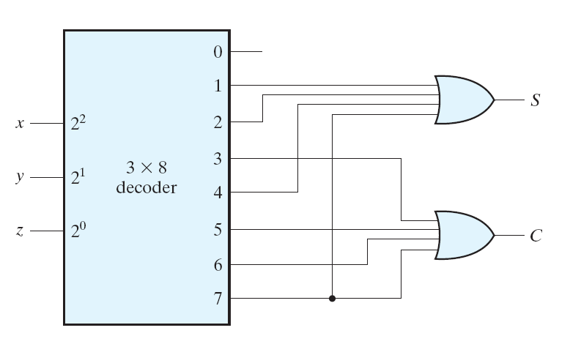
Decoders: Designing Logic Circuits
Full Adder

Slide 16
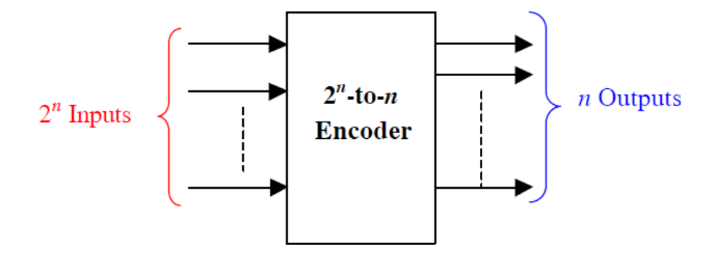
Encoders
An encoder performs the inverse operation of a decoder
It has 2^{n} inputs, and n output lines.
Only one input can be logic 1 at any given time (active input). All other inputs must be 0’s.
Output lines generate the binary code corresponding to the active input.

Slide 17
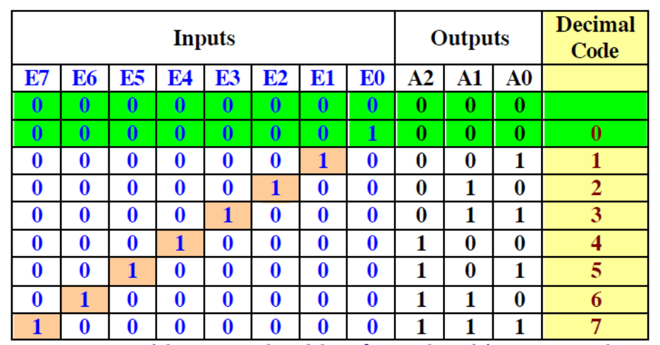
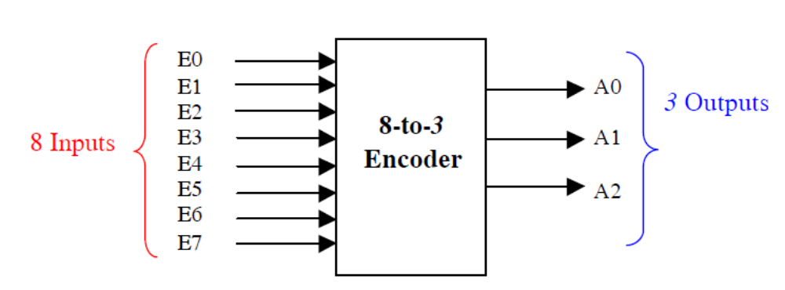
Octal-to-binary encoder
A0 = E1 + E3 + E5+ E7
A1 = E2 + E3 + E6+ E7
A2 = E4 + E5 + E6+ E7

Slide 18
Major Limitation of Encoders
Exactly one input must be active at any given time.
If the number of active inputs is less than one or more than one, the output will be incorrect.
For example, if E3 = E6 = 1, the output of the encoder A2A1A0 = 111, which implies incorrect output.

Slide 19
Two Problems
If two or more inputs are active at the same time, what should the output be?
An output of all 0's is generated in 2 cases:
  when all inputs are 0
  when E0 is equal to 1.

Slide 20
Priority Encoders
If more than one input is active, the higher-order input has priority over the lower-order input.
  The higher value is encoded on the output
A valid indicator, d, is included to indicate whether or not the output is valid.
  Output is invalid when no inputs are active
    d = 0
  Output is valid when at least one input is active
    d = 1

Slide 21
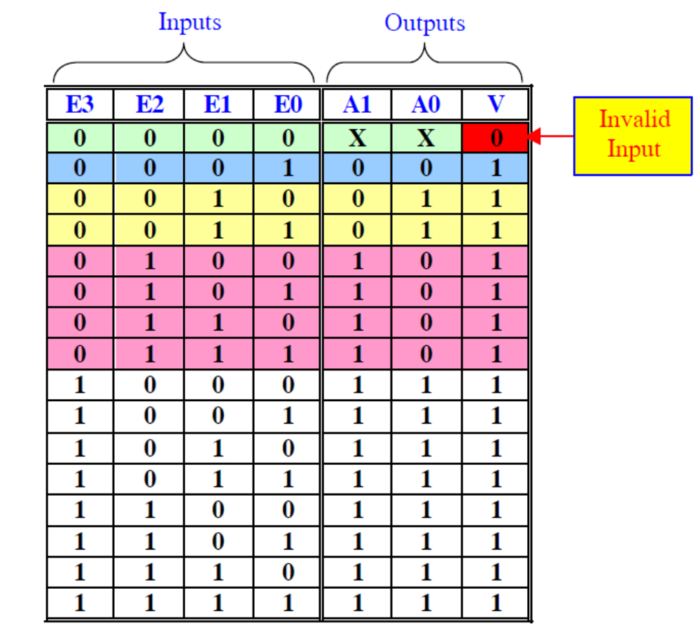
4-to-2 Priority Encoders

Slide 22
