Slide 1
Compiling and Executing WRF-Hydro
October 17-19, 2017

Slide 2
Compiling and Running (Ch. 2.4 in Documentation)
Configure
Setting up environment & dependencies
Choose compiler options
Compiling
For coupled runs, WRF-Hydro will be compiled as a library (.o) and called by WRF as an external function.
Run (constant files and one namelist file)
Offline
Coupled with other systems

Slide 3
Compiling and Running
Configure
Setting up some environments and dependencies:
setenv WRF_HYDRO 1 - A "1" will activate additional WRF-Hydro environment settings. "0" or no definition will default to the WRF model environment settings only when WRF is run.
(optional) setenv HYDRO_D 1 - A "1" for HYDRO_D results in WRF-Hydro producing some run-time diagnostic information. When HYDRO_D is set to "0 "or not defined, the diagnostic information will not be produced during run-time.
setenv NETCDF_INC "$path/netcdf/include“
setenv NETCDF_LIB "$path/netcdf/lib"

Slide 4
Compiling and Running
Configure
Choose compiler options
%./configure - Executing this command will produce the following options:
Please select from following supported options.
1. Linux PGI compiler sequential
2. Linux PGI compiler dmpar
3. IBM AIX compiler sequential, xlf90_r
4. IBM AIX compiler dmpar
5. Linux gfort compiler sequential
6. Linux gfort compiler dmpar
7. Linux ifort compiler sequential
8. Linux ifort compiler dmpar
0. exit only
Enter selection [0-8] :

Slide 5
Compiling and Running
Compiling

Slide 6
Compiling and Running
Compiling:
Uncoupled to WRF:
Issue proper compile script:
compile_Noah.csh OR compile_NoahMP.csh
This will produce the ‘uncoupled’ executable in the ‘Run/’ directory, called wrf_hydro.exe
Coupled to WRF:
First verify that uncoupled model compiles
Then issue ‘make clean’
Compile wrf as normal, setting of ‘WRF_HYDRO 1’ environment variable will ‘instruct’ wrf to compile wrf-hydro…successful compile will produce 1 ‘wrf.exe’ file

Slide 7
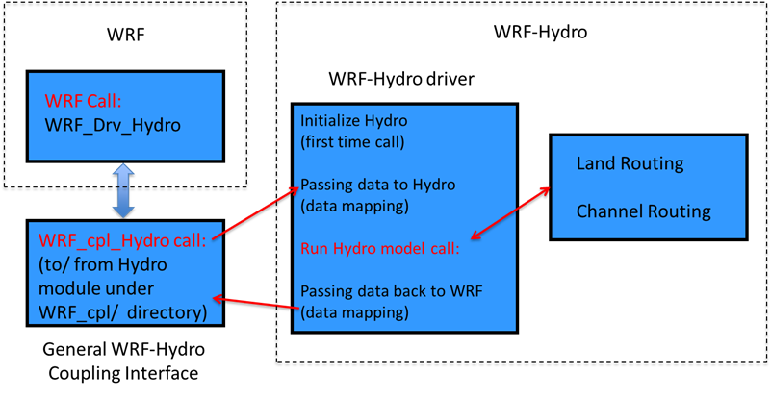
Compiling and Running
Coupling structure:

Slide 8
Compiling and Running
Running:
Fill out namelists:
Uncoupled: namelist.hrldas – for Noah and the hydro.namelist for hydrological model options
Coupled to LIS: LIS.config - for LIS and the hydro.namelist for hydrological model options
Coupled to WRF: namelist.input – for WRF and the hydro.namelist for hydrological model options

