Slide 1
Verilog HDL - FSM

Slide 2
What’s finite-state machine, FSM
A finite-state machine (FSM) or simply a state machine, is a mathematical model of computation used to design sequential logic circuits.
The machine is in only one state at a time; the state it is in at any given time is called the current state. It can change from one state to another when initiated by a triggering event or condition; this is called a transition. A particular FSM is defined by a list of its states, and the triggering condition for each transition.

Slide 3
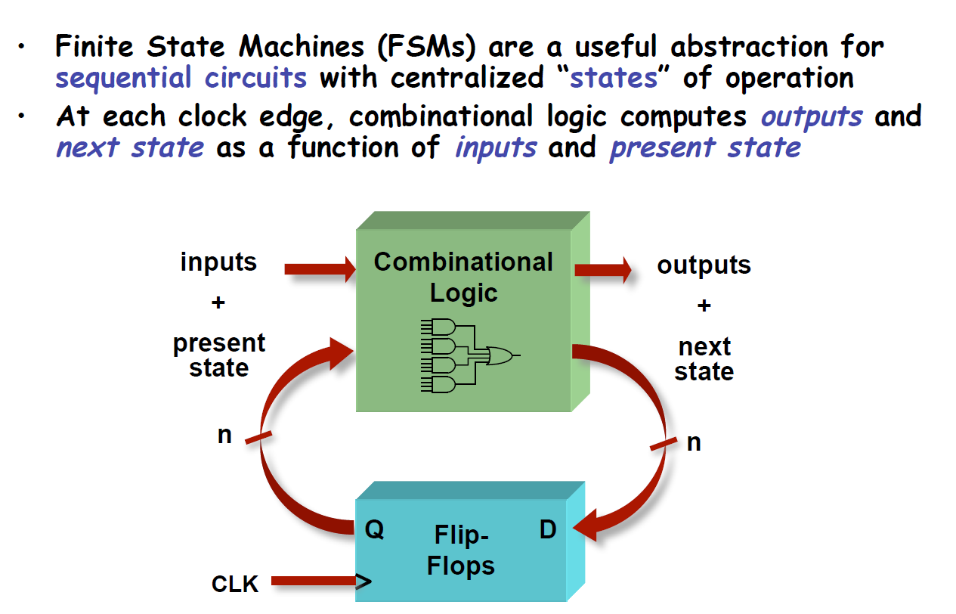
Finite State Machines

Slide 4
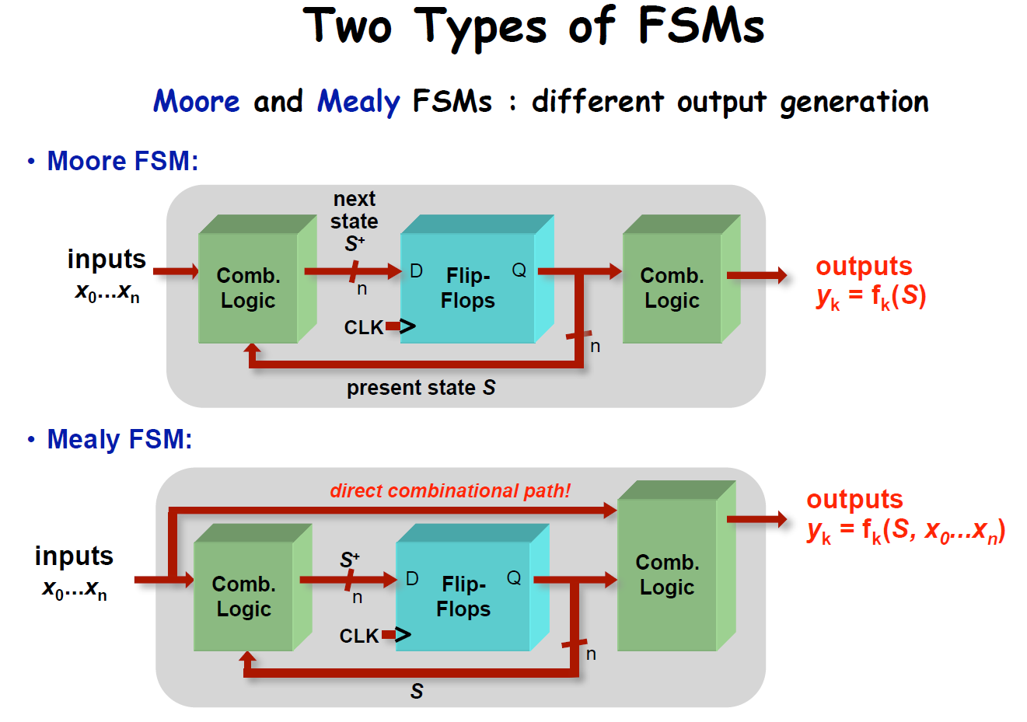
FSM

Slide 5
Moore VS Mealy
Compared to a Moore FSM, a Mealy FSM might...
Be more difficult to conceptualize and design
Have fewer states
Mealy outputs generally occur one cycle earlier than a Moore

Slide 6
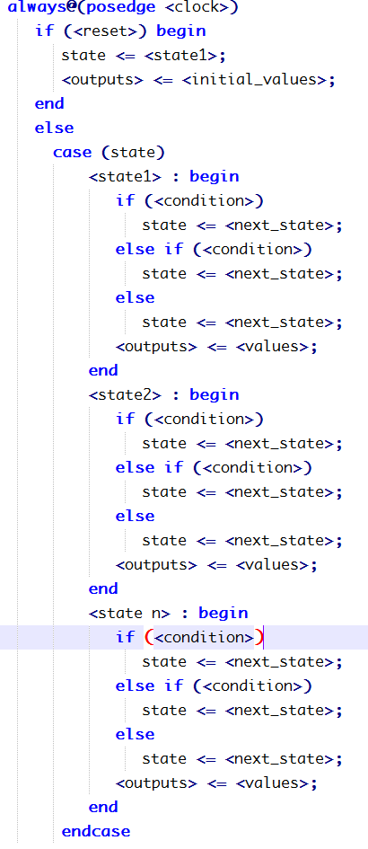
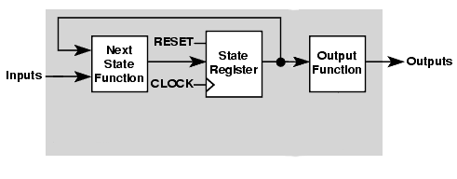
FSM-1段

Slide 7
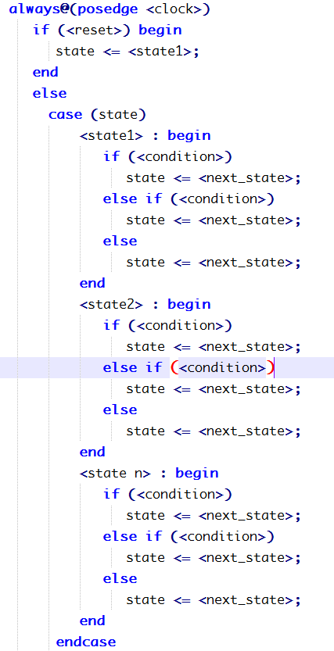
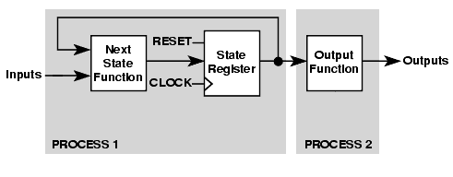
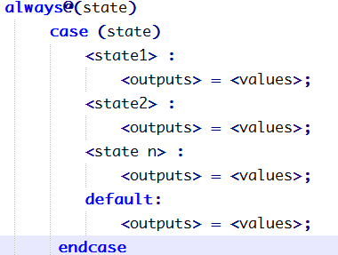
FSM-2段

Slide 8
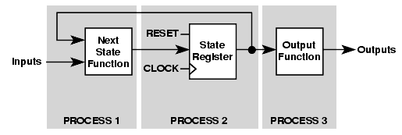
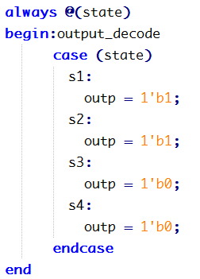
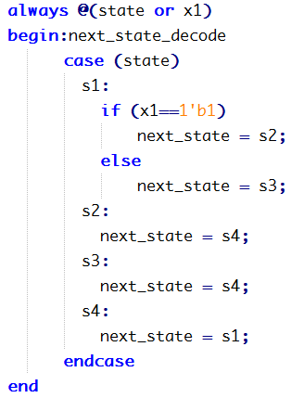
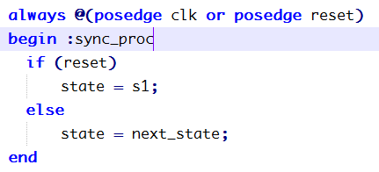
FSM-3段

Slide 9
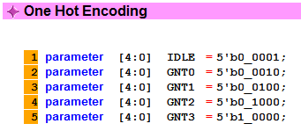
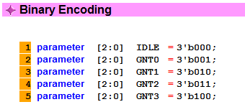
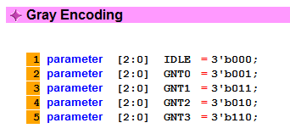
FSM encoding
Binary Encoding
One Hot Encoding
One Cold Encoding
Almost One Hot Encoding
Almost One Cold Encoding
Gray Encoding

Slide 10
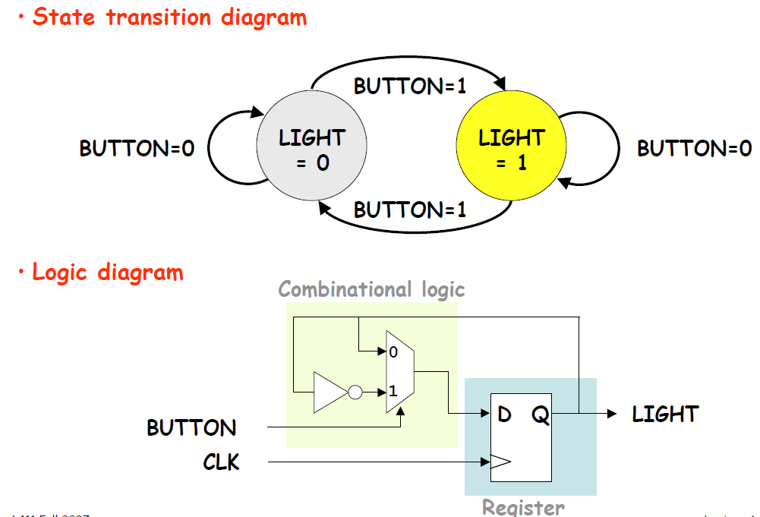
Light Switch

Slide 11
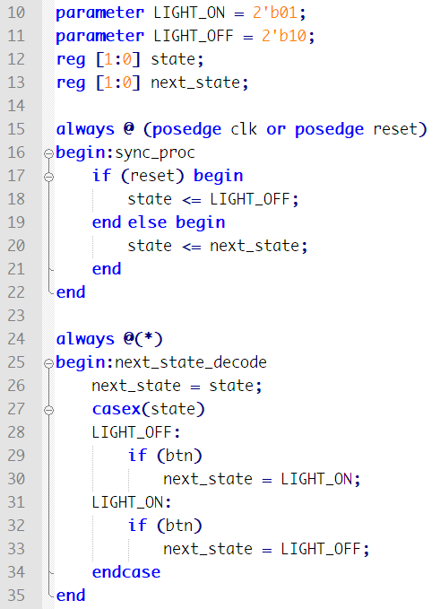
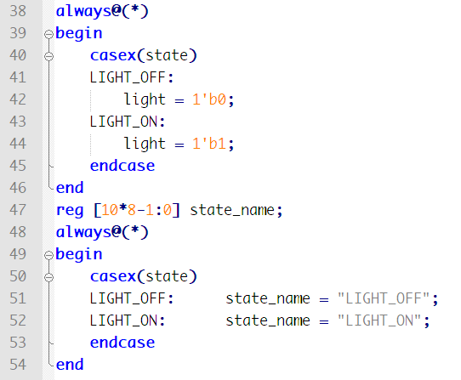
Light Switch

Slide 12
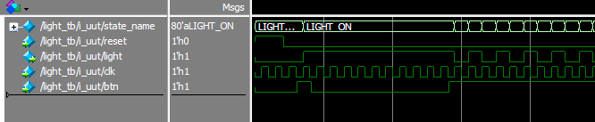
Light Switch

Slide 13
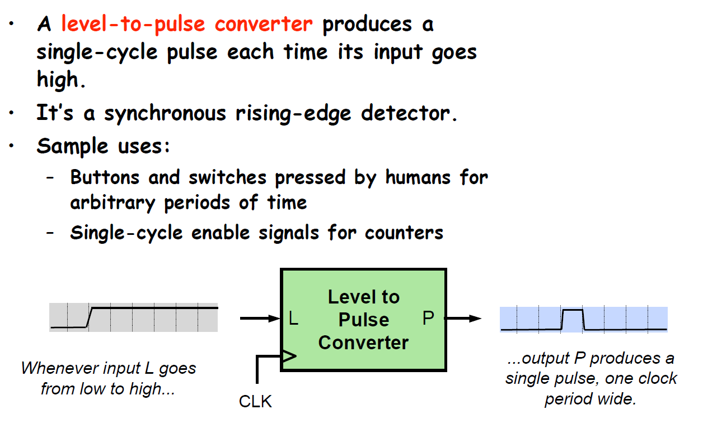
FSM – Example : Level to pulse converter

Slide 14
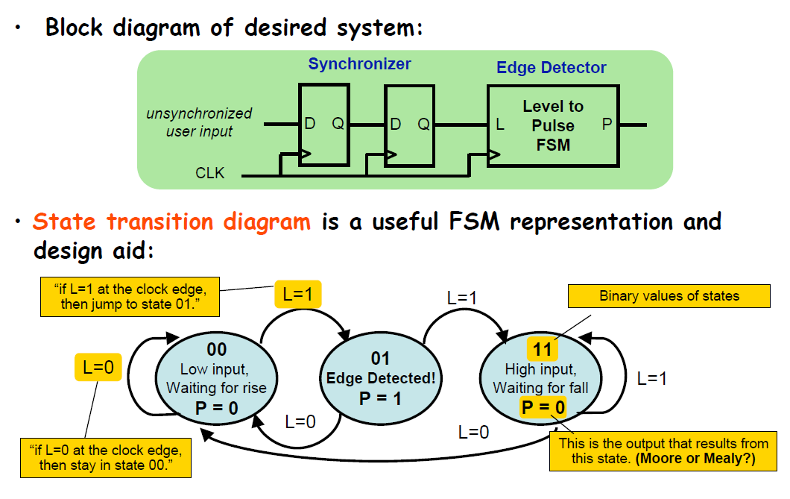
Moore State Transition Diagram

Slide 15
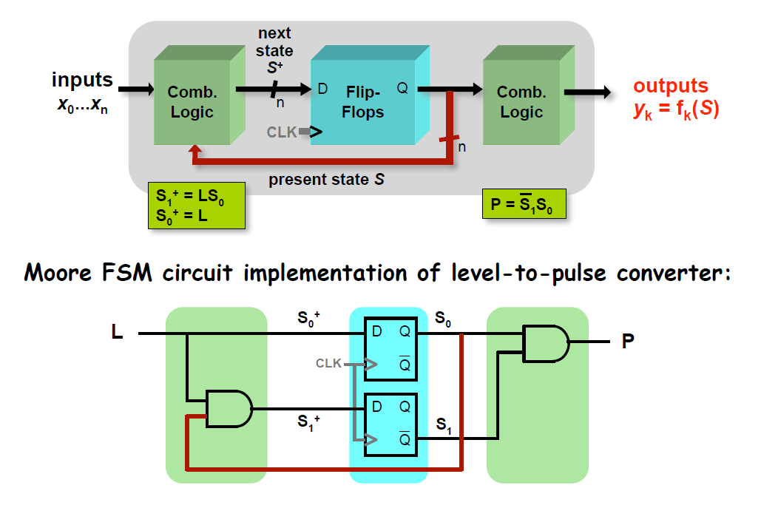
Moore FSM

Slide 16
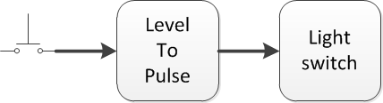
Have another try

Slide 17
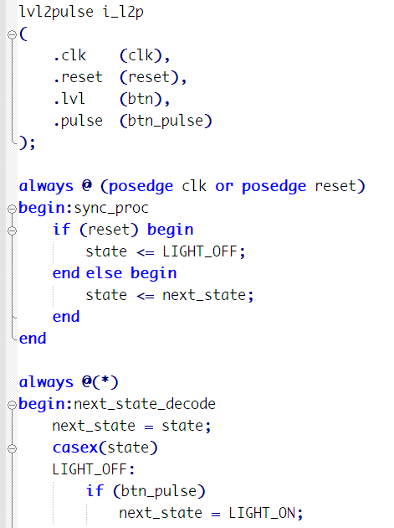
Have another try

Slide 18
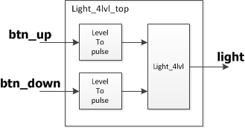
Light 4-Level
Input:
btn_up[1]
btn_down[1]
reset[1]
clk[1]
Output:
light[2]
00:lvl0
01:lvl1
10:lvl2
11:lvl3
Btn_up: 00->01->10->11
Btn_down:11->10->01->00

Slide 19
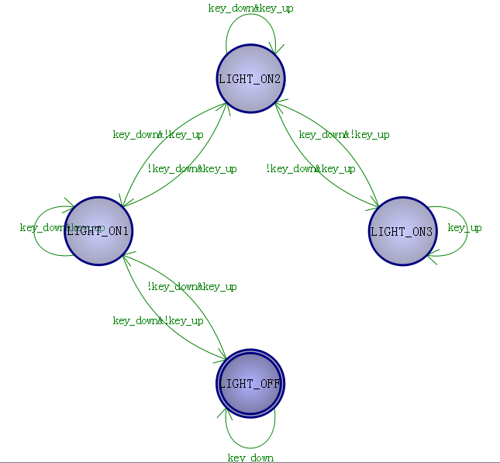
Another try

Slide 20
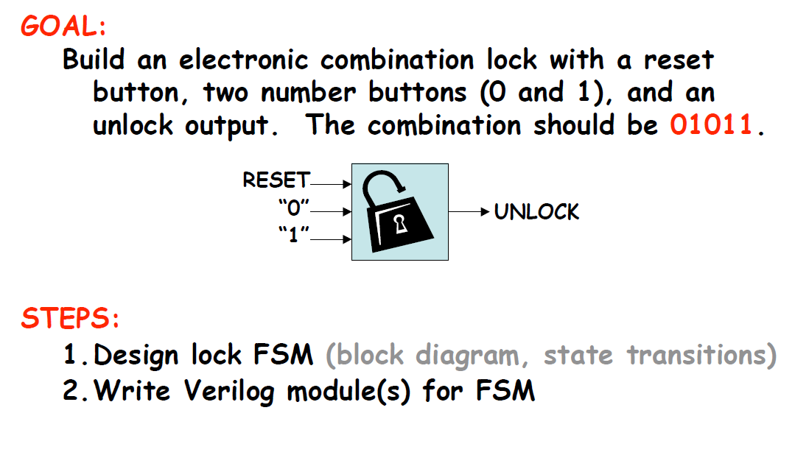
Practice

Slide 21
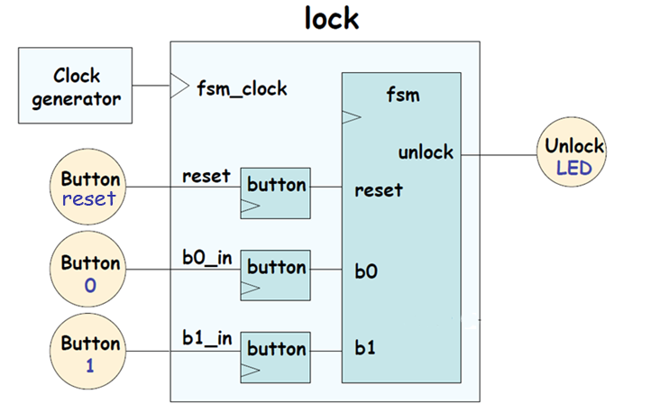
Step 1 Block Diagram

Slide 22
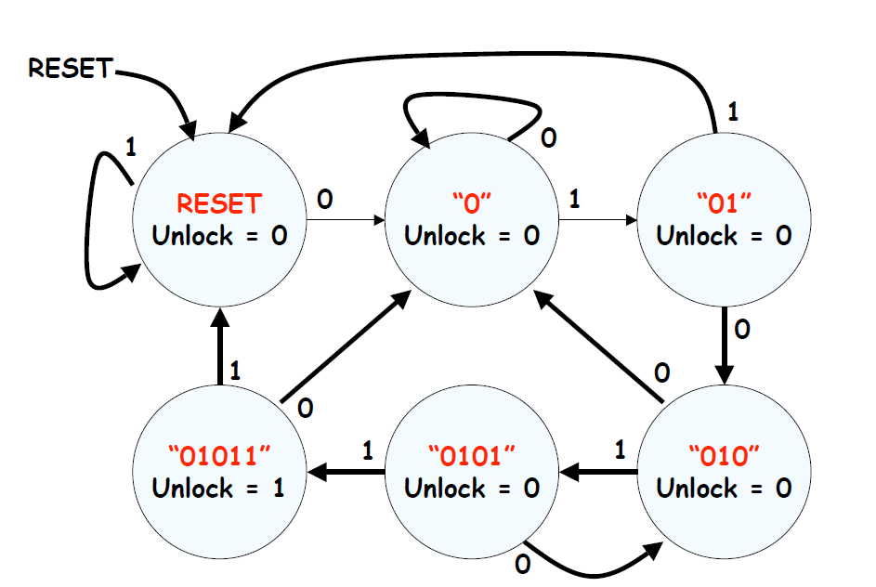
Step 2 State transition diagram

Slide 23
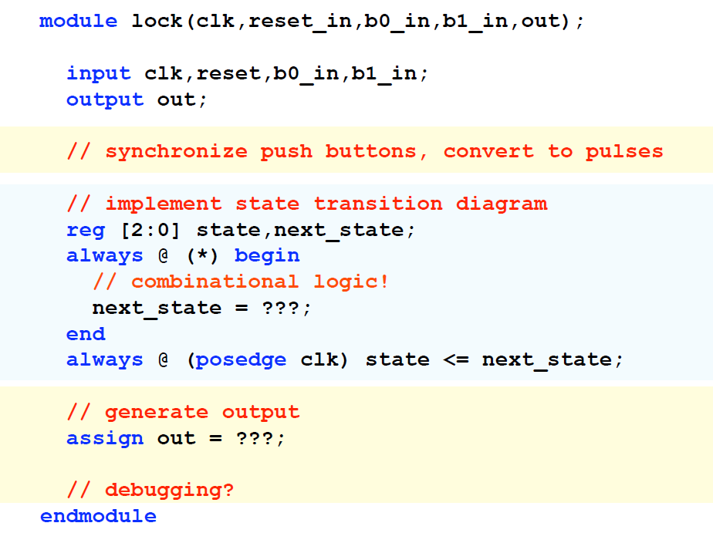
Step 3 out line

Slide 24
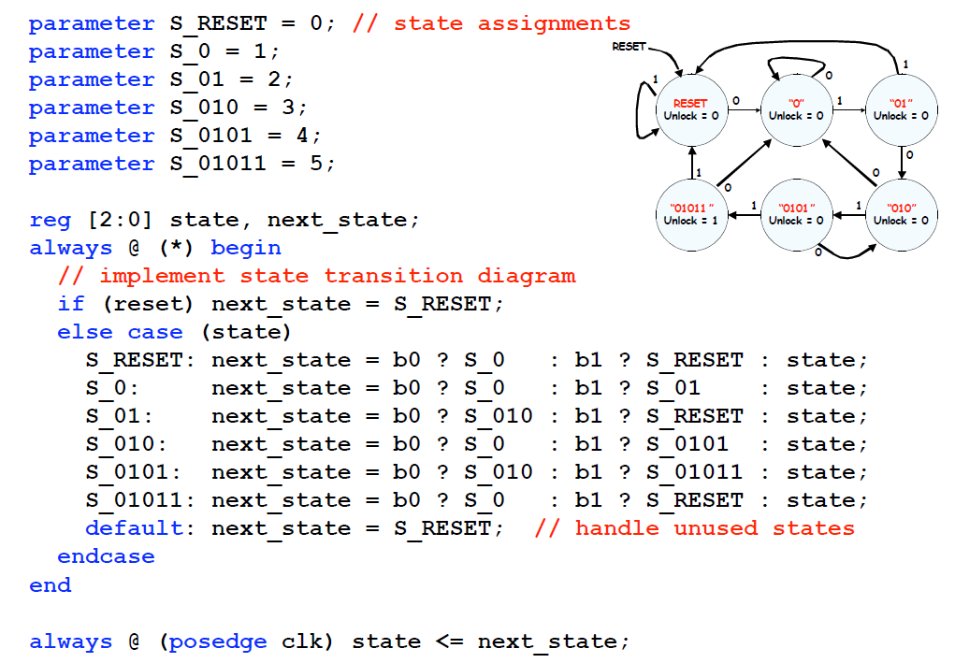
Step 4.2 module

Slide 25
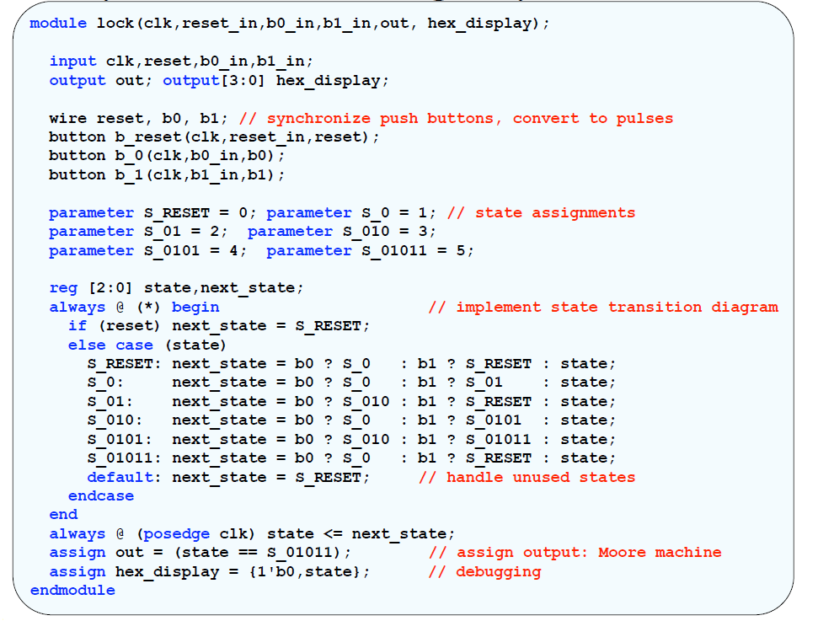
Step 4 Verilog

