Slide 1
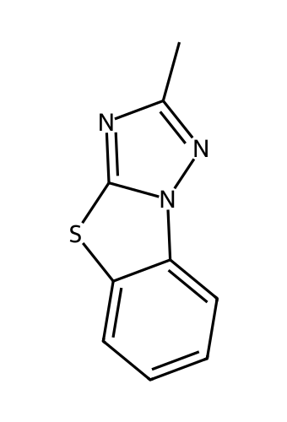
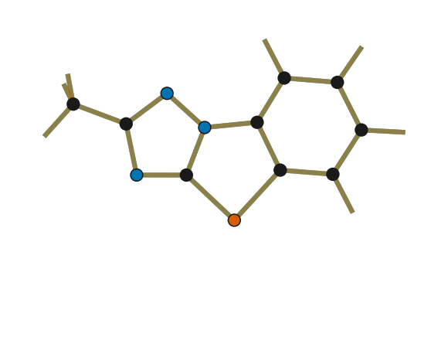
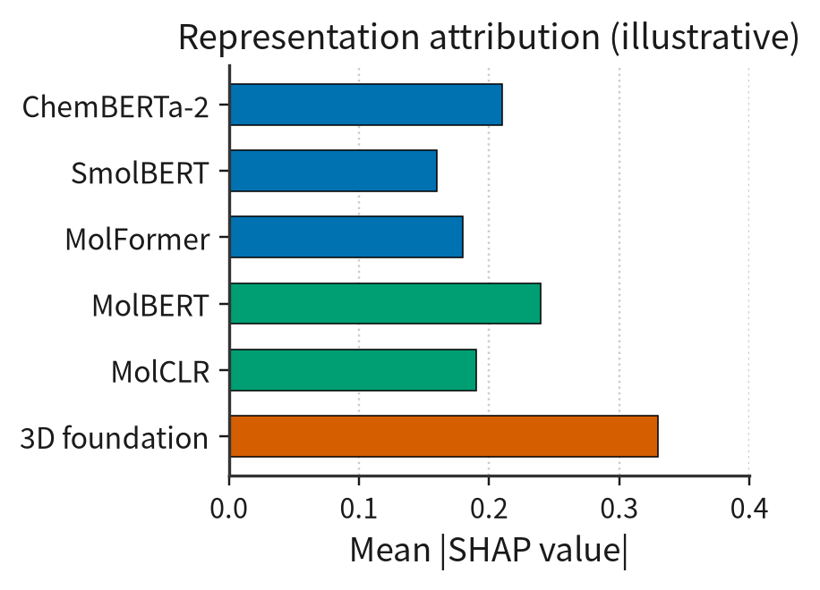
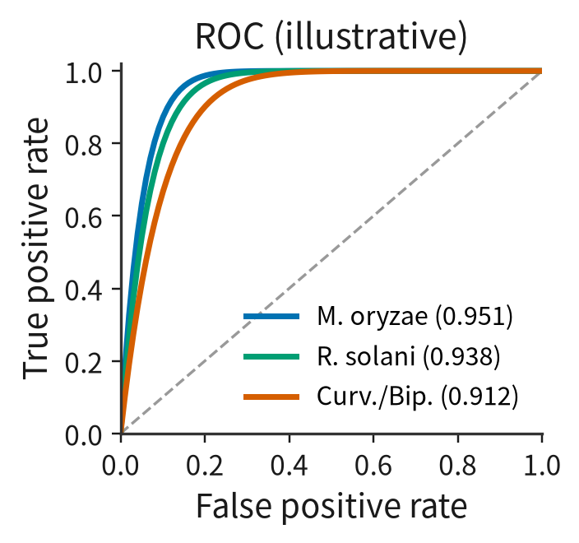
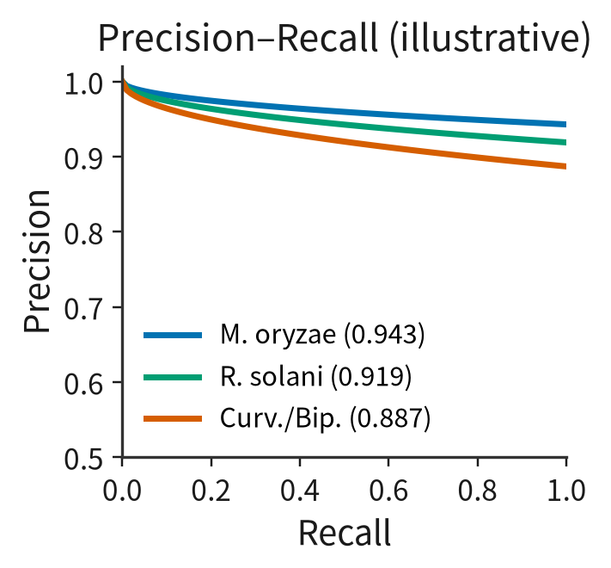
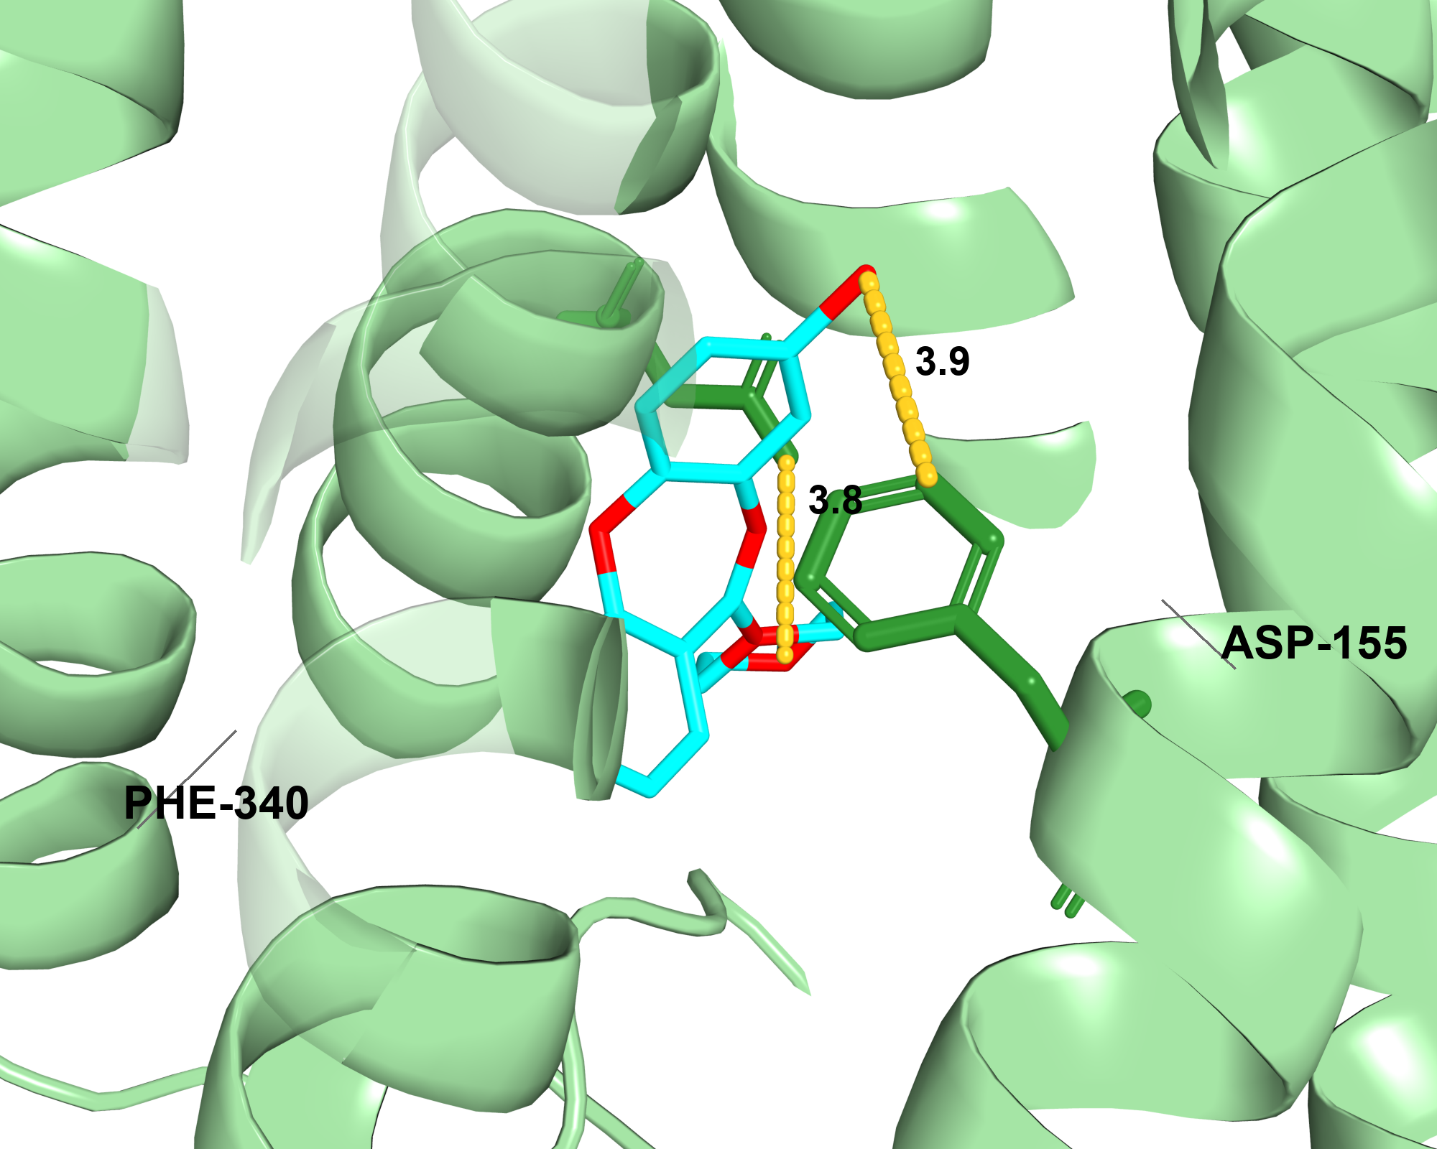
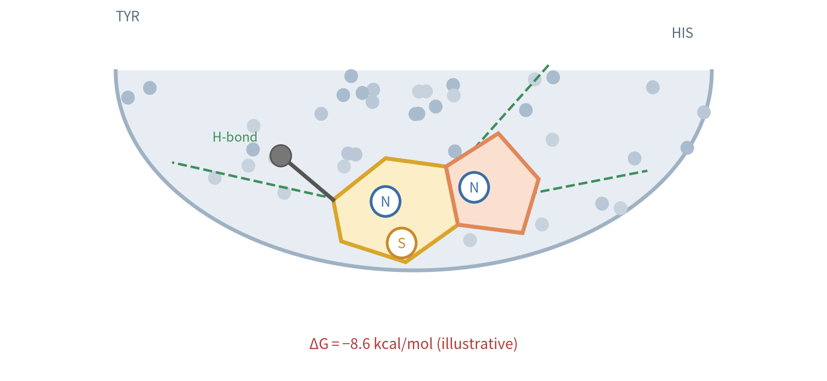
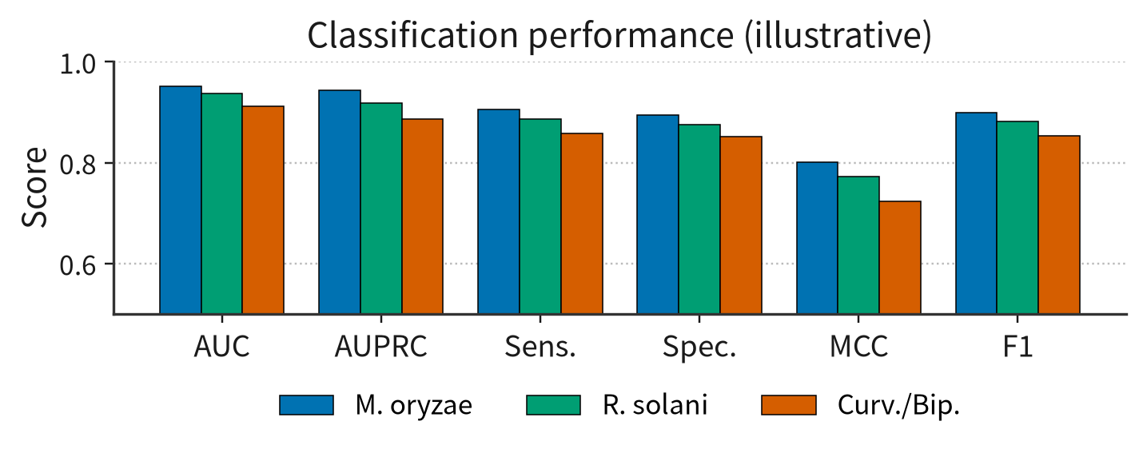
(A) Dataset curation
Pathogen
Source
Unique
Positive
Negative
Curation rules
M. oryzae
ChEMBL+PubChem
1,686
+728
−958
assay-level whole-cell labels; positive & negative from the same library (organism & database); no generic or cross-species strains; balanced 1:1; no MIC / IC50 regression
R. solani
ChEMBL+PubChem
1,749
+506
−1,243
C. lunata+B. oryzae
ChEMBL
661
+246
−415
(B) AgriMolPred framework
Input molecule
canonical SMILES
1D · Sequence encoders
2D · Graph encoders
3D · Conformer encoder
frozen
frozen
frozen
ChemBERTa-2
MolBERT
3D foundation model
(Uni-Mol / 3D-MoLM)
SmolBERT
MolCLR
MolFormer
Stage 1
pairwise cross-attention
h₁
1D × 2D
h₂
2D × 3D
h₃
1D
Q ← K, V
2D
2D
Q ← K, V
3D
multi-head cross-attention
multi-head cross-attention
Add & Norm · sigmoid gate
Add & Norm · sigmoid gate
f₁₂
f₂₃
Stage 2
cross-again
gated cross-fusion f₁₂ × f₂₃
multi-head cross-attn
unified embedding
sigmoid gate
Stage 3
capsule classifier
SHAP interpretation
PrimaryCaps
dynamic routing
ClassCaps (one binary head each)
p1
p2
M. oryzae
R. solani
C. lunata /
B. oryzae
p3
p4
active
active
active
p5
p6
inactive
inactive
inactive
Why SHAP: Shapley values assign each prediction to atoms & representations, independently of weights.
Why capsules: vectors retain substructure identity; iterative routing aggregates parts → whole by agreement, more robust than scalar neurons with max-pooling.
Asymmetric Loss (ASL) for class imbalance; per-pathogen non-exclusive binary heads (scalable to more pathogens)
(C) Benchmarking case study
(D) Interpretation & molecular docking
Atom-level SHAP
red atoms push the prediction toward active; blue toward inactive; SHAP exposes the substructure the capsule head relies on.
Illustrative — values to be replaced with final results
Illustrative — final docking poses & attribution to be inserted

