Slide 1
DE-FRAGMENTING CODE-EMBEDDED UML: A DESIGN
Eric Braude Boston University MET Computer Science

Slide 2
Problems with UML in Agile Development
Diagrams (“documentation”) secondary
UML expensive to maintain
UML class models become unwieldy

Slide 3

Problems with UML in Agile Development
BUT UML provides excellent insight
(in the small)

Slide 4
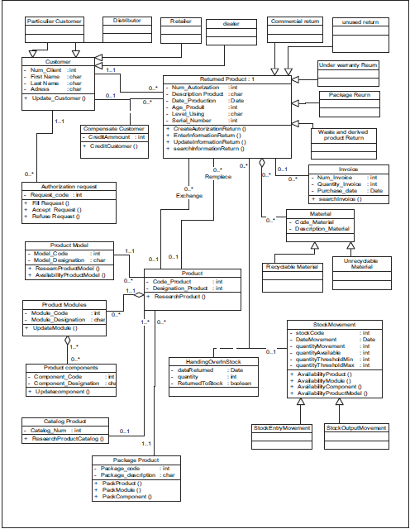
UML Example (hundreds(!))
“Object-oriented Modeling and Design of Reverse Logistics Management System using UML” by Asma Boussellaa and Mourad Abed

Slide 5
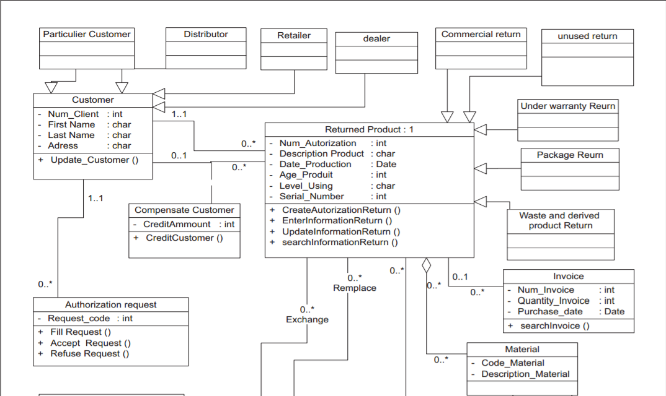
UML Example: Top Half

Slide 6
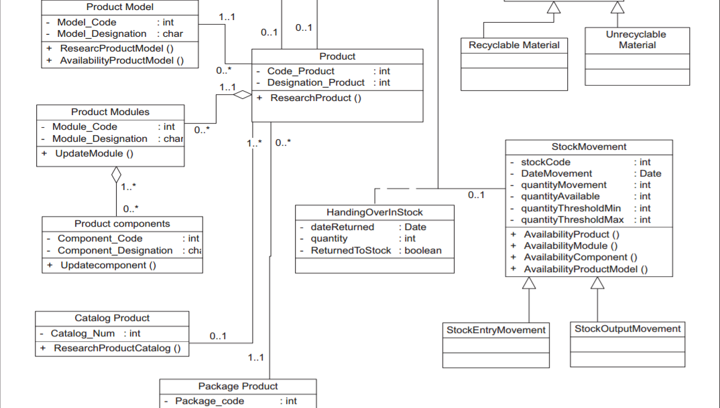
UML Example: Bottom Half

Slide 7
Solution
Visualize design while programming
Clarify UML class models

Slide 8
Premises
One sprint’s worth of requirements
No design for it performed yet
Source code is sole medium
Have prior sprints’ implementation

Slide 9
The Approach: Overall
Embed graphical UML class model fragments within code comments.

Slide 10
The Approach: More Specifically
For a given user story:
Identify and position needed subsidiary functions as they become needed
e.g., for e-commerce consumer site,
position …
display_product_image(),
verify_credit(), and
process_payment()

Slide 11
Thus …
The existence of subsidiary functions is among a function’s preconditions.
Their positioning in classes is among its postconditions.
(Higher-order specification)

Slide 12
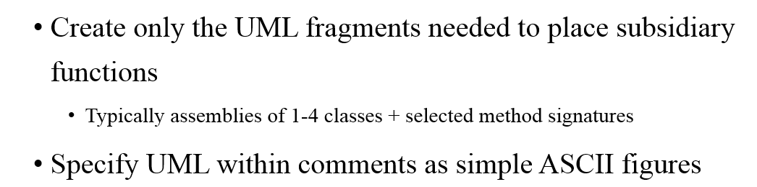
Approach ctd.

Slide 13
Approach ctd.
Create only the UML fragments needed to place subsidiary functions
Typically assemblies of 1-4 classes + selected method signatures
Specify UML within comments as simple ASCII figures
Each new UML fragment should relate to an existing one
Subsidiary functions may require subsidiary functions (recursively)

Slide 14
Example: Kitchen Visualization
Enables user to visualize a given kitchen layout in various styles such as “antique” or “modern.”
Example of generic layout:
w - - - -
- - f - -
- - - - -
- - - - w
- - - - f

Slide 15
Execution of arrange_kitchen_with("ANTIQUE")
… produces:
awc - - - -
- - afc - -
- - - - -
- - - - awc
- - - - afc

Slide 16
Select Function to Work On
Execution produces desired functionality of (sub)system
Example:
def arrange_kitchen_with(a_style):
Relies on subsidiary functions \
(to draw cabinets in various styles)

Slide 17
Example Preconditions for arrange_kitchen_with(a_style)
a_style = 'MODERN' or 'ANTIQUE’
cabinet_arrangement specifies where the floor- and wall cabinets should be located on a two-dimensional grid
place_y_x_cabinet(a_position) are defined, each placing an x cabinet in style y at a_position on the console, where y = modern or antique and x = floor or wall
arrange_kitchen() is defined, using place_x_cabinet() with x = floor or wall, to produce a picture of a kitchen on the console.

Slide 18
Example Postconditions for arrange_kitchen_with(a_style)
arrange_kitchen() and place_x_cabinet() are in position
place_y_x_cabinet() are in position for x = floor/wall and y = modern/antique
Kitchen.place_x_cabinet(), for x = floor/wall, delegates to place_y_x_cabinet() where y corresponds to a_style
A kitchen is displayed on the console as per cabinet_arrangement and a_style

Slide 19
First Subgoal
--(Postcondition 1 +):
arrange_kitchen(), place_floor_cabinet(), and place_wall_cabinet() are in position
AND
the_kitchen is a Kitchen instance with cabinet_arrangement

Slide 20
Fulfillment of First Subgoal 1: Define when needed
’’’
|Kitchen |set_arrangement() |place_floor_cabinet() |place_wall_cabinet()
’’’

Slide 21
Fulfillment of First Subgoal 2: Pretty-printing and Automatic Creation
’’’
_____________________ |_______Kitchen_______| | set_arrangement() | |place_floor_cabinet()| | place_wall_cabinet()|
|_____________________|
’’’
class Kitchen: def set_arrangement(self):
pass def place_floor_cabinet(self):
pass def place_wall_cabinet():
pass

Slide 22
Fulfillment of First Subgoal 3: Use to Complete
’’’
_____________________ |_______Kitchen_______| | set_arrangement() | |place_floor_cabinet()| | place_wall_cabinet()|
|_____________________|
’’’
from … import Kitchen the_kitchen = Kitchen() the_kitchen.set_arrangement(cabinet_arrangement)

Slide 23
Second Subgoal: Fulfill Postcondition 2
Select subgoals so UML fragments connect
--(Postcondition 2): place_y_x_cabinet() is in position
with x = floor or wall and y = antique or modern

Slide 24
Fulfillment of Second Subgoal 1: Specification
’’’ |Kitchen<>-wall_cabinet--->|WallCabinet
|WallCabinet
^ |AntiqueWallCabinet |place_antique_wall_cabinet()
|WallCabinet
^ |ModernWallCabinet
|place_modern_wall_cabinet()
’’’

Slide 25
Fulfillment of Second Subgoal 2: Pretty-printing and Automatic Creation
’’’ ___________ Kitchen<>-wall_cabinet--->|WallCabinet|
|___________| ____________________________ ^ ___________________________ |____AntiqueWallCabinet______| |____ModernWallCabinet______| |place_antique_wall_cabinet()| |place_modern_wall_cabinet()|
|____________________________| |___________________________|
’’’

Slide 26
Verification at Creation
Ensures … intra-code specification actually realized in code.
… UML fragments consistent.

Slide 27
Verification at Creation
Ensures … intra-code specification actually realized in code.
… UML fragments consistent.
Includes:
Class specified in more than one location as new.
Class specified in more than package.
Every UML fragment references part of another fragment

Slide 28
Visualization
Local pretty-printing*
Global class model
* Ongoing work with Jason Van Schooneveld

Slide 29
The Process 1
package s
class t
…
‘’’
|Kitch…
Generate & pretty-print

Slide 30
The Process 2
package s
class t
New class
Generate & pretty-print

Slide 31
The Process 3
package s
compile
XML for
fragment F_{s}
class t
New class

Slide 32
package s
XML for
fragment F_{st}
XML for entire class model
class t
compile
UML
Tool
Visualization
Pretty-print
Integrate & Verify
Prettyprinted UML
Pretty-print
package u
XML for
fragment F_{uv}
Errata and warnings
class v
compile

Slide 33
Pretty-printed Global UML: Hierarchies
_______________
|ReturnedProduct|<>-->Material
|_______________|<>-->Customer
∆
|__________________________________________________________________________________
_________|_________ ______|______ ____|______ _______|________ _____|______
|UnderWarrantyReturn| |PackageReturn| |WasteReturn| |CommercialReturn| |UnusedReturn|
|___________________| |_____________| |___________| |________________| |____________|
________
|Customer|
|________|
∆
|____________________________________________________
__________|_______ _____|_____ ___|____ __|___
|ParticularCustomer| |Distributor| |Retailer| |Dealer|
|__________________| |___________| |________| |______|
________
|Material|
|________|
∆
|______________________________
_________|________ _________|__________
|RecyclableMaterial| |UnrecyclableMaterial|
|__________________| |____________________|

Slide 34
Pretty-printed Global UML: Aggregation
_____________
|StockMovement|<>-->ReturnedProduct
| | __________________
| |<>-->|HandingOverInStock|
|_____________| |__________________|
∆
|_____________________________
__________|_______ ________|__________
|StockEntryMovement| |StockOutputMovement|
|__________________| |___________________|
================================= ==================================== ===================================
_______
|Invoice|<>-->ReturnedProduct
|_______|
__________________
|CompensateCustomer|<>-->Customer
|__________________|<>-->ReturnedProduct
____________________
|AuthorizationRequest|<>-->Customer
|____________________|
______________ _______ ______________
|PackageProduct|<>-->|Product|<>-->|ProductModules|<>-->ProductComponents
|______________| | | |______________|
______________ | | ____________
|CatalogProduct|<>-->|_______|<>-->|ProductModel|
|______________| |____________|

Slide 35
Known Issues to be Dealt With
Revisions—to take effect throughout
Experiments: how developers react
Volunteer faculty wanted

Slide 36
Summary: Using PREXEL,
agile developers …
Specify classes within current code just in time
Classes are—created
—pretty-printed locally
Specifications are compiled
Global UML pretty-printed

