Slide 1
Topic Aware Neural Response Generation
Microsoft Research, Beijing, China
AAAI 2017
CC:1
Chun Chen Lin

Slide 2
Outline
Background
Motivation
Related work
Main idea
Evaluation
Conclusion

Slide 3

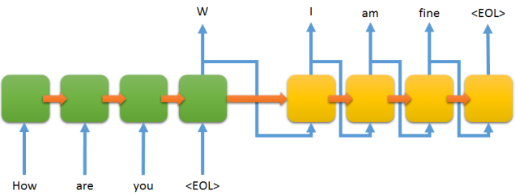
Background
Seq2Seq model
Encoder
Decoder

Slide 4
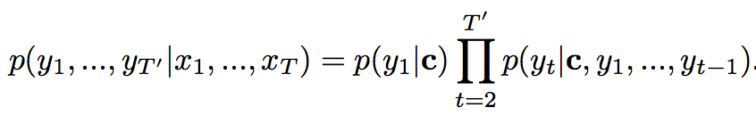


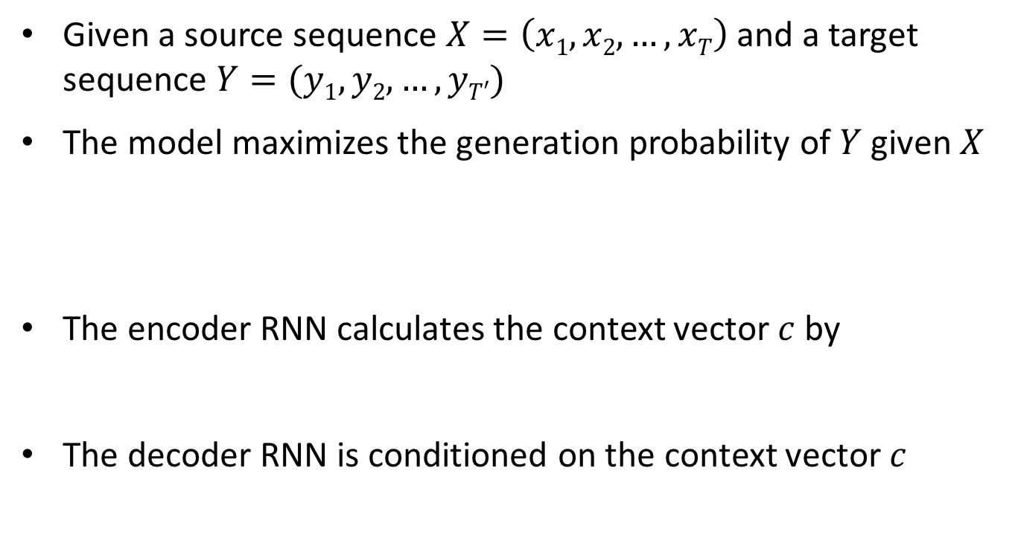
Background (Cont.)
Given a source sequence $X=\left(x1,x2,…,xT\right)$ and a target sequence $Y=(y1,y2, …,yT′)$
The model maximizes the generation probability of $Y$ given $X$
The encoder RNN calculates the context vector $c$ by
The decoder RNN is conditioned on the context vector $c$

Slide 5

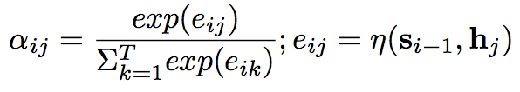

Background (Cont.)
Seq2Seq with Attention
different words in $Y$ could be semantically related to different part of $X$
each $yi$ in $Y$ corresponds to a context vector $ci$

Slide 6
Motivation
Chatbot
Not only natural and fluent but also informative and interesting
However, it tends to generate trivial responses due to high frequency of these patterns in data
”I like basketball.” → “Me too.”
”Do you think CLE can reverse the game?” → “Well…”
“Kevin Durant will be the MVP” → “I see.”
Safe but boring

Slide 7
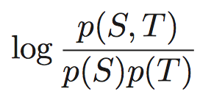
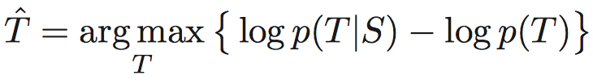
Related work
Seq2Seq-MMI
Use “Maximum Mutual Information” as objective function
Measure the mutual dependency between input and output
Passively avoid generating trivial responses by penalizing their generation probabilities

Slide 8
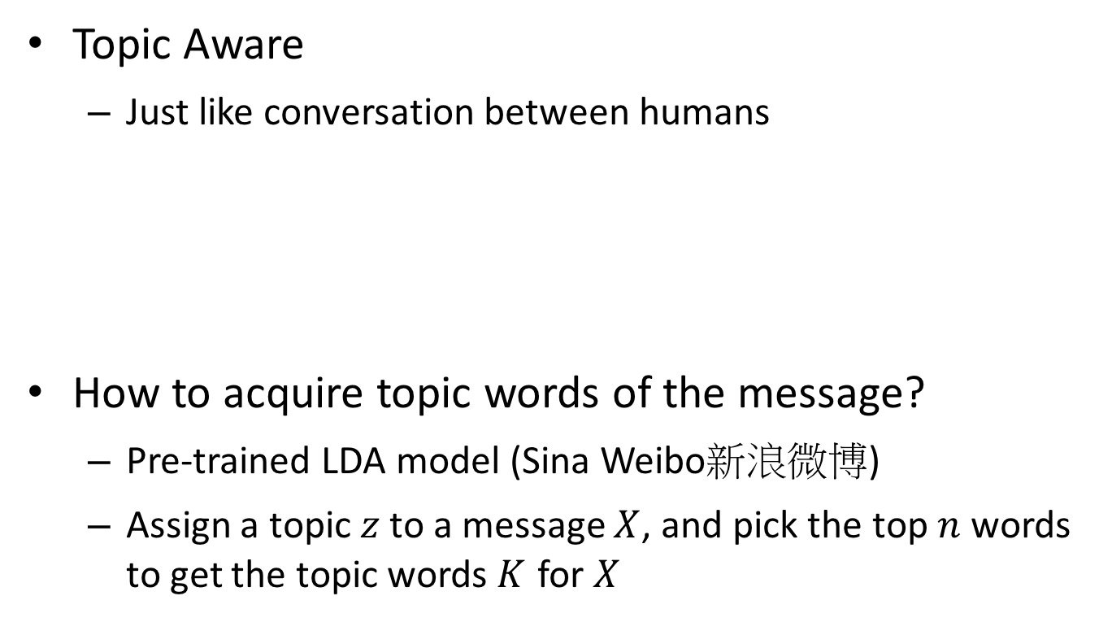
Main idea
Topic Aware
Just like conversation between humans
How to acquire topic words of the message?
Pre-trained LDA model (Sina Weibo新浪微博)
Assign a topic $z$ to a message $X$, and pick the top $n$ words to get the topic words $K$ for $X$
My skin is so dry
“skin”
Then hydrate and moisturize your skin

Slide 9

Main idea (Cont.)
How to learn with input $X$ and topic words $K$ ?
Joint Attention and Biased Generation Probability

Slide 10
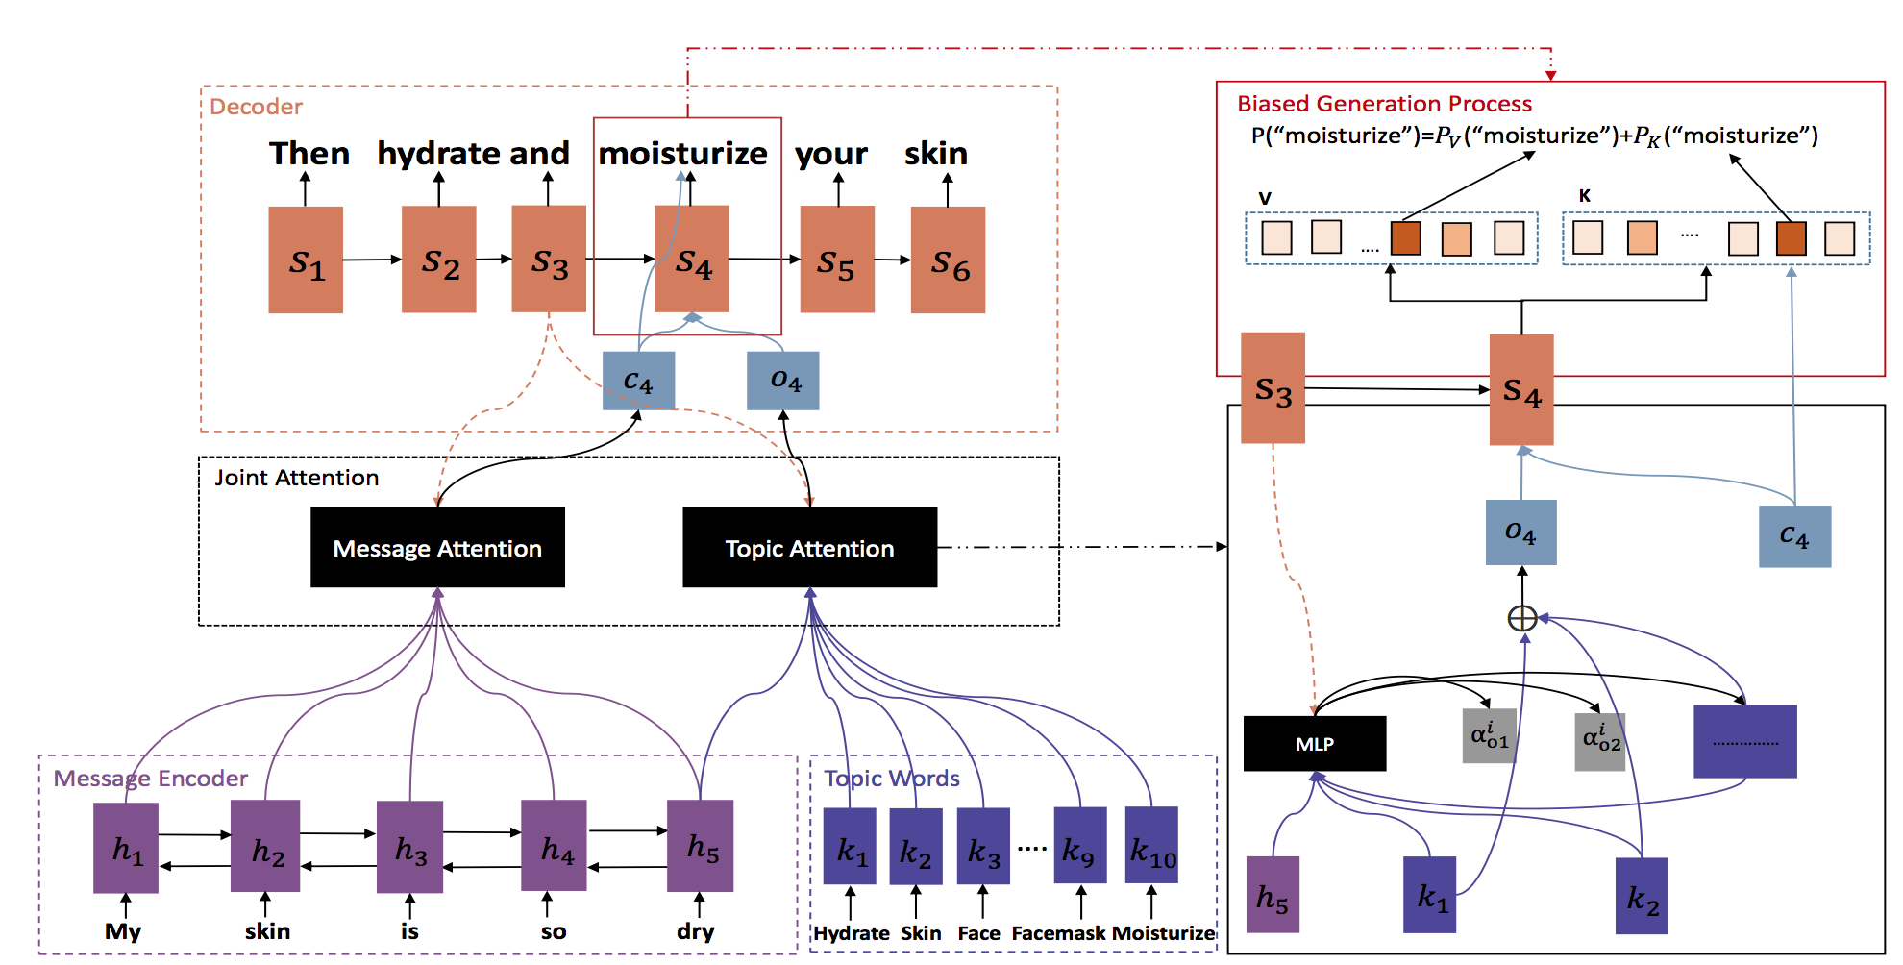
Main idea (Cont.)

Slide 11

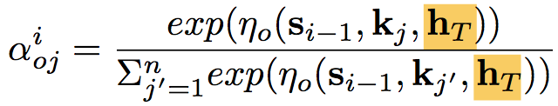

Main idea (Cont.)
We already know context vector $ci$by Message Attention
How about topic vector $oi$by Topic Attention?

Slide 12

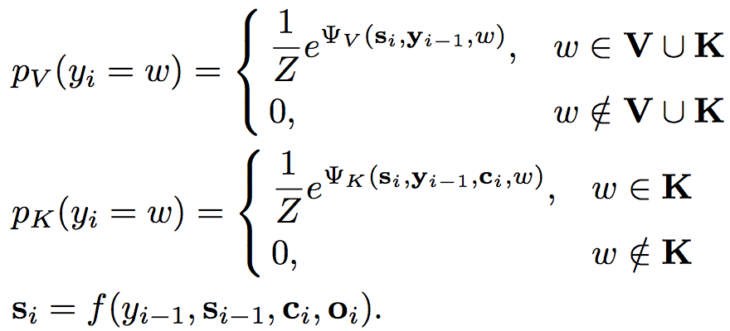
Main idea (Cont.)
Define generation probability

Slide 13
Evaluation
Dataset
Baidu Tieba (百度貼吧)
20 million post-common pairs
Remove pairs appearing more than 50 times to prevent them from dominating learning
5 million for training; 10 thousand for validation; 1000 for testing

Slide 14
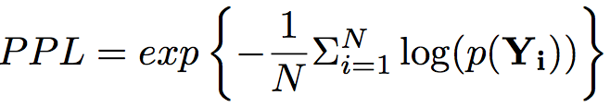
Evaluation (Cont.)
Perplexity
Distinct-1 & Distinct-2
Count the numbers of distinct unigrams and bigrams
Measure how informative and diverse
Human annotation
+2: not only relevant and natural but also informative and interesting
+1: can be used as a reply but too universal
0: cannot be used as a reply

Slide 15
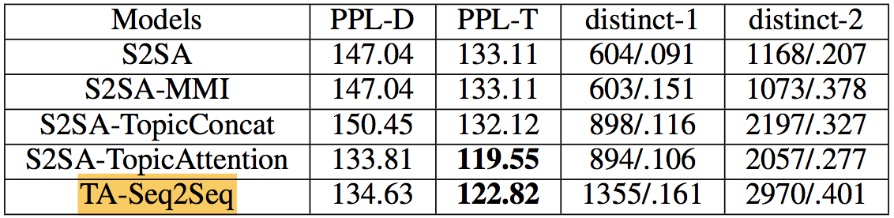

Evaluation (Cont.)
Results on automatic metrics
S2SA-TopicConcat: replace $oi$ by a simple topic vector obtained by concatenating embeddings of topic words
S2SA-TopicAttention: keep the topic attention but remove the bias probability

Slide 16
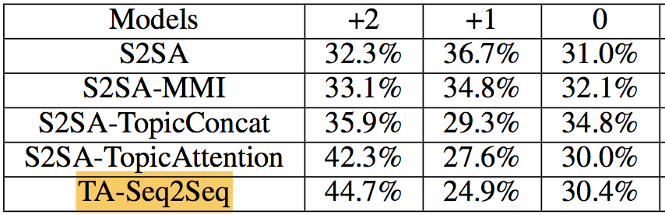
Evaluation (Cont.)
Human annotation results

Slide 17
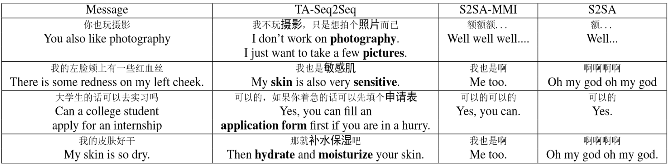
Evaluation (Cont.)
Case study

Slide 18
Conclusion
Pros
Leverage the topic information
Intuitive and useful
Cons
Hard to tell the quality of the response

