Slide 1
Snapshot Ensembles: Train 1, Get M for Free
ICLR‘17
CC: 8
Gao Huang, Yixuan Li, Geoff Pleiss
(Cornell University)

Slide 2
Motivation
Ensembles of neural networks
More robust and accurate than individual network
Training multiple networks is computationally expensive
High training cost
Uneconomical

Slide 3
How to ensemble at no additional training cost?

Slide 4
Outline
Related work
Main idea
Evaluation
Conclusion

Slide 5
Related work
Implicit Ensemble
Dropout (Srivastava et al., 2014)
DropConnect (Wan et al., 2013)
Stochastic Depth (Huang et al., 2016)
A
B
C
A
B
C
A
B
C
A
B
C

Slide 6
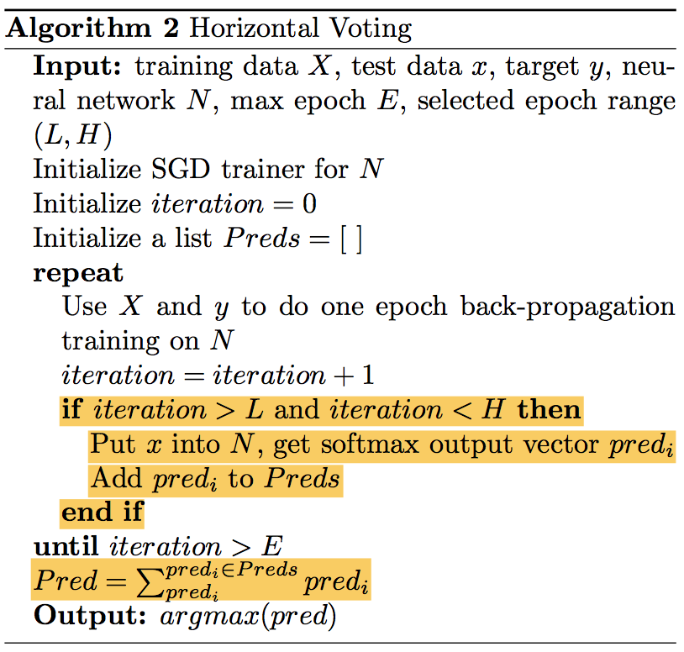
Related work (Cont.)
Explicit Ensemble
Horizontal Ensembling (Xie et al., 2013)

Slide 7
Challenge
Ensembles work best if the individual models
(1) have low test error
(2) do not overlap in the set of examples they misclassify

Slide 8
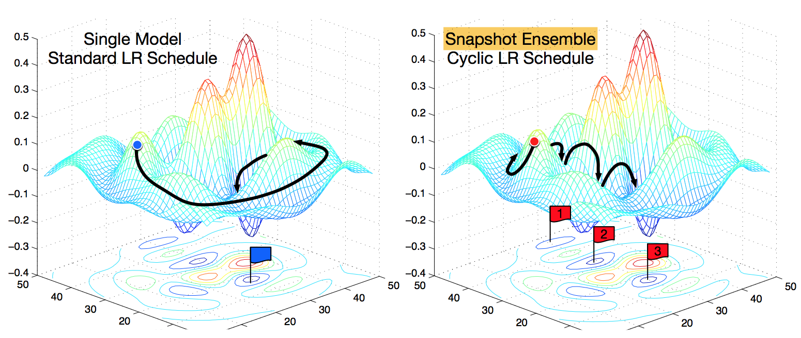
Main idea
Let SGD converge M times to local minima along its optimization path
Notes:
Argue that these local minima contain useful information that may improve model performance

Slide 9
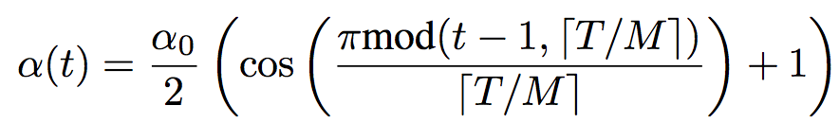
Main idea (Cont.)
How to converge M times?
Cyclic Learning Rate [1]
[1] Loshchilov & Hutter, “Stochastic gradient descent with restarts”, ICLR’17

Slide 10
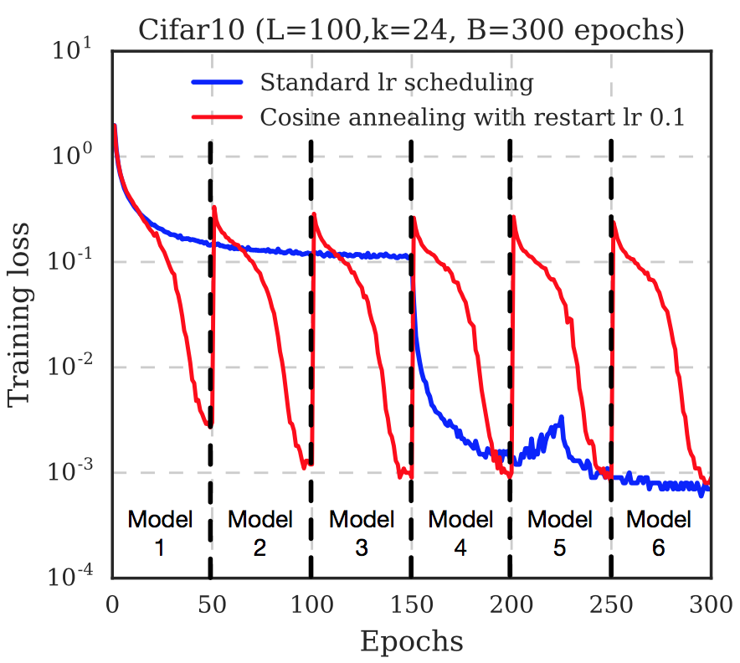
Main idea (Cont.)
Snapshot Ensembling (M=6)

Slide 11



Main idea (Cont.)
At test time
Let $x$ be a test sample, and let $hi(x)$ be the softmax score of snapshot $i$

Slide 12
Evaluation
Dataset
CIFAR-10, CIFAR-100
SVHN (Street View House Number)
Tiny ImageNet
ImageNet
Architecture
ResNet (He et al., 2016)
Wide ResNet (Zagoruyko & Komodakis, 2016)
DenseNet (Huang et al., 2016)

Slide 13
Evaluation (Cont.)
Baseline
Single Model
Dropout
NoCycle Snapshot Ensemble (similar to Horizontal Ensembles)
SingleCycle Snapshot Ensemble (re-initialize parameter at every cycle)

Slide 14
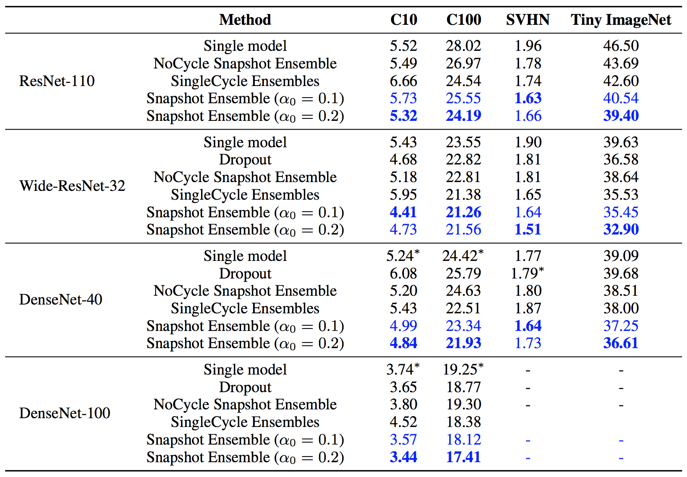
Evaluation (Cont.)

Slide 15
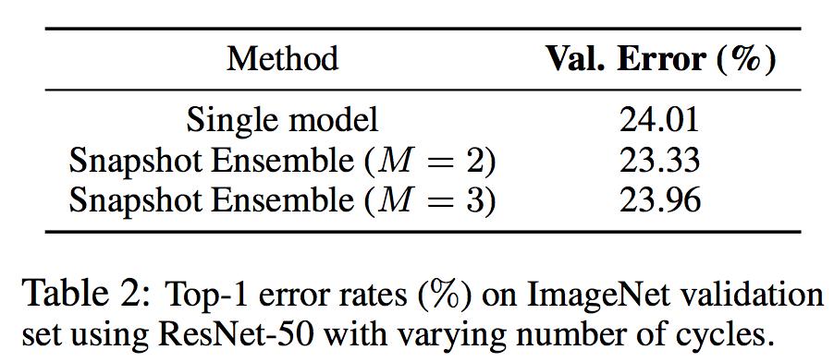
Evaluation (Cont.)

Slide 16
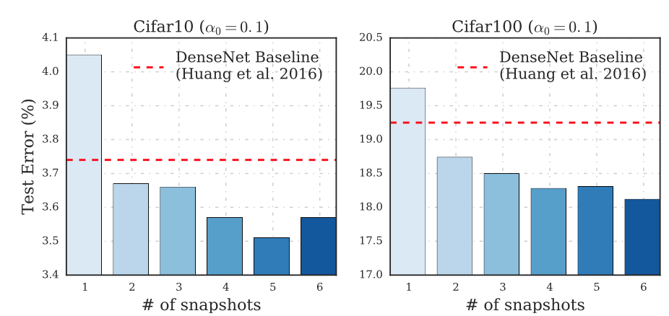
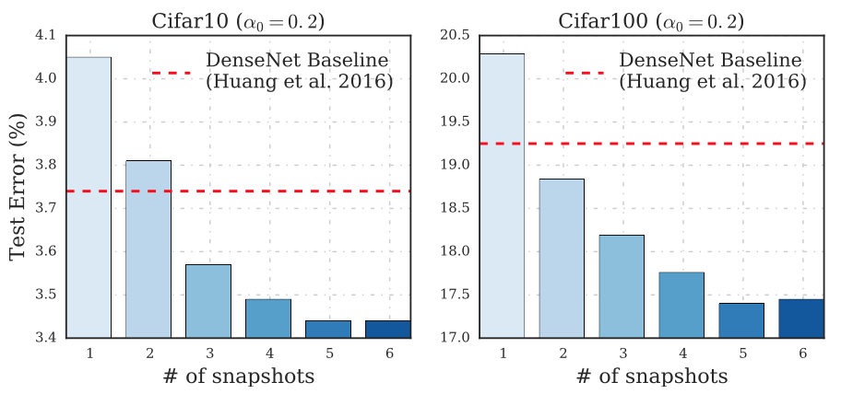
Evaluation (Cont.)

Slide 17
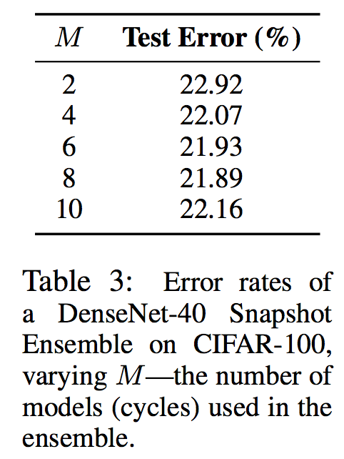
Evaluation (Cont.)

Slide 18
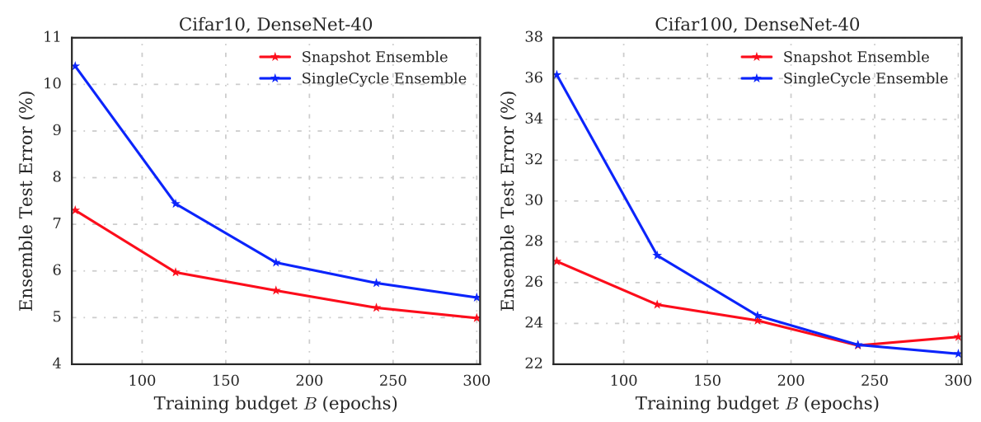
Evaluation (Cont.)
Snapshot Ensembles under different training budgets
(the number of cycles is fixed at M=6)

Slide 19
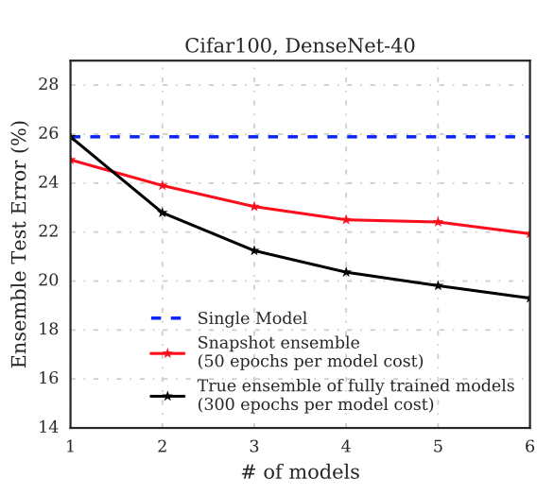
Evaluation (Cont.)
Comparison of Snapshot Ensembles with true ensembles

Slide 20
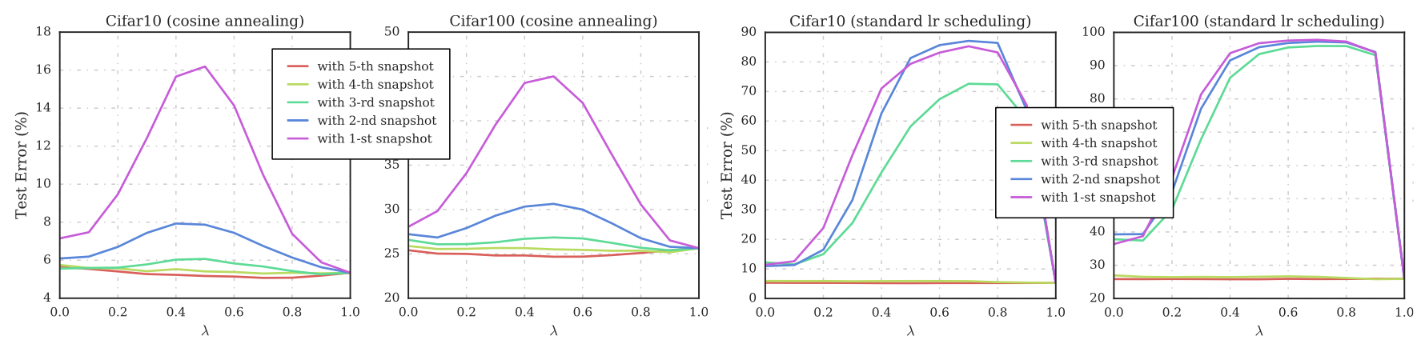

Evaluation (Cont.)
Parameter Space
Linear interpolate: $J(λ\left(θ1\right)+(1−λ)θ2)$
Notes:
The left two plots show Snapshot Ensemble models trained with a cyclic learning rate, while the right two plots show NoCycle Snapshot models.

Slide 21
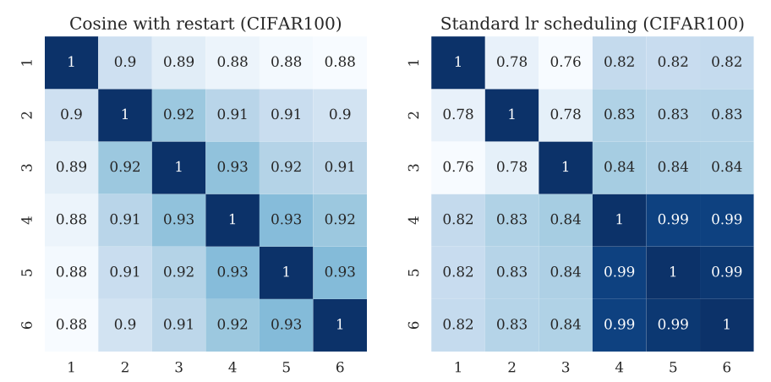
Evaluation (Cont.)
Activation Space
Pairwise correlation of softmax output

Slide 22
Conclusion
Pros
Simple, yet surprisingly effective
Cons
How about ensemble different architectures?

