Slide 1
Collaborative Metric Learning
Authors:
- Cheng-Kang Hsieh
- Longqi Yang
- Yanyan Lan
- Yin Cui
- Tsung-Yi Lin
- Serge Belongie
- Deborah Estrin
WWW 2017
Chun Chen Lin

Slide 2
Outline
Background
Problem Formulation
Related work
Challenge
Main idea
Evaluation
Conclusion

Slide 3
Background
Collaborative Filtering (CF)
Recommend items based on similarity between users and/or items.
E.g., The items recommended to a user are those preferred by similar users.
E.g., The items recommended to a user are those similar to items which he/she prefers.

Slide 4
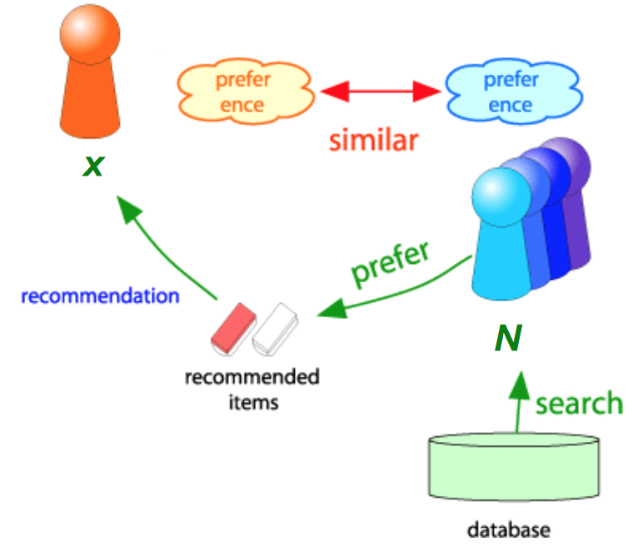
Background(Cont.)
Consider user x

Slide 5
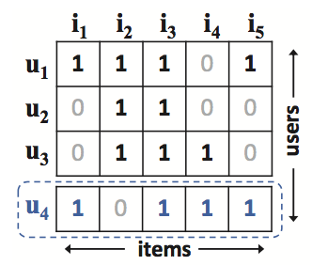
Background(Cont.)
Jaccard Similarity/ Cosine Similarity
Matrix Factorization (MF)
Most well-known and powerful CF technique, e.g., Netflix Prize
Use the dot product between user/item vectors to capture the known ratings,
And uses the dot product of those vectors to predict the unknown ratings.

Slide 6

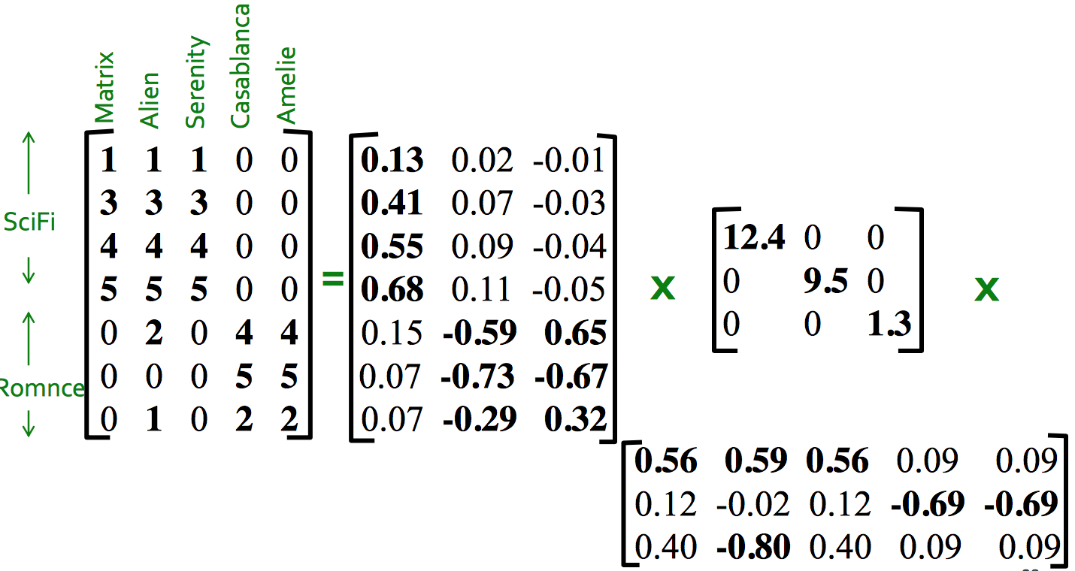
Background(Cont.)
R = U Σ V^{T}
Ref: http://web.stanford.edu/class/cs246/slides/dim-red.pdf

Slide 7
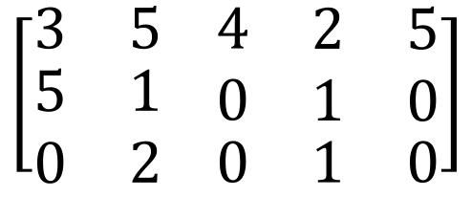
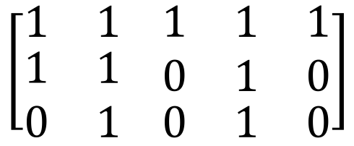
Background(Cont.)
Explicit Feedback
Rating score, more specific
E.g., 0-5 stars
Implicit Feedback
Click-through, like-or-not
More abundant and less biased
Issue: Capture user’s relative preferences

Slide 8
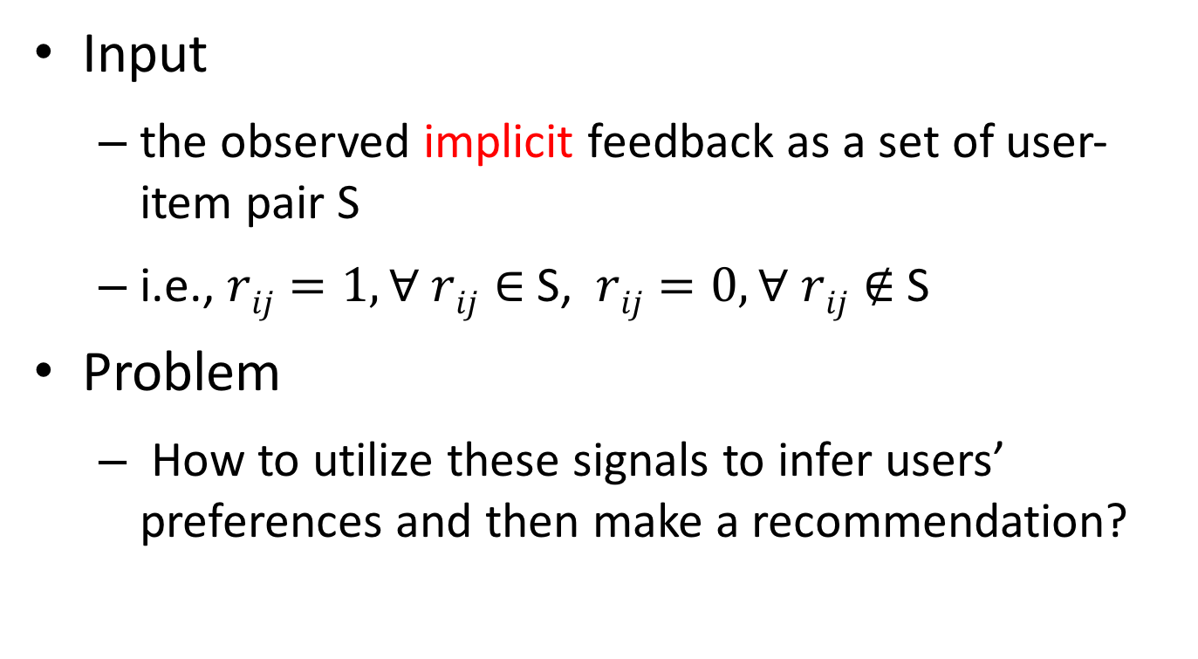
Problem Formulation
Input
the observed implicit feedback as a set of user-item pair S
i.e., $rij=1, ∀ rij∈$ S, $rij=0, ∀ rij∉$ S
Problem
How to utilize these signals to infer users’ preferences and then make a recommendation?

Slide 9


Related work
Matrix Factorization (MF)
Weighted Regularized Matrix Factorization (WRMF)
Bayesian Personalized Ranking (BPR)

Slide 10
Challenges
MF-based method
dot product doesn’t satisfy the crucial triangle inquality
d(y,z) ≤ d(x,y) + d(x,z) ?
E.g., (x,y), (x,z) → (y,z) ?
Cannot reliably capture the users/items relationship
Suboptimal !!!

Slide 11
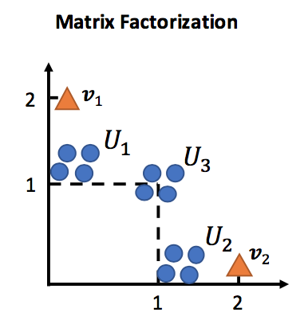
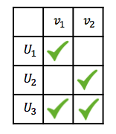

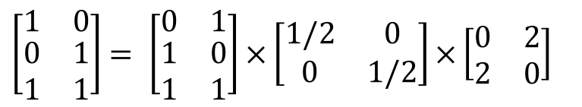
Challenges (Cont.)
$\left[\begin{matrix}1 & 0 \\ \begin{aligned}0 \\ 1\end{aligned} & \begin{aligned}1 \\ 1\end{aligned}\end{matrix}\right]$ $= \left[\begin{matrix}0 & 1 \\ \begin{aligned}1 \\ 1\end{aligned} & \begin{aligned}0 \\ 1\end{aligned}\end{matrix}\right]×\left[\begin{matrix}1/2 & 0 \\ 0 & 1/2\end{matrix}\right]×\left[\begin{matrix}0 & 2 \\ 2 & 0\end{matrix}\right]$

Slide 12
Main idea
Collaborative Metric Learning (CML)
Encodes the user-item relationships and user-user/item-item similarity in a joint space
Learn the metric that pulls the pair in S closer and pushs the others relatively further apart

Slide 13

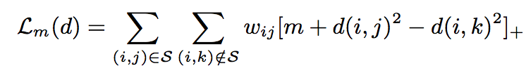

Main idea (Cont.)
Model Formulation
represent each item and each user with a user vector $ui ∈Rr$ and an item vector $vj$ $∈Rr$

Slide 14
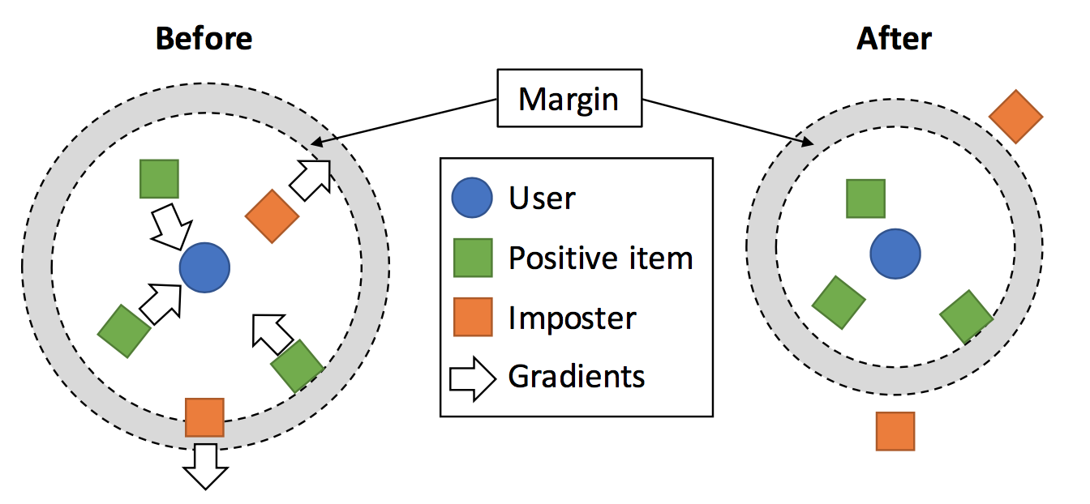
Main idea (Cont.)

Slide 15
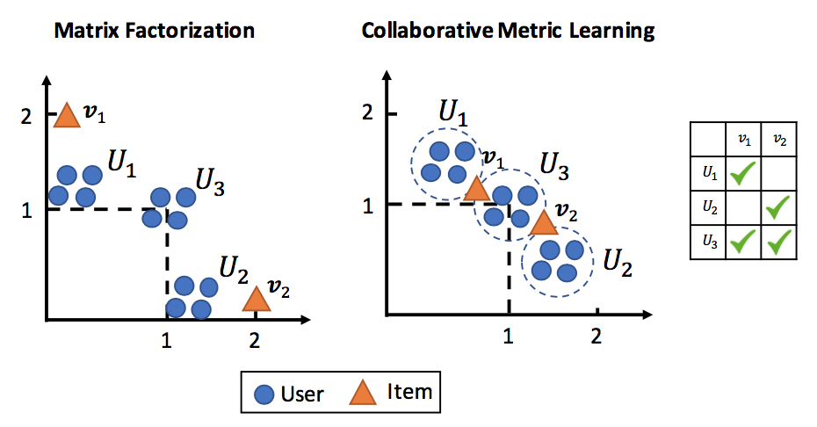
Main idea (Cont.)
Comparison between MF and CML

Slide 16

Main idea (Cont.)
Penalize items at a lower rank

Slide 17

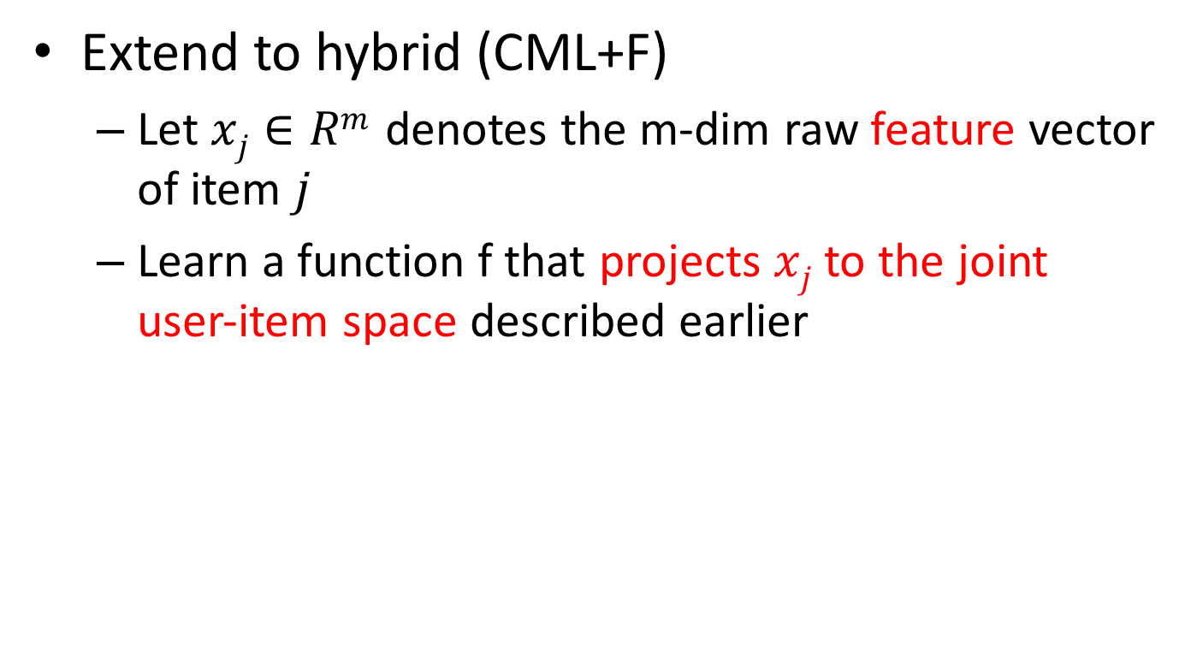
Main idea (Cont.)
Extend to hybrid (CML+F)
Let $xj∈Rm$ denotes the m-dim raw feature vector of item $j$
Learn a function f that projects $xj$ to the joint user-item space described earlier

Slide 18
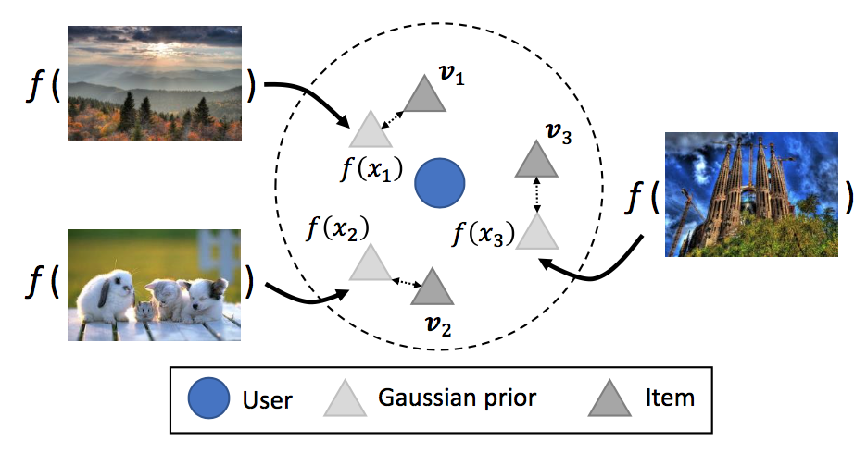
Main idea (Cont.)

Slide 19
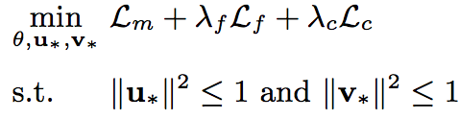
Main idea (Cont.)
The complete objective function

Slide 20
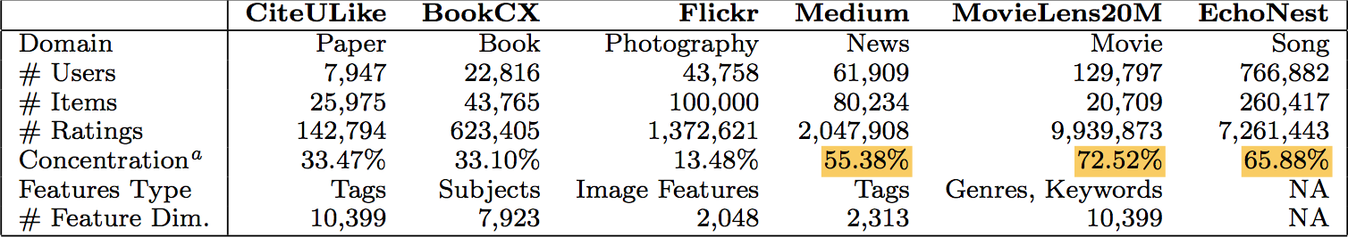
Evaluation
6 different domains

Slide 21
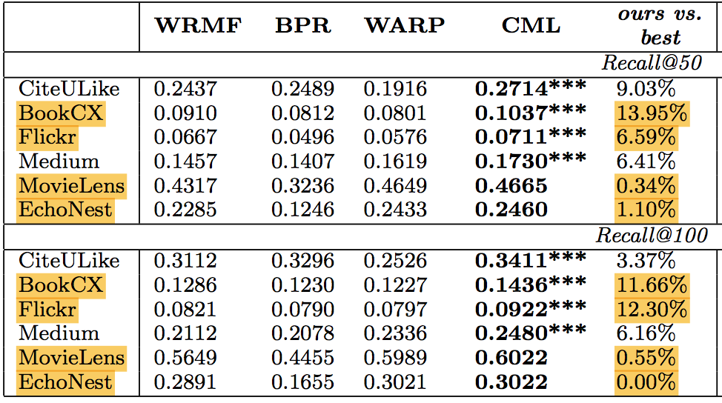
Evaluation (Cont.)
Recommendation Accuracy (w/o item features)

Slide 22
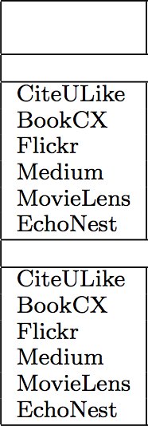
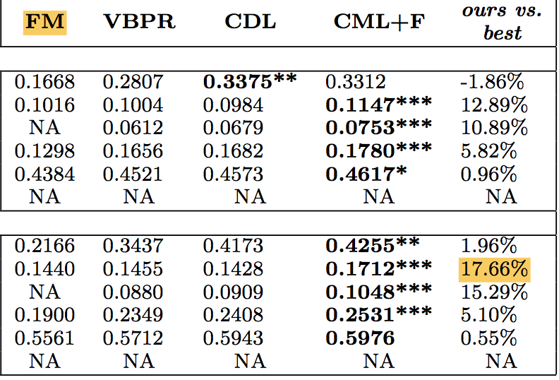
Evaluation (Cont.)
Recommendation Accuracy (w/ item features)

Slide 23
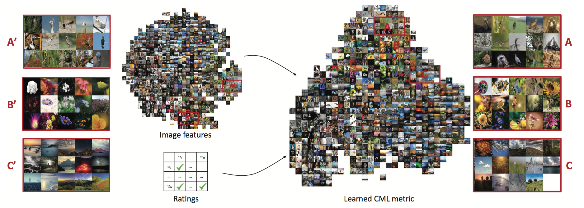
Evaluation (Cont.)
Metric Visualization
t-SNE embedding of the learned metric for Flickr

Slide 24
Conclusion
Apply metric-based algorithm to CF
Easy and intuitive but useful
Handle the MF’s crucial problem

