Slide 1
Introspection: Accelerating Neural Network by Learning Weight Evolution
ICLR’ 17
CC: 0
Abhishek Sinha, Aahitagni Mukherjee, Mausoom Sarkar, Balaji Krishnamurthy

Slide 2
Motivation
Training a deep neural network is a time-consuming process
That is, taking lots of time to converge

Slide 3
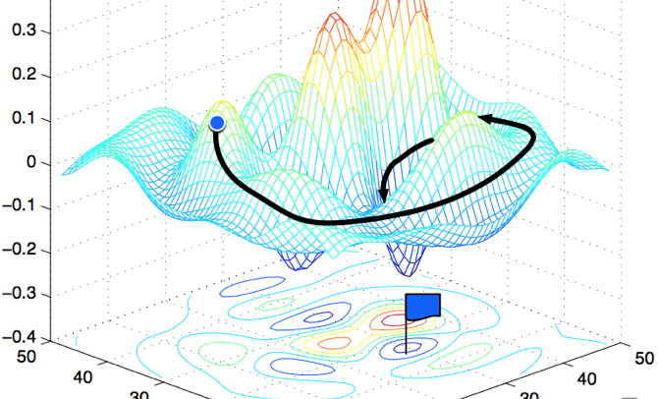
Related Works
Optimizer
－ Stochastic Gradient Descent
Reduce the convergence time by suitably altering the learning rate
－ Adagrad
－ Adadelta
－ RMSProp
－ Adam
Notes:
iteratively updates the parameters (weights) of a network based on a batch of training examples, to minimize an objective function

Slide 4
There is still a need for achieving faster convergence

Slide 5
Outline
Observation
Main idea
Evaluation
Conclusion

Slide 6
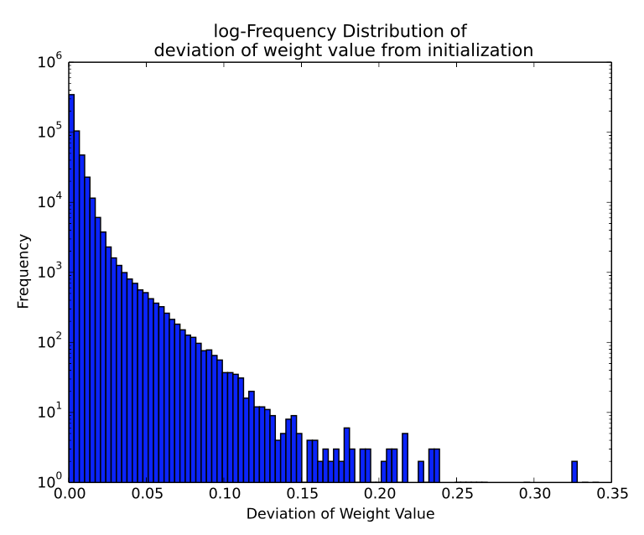
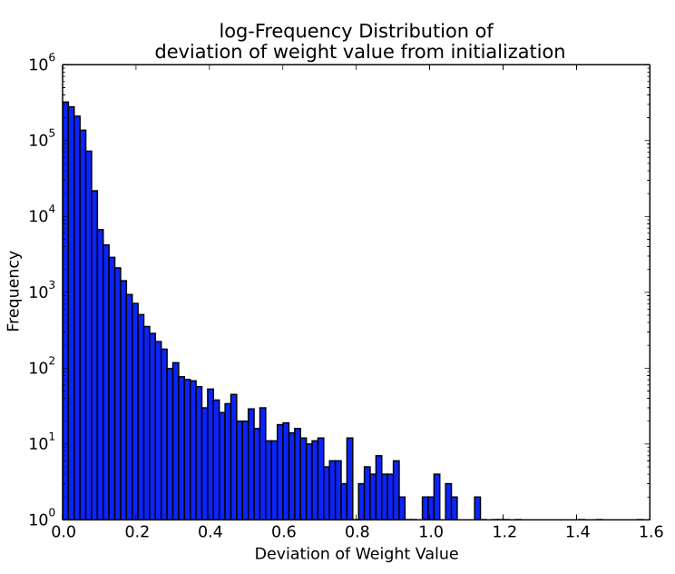
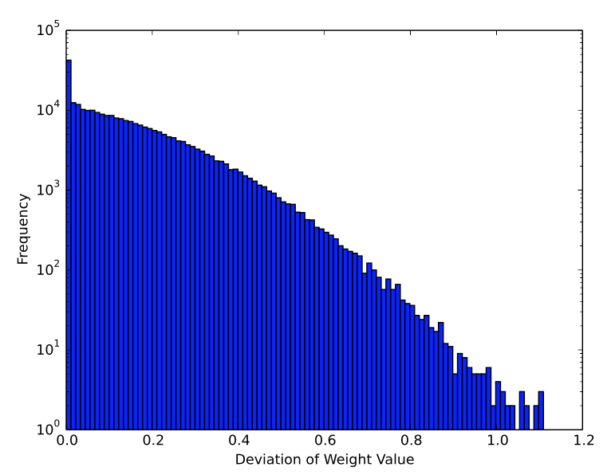
Observation
Pattern in Weight Evolution – Difference between final and initial values
Notes:
CNN(MNIST), FC(MNIST), CNN(CIFAR10)

Slide 7
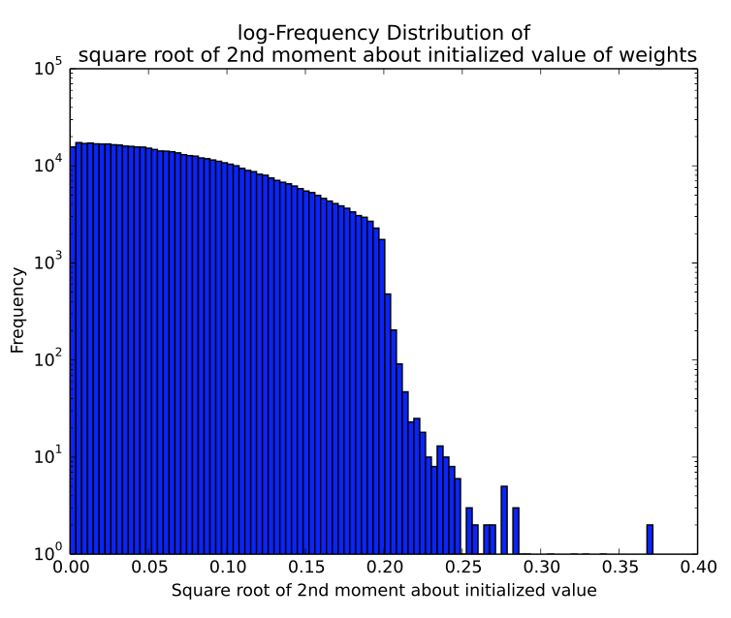
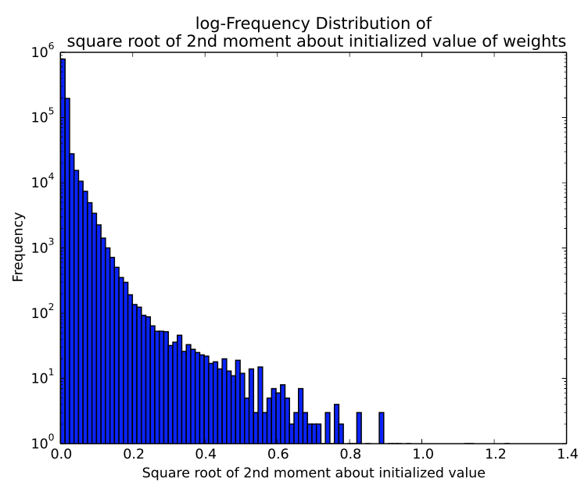
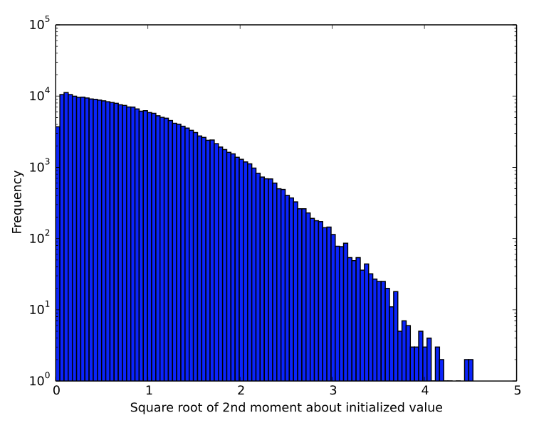
Observation (Cont.)
Pattern in Weight Evolution – Square Root of 2nd moment (oscillation)

Slide 8
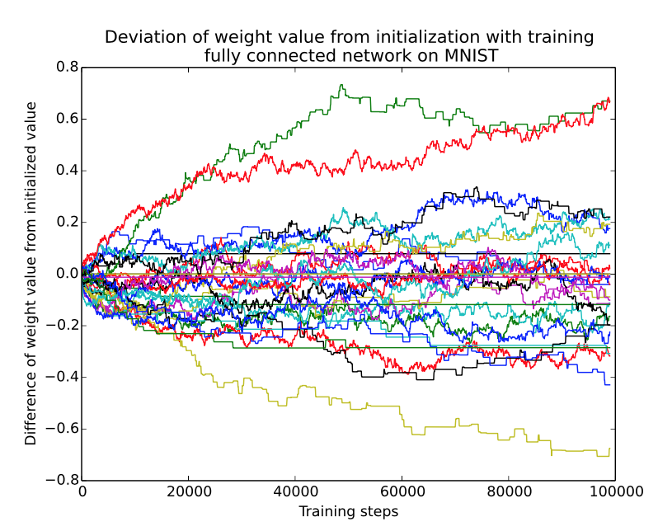
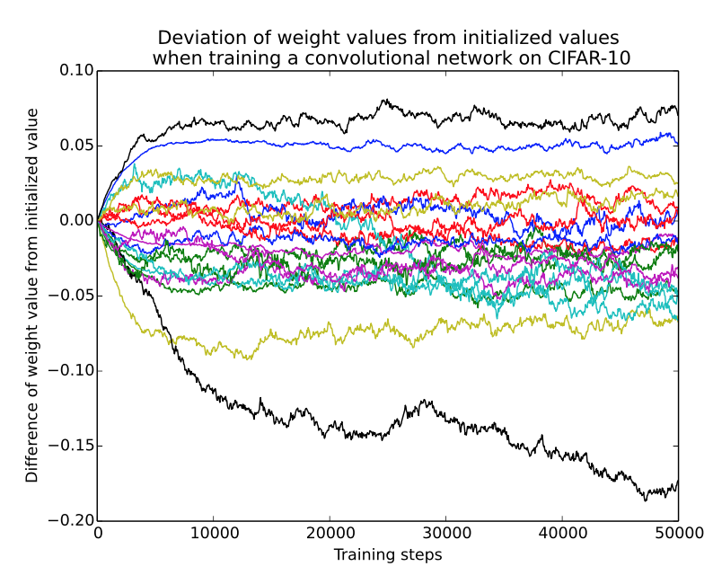
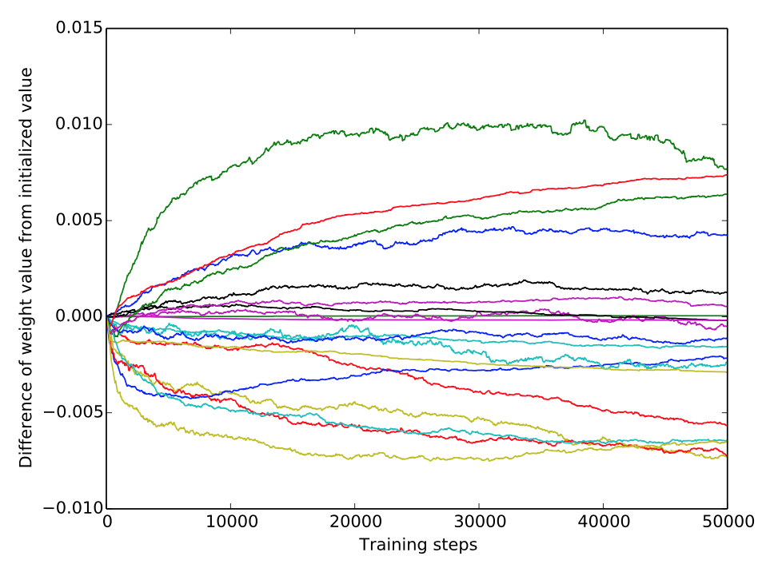
Observation (Cont.)
The evolution follows a general trend
Most of the weight values do not undergo significant change
The few that did change significantly would keep on increasing or decreasing in a predictable way
Notes:
predictable patterns

Slide 9
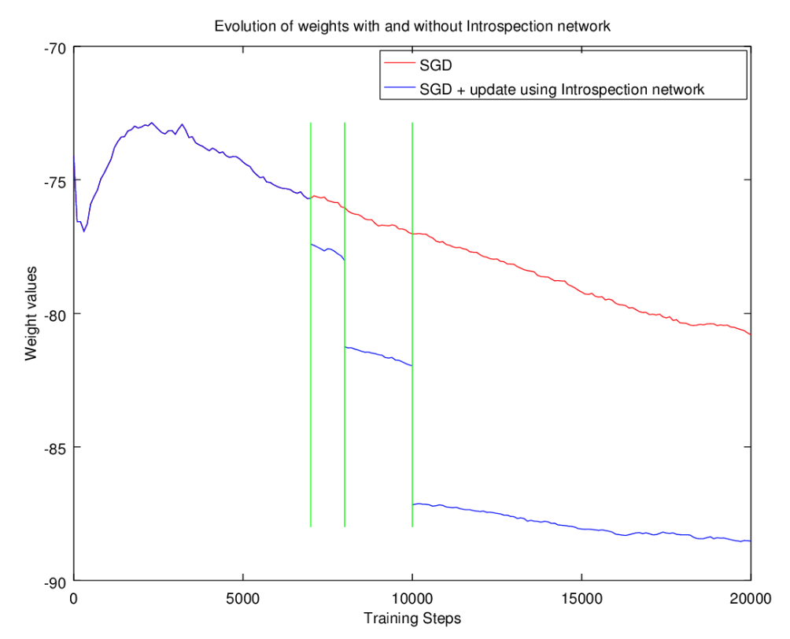
Main idea
Use the weight history to predict its future value

Slide 10
Main idea (Cont.)
Introspection Network
Predict the future values of each weight based on its values in the previous time steps
Smaller network (1-layered feedforward net)
Notes:
Inference time can be ignored

Slide 11
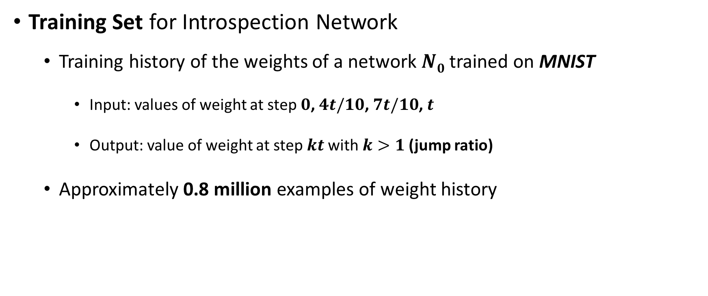
Evaluation
Training Set for Introspection Network
Training history of the weights of a network $N0$ trained on MNIST
Input: values of weight at step $0$, $4t/10$, $7t/10$, $t$
Output: value of weight at step $kt$ with$k>1$(jump ratio)
Approximately 0.8 million examples of weight history

Slide 12
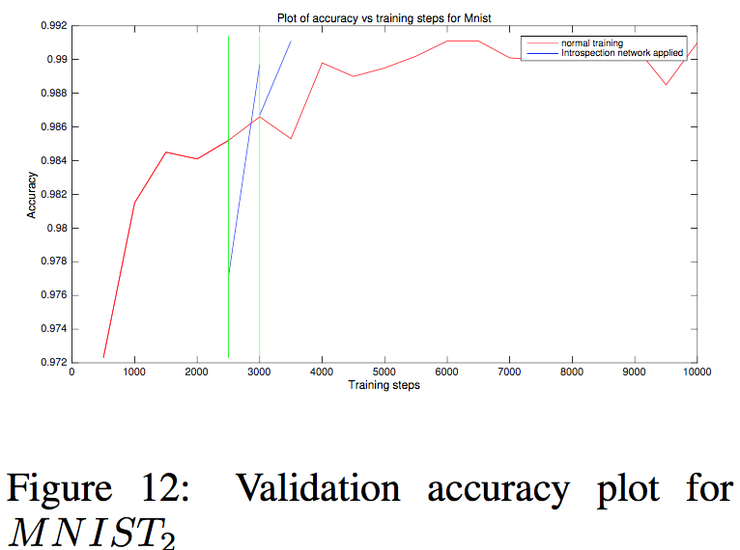
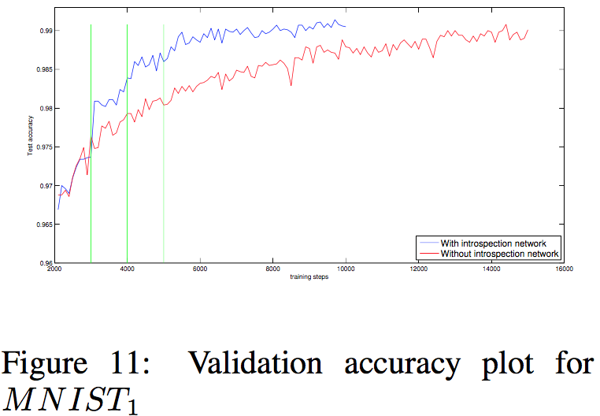
Evaluation (Cont.)
MNIST with four different architectures
Notes:
The initial drop in accuracy seen after a jump in MNIST2 figure 12 can be attributed to the fact that each weight scalar is predicted independently, and the interrelationship between the weight scalars in a layer or across different layers is not taken into consideration. This interrelationship is soon reestablished after few SGD steps. This phenomenon is noticed in the CIFAR and ImageNet cases too.

Slide 13
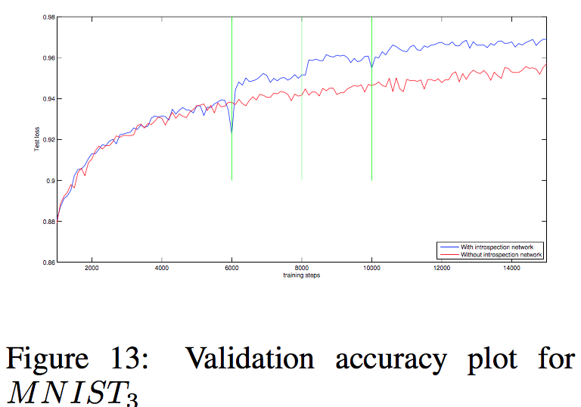
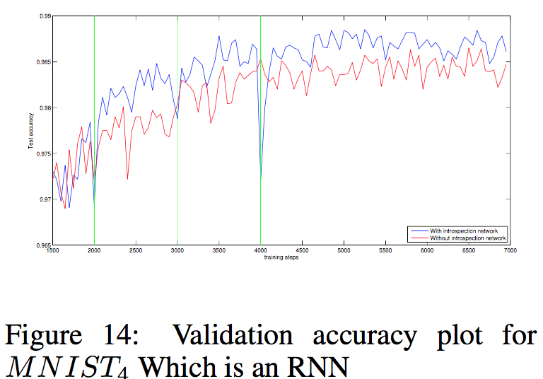
Evaluation (Cont.)
MNIST with four different architectures

Slide 14
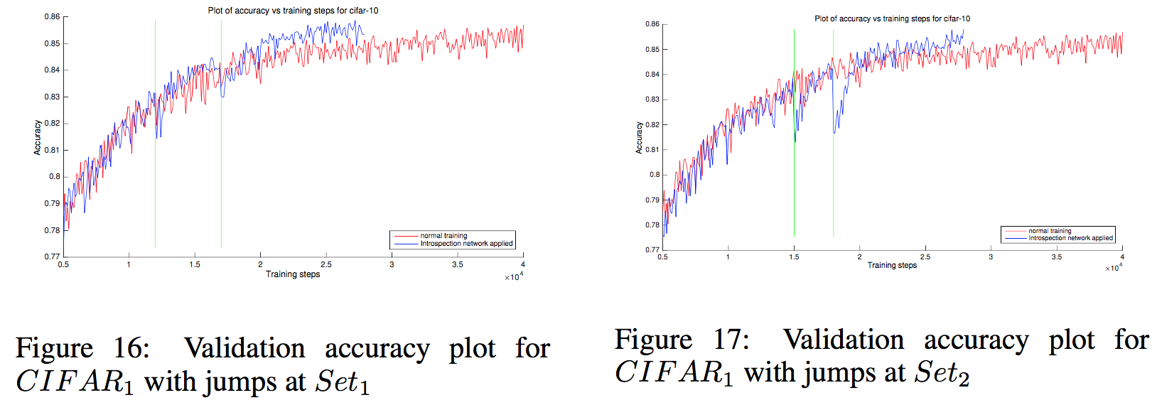
Evaluation (Cont.)
CIFAR-10
Notes:
CNN

Slide 15
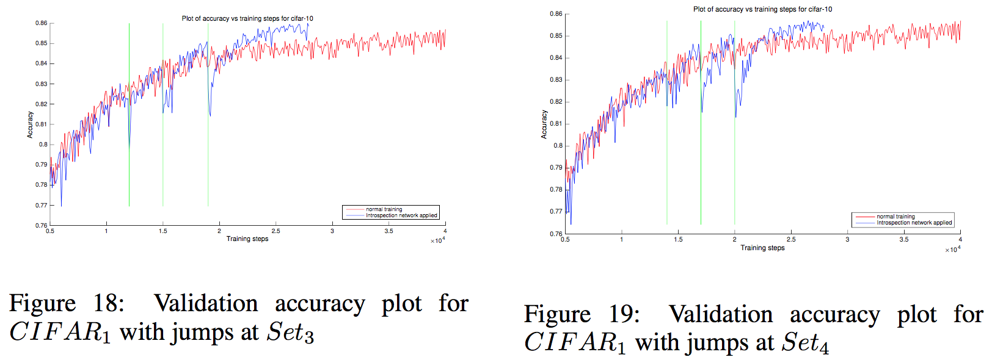
Evaluation (Cont.)
CIFAR-10
Notes:
1. the introspection network trained on MNIST weight evolutions is able to generalize to a different network and different dataset
2.

Slide 16
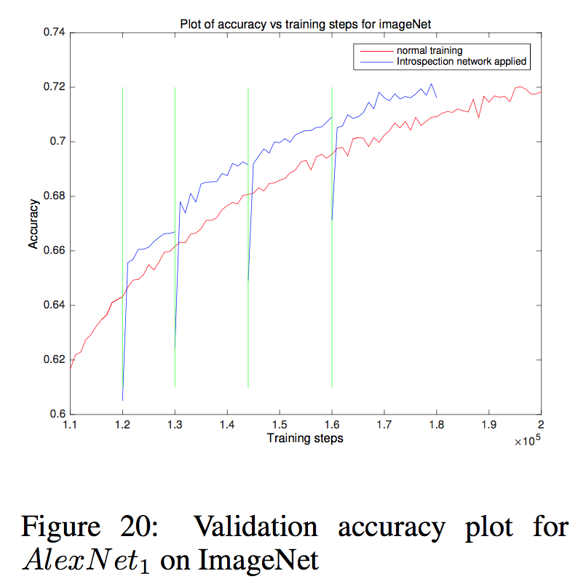
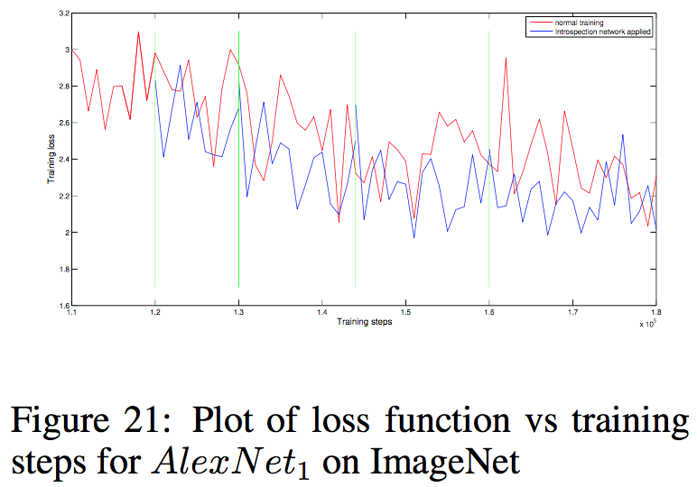
Evaluation (Cont.)
ImageNet
Notes:
AlexNet

Slide 17
There is a remarkable similarity in the weight evolution across datasets and network architectures
Notes:
General Trend

Slide 18
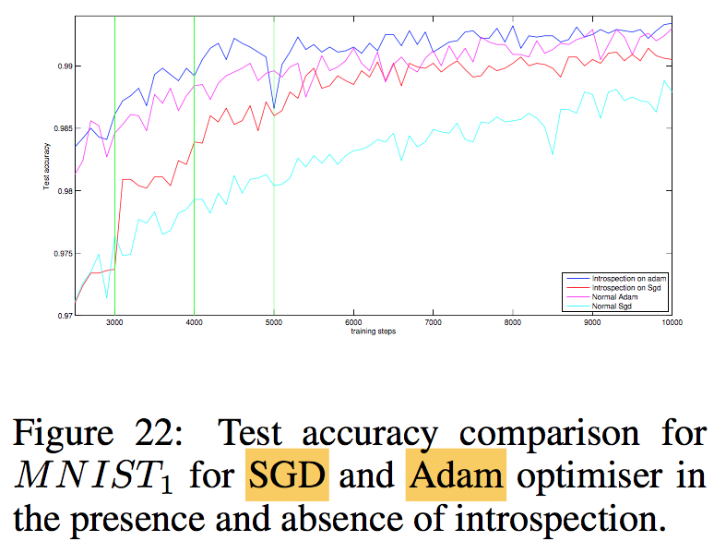
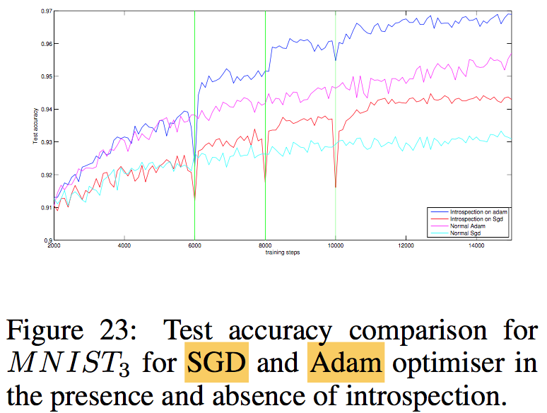
Evaluation (Cont.)
Compare with Adam optimizer
Notes:
successfully apply the introspection network on Adam optimizer and accelerate it.

Slide 19
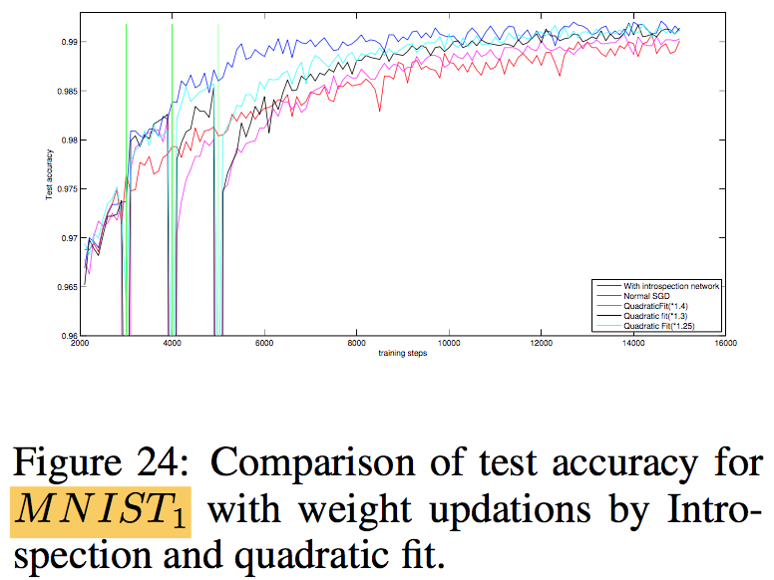
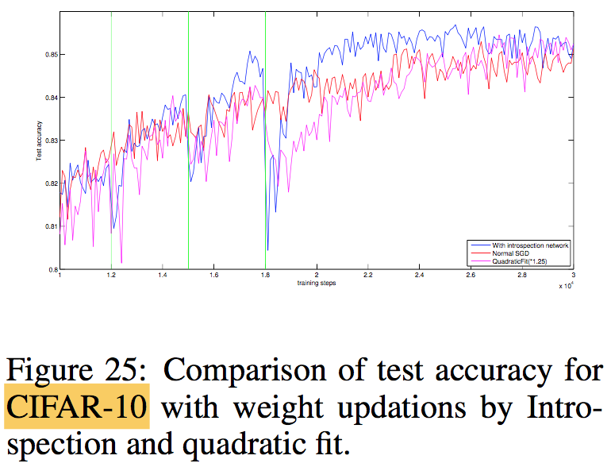
Evaluation (Cont.)
Compare with Quadratic Curve Fit
Notes:
1.25x, 1.3x, 1.4x For other higher jump ratios the updates would cause the model to diverge, and lower jump ratios did not show much improvement in performance.

Slide 20
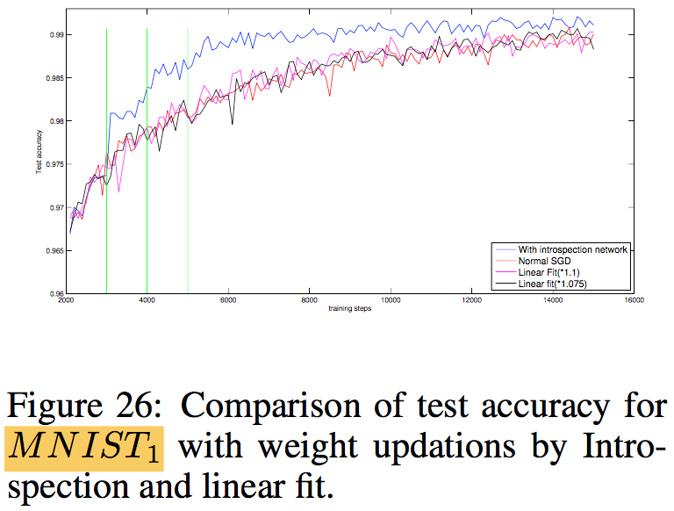
Evaluation (Cont.)
Compare with Linear Curve Fit
Notes:
1.1x, 1.075x

Slide 21
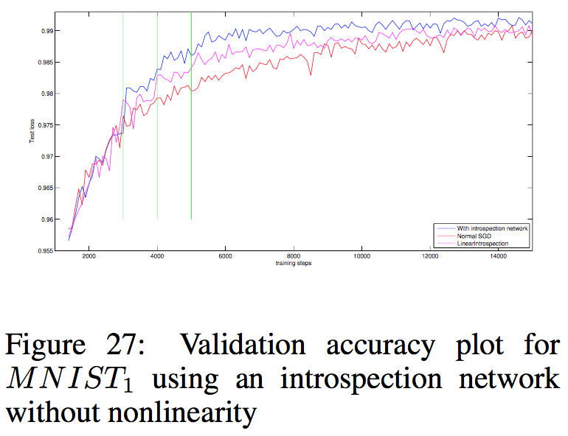
Evaluation (Cont.)
Compare with Linear Introspection Network
Remove ReLU nonlinearity

Slide 22
Conclusion
Pros:
Apply meta learner
Efficient
Cons:
Determination of optimal jump points?
Generalization capacity in non-image tasks?

