Slide 1
Your Cart tells you: Inferring Demographic Attributes from Purchase Data
Authors:
- Pengfei Wang
- Jiafeng Guo
- Yanyan Lan
- Jun Xu
- Xueqi Cheng
WSDM 2016
Peter Lin

Slide 2
Outline
Motivation
Problem Formulation
Related work
Challenge
Main idea
Evaluation
Conclusion

Slide 3
Motivation
Automatically infer users’ demographic attributes based on their purchase data.
Obtaining users’ demographic attributes is crucial for retailers to conduct market basket analysis, adjust marketing strategy, and provide personalized recommendations.

Slide 4
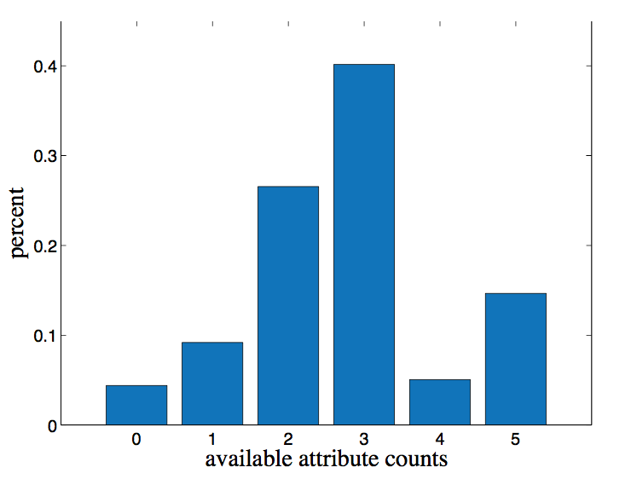
Motivation (Cont.)

Slide 5


Problem Formulation
Given a set of users with partial demographic attributes, how to predict the unknown attributes? (referred to as Partial-Label prediction)
Given a set of users with partially/fully labeled attributes, how to predict the demographic attributes for new users? (referred to as New-User prediction)

Slide 6
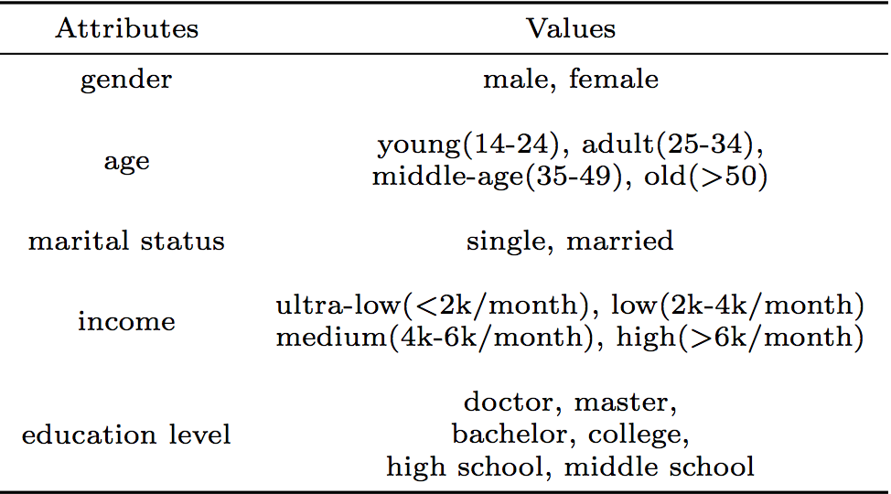
Problem Formulation (Cont.)
Demographic prediction can be formalized as a multi-task multi-class problem.

Slide 7
Related work
Demographic Prediction
Linguistics writing and speaking
Content of reviews
Users’ browsing history
Profiles
Mobile data
Information on followers of each website on Twitter
Models training on the independent social datasets
Notes:
They demonstrated that by leveraging social and search data in a common representation, they can achieve better accuracy in demographic prediction.
seldom practice has been conducted on demographic prediction based on purchase behaviors in retail scenario.

Slide 8
Related work (Cont.)
Multi-task Prediction
Learn tasks in parallel while using a shared representation
Multi-task learning with various kernels and regularizers to address the correlation between tasks
Multi-class Prediction
One-against-one
One-against-all
Notes:
The idea of learning multiple tasks together is to improve the generalization performance by leveraging the information contained in the related tasks. A typical way for this purpose is to learn tasks in parallel while using a shared representation.

Slide 9
Challenges
Human defined features may suffer from under specification since it is difficult to identify those hidden complicated factors for prediction tasks.
There might be correlations among different tasks that can be leveraged to improve the prediction accuracy.
Notes:
Some recent work employs unsupervised feature learning methods, like Singular Vector Decomposition (SVD), to automatically extract low-dimension features from the raw data.
For example, users’ marital statuses are more likely to be single if they are young, and a better educated person may have more chance to have higher income. However, most previous work treated different attributes as separate prediction tasks, thus ignored the correlations among these attributes.

Slide 10
Main idea (1)
Automatically learn representations of users for demographic prediction in a supervised way.
Turning the multi-task multi-class prediction into a single structured prediction task.

Slide 11
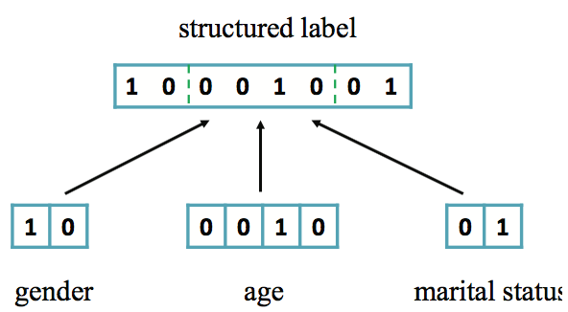
Main idea (2)
Encode each task’s label by a one-hot representation, and concatenate these labels to generate a single structured label.
Notes:
the correlation among tasks can now be explicitly encoded in this label vector.
e.g. young and single is much more popular than that referring to young and married.

Slide 12
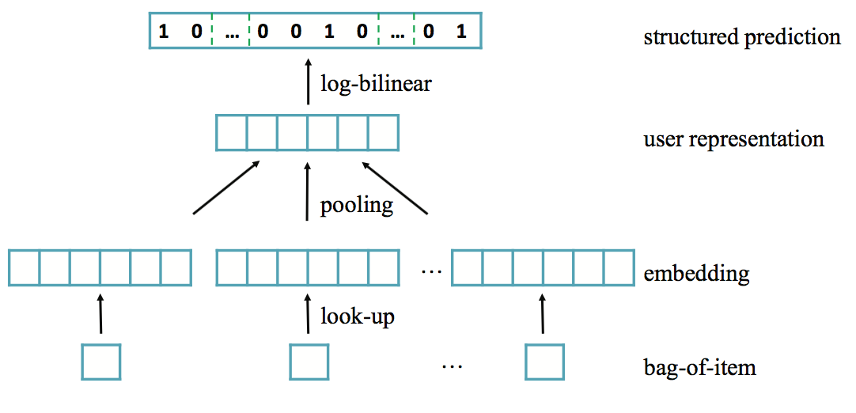
Main idea (3)
Structured Neural Embedding Model
Notes:
take the bag-of-item representation as the user input, and map each item to a vector in a continuous space. We then aggregate all the item vectors using some operator to form the user representation, and feed this representation to a log-bilinear model for the structured prediction.

Slide 13


Main idea (4)
Terms
$xi$ → a set of purchased items of $i$ ^{th} user
D d → user representation

Slide 14
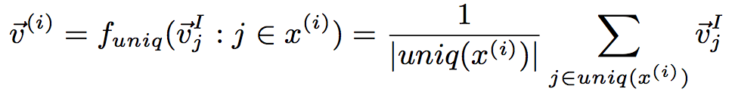
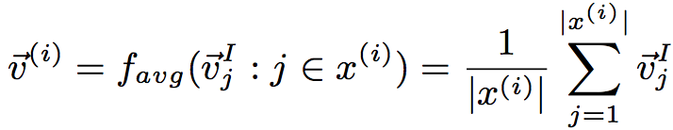
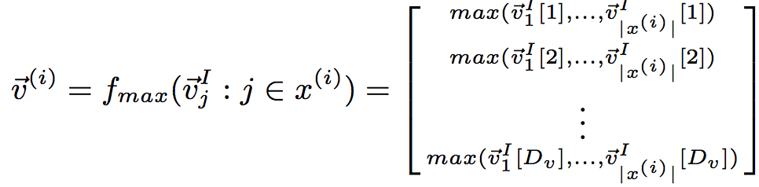
Main idea (5)
Pooling
Unique
Average
Max

Slide 15
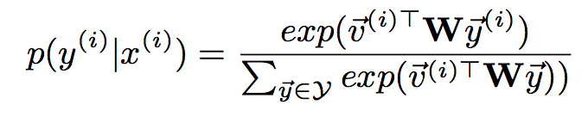



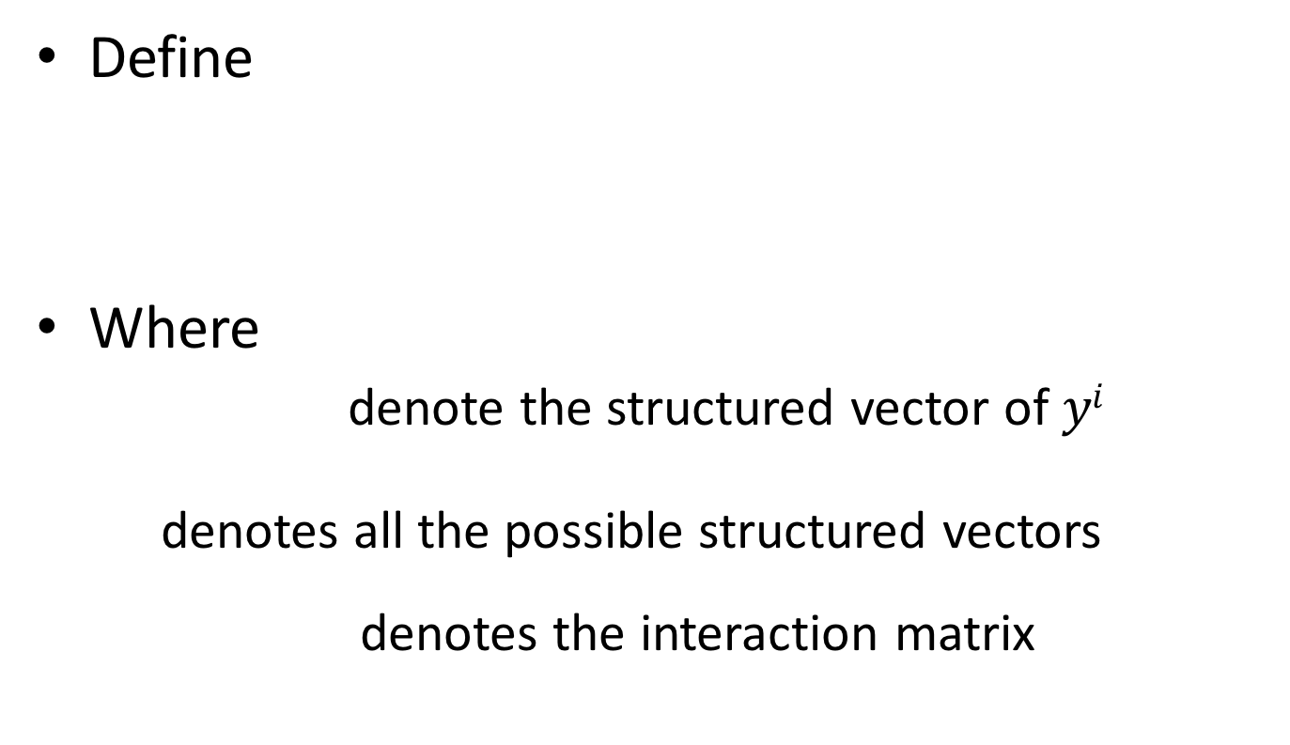
Main idea (6)
Define
Where
denote the structured vector of $yi$
denotes all the possible structured vectors
denotes the interaction matrix
Notes:
log-bilinear model (LBL) is perhaps the simplest neural language model.
Y denotes all the possible structured vectors of different combinations of attributes.
The total size of Y is C1*C2*…*Ck

Slide 16
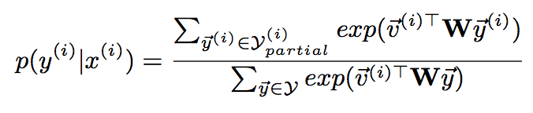
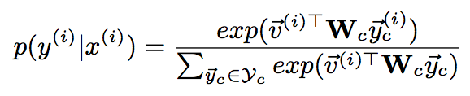

Main idea (7)
When $yi$ only contains partial attributes
Notes:
the subscript c denotes a compact version.
A compact structured vector c is a concatenation of
one-hot representations of known attributes in y(i), while a compact interaction matrix Wc is formed by removing the columns corresponding to the missing attributes from the original W

Slide 17
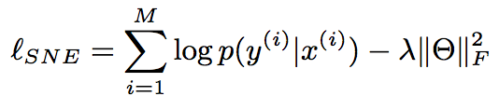
Main idea (8)
Objective function (log-likelihood)
Then apply Stochastic Gradient Descent to maximize the new objective function
Notes:
The objective function of SNE

Slide 18
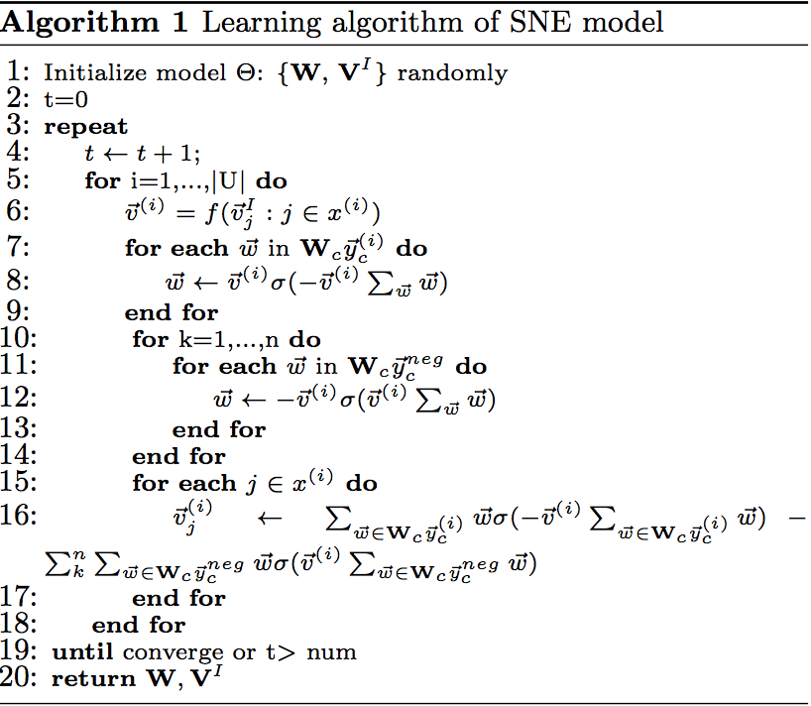
Main idea (9)

Slide 19
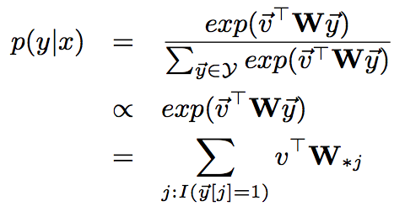

Main idea (10)
How to predict?
Where
denotes the j-th column of W
Notes:
the probability of an attribute set is proportional to the sum of scores.
the best attribute set is then a combination of assignments with the highest score from each task given the input.
In this way, for each user input, we only need to conduct a forward computation to generate the scores for each attribute entry, and select the highest one for each task as the final prediction. For Partial- Label problem, we simply select for those missing attributes while leaving the known attributes fixed.

Slide 20
Evaluation
Dataset
BeiRen dataset, a large retailer in China
Evaluation Metrics
Hamming Loss
Weighted F1
wPrecision
wRecall
wF1

Slide 21
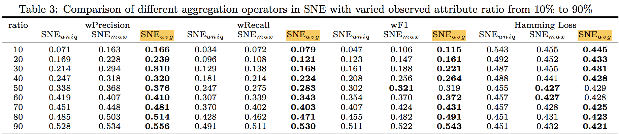
Evaluation (Cont.)
Any idea?
Notes:
The results indicate that the frequency information of items is important for demographic prediction.
This is reasonable since someone who frequently buys wine and cigarette is more likely to be an adult man than someone happens to buy these items.

Slide 22
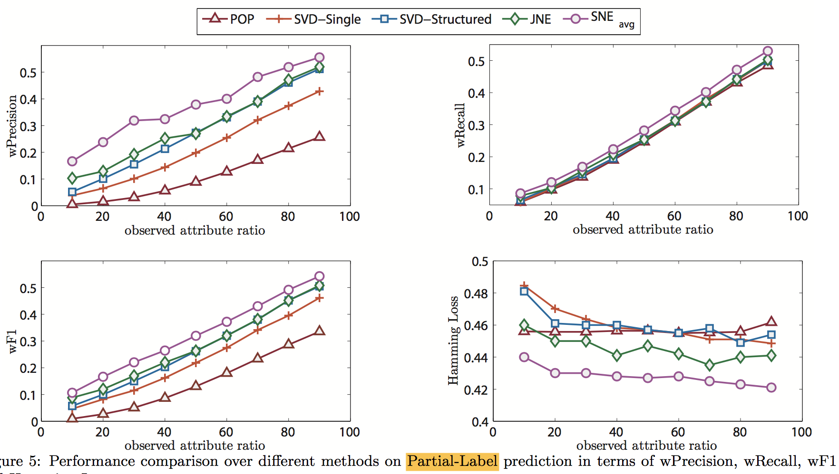
Evaluation (Cont.)
Notes:
POP: Popular combination of demographic attributes. Heuristic baseline ignores users’ purchase history, and only relies on the correlations among demographic attributes for prediction.
SVD-single: obtain low dimensional representations of users, predict each demographic attribute separately.
SVD-Structured: a structured learning model (i.e., log-bilinear model)
JNE: The joint neural embedding, each attribute is modeled as a separate prediction task, thus the correlation between attributes (like seeing one attribute makes it more likely to see another simultaneously) is ignored.

Slide 23
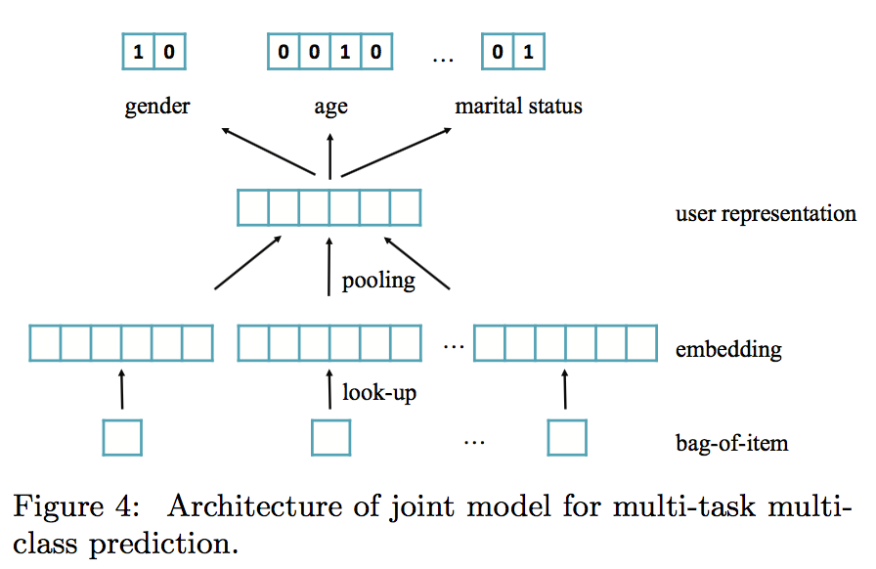
Evaluation (Cont.)
JNE

Slide 24
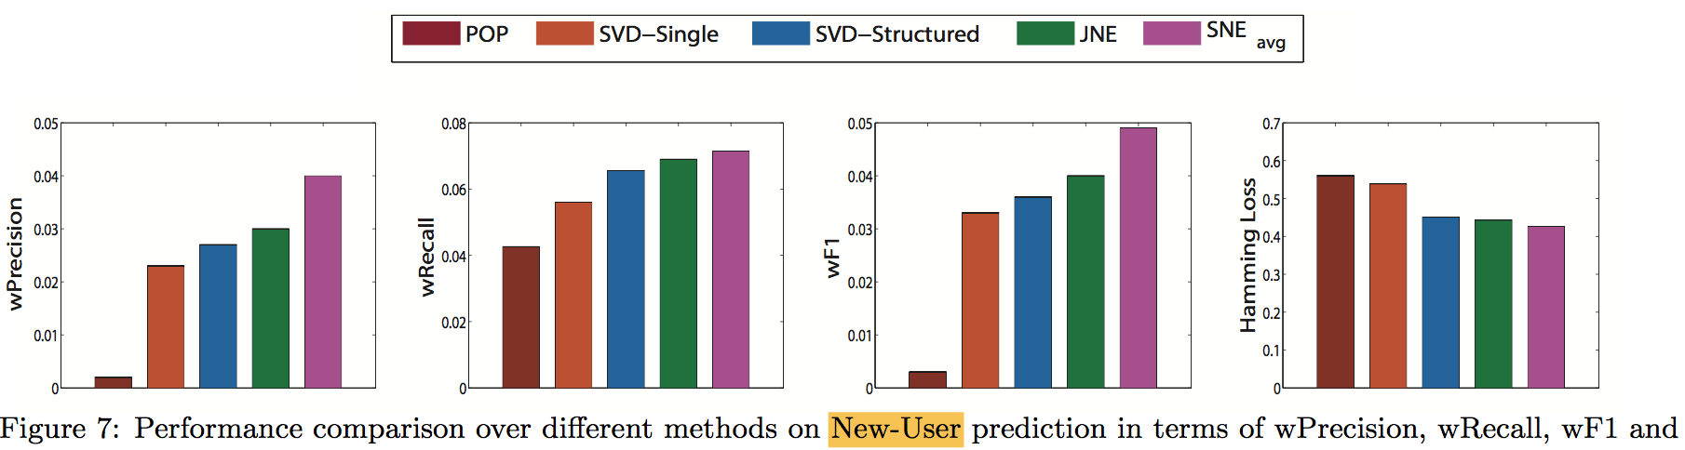
Evaluation (Cont.)

Slide 25
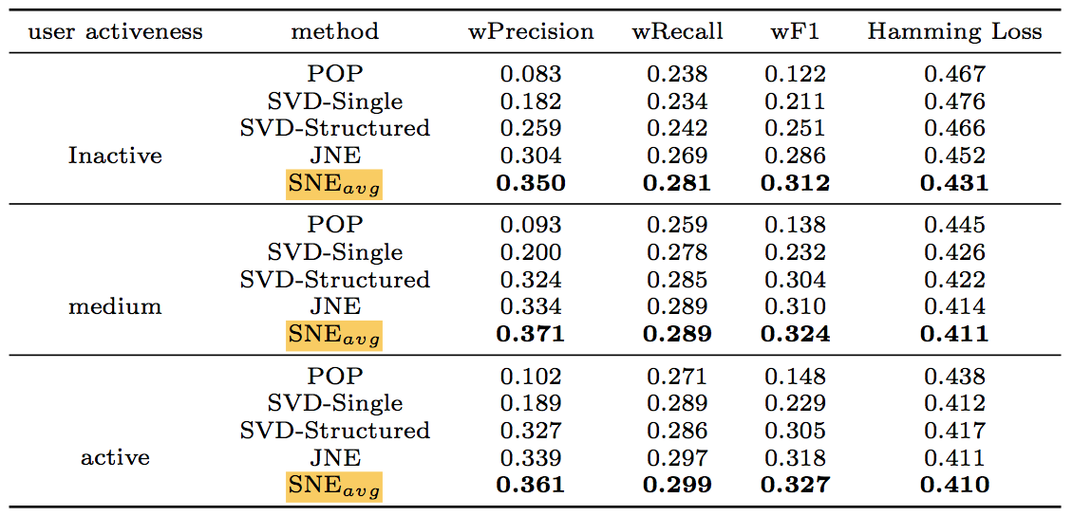
Evaluation (Cont.)
Notes:
In other words, the performance gain of SNE is larger on inactive users than medium and active users. The results indicate that structured prediction can work better by leveraging the correlation between tasks to compensate the limited input information, as compared with joint prediction.

Slide 26
Conclusion
First attempt to investigate users’ purchase data for demographic prediction.
Propose a novel SNE model for the multi-task multi-class prediction problem.
Conduct experiments on a real-world retail dataset.
Notes:
which can not only learn the data representations automatically but also capture the relations between different attributes in a structured way.

