Slide 1
Dual Learning for Machine Translation
NIPS’16
CC: 12
Di He et al. (Microsoft Research Asia)

Slide 2
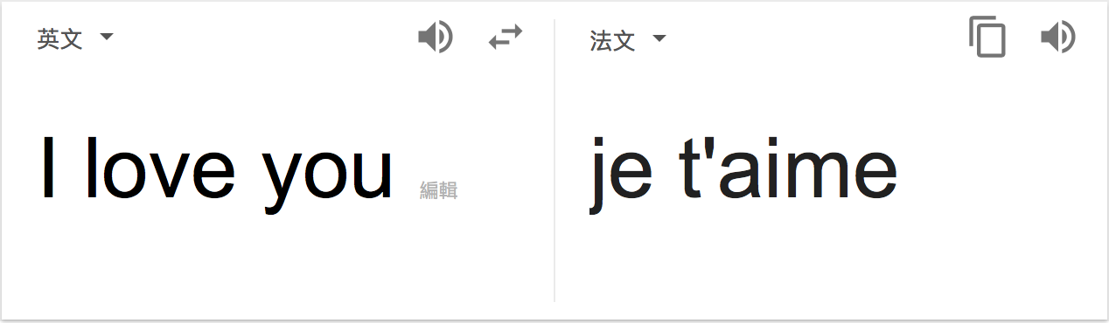
Background
Machine Translation
E.g., English-to-French, and vice versa

Slide 3
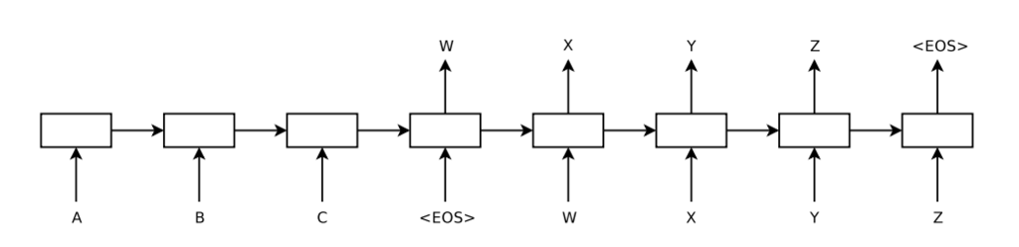
Background (Cont.)
Neural Machine Translation (NMT)
Encoder
Decoder

Slide 4



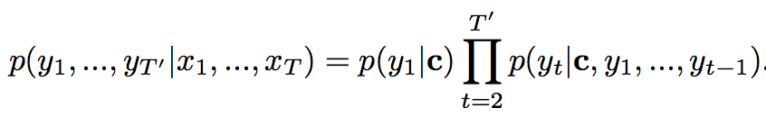
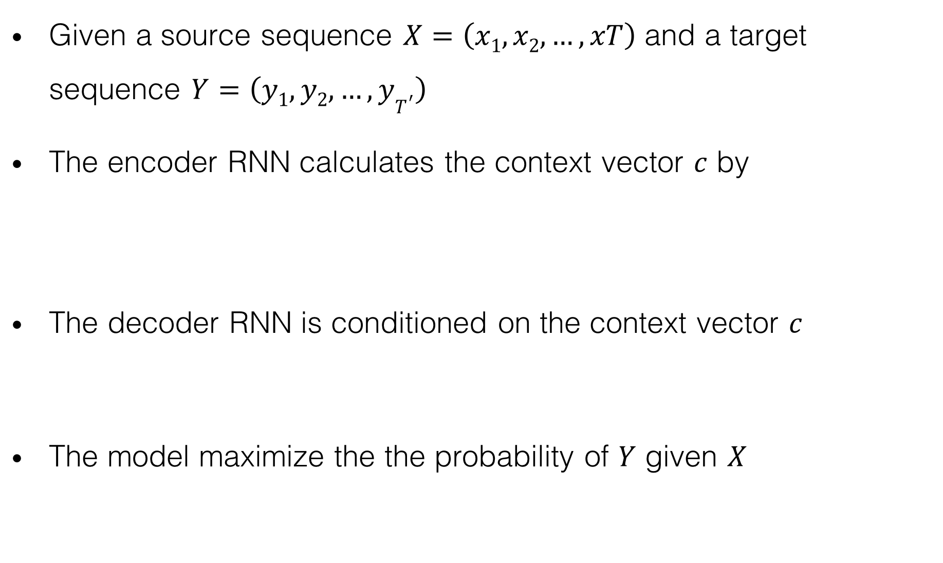
Background (Cont.)
Given a source sequence $X=\left(x1,x2,…,xT\right)$ and a target sequence $Y=\left(y1,y2, …,yT^{′}\right)$
The encoder RNN calculates the context vector $c$ by
The decoder RNN is conditioned on the context vector $c$
The model maximize the the probability of $Y$ given $X$
or

Slide 5
Background (Cont.)

Slide 6
Motivation
Recent success of NMT has been due to the availability of large amounts of high quality, sentence aligned corpora.
Tons of bilingual sentence pairs are needed for training
Human labeling is very costly
But we have unlimited monolingual data everywhere

Slide 7
How to tackle this training bottleneck?
Or somehow utilize the monolingual data?

Slide 8
Outline
Related Work
Main Idea
Evaluation
Discussion
Conclusion

Slide 9
Related Works
Train a language model of the target language, and then integrate it with the NMT model [1][2]
-> Does Not address the shortage of bilingual data
Generate pseudo bilingual data from monolingual data [3][4]
-> No guarantee on the quality of the pseudo bilingual data
[1] T. Brants et al., “Large language models in machine translation”, EMNLP 2007
[2] C. Gucehre et al., “On using monolingual corpora in neural machine translation”, arxiv 2015
[3] R. Sennrich et al., ”Improving machine translation models with monolingual data” ACL 2016
[4] N. Ueffing et al., “Semi-supervised model adaption for statistical machine translation”, MT Journal 2008

Slide 10


Main idea
Dual Learning (Dual Game)

Slide 11

Main idea
Dual Learning (Dual Game)
$DA :$corpus of language A
$DB :$corpus of language B (not necessarily aligned with $DA$)
D_{A}
D_{B}

Slide 12

Main idea
Dual Learning (Dual Game)
$LMA\left(.\right) :$learned language model of A
$LMB\left(.\right) :$learned language model of B
D_{A}
D_{B}
LM_{A}(.)
LM_{B}(.)

Slide 13
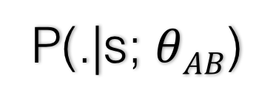
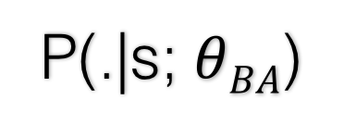

Main idea
Dual Learning (Dual Game)
$P(.|s;θAB)$: translation model from A to B
$P(.|s;θBA)$: translation model from B to A
D_{A}
D_{B}
LM_{A}(.)
LM_{B}(.)
P(.|s; $θAB$)
P(.|s; $θBA$)

Slide 14



Main idea
Dual Learning (Dual Game)
$$S$$
$$Smid$$

Slide 15
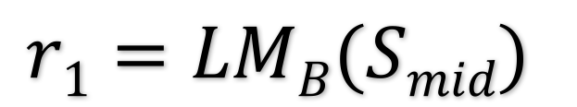
Main idea
Dual Learning (Dual Game)
The man checks the message from the woman whether it is natural in language B (Note that he may not be able to verify the correctness of the translation)
$$S$$
$$Smid$$
$$r1=LMB(Smid)$$

Slide 16

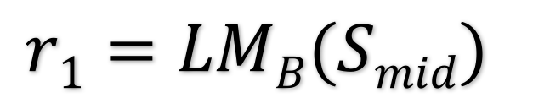
Main idea
Dual Learning (Dual Game)
$$S$$
$$Smid$$
$$r1=LMB(Smid)$$

Slide 17
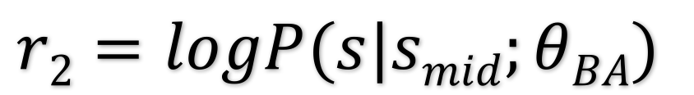
Main idea
Dual Learning (Dual Game)
The woman checks if the message she received is consistent with her original language
$$S$$
$$Smid$$
$$r2=logP(s|smid;θBA)$$
$$r1=LMB(Smid)$$

Slide 18
Through the feedback, both can know whether their models perform well and can improve them accordingly.

Slide 19
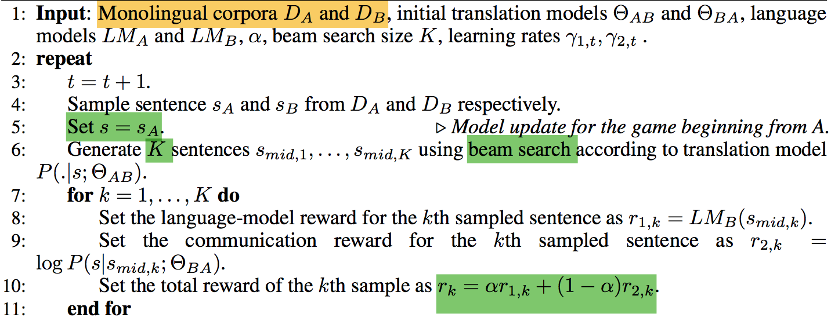
Main idea (Cont.)

Slide 20
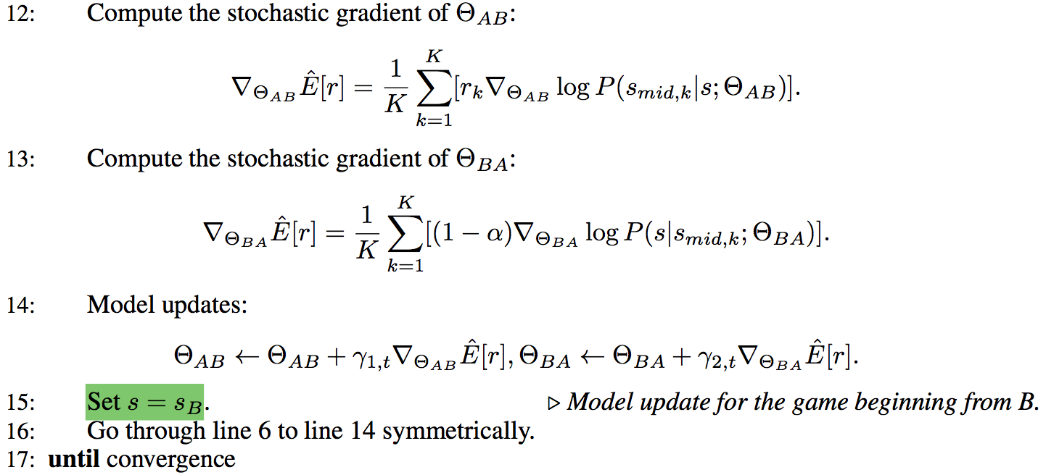
Main idea (Cont.)

Slide 21
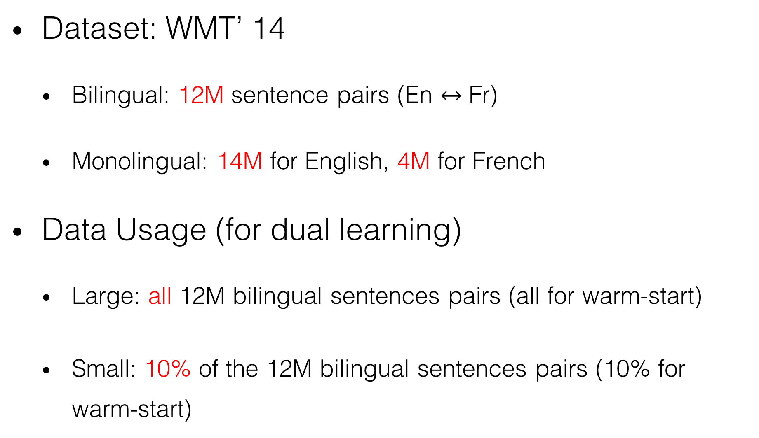
Evaluation
Dataset: WMT’ 14
Bilingual: 12M sentence pairs (En $↔$ Fr)
Monolingual: 14M for English, 4M for French
Data Usage (for dual learning)
Large: all 12M bilingual sentences pairs (all for warm-start)
Small: 10% of the 12M bilingual sentences pairs (10% for warm-start)

Slide 22
Evaluation (Cont.)
Evaluation Metric
BLEU score
Baseline
NMT [1]
pseudo-NMT [2]
[1] Y. Bengio et al., “Neural machine translation by jointly learning to align and translate”, ICLR’15
[2] R. Sennrich et al., ”Improving machine translation models with monolingual data”, ACL 2016

Slide 23
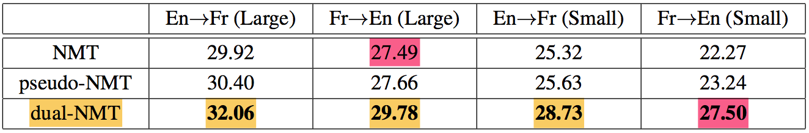
Evaluation (Cont.)
With only 10% bilingual data, dual-NMT achieves comparable translation accuracy as vanilla NMT using 100% bilingual data.
Notes:
1. With only 10% bilingual data, dual-NMT achieves comparable translation accuracy as vanilla NMT using 100% bilingual data.
2. Our hypothesis is that the quality of pseudo bilingual sentence pairs generated from the monolingual data is not very good, which limits the performance gain of pseudo-NMT.
3. When the parallel bilingual data are small, dual-NMT makes larger improvement. This shows that the dual-learning mechanism makes very good utilization of monolingual data.

Slide 24
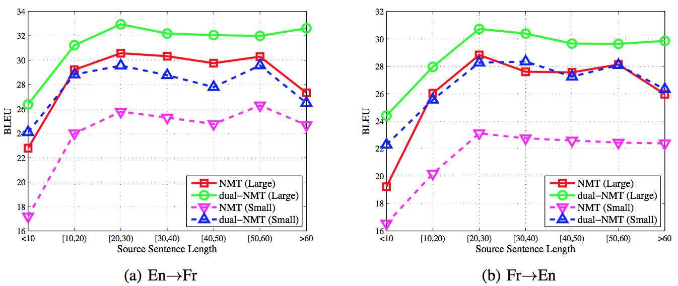
Evaluation (Cont.)
Notes:
Improvement is significant for long sentences.

Slide 25
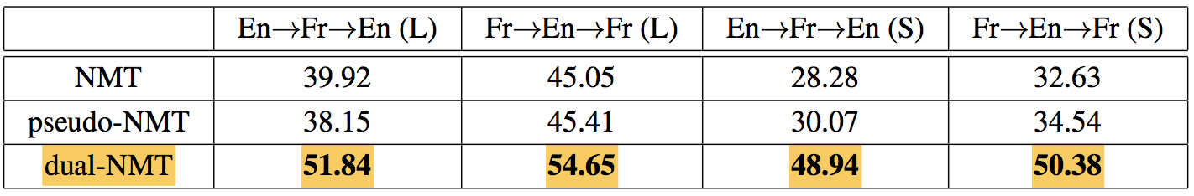

Evaluation (Cont.)
dual-NMT consider Reconstruction Reward ($r2$)

Slide 26
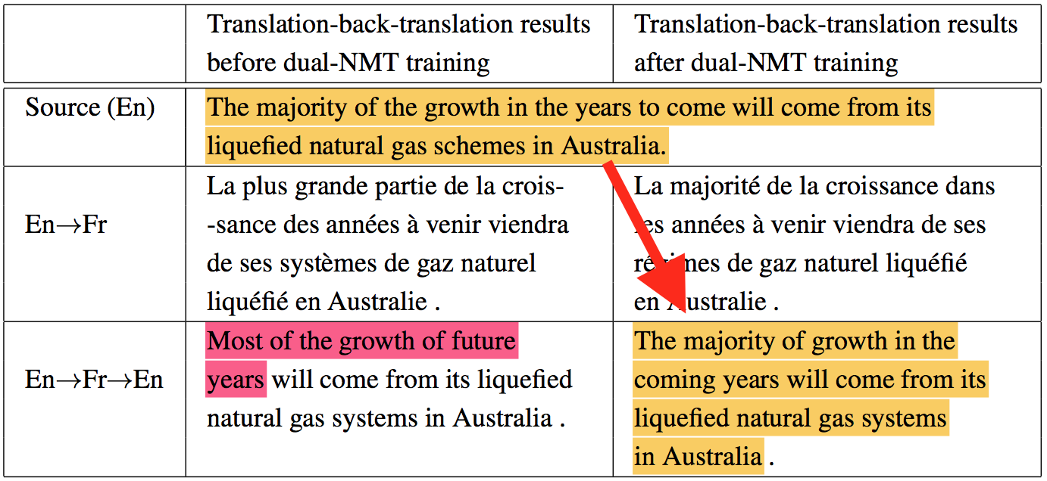
Evaluation (Cont.)

Slide 27
To sum up, all the results show that the dual-learning mechanism better utilizes the monolingual data.

Slide 28
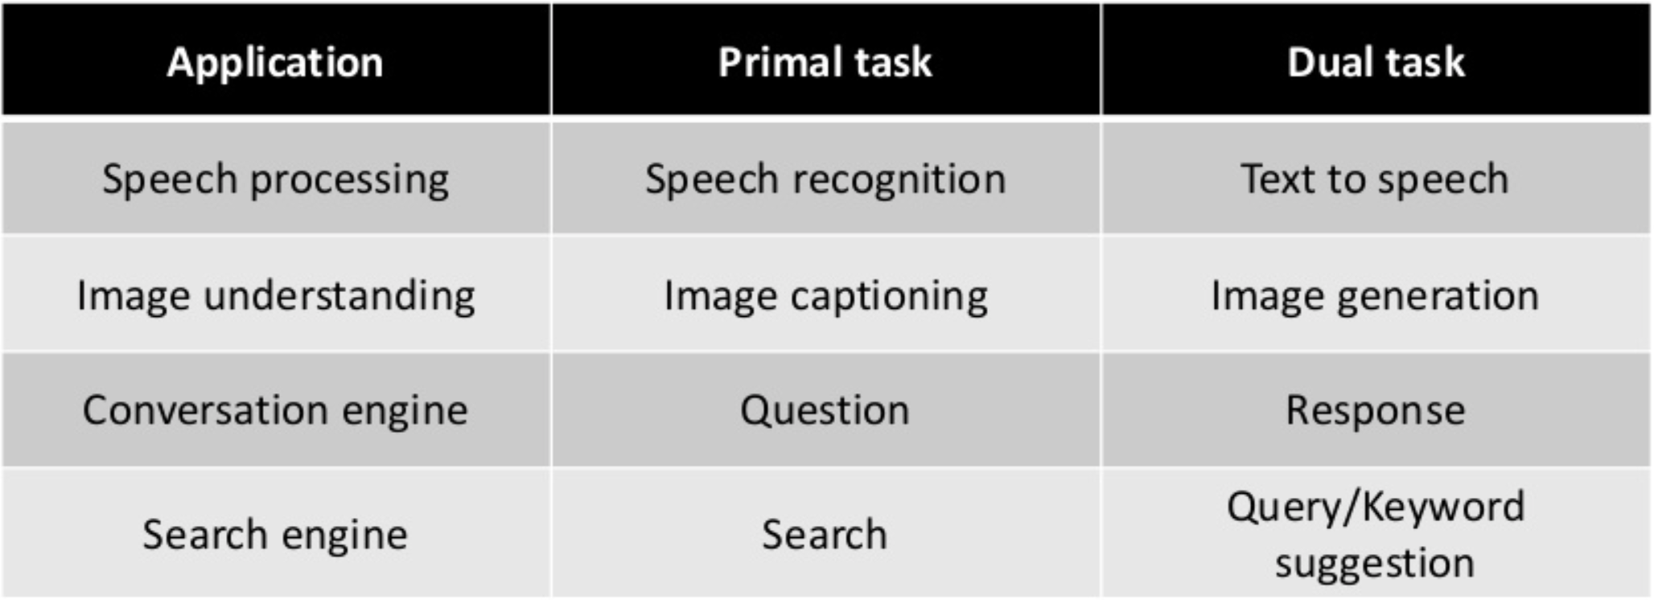
Discussion
Many tasks are naturally in dual form
-- ”Dual Supervised Learning”, ICML’17
Notes:
extension

Slide 29
Discussion (Cont.)
Dual Learning is not restricted to two tasks
Closed loop (feedback)
Ch→En→Fr→…→Ch’
X→Y→…→X’
Notes:
As long as we have …

Slide 30
Conclusion
Pros:
Open a new window to learn to translate from scratch
Apply Policy Gradient
Cons:
Time cost

