Slide 1


Eric Wright, Technology Evangelist @VMTurbo
@DiscoPosse

Slide 2


about:me
Eric Wright
Blogger, Cloud Pundit
Principal Solutions Engineer and Technology Evangelist, VMTurbo
@DiscoPosse on Twitter
LinkedIn (Just search for DiscoPosse)

Slide 3
The art of the Ignore: Using .gitignore
Allows local files to be restricted from version control
Prevents contamination with temporary files, configuration files, VM images and more
Easily edited
.gitignore file is stored in your Git repository

Slide 4
.gitignore usage
Blank lines allowed
Comments begin with #
Escape the # if needed in a patter match: \#
Explicit file: filename.ini
Accepts wildcards: *.box
Cross-OS folder nomenclature: folder/subfolder/file.extension
Folder support:
All files in folder: foldername/**
All objects in a folder: foldername/

Slide 5

Example 1: Configuration Files
*.yaml
*.config
*.yourextensionhere
Hint: http://12factor.net/config

Slide 6

Example 2: VM Instances
*.box
*.vdi
.ssh/

Slide 7

Example 3: Keys
id_rsa
id_rsa.pub
*.pem
*.cer

Slide 8
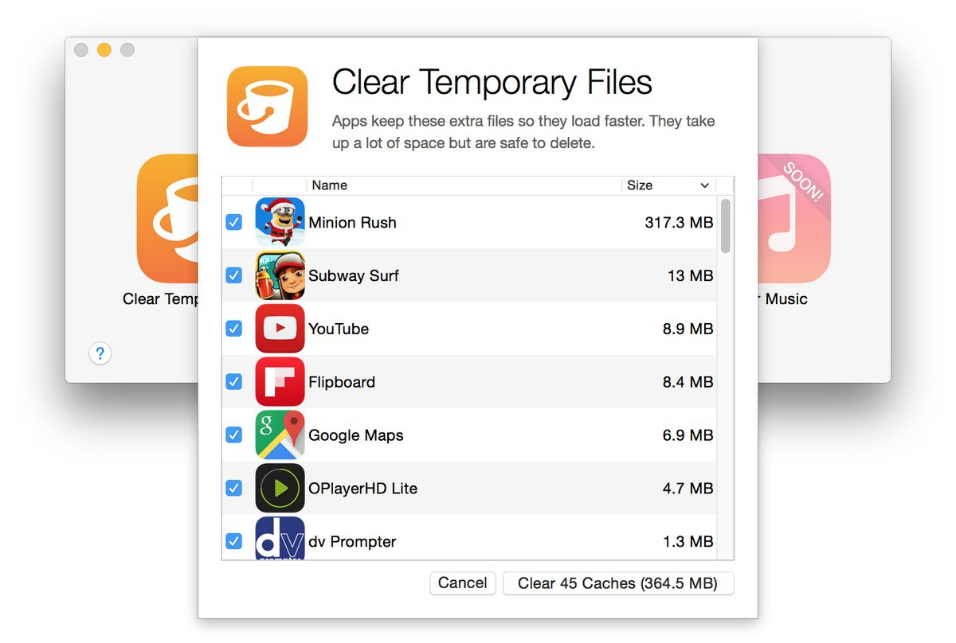
Example 4: Temporary Files
*.temp
*.tmp
*.whateveryoupick

Slide 9

More Resources
.gitignore manual: http://git-scm.com/docs/gitignore
.gitignore examples:
Git check-ignore: http://git-scm.com/docs/git-check-ignore

Slide 10
Thank you!

