Slide 1
Group name: GalaXY Mingze Gao, Yang Xie, Zhiyuan Yang
Project A: Crowd Shipping

Slide 2
Problem Formulation

Slide 3
Uber Routing Problem
Given a road network, real-time customer information and competitor information, the goal of this work is to maximize income by prepositioning the car and make decisions about which customers to pick-up

Slide 4
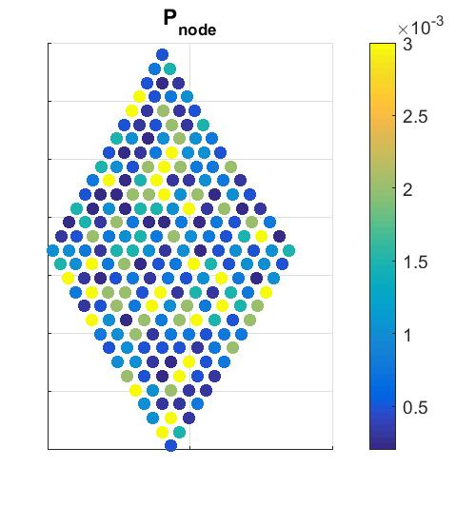
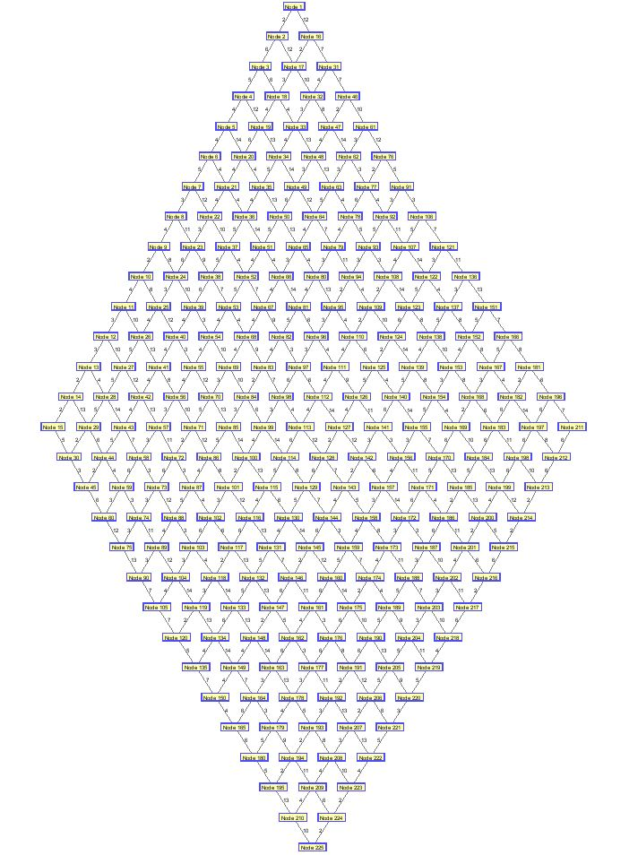
Input information
G: street network
P_{i}: probability that a customer appears at node i
D_{ij}: probability that the customer at node i requests a ride to node j
M_{ij}: income for a ride from node i to node j
My starting point
Competitors’
starting points
Problem 2 Instance 1

Slide 5
Two Major Decision Problems
How to route my car when it’s empty?
Preposition policy: approaching nodes that have high income expectation
How to decide whether to accept or reject a customer?
Rejection policy: compare the loss for rejection and the expected loss for driving to pick up the customer, reject if the later is larger

Slide 6
Preposition Policy

Slide 7
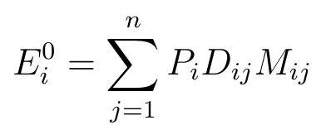
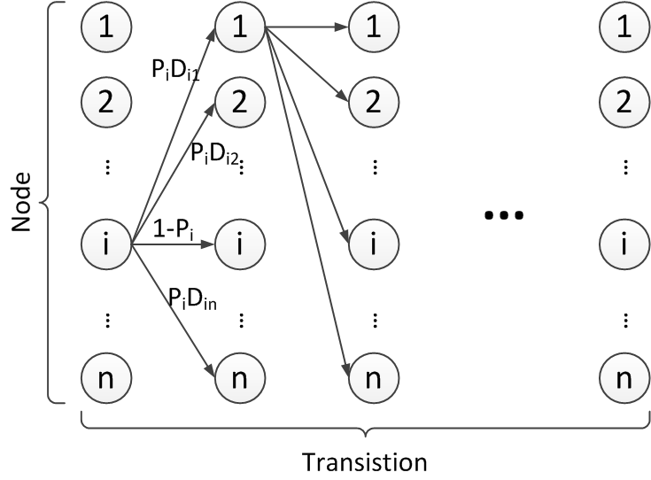
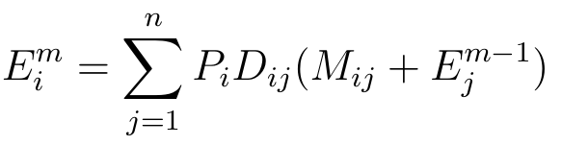
Income Expectation Calculation
P_{i}: probability that a customer appears at node i
D_{ij}: probability that the customer at node i requests a ride to j
M_{ij}: cost from node i to node j
Expected income for node i:
Expected income for node i:
look ahead m transitions
Converge after m=5

Slide 8
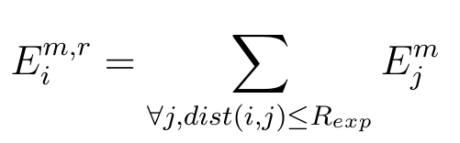
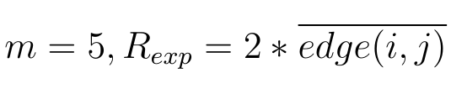
Income Expectation Calculation
r
My starting point
Accumulated expected income around node i
within a range R_{exp}
look ahead m transitions

Slide 9
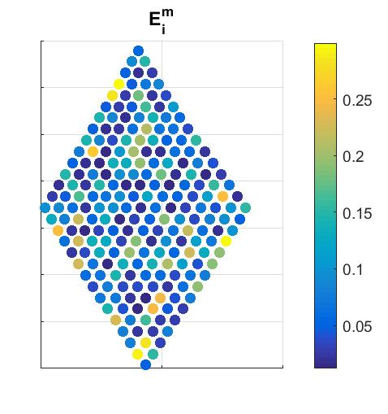
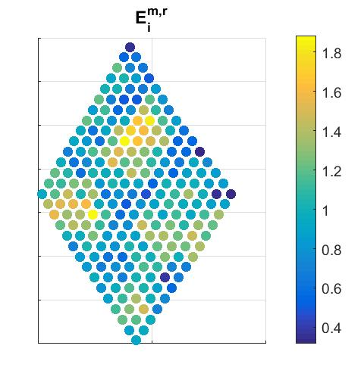

Income Expectation Result
Expected income for node i
(look ahead m transitions):
Accumulated expected income around node i (within a range r & look ahead m transitions):

Slide 10
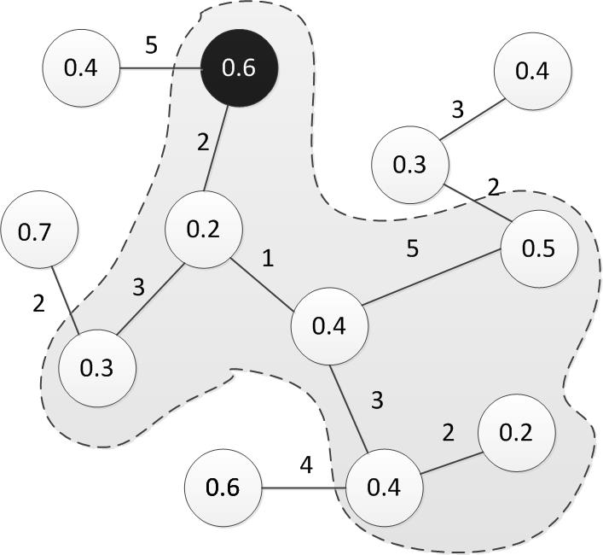
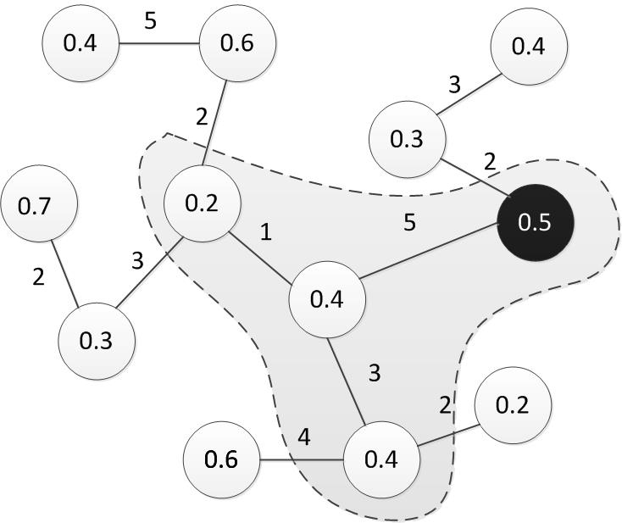


Preposition When Empty
Move to a reginal maximum node via the shortest path
$$R_{mov} = 5$$
Current Node
Current Node
Preposition to a neighbor
Preposition within $R_{mov}$

Slide 11
Rejection Policy

Slide 12
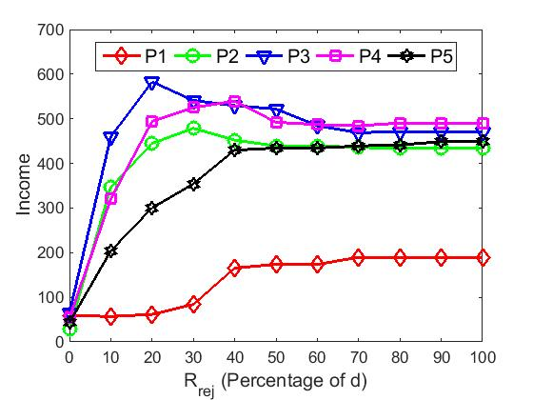
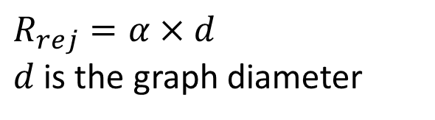
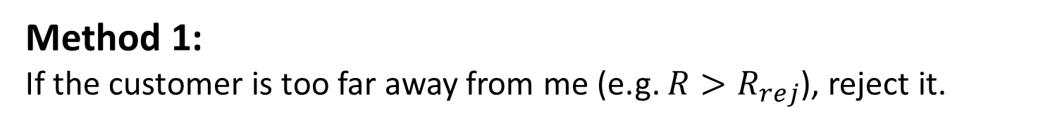
Reject “Bad” Customers
Method 1:
If the customer is too far away from me (e.g. $R>R_{rej}$), reject it.
$R_{rej}=α×d$
$d$ is the graph diameter

Slide 13
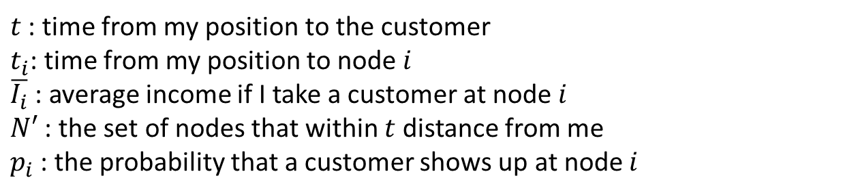
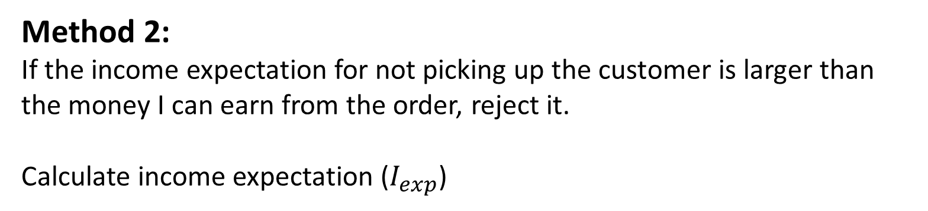

Reject “Bad” Customers
Method 2:
If the income expectation for not picking up the customer is larger than the money I can earn from the order, reject it.
Calculate income expectation ($I_{exp}$)
$t$ : time from my position to the customer
$t_{i}$: time from my position to node $i$
$\overline{I_{i}}$ : average income if I take a customer at node $i$
$N′$ : the set of nodes that within $t$ distance from me
$p_{i}$ : the probability that a customer shows up at node $i$
$$I_{exp}=\sum_{i∈N′}{\left[1−{\left(1−p_{i}\right)}^{t−t_{i}}\right]×\overline{I_{i}}}$$

Slide 14
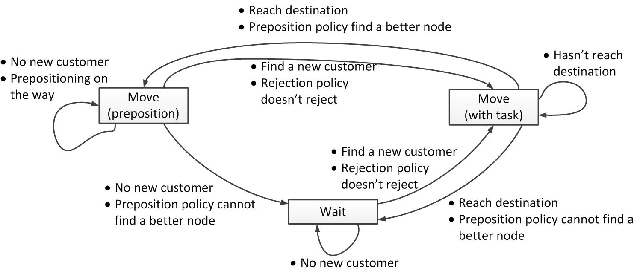
Decision Flow

Slide 15
Results

Slide 16
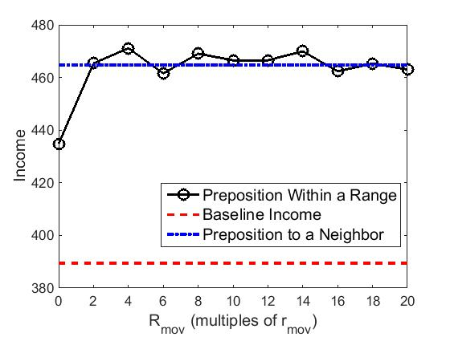
Compare Preposition Policy
Use Method 2 to reject the bad customers
Compare the two moving policies when car is empty
$R_{mov}={β ×r}_{mov}=β ×\overline{edge(i,j)}$and sweep$β$
Conclusions:
Move is better than stay
Move policies have similar performance
Data is averaged across all instances

Slide 17
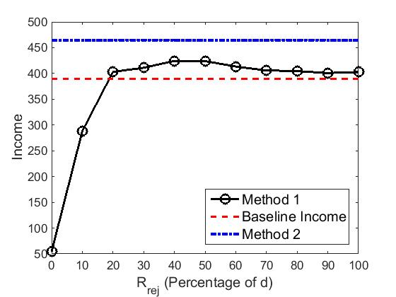
Compare Reject Policies
Use preposition to the neighbor policy when car is empty
Compare the two rejection policies
$R_{rej}=α×d$, $d$ is the graph diameter
Conclusions:
Method 2 is better
Data is averaged across all instances

