Slide 1
Teaching Systems Software with FreeBSD and Tracing
George V. Neville-Neil
Robert N. M. Watson

Slide 2
Motivations
Promulgate the understanding of large and complex systems
Bring modern tools to a wide variety of audiences
Advance the practice of software and systems engineering
Promote FreeBSD as a platform for teaching, research and development

Slide 3
Audiences
Practitioners
Experience with some programming language
Work experience
Masters Students in Computer Science
May not have an undergrad CS degree
Focus is on research skills
Undergraduates in Computer Science
Highest variability in background
May not know C

Slide 4
Operating-system teaching styles
Trial by fire (undergraduate): in micro, recreate classical elements and forms of OS design: kernels, processes, filesystems
Trivial Tinkering (undergraduate): study the basics of the OS and replace a small driver or modify only in the small
Research readings course (graduate): read, present, discuss, and write about classic research; term project/exams
Deep-dive experimentation course (graduate): learn about and analyse specific CPU/OS/protocol behaviours using tracing
mitigates the risk of OS kernel hacking in a short course;
works on real-world systems rather than toys; and
targets research skills, not just OS design
Only recently possible due to development of integrated tracing and profiling tools; e.g., DTrace, CPU performance counters, etc.

Slide 5
Software Tool Set
FreeBSD
DTrace
hwpmc(4)
dummynet
R and numpy

Slide 6
Core Texts
Operating systems: Marshall Kirk McKusick, George V. Neville-Neil, and Robert N. M. Watson, The Design and Implementation of the FreeBSD Operating System, 2nd Edition, Pearson Education, Boston, MA, USA, September 2014.
Performance measurement: Raj Jain, The Art of Computer Systems Performance Analysis: Techniques for Experimental Design, Measurement, Simulation, and Modeling, Wiley - Interscience, New York, NY, USA, April 1991.
Tracing and profiling: Brendan Gregg and Jim Mauro, DTrace: Dynamic Tracing in Oracle Solaris, Mac OS X and FreeBSD, Prentice Hall Press, Upper Saddle River, NJ, USA, April 2011.

Slide 7
Aims of the Masters course
Teach methodology, skills, and knowledge required to understand and perform research on contemporary operating systems by...
Teaching systems-analysis methodology and practice
Exploring real-world systems artifacts
Developing scientific writing skills
Reading selected original systems research papers

Slide 8
Masters Course Structure
6× One-hour lectures
Theory, methodology, architecture, and practice
5× Two-hour labs
30-minute lecturelets on artifacts, tools, and practical skills
Remainder on hands-on measurement and experimentation
Exploratory questions vs. experimental goals
Assigned readings
Selected portions of module texts
Historic and contemporary research papers
Assessed lab reports
Based on experiments done in (and out) of labs
Refine scientific writing style suitable for systems research
One ‘practice run’ marked but not assessed
Two assessed; 50% of final mark each

Slide 9
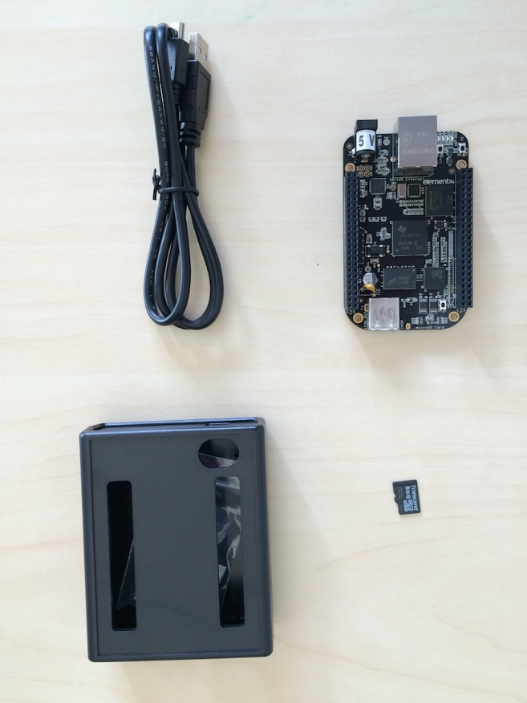
The lab platform
Beagle Bone Black
1GHz 32-bit ARM Cortex A-8
Superscalar, MMU, L1/L2 caches
Serial,network USB target from lab workstations
SDcard software images
FreeBSD operating system
DTrace, CPU performance counters
Custom microbenchmarks
POSIX I/O, POSIX IPC, TCP

Slide 10
Weeks 1–2: Introduction to kernels and tracing
Lecture1: Introduction: OSes ,Systems Research ,andL41
Lecture2: Kernels and Tracing
Lab1:Getting started with kernel tracing / POSIX I/O
LabReport1: I/O Performance(practice)

Slide 11
Weeks 3–5: The process model
Lecture 2–3: The Process Model
Lab2: Kernel implicationsof IPC
Lab3: Micro-architectural implications of IPC
LabReport2:IPC Performance (assessed)

Slide 12
Weeks 6–8: TCP/IP
Lecture5–6: The Network Stack
Lab4: The TCP State Machine
Lab5: TCP Latency and Bandwidth
LabReport3: The TCP State Machine, Latency, and Bandwidth (accessed)

Slide 13
A good outcome

Slide 14
What worked?
Tracing is a great way to teach about complex systems!
Surprisingly comprehensive and good lab reports/analysis
E.g., cache hit vs. system-call rates to explain IPC performance
TCP time-sequence plots! TCP state machines!
Real explanations of interesting artefacts
E.g., probe effects, superpages, DUMMYNET timer effects, etc.
Embedded board platform(generally) worked really well
Could not have done these experiments on VMs

Slide 15
Teaching Practitioners
We can assume more background:
Some knowledge of programming
Experience with Unix
Have real problems to solve
But not assume everything:
Kernel Internals
Deep understanding of corner cases

Slide 16
Goals of the Practitioner Course
Familiarize people withDTrace
Give them practical tools for their problems
Educate them about how the OS works
Dispel fear

Slide 17
The Practitioner’s Course
Two, 8 hour days
Platform Is student’s laptop or virtual machine
Taught at AsiaBSDCon 2016, BSDCan 2015, 2016,
Next course: EuroBSD 2016 in Belgrade

Slide 18
What we teach
Intro to DTrace
Locking
Scheduler
Files and the Filesystem
Networking

Slide 19
Course is a set of Worked Examples
What names are being looked up?
dtrace -n ’vfs:namei:lookup:entry \
{ printf("%s", stringof(arg1));}’
CPU ID FUNCTION:NAME
2 27847 lookup:entry /bin/ls
2 27847 lookup:entry /libexec/ld-elf.so.1
2 27847 lookup:entry /etc
2 27847 lookup:entry /etc/libmap.conf
2 27847 lookup:entry /etc/libmap.conf

Slide 20
What we learned
Labs work well
Re-use the students’ example code
VMs are better for a time constrained class
Difficult to talk about performance with VMs alone

Slide 21
Teaching Undergraduates
Requires a far more background material
Need to focus on the why as well as the what
Pacing is key to understanding
Repetition is required
Teach the students how a large piece of systems software works
Get them to understand how the whole system works

Slide 22
Deeper Background
Mutual Exclusion
Locking
Deadlocks
Virtual Memory
TLB
History of Hardware and Software Co-Design

Slide 23
How do you explain deadlock?

Slide 24
How do you explain deadlock?

Slide 25
How do you explain deadlock?

Slide 26
How do you explain deadlock?

Slide 27
How do you explain deadlock?

Slide 28
Questions we expect them to answer
Name three pieces of software found in the kernel
Name three pieces of software found in user space
What states does a process go during the process life cycle?
Draw a diagram of two threads that are deadlocked.
Write a DTrace one-liner that captures sockets entering the fin-wait-1 state
Why does the name cache store negative entries?
What happens when you load a web page?

Slide 29
sh
fork()
exec()
master
socket()
bind()
listen()
read()
write()
close()
open()
read()
close()
write()
read()
sh
fork()
exec()
chrome
close()
wait()
exit()
socket()
connect()

Slide 30
Continuing improvements
Retain current approach, structure – it worked!
Revise/tidy up/re-sort 30 percent of material
Implement Python framework for data collection and analysis
More and better DTrace on embedded
hwpmc(4) on bhyve
Convert material to PowerPoint
Add copious speaker notes
Integration of hwpmc(4) and DTrace
DTrace objects
Polish the teaching platform
Eventual upgrade to 64 bit multicore
Select a cheaper alternative

Slide 31
Thank You
Ruslan Bukin
Mark Johnston
Ed Maste
Andy Turner
Bjoern Zeeb
Kirk McKusick
Hiroki Sato
The FreeBSD Foundation

Slide 32
Course material
Teaching Guides
Example Problems and Solutions
Marking Guides
Example quizs and final exam in a private repo
DTrace and associated scripts
Video Versions
Packaged Materials under a permissive license
Available online http://teachbsd.org
Japanese Translation 60% complete

