Slide 1

u
N
e
r
t
e
c
N

Slide 2
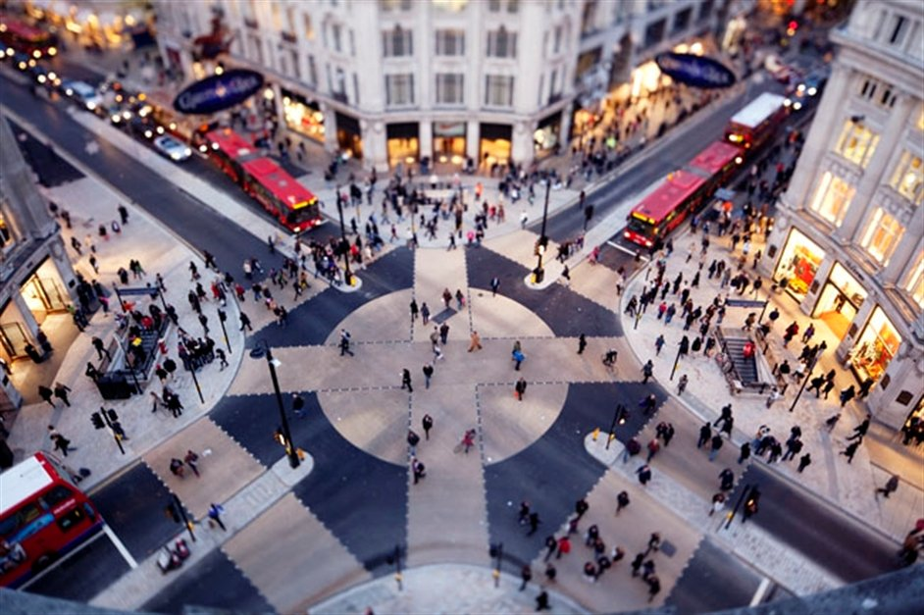

Slide 3
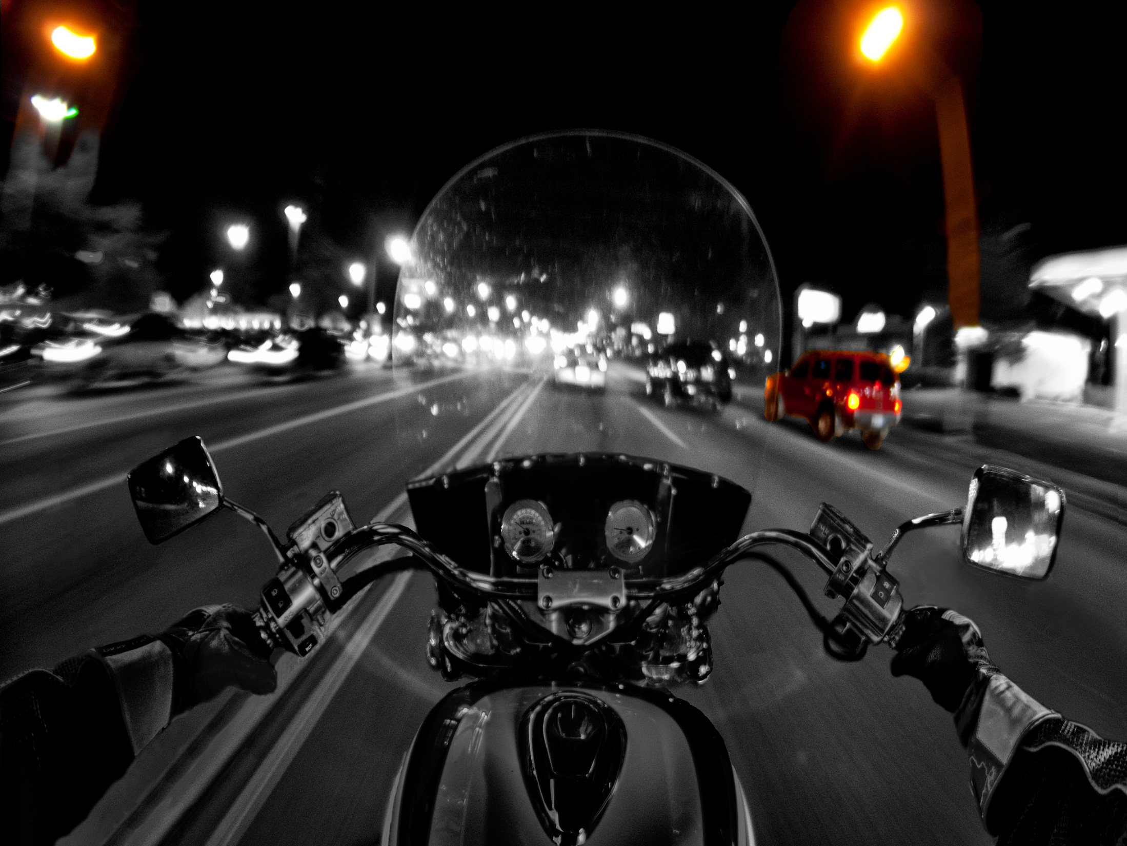

Cars at rear left
Cars at rear right
Advisory speed
60 KM

