Slide 1
Shannon meets Nyquist : Capacity Limits of Analog Sampled Channels
Yuxin Chen
Stanford University
Joint work with Andrea Goldsmith and Yonina Eldar

Slide 2
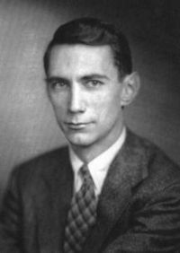

Capacity of Analog Channels
Continuous-time
Signals
Point-to-Point Communication
Maximum Achievable Rate (Channel Capacity)
No Sampling Loss
Analog Channel
Noise
Message
Encoder
Decoder
Message
Proof: Karhunen-Loeve Decomposition or DFT
C. E. Shannon

Slide 3
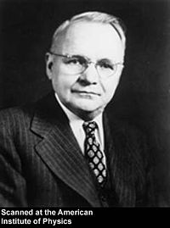
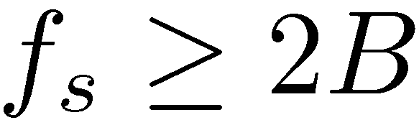
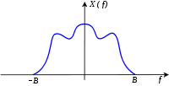
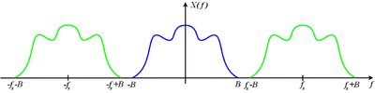
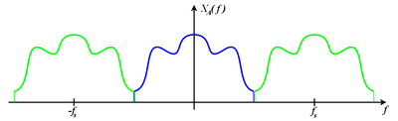
Sampling Theory
Nyquist Band-limited Sampling:
Perfect Recovery: (Nyquist Sampling Rate)
reconstruction filter
Sub-Nyquist sampling?
H. Nyquist
Notes:
Use multiple points, if necessary.

Slide 4




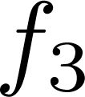
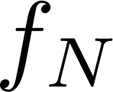

Violating Nyquist
Sparse signals can be reconstructed from sub-Nyquist rate samples (compressed sensing)
Analog Compressed Sensing – Xampling [MishaliEldar’10]
Multi-band receivers at sub-Nyquist sampling rates
Can be used in low-complexity cognitive radios

Slide 5
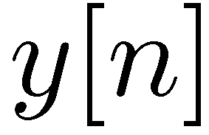
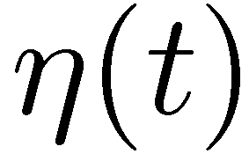
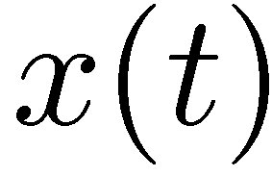
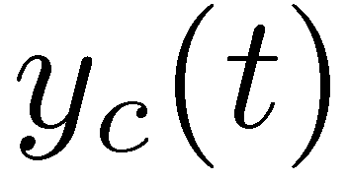
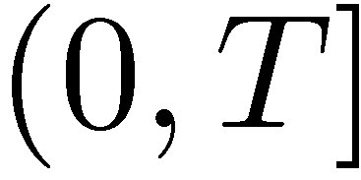
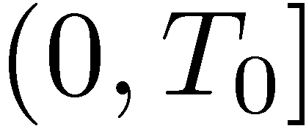
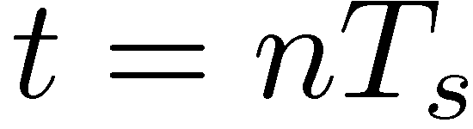
Information Theory meets Sampling Theory
Known: capacity based on optimal input for given channel H(f)
Known: optimal sampling mechanism for given input y(t)
Analog
Channel
Sampler

Slide 6
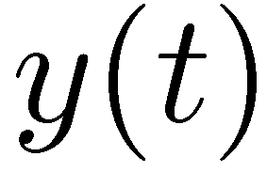
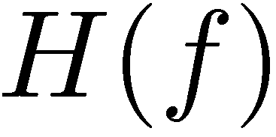
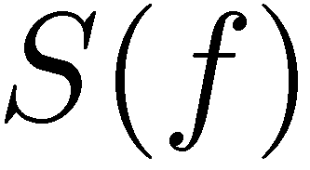
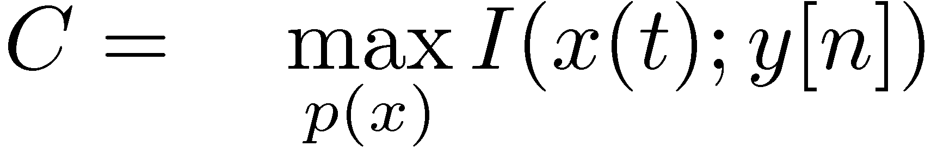
Capacity of Sampled Analog Channels
Questions:
What is the capacity of sampled analog channels?
What is the tradeoff between capacity and sampling rate?
What is the optimal sampling mechanism?
Ideal vs Non-ideal Sampling
Uniform vs Non-uniform
What is optimal input signal for a given sampling mechanism?
i.e. what is
digital sequence

Slide 7
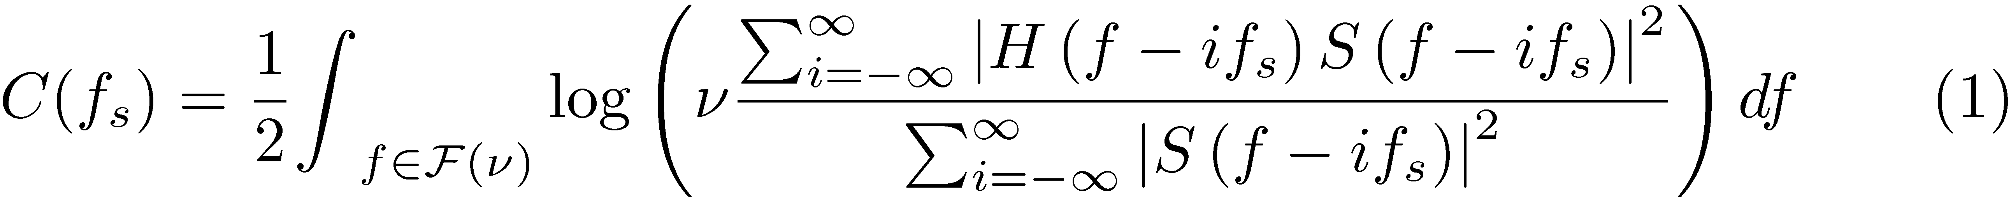
Capacity under Sampling w/ Filtering
Gaussian noise
Theorem 1: The channel capacity under sampling with prefiltering is
nonideal sampling; linear distortion; …
Determined by
water-filling strategies
“Folded” SNR modulated by S(f)

Slide 8
Sampling as Diversity-Combining
Aliasing leads to diversity-combining
“modulated” aliasing
fixed “combining” technique
MRC w.r.t. modulated channels
Colored noise density

Slide 9
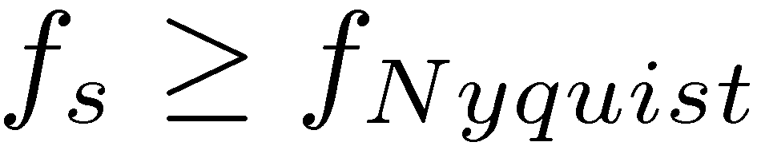
Sampling w/ A Filter
Theorem 2: The channel capacity with general uniform sampling can be given as
If , reduces to classical capacity results [Gallager’68]
alias-free (only one term left in the periodic sum)
Water-filling
Aliasing + modulated MRC
Power of colored noise

Slide 10


Hold On…
What is Sampled Channel Capacity?
1. For a given sampling system:
Sampler: given
A new channel…
2. For a given sampling rate: optimizing over a class of sampling methods
Joint Optimization
( of Input and Sampling Methods!)

Slide 11
Filter Optimization
Optimizing the prefilter design
Jointly with the input distribution
Like a MIMO channel – but with output combining

Slide 12
Prefilter selects “best branch”
Filter zeros out aliasing
Aliasing increases noise
Selection combining with noise suppression
highest SNR
low SNR
low SNR

Slide 13
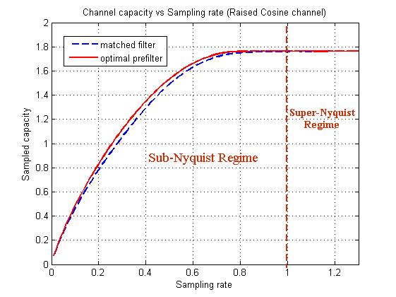
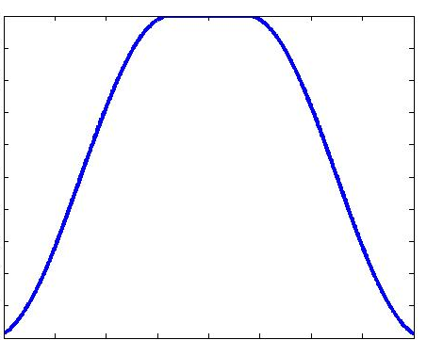
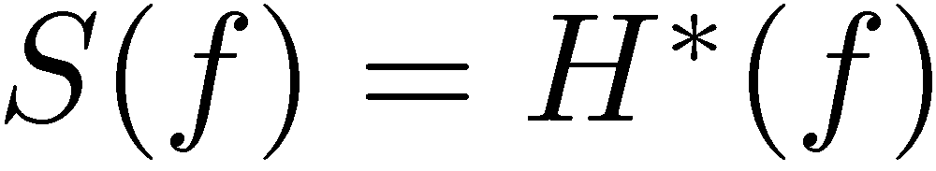
Capacity with an Optimal Prefilter
Optimal Pre-filters
Example (monotone channel)
Optimal filter: low-pass
“Matched” filter:
Optimal
Prefilter
(Ideal LP)

Slide 14
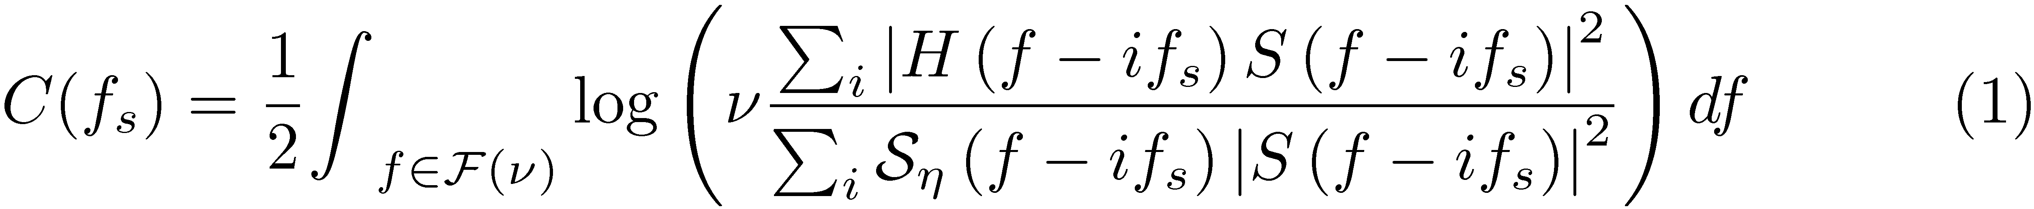
Connections with the MMSE
Sampling perspective
For wide-sense stationary inputs, optimal filter minimizes the MMSE.
optimizing data rate minimizing MMSE
Generalization (Colored noise)
Corollary 1: The channel capacity with colored noise under general uniform sampling can be given as

Slide 15
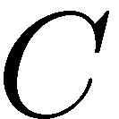
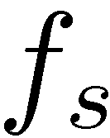


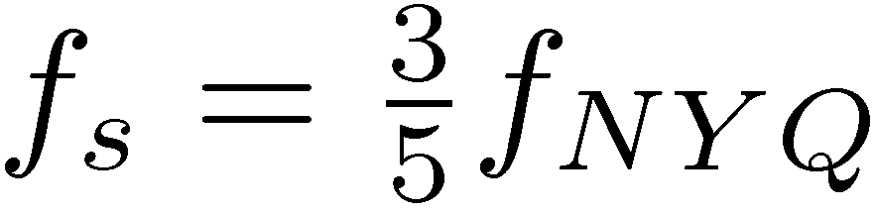
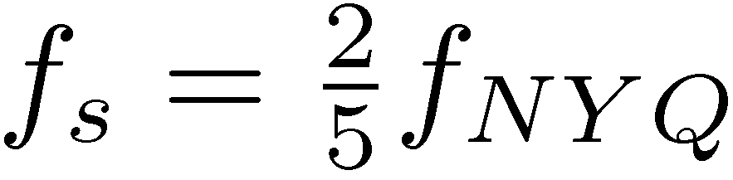
Capacity vs. Sampling Rate
Question
Tradeoff between and ?
Intuitively, more samples should increase capacity
Not true, under uniform sampling.
Example:
1 DoF…
2 DoFs !

Slide 16
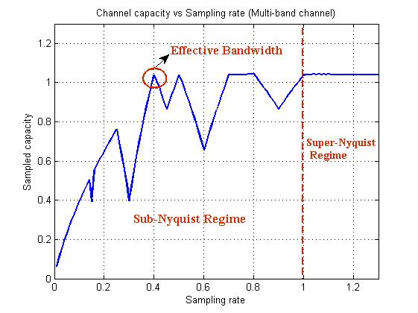
Capacity not monotonic in f_{s}
Consider a “sparse” channel
Capacity not
monotonic in f_{s}!
Unform sampling
fails to exploit
channel structure

Slide 17
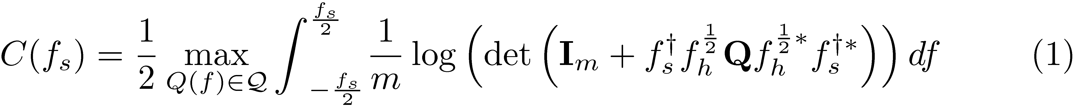
Capacity under Sampling with a Filter Bank
Theorem 3: The channel capacity of the sampled channel using a bank of m filters with aggregate rate is
Similar to MIMO

Slide 18
MIMO Interpretation
Heuristic Treatment (non-rigorous)
MIMO Gaussian Channels!
Correlated Noise → Prewhitening!
Mutual Interference → Decoupling!

Slide 19
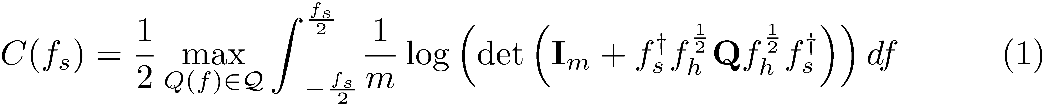
Sampling with a Filter Bank
Theorem 3: The channel capacity of the sampled channel using a bank of m filters with aggregate rate is
MIMO – Decoupling
Pre-whitening
Water-filling based on singular values

Slide 20
Sampling with an Optimal Filter Bank
Optimal Filter-banks
jointly optimize input distribution and filter-banks

Slide 21

Sampling with an Optimal Filter Bank
Optimal Pre-filters
Selecting the branches with highest SNR
Example (2-channel case)
low SNR
highest SNR
Second highest SNR
low SNR

Slide 22
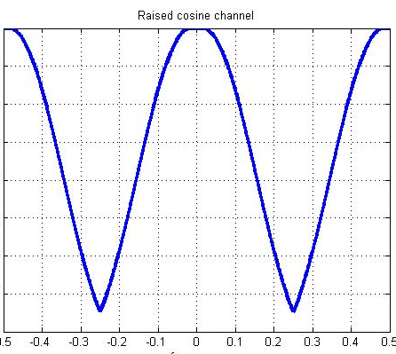
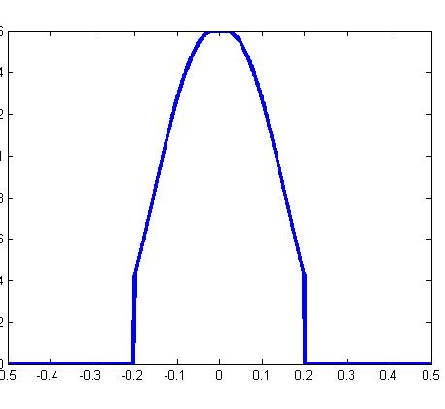
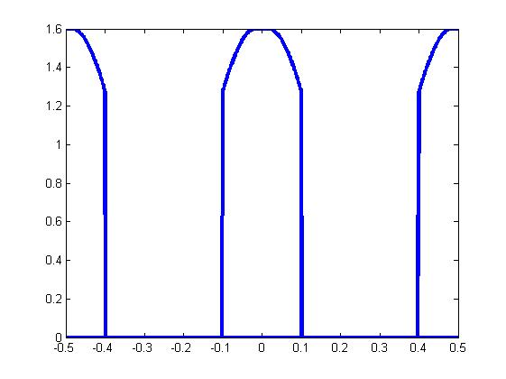
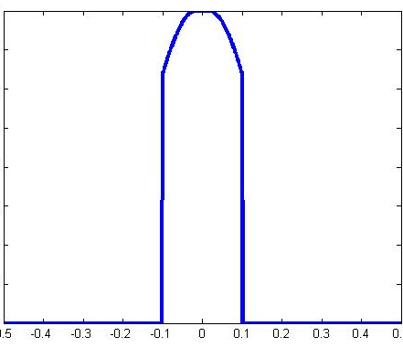
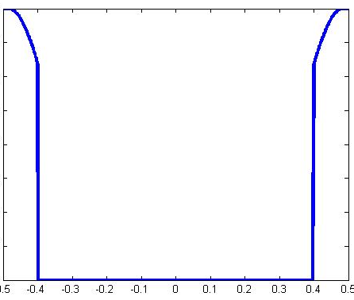
Numerical Example
Optimal Filter-bank
Example → Select two best subbands!
Origianl Channel
Single-Channel
Two-Channel
Combining them forms a better channel !

Slide 23
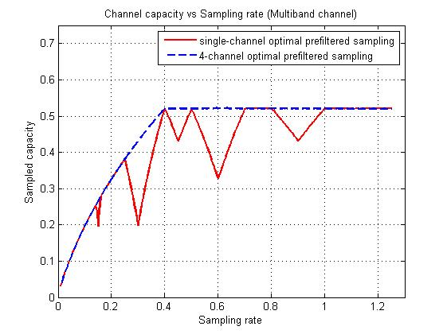
Capacity Gain
Consider a “sparse” channel (4-channel sampling with optimal filter bank)
Outperforms single-channel
sampling!
Achieves full-capacity above Landau Rate
Landau Rate: sum of total bandwidths

Slide 24
Sampling w/ Modulation and Filter Banks
Post-modulation filtering
e.g. weighting spectral contents within an aliased frequency set
Pre-modulation filtering
e.g. suppress out-of-band noise
Modulation (scramble spectral contents)

Slide 25
MIMO Interpretation
Modulation
mixes spectral contents from different aliased frequency set
generate a larger aliased set
Post-modulation filtering
Pre-modulation filtering
Modulation (mixing…)

Slide 26
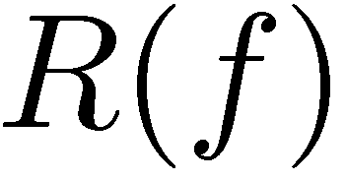
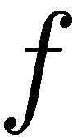
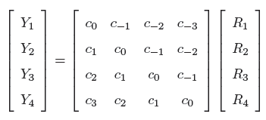


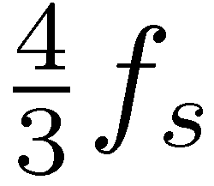
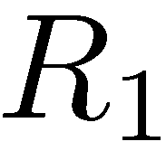
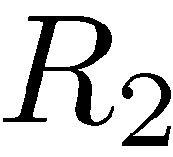
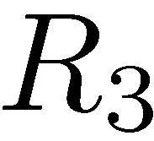
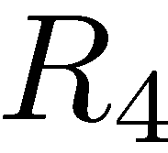
Example (Single-branch case)
zzzzzzzzzz
zzzzzzzzzz
Toeplitz

Slide 27
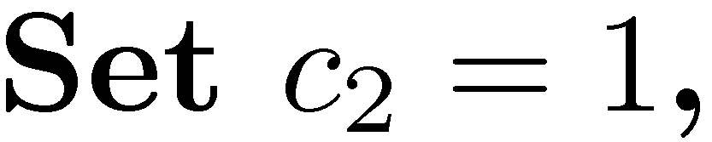
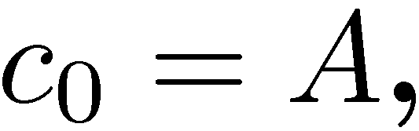
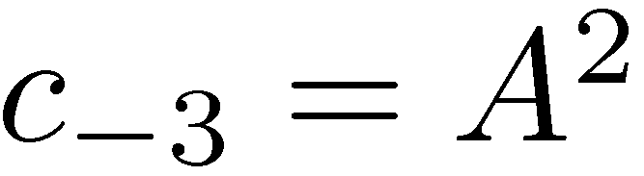
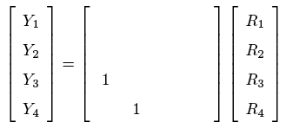








Example (Single-branch case)
zzzzzzzzzz
zzzzzzzzzz

Slide 28
Single-branch Sampling with Modulation
zzzzzzzzzz
zzzzzzzzzz
For piecewise flat channel:
Optimal Modulation == Filter-bank Sampling
No Capacity Gain
But Hardware Benefits!

Slide 29


Caution !!
ALL analyses I just presented are:
non-rigorous !
Rigorous treatment
block-Toeplitz operators
http://arxiv.org/abs/1109.5415

Slide 30






Proof Sketch
Channel Discretization
continuous:
discrete approximation:
Taking limits: approximation → exact
Asymptotic Equivalence for bounded Matrix sequences
continuous function , we have
Asymptotic Spectral Properties of Block Toeplitz Matrices
continuous function , we have

Slide 31
Getting back to Sampled Channel Capacity
for a given sampling rate
For a given sampled system
sampling w/ a filter
sampling w/ a bank of filters
sampling w/ modulation and filter banks
For a class of sampling mechanisms
sampling w/ a filter
sampling w/ a bank of filters
sampling w/ modulation and filter banks
For most general sampling mechanisms
irregular sampling grid
most general nonuniform sampling methods
what system is optimal
gap between this and analog capacity
✔
✔
✔
✔
✔
✔
?
?
?
?

Slide 32



General Nonuniform Sampling
irregular / nonuniform
Analog
Channel
Preprocessor
1. How to define the sampling rate for general nonuniform sampling?
2. What class of preprocessors is physically meaningful?

Slide 33






Sampling Rate
irregular / nonuniform
Define the sampling rate for irregular sampling set through …
Beurling Density:
Count avg # sampling points for finite T
2. Passing to the limits
-- For uniform sampling grid with rate : we have

Slide 34



Time-preserving Preprocessor
Preprocessor
Linear preprocessors Linear operators
Question: are all linear operators physically meaningful?
Example (Compressor)
Effective rate:
inconsistent
The Preprocessor should NOT be time-warping!
-- or equivalently, should NOT be frequency-warping.

Slide 35


Time-preserving Preprocessor
Preprocessor
What operations preserve the time/frequency scales?
-- Scaling
Filtering
-- Mixing
Modulation
Time Preserving System:
-- modulation modules and filters connected in parallel or in serial

Slide 36



Sampled Channel Capacity (Converse)
Theorem (Converse): For all time-preserving sampling systems with rate , the sampled channel capacity is upper bounded by
: The frequency set of size w/ the highest SNRs

Slide 37





The Converse (Intuition)
For any sampling system , the sampled output is
Operator analysis
Matrix Analog
Sampled Signal
Colored noise
noise whitening
white noise
Orthonormal !
white

Slide 38




The Converse (Intuition)
Operator analysis
Matrix Analog
Orthonormal
Capacity depends on

Slide 39






Aside: A Fact on singular values
Consider the following matrix:
Fact: suppose , then

Slide 40

The Converse (Intuition)
Operator analysis
Matrix Analog
Orthonormal
Capacity depends on
Upper Bounds:
water-fills over
The spectral Content of
-- the frequency set of size
w/ the highest SNRs

Slide 41
Achievability
Theorem (Achievability): The upper bound can be achieved through
1. Filter-bank sampling
2. A single branch of sampling with modulation and filtering
Implications:
-- Suppress aliasing
-- Nonuniform sampling grid does not improve capacity
-- Capacity limit is monotone in the sampling rate

Slide 42
The Way Ahead
Decoding-constrained information theory
Sampling Rate Constraints
constrained
decoder
Decoding Method Constraints
Duality: decoding constraint v.s. encoding constraint
Each linear decoding step can be shown equivalent to an encoding constraint.
Optimizing over encoding methods v.s. decoding methods.

Slide 43
The Way Ahead
Alias suppressing v.s. Random Mixing
Alias suppressing optimal when CSI is constant and perfectly known
How about other comm situations?
Compound Channel
MAC Channel
Random Access Channel
No single sampler dominates all others
Investigate other metrics:
minimax, Bayes…

Slide 44
Reference
Y. Chen, Y. C. Eldar, and A. J. Goldsmith, “Shannon Meets Nyquist: The Capacity Limits of Sampled Analog Channels,” under revision, IEEE Transactions on Information Theory, September 2011, http://arxiv.org/abs/1109.5415.
Y. Chen, Y. C. Eldar, and A. J. Goldsmith, “Channel Capacity under Sub-Nyquist Nonuniform Sampling,” submitted to IEEE Transactions on Information Theory, April 2012, http://arxiv.org/abs/1204.6049.
Will be presented at ISIT 2012 next month.
Thank You!

Slide 45
Concluding Remarks (Backup)
Capacity of sampled channels derived for certain sampling
Aliased channel -- combining technique
Reconciliation of IT and ST: Capacity vs MMSE
Channel structure should be exploited to boost capacity
Limitation of uniform sampling mechanism
calls for general non-uniform sampling
Multi-user Sampled Channels
Many open questions…

