Slide 1
MobileInsight-Cloud
(Cloud service and Web interface of MobileInsight)
Yi-Chun Lo, Lily Lin, Chun-Yao Chang, Po-Nien Kung

Slide 2
Outline
Overview
Data Transform
Data Filters
MobileInsight-Cloud
Demo
Limitations and Future Work

Slide 3
Overview

Slide 4
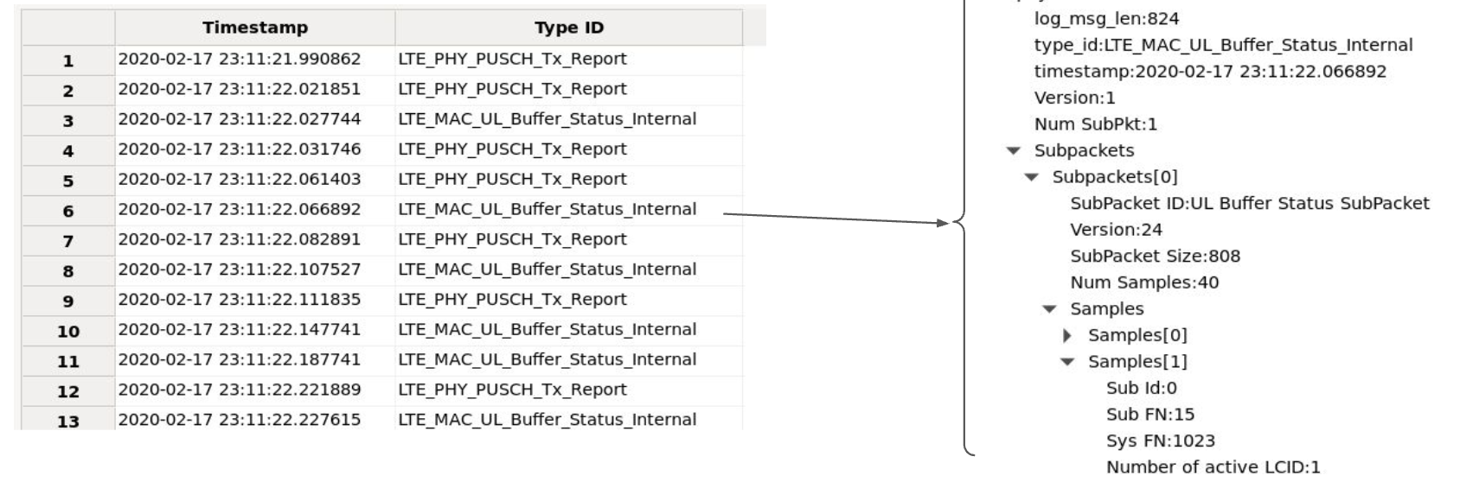
MobileInsight
A software tool which enables runtime cellular network monitoring and analytics on smartphones.
Providing open access (in software) to fine-grained cellular information on 5G protocols.
Facilitate researchers and developers to readily and quickly obtain the low-level network information through easy-to-use APIs.
Notes:
MobileInsight is a software tool designed to enable real-time cellular network monitoring and analytics directly on smartphones. It provides open access, via software, to detailed and fine-grained cellular information, specifically on 5G protocols. This tool facilitates researchers and developers by allowing them to quickly and easily obtain low-level network information through user-friendly APIs. And it also has a GUI tool for visualize the log.

Slide 5
Limitation
MobileInsight only works in local machine.
Can’t share log with other users.
Need to deal with complicated dependencies when installing.
Especially for Windows and Mac with M-series chip.
Lack of features in current GUI.
No filters
No download option
Notes:
Let's now discuss some limitations of MobileInsight.
Firstly, MobileInsight operates solely on the local machine, meaning you can't share logs with other users. Additionally, the installation process can be challenging due to complicated dependencies, particularly for Windows and Mac machines with M-series chips.
Moreover, the current graphical user interface lacks several features. It doesn't have filters, and there is no option to download data directly from the interface.

Slide 6
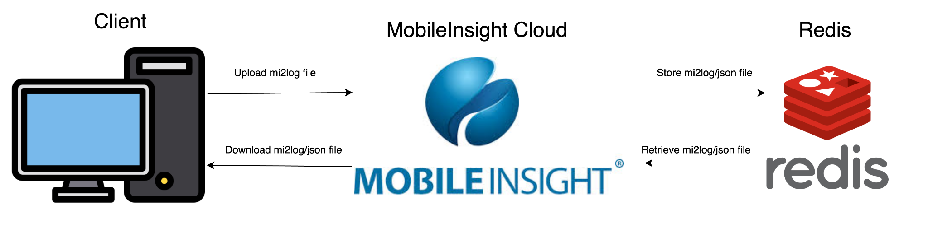
Solution
Provide a cloud version of MobileInsight - MobileInsight Cloud
Can filter, upload, and download log.
No need for installing MobileInsight.
Use Redis as log-stored database.
In-memory database, fast
Key-value storage, high scalability
Notes:
To address these limitations, we propose the following solution:
Introducing a cloud version of MobileInsight, known as MobileInsight Cloud. This version will allow users to filter, upload, and download logs seamlessly. By using the cloud, there is no need to install MobileInsight on local machines, thereby eliminating the challenges associated with complicated dependencies and installations.
For efficient log management, we will use Redis as the log-stored database. Redis is an in-memory database, which ensures fast data access and processing. Its key-value storage system offers high scalability, making it an ideal choice for handling large volumes of data with ease and speed.
By moving to a cloud-based solution and leveraging Redis, MobileInsight Cloud aims to provide a more user-friendly and powerful tool for cellular network monitoring and analytics.
The figure below is the overview of the whole MobileInsight Cloud framework. After the client has uploaded the mi2log file to MobileInsight Cloud. The MobileInsight Cloud will parse the file to json format and then store both the mi2log file and json file in Redis. If client want to do some analysis or filtering the log, the MobileInsight Cloud can retrieve the mi2log and json from redis. Then perform some operation on MobileInsight Cloud. Finally, the client can download the mi2log or json file to their machines.

Slide 7
Data Transform

Slide 8
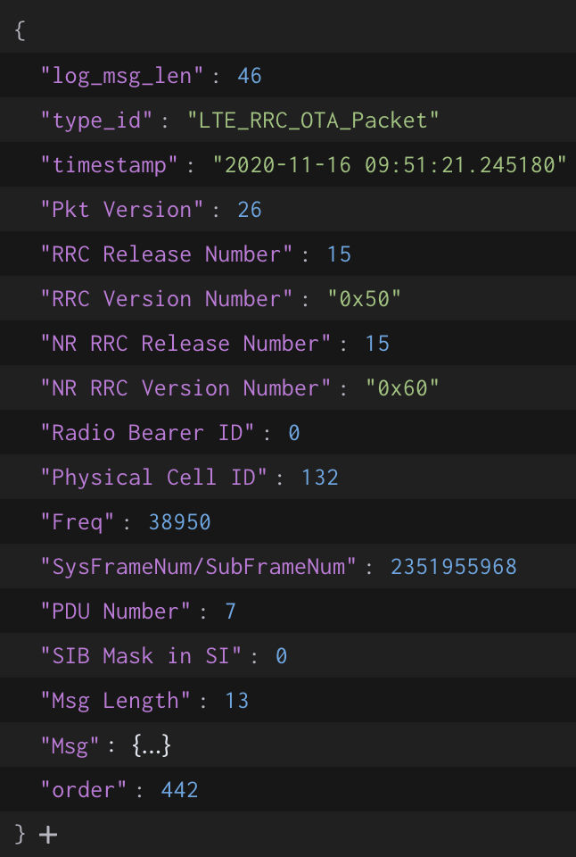
Data Transform
Convert the raw mi2log log file to JSON object and store in Redis.
JSON object is easy to display.
Key: f'{filename}:{type_id}:{timestamp}:{order}'
Get enough information of the file without loading all the data.
Allows us to filter more efficiently without accessing the content
Value: log file with json format
Extend the Analyzer class in mobile_insight library to process mi2log format.
Parse the raw XML string to XML object in “Msg” field.
Add “order” field to preserve the order of the log item.
Also store the raw mi2log file
For user to download the mi2log file.
Notes:
Lily:
Next, let's talk about data transformation in MobileInsight Cloud.
We convert the raw mi2log log file to a JSON object and store it in Redis. JSON objects are easier to display and manage. The key for each entry is formatted as `'{filename}:{type_id}:{timestamp}:{order}'`, which allows us to obtain sufficient information about the file without loading all the data. This also prevents unnecessary access to content when filtering.
The value stored is the log file in JSON format. To achieve this, we extend the Analyzer class in the mobile_insight library to process the mi2log format. We parse the raw XML string into an XML object in the “Msg” field and add an “order” field to preserve the order of the log items.
Additionally, we store the raw mi2log file itself. This allows users to download the original mi2log file if needed. By handling data in this manner, we ensure both efficient processing and ease of access.

Slide 9
Data Filters

Slide 10
Data Filter
Originally, MobileInsight only support time-based and type_id filtering:
Time: python time.time()
Type_id
LTE_RRC_OTA_Packet
LTE_NAS_ESM_OTA_Incoming_Packet
Requirement: We need to add timestamp as a new filtering feature.
start_timestamp = datetime(2020, 11, 16, 9, 49, 0)
end_timestamp = datetime(2020, 11, 16, 9, 50, 0)
Need to modify MobileInsight APIs to process timestamp
Notes:
3 sentences

Slide 11
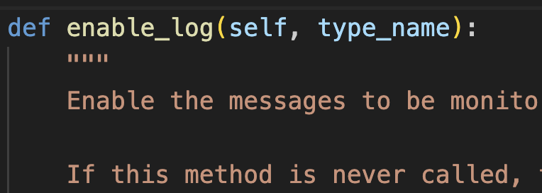
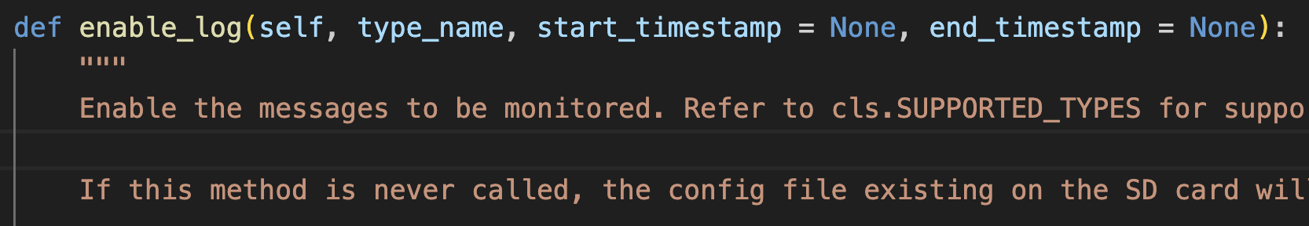
New Feature: Timestamp
We add the timestamp as new feature by tracing through and modifying the following code: offline_replayer.py
Here the timestamp is a python datetime object.
Looks simple, but, needs several steps to work.
Notes:
original filter: type_id
small modifications so if start and end timestamp then it detaults back to original mobileinsight API
add two parameters to pass in python datetimeobject

Slide 12
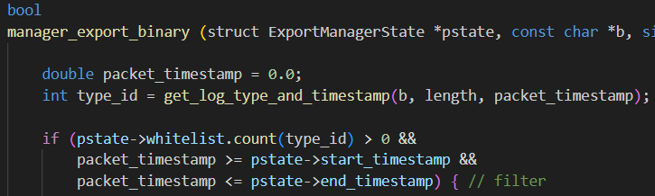
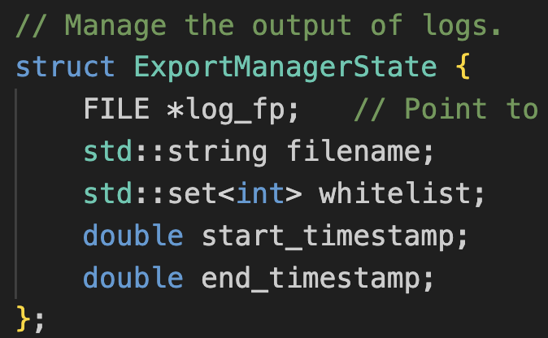
Continue Tracing
Add time interval attribute in export manager
dm_collector_c.cpp
dm_collector_c_set_filtered
dm_collector_c_receive_log_packet
export_manager.cpp
manager_export_binary
manager_set_filter
export_manager.h
struct ExportManagerState
Notes:
After continuing tracing the code, we found that the APIs which filter and get packets is in dm_collector_c module. the set_filter function only filter the type_id, so we need to add timestamp interval for filtering. The receive_log_packet function will first call the manager_export_binary to retrieve the binary packet and decode it. Therefore, we take a further look and find out that the core filtering action is in manager_export_binary function. To filter by packet timestamp, we add the new condition. Also, we add the starting and ending timestamp in ExportManagerState structure to pass the interval we like to filter.

Slide 13
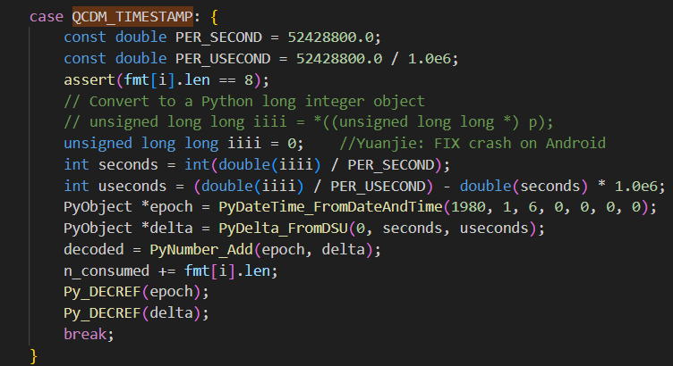
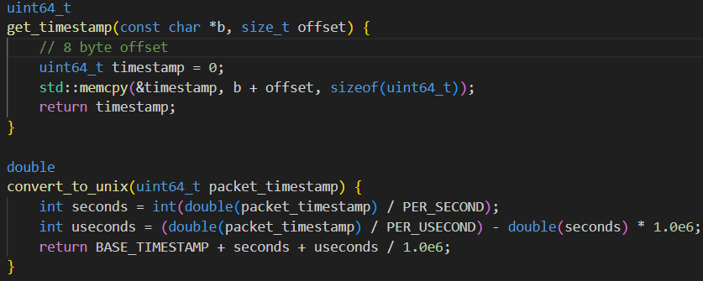
Compute Timestamp
Extract timestamp from packet and convert it to UNIX format
log_packet.cpp
export_manager.cpp
Notes:
retrieve timestamp from binary log packet + do necessary conversion as shown in QCDM_TIMESTAMP

Slide 14
MobileInsight-Cloud

Slide 15
MobileInsight-Cloud
Powered by Streamlit - a Python library for web applications.
All in pure Python. No front‑end experience required.
Easy deployment
Strong open-source community

Slide 16
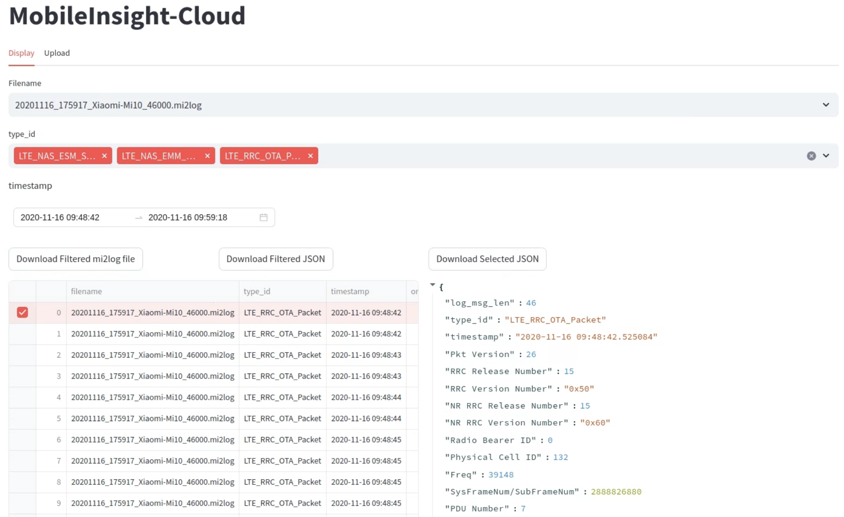

Slide 17
Demo

Slide 18
Limitation and Future Work

Slide 19
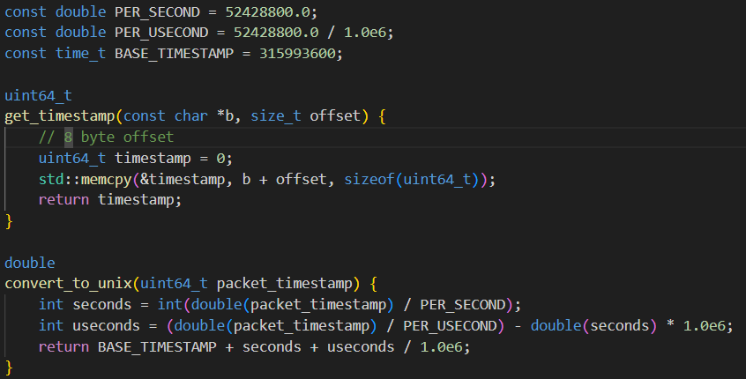
Timestamp
Recall that we compute timestamp with the following conversion:
Base_timestamp is based on LA’s time zone
Different time zone will not filter correctly

Slide 20
mi2log File Upload
Currently, we only support uploading mi2log files in the same directory as MobileInsight-Cloud.
It’s not feasible to get the file absolute path when uploading files.
Limit the ability to upload files remotely.
We can get the mi2log object and its filename. But current MobileInsight does not support loading bytes object as input.
The OfflinePlayer class only accept file path as input.
Takes about 30mins to upload 1095 files (~200MB).
Duplicate file operation.
First upload the file to get the filename.
Then open the file to process data.

Slide 21
mi2log File Download
Similar issue with mi2log file upload.
Short-term solution:
Load the Redis’s data to a tmp.mi2log file for buffering.
Perform filtering on tmp.mi2log.
Save the tmp.mi2log file as the desired filename
Notes:
needs to take in an input path
tmp.mi2log as input path

Slide 22
Future Work
Process the timestamp based on local setting.
Implement a loading/saving function that directly takes a byte object as input/output.
Prevent duplicate file operations.
Enable upload/download operations on remote server.
Necessary for deploying to the cloud.
Scale up to do further performance analysis.

Slide 23
Q & A

