Slide 1

Problem Statement and Team Details
Problem Statement: AI – Powered Object Detection System inside a Space Station
Duality AI’s Space Station Challenge : Safety Object Detection
Team Name: Team Dominators
Team Leader Name: Kondru Hemanth Sai
Institute Name: KLH University, Bowrampet
Team Leader Email ID: kondru.hemanthsai@gmail.com

Slide 2
Problem and Solution
Problem –
In high-risk environments like space stations, missing safety equipment can lead to catastrophic consequences. Manual monitoring is slow, error-prone, and resource-intensive.
Solution –
Build a real-time object detection AI model (using YOLO on Falcon platform).
Detect and classify safety-critical objects with high accuracy.
Provide a dashboard interface where users can upload images/videos and see results instantly.
Enable safety monitoring automation for astronauts and crew.

Slide 3
Methodology & Implementation
Dataset collected from Falcon platform.
Preprocessing: resizing, normalization, augmentation.
YOLO model selected for speed + accuracy.
Evaluated with precision, recall, and mAP.
Deployed via Flask backend.
React.js frontend for uploads, detections, and metrics visualization.
Our model has an accuracy percentage of 67% which means when 100 images are uploaded 67 results might be accurate.

Slide 4
Technology Used
AI Model: YOLO (You Only Look Once) – for real-time object detection.
Training Platform: Duality AI Falcon.
Backend: Flask(REST API endpoints).
Frontend: React.js + Tailwind CSS for UI.
Deployment: Falcon cloud / Dockized container.

Slide 5
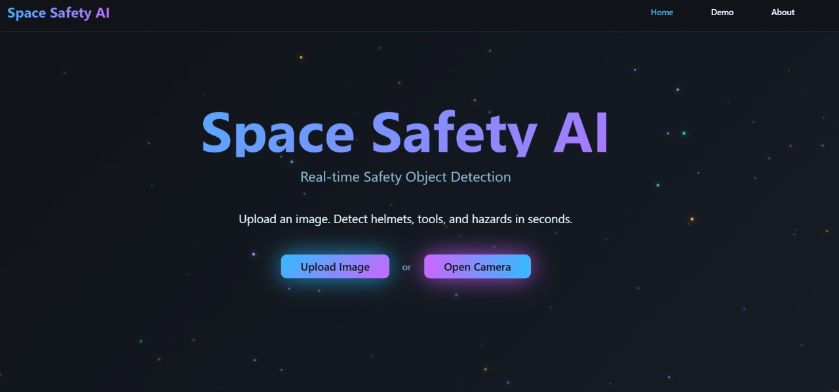
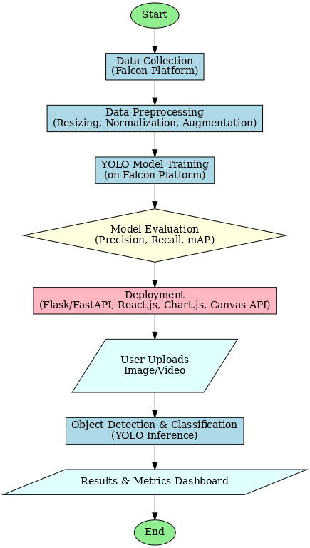
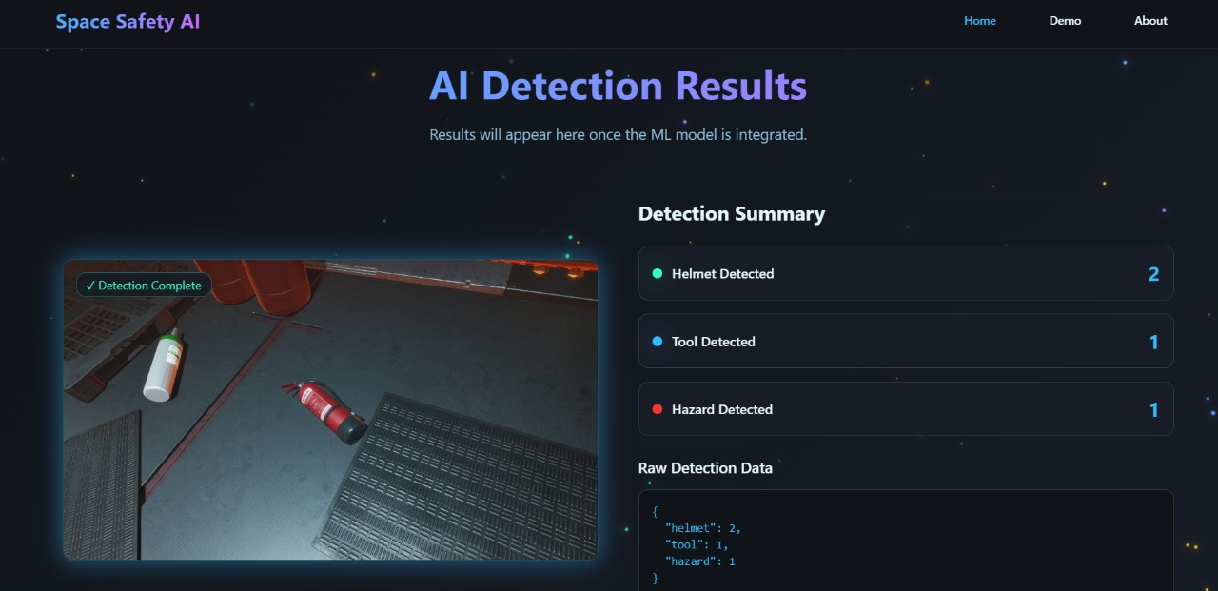
Flowchart & Supporting Images
Flowchart

Slide 6
Feasibility and Market Use
Feasibility -
Built on Falcon and YOLO → scalable and cost-effective.
Deployable on cloud or local servers with GPU support.
Market Use -
Space missions: astronaut safety checks.
Industrial safety: detect helmets, gloves, jackets.
Smart surveillance: workplace and hazard monitoring.

Slide 7
Conclusion
Developed a robust, real-time safety object detection system.
Combines YOLO’s speed with Falcon’s training capabilities.
Applicable in space, industrial, and surveillance environments.
Future scope: integration with IoT, robotics, and AR/VR dashboards.

