Slide 1
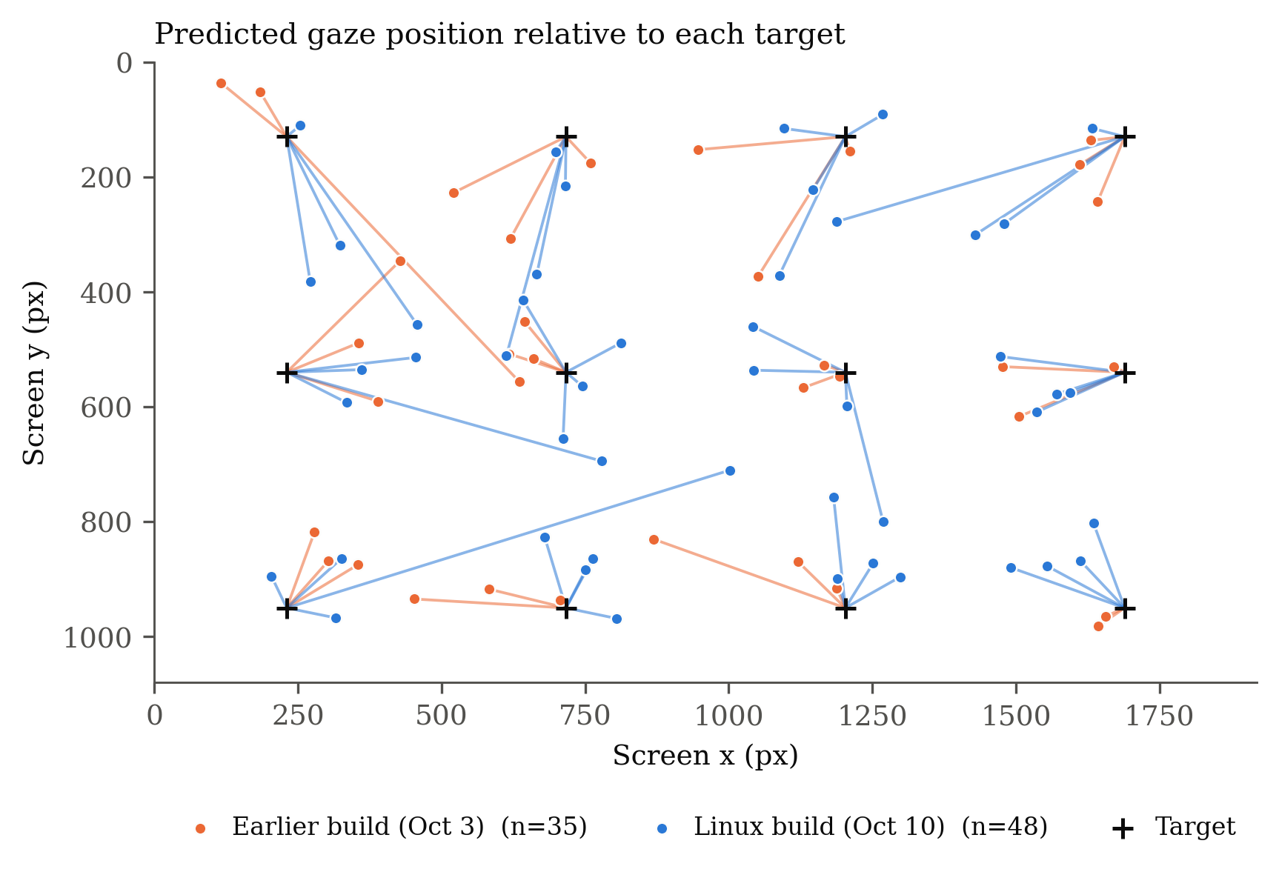
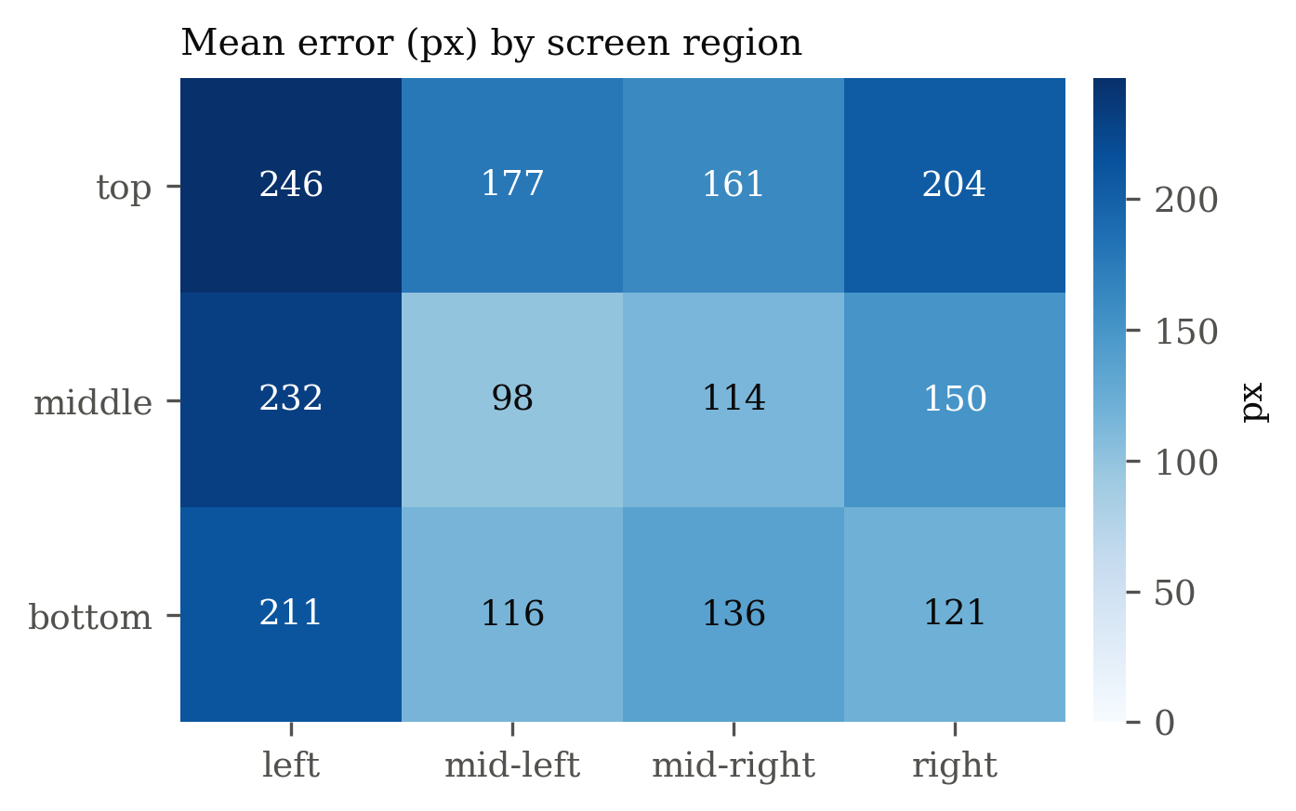
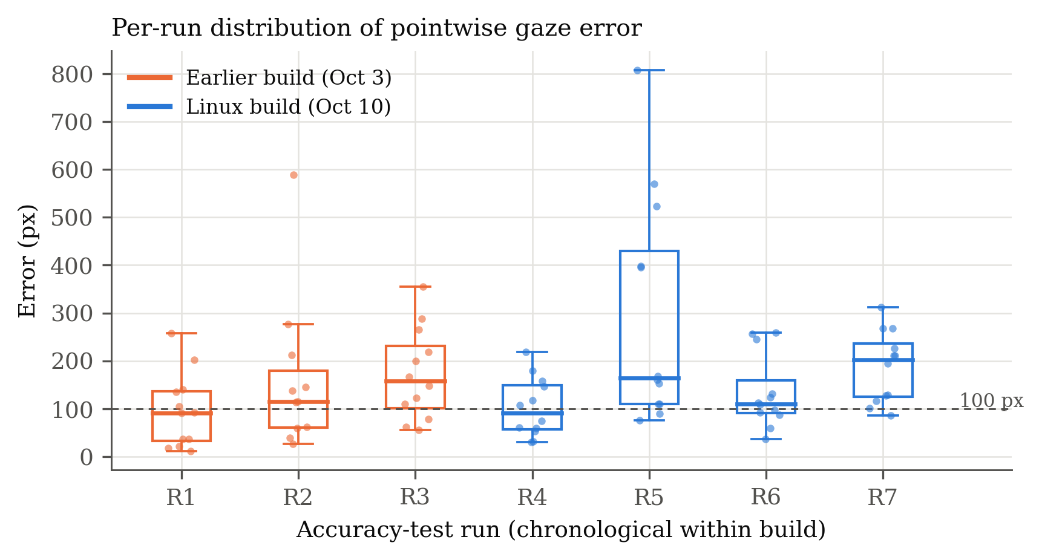
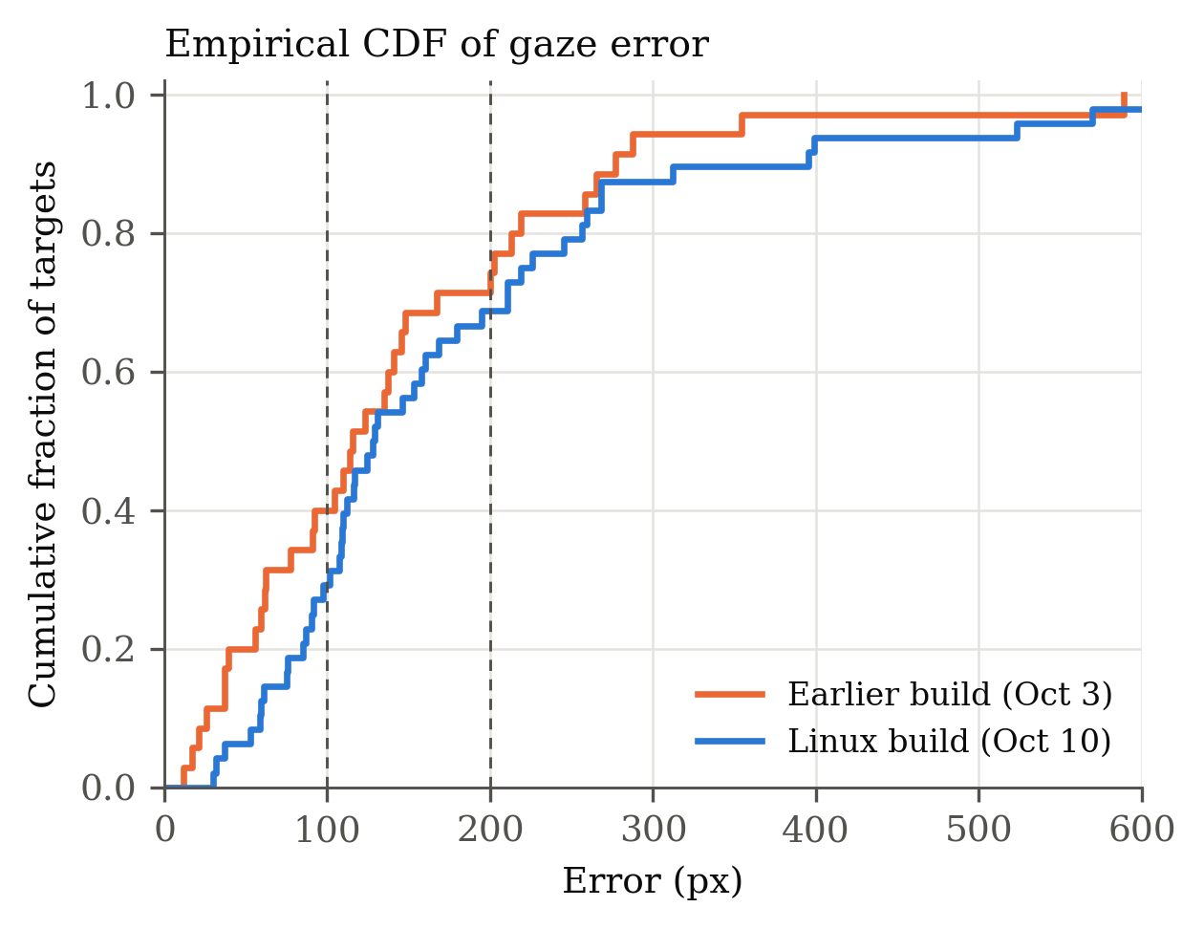
Gaze: Hands-Free Cursor Control from a Webcam
Measuring the on-screen accuracy of a calibrated, webcam-only eye tracker (Linux, Wayland port)
[Author name(s)] · ASDRP · Research poster, due Oct 11
Abstract
Results
Where the error is
Eye tracking can give people with limited motor control a way to use a computer without their hands, but most systems need dedicated infrared hardware. Gaze estimates where a user is looking from an ordinary webcam, calibrates that signal to the screen, and drives the real system cursor. We built a Linux (Wayland) port and an accuracy test that logs each target's predicted position. Across 7 valid runs (83 targets) the mean error was 164 px (median 124 px) on a 1920×1080 display, and 70% of targets landed within 200 px.
Figure 3. Mean error (px) by screen region. The left column is worst.
Motivation
Commercial gaze trackers are costly and tied to specific hardware. A webcam-only tool that runs locally keeps video on the device and works on the laptop a person already owns. The open question is whether its accuracy is good enough to hit real interface targets.
Figure 1. Predicted gaze position for each target (+), all valid runs. Lines join each prediction to its target.
164 px
124 px
70%
mean error
median error
within 200 px
Methods
Face and iris landmarks from MediaPipe FaceLandmarker (Lugaresi et al., 2019), with head pose.
One-Euro smoothing of the gaze signal.
Calibration: a 5×5 grid, a dwell window per point, then smooth-pursuit passes. A ridge regression maps eye features to screen position.
Accuracy test: 12 shuffled targets per pass, 600 ms settling time per target, mean predicted position logged against the target.
Cursor control: macOS CoreGraphics, Linux X11 XTest, and Wayland RemoteDesktop portal (libei).
Figure 4. Per-run error. Orange: earlier build; blue: Linux build. Run-to-run spread is large.
Discussion and limitations
Error was 100–250 px across most of the screen: enough for large controls, not small ones.
The earlier and Linux builds do not differ beyond run-to-run spread (mean 143 vs 180 px).
Left-edge targets averaged 211–246 px; centre columns 98–136 px.
Few runs, one participant, one display: results are descriptive. Viewing distance was not recorded, so no visual angle.
Figure 2. Cumulative distribution of error. Dashed lines mark 100 px and 200 px.
n = 83 targets, 7 runs. Two runs were excluded: one aborted after 2 points, one never held calibration (predictions stayed near x = 0.43).
Reference: Lugaresi, C. et al. (2019). MediaPipe: A Framework for Building Perception Pipelines. arXiv:1906.08172. Code and data: the Gaze repository (analysis/).

