Slide 1
Computational Geoscientist Assignment
Geomechanics

Slide 2
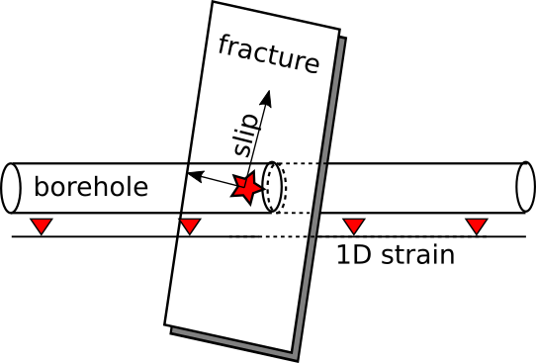
Modeling DAS data from hydraulic fracturing: overview
Chunfang Meng
A borehole section is pressurized to create hydraulic fracture (HF), while a fiber optic cable is embedded in the cement between the tube and rock matrix to sense the axial (1D) strains.
A numerical model already provides the borehole pressure and fracture opening in a time sequence.
Candidates are required to read in the synthetic dataset, perform two tasks, and answer three questions.

Slide 3
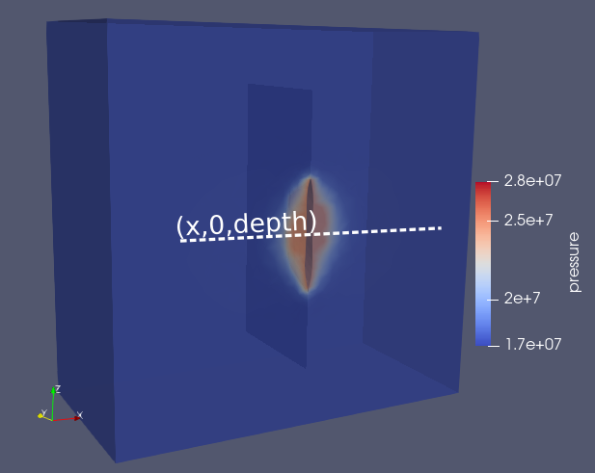
Modeling DAS data from hydraulic fracturing: visualization
HDF5 files:
Three-component displacement, pressure, and six-component stress measured along a synthetic DAS trace, in the axial dimension of the injection well.
fracture (three-component) slip on a fracture grid.
Above fields span multiple time frames of a interval dt.
Coordinates and orientation of the fracture grid.
Coordinates of the DAS trace.
Additional information about the rock matrix properties, a injection/flowback schedule, and a H5 field explanation, all in a README.md file.
Task 1:
Here, DAS is meant to measure (static) strain, but there is no strain in the H5 fields. The candidate will use the other fields to calculate the axial strain, in a time sequence;
produce a heat plot of the strain, horizontal axis being the axial-(x) dimension [m], vertical axis being time (s), and brightness being the synthetic stain.
Note that we expect to see two vertically spaced bright spots for two injection cycles respectively.

Slide 4
Modeling fiber optic data from hydraulic fracturing: analysis
Task 2:
From the fracture data, approximate a sequence of fracture radius, fracture volume, and average fracture width.
Sample two strain sequences, one at the intersection of the HF and DAS trace, and the other off the intersection by 10 meters. Produce two plots for the two strain sequences respectively, horizontal axis being the strains and vertical axis being the fracture attributes, including the radius, volume, the width at the intersection, and the average width.
Questions:
When the fracture stays closed, why the strains still change?
From these plots, which strain sequence is suited for sensing which fracture attributes, and why?
Can such strain data uniquely determine a disk-shaped fracture of a uniform width, and why?

