Slide 1
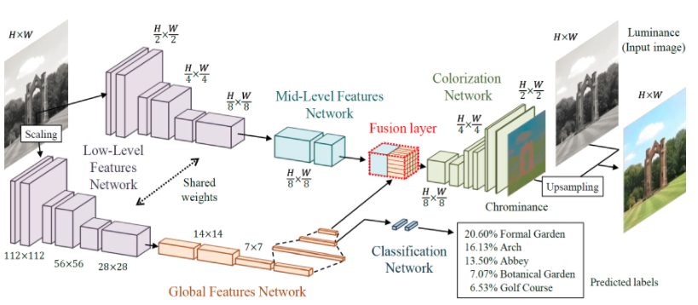
흑백 사진 색 복원하기
Low-level features network
Mid-level features network : local feature
Global features network : global feature
Colorization network : end-to-end model

Slide 2
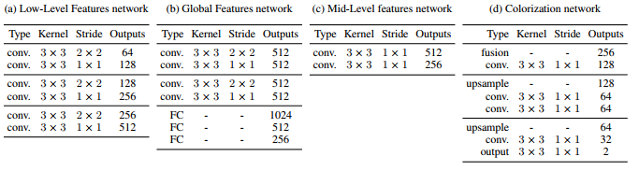
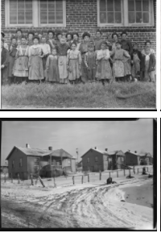
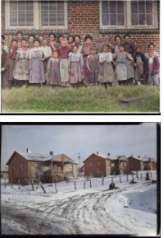
Input image
Output image

