Slide 1
Conditional Process Analysis
prepared by processR package

Slide 2
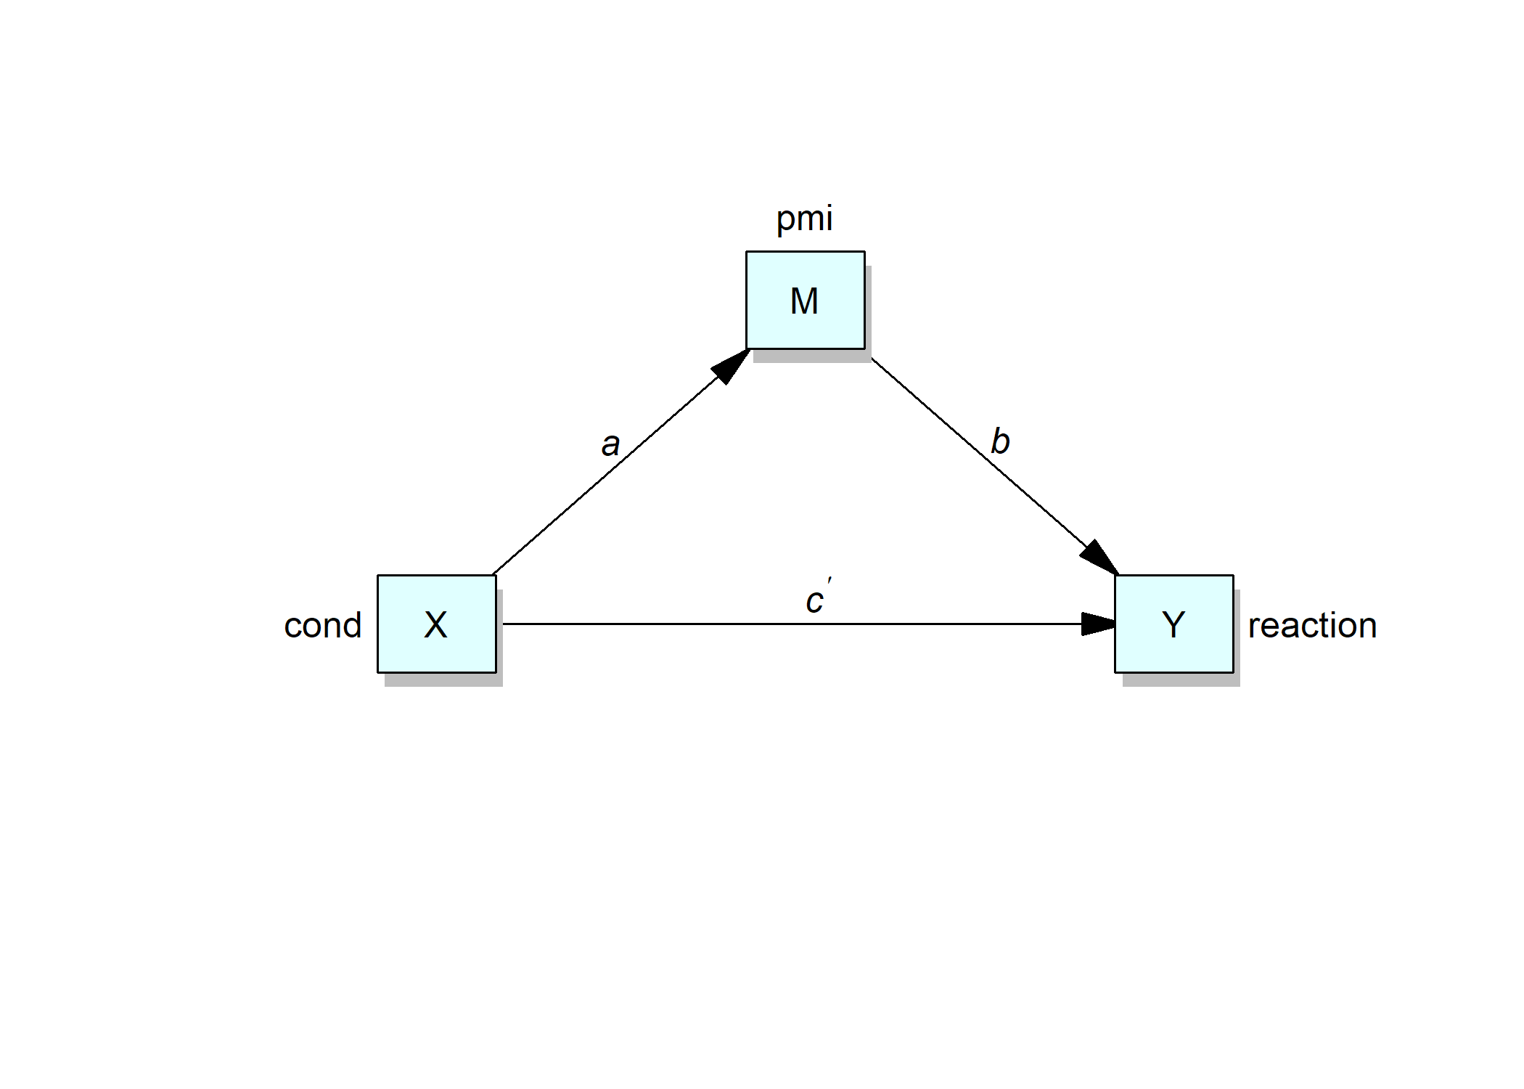

Slide 3
 | Consequent | Consequent | Consequent | Consequent | Consequent | Consequent | Consequent | Consequent | Consequent | Consequent | Consequent
 |  | pmi(M) |  |  |  |  |  | reaction(Y)
Antecedent |  | Coef | SE | t | p |  |  | Coef | SE | t | p
cond(X) | a | 0.477 | 0.236 | 2.022 | .045 |  | c' | 0.254 | 0.256 | 0.994 | .322
pmi(M) |  |  |  |  |  |  | b | 0.506 | 0.097 | 5.219 | <.001
Constant | i_{M} | 5.377 | 0.162 | 33.222 | <.001 |  | i_{Y} | 0.527 | 0.550 | 0.958 | .340
Observations |  | 123 |  |  |  |  |  | 123
R2 |  | 0.033 |  |  |  |  |  | 0.206
Adjusted R2 |  | 0.025 |  |  |  |  |  | 0.193
Residual SE |  | 1.305 ( df = 121) |  |  |  |  |  | 1.393 ( df = 120)
F statistic |  | F(1,121) = 4.088, p = .045 |  |  |  |  |  | F(2,120) = 15.557, p < .001

Slide 4
