Slide 1
10710EECS204001 Data Structures Homework 3
2018/11/1 10:10
~
2018/11/22 23:59

Slide 2
Tree representation – S-Expression
Tree can be recursively defined
Tree = ( root (left_tree)(right_tree) )
Empty tree = ()
Tree with one node ( 1 ()() )
Tree represented as (1(2()())(3()()) )
1
1
2
3

Slide 3
More complicated case
(1 (2()(3()()))(4()()))
Root
Left sub-tree
Right sub-tree
1
2
4
3

Slide 4
(1(2(4()())(5()()))(3(6()())(7()())))
1
2
3
4
5
6
7

Slide 5
Homework3
In this homework, you have to implement the following functions
Construct_tree
Inorder traversal
Preorder traversal
Postorder traversal
Levelorder traversal
Tree height
Tree weight sum
Maximum Path Sum
Invert

Slide 6
Construct_tree
Construct a binary tree for the given s-expression
Input: S-expression of binary tree
(1 (2()(3()())) (4()())
Output: A node, which is the root node of the binary tree represented by input s-expression

Slide 7
traversal
1
Inorder traversal
Print every node’s weight in inorder
4 2 5 1 6 3 7
Preorder traversal
Print every node’s weight in preorder
1 2 4 5 3 6 7
Postorder traversal
Print every node’s weight in postorder
4 5 2 6 7 3 1
Level-order traversal
Print every node’s weight in level order
1 2 3 4 5 6 7
2
3
4
5
6
7

Slide 8
Tree height
1
2
3
Calculate the tree height of a binary tree
Input: root of the binary tree
Output: an integer, indicating the height of the tree
In this example, height = 3
4
5
6
7

Slide 9
Weight sum
1
2
3
Sum of all the node weights in the binary tree
Input: the root of the tree
Output: the sum of weights of all the nodes
In this example, sum = 28
4
5
6
7

Slide 10
Maximum Path Sum
1
2
3
Find a path from root to leaf,
such that the summation of node weights
in the path is maximum.
Input: the root of the tree
Output: the maximum sum of the path
In this example, output 11 (1->3->7)
4
5
6
7

Slide 11

Invert
Invert binary tree
Problem of google interview

Slide 12
Invert
Invert the binary tree
Input: the root of the tree
Output: the root of the tree, where the nodes in this tree are reversed
1
1
2
3
3
2
4
5
6
7
7
6
5
4

Slide 13
Hint for constructing the tree
Parse the given string to find the root, the left sub-tree and the right sub-tree.
(1(2(4()())(5()()))(3(6()())(7()())))
Root = 1
Left sub-tree = (2(4()())(5()()))
Right sub-tree = (3(6()())(7()()))
How to identify sub-trees?

Slide 14
Hint for constructing the tree
Note that a tree must start with a ‘(‘ and end with a ‘)’
You can use a stack to match ‘(‘ and ‘)’
Push a ‘(‘ in the beginning, and pop when seeing a ’)’
When the stack is empty, a sub-tree is built
Or you can simply use a variable to do this

Slide 15
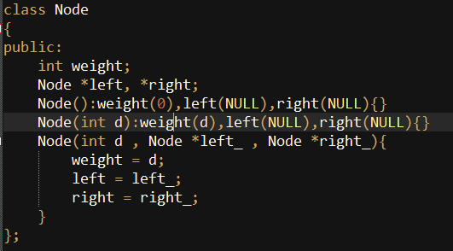
Partial judge header
Definition of tree node is as follows

Slide 16
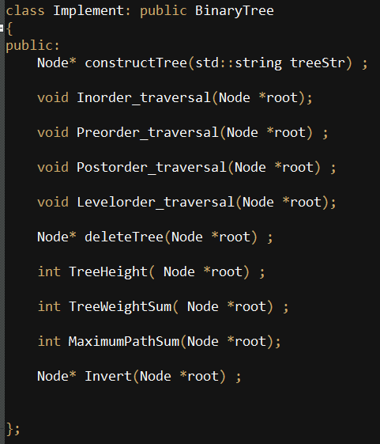
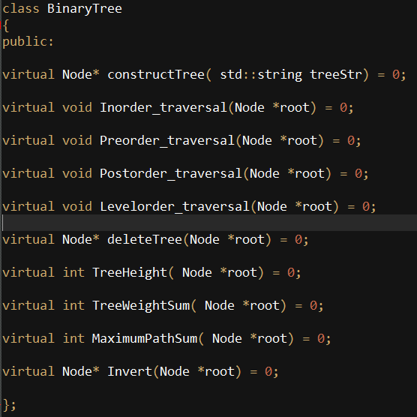
Partial judge header
You have to implement the class “Implement” which inherits the binary tree class.

Slide 17
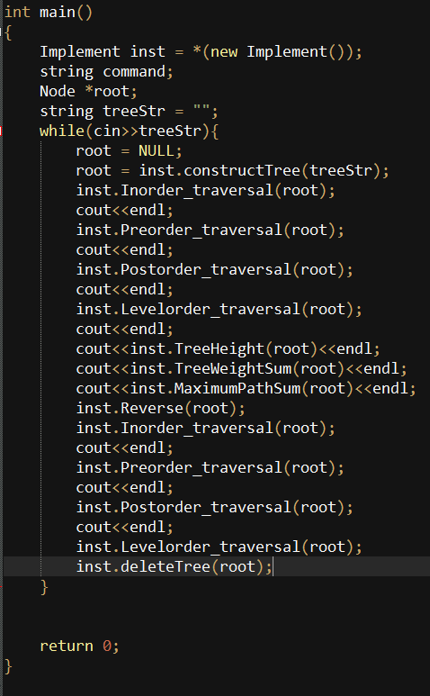
Partial judge code
In main function, we will test every
function that you need to implement

Slide 18
Sample input
Input: we will give you a string of s-expression, and you need to construct a tree from the string
(1(2(4()())(5()()))(3(6()())(7()())))
1
2
3
4
5
6
7

Slide 19
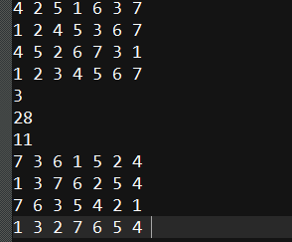
Sample output
According to main function we give you, print the following information
Inorder traversal
Preorder traversal
Postorder traversal
Levelorder traversal
Height of tree
Weight sum of tree
Maximum path sum of tree
Inorder traversal after inverting
Preorder traversal after inverting
Postorder traversal after inverting
Levelorder traversal after inverting

Slide 20
Submit
Online Judge: 12052
http://140.114.86.238/problem/12052/
ilms: submit main, function.h, makefile and your function.cpp to ilms before deadline

