Slide 1
10710EECS204001 Data Structures Homework 4
2018/11/13 10:10
~
2018/11/27 23:59

Slide 2
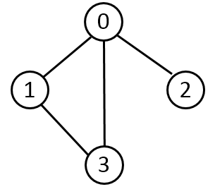
Graph
A graph is represented as follows
VertexArr
0
1
2
3
neighbors:
3
2
1
neighbors:
3
0
neighbors:
0
neighbors:
1
0

Slide 3
Graph
No self loops
No multiple edges
0
0
1

Slide 4
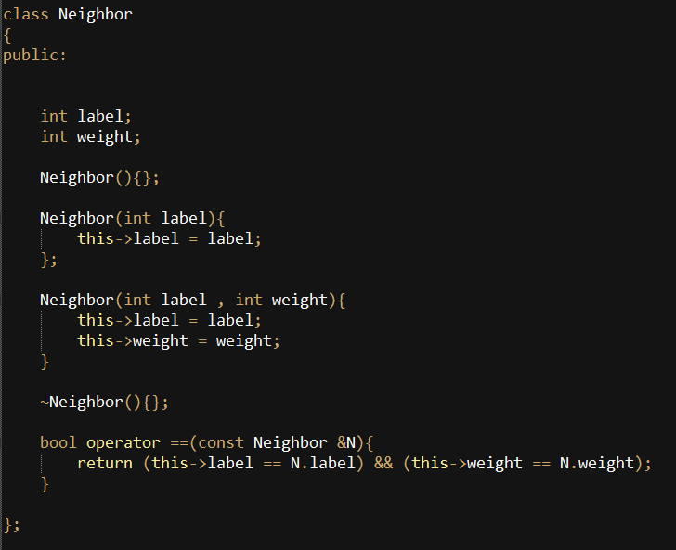
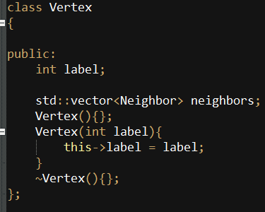
Declaration of vertex and edge
Edge Vertex

Slide 5
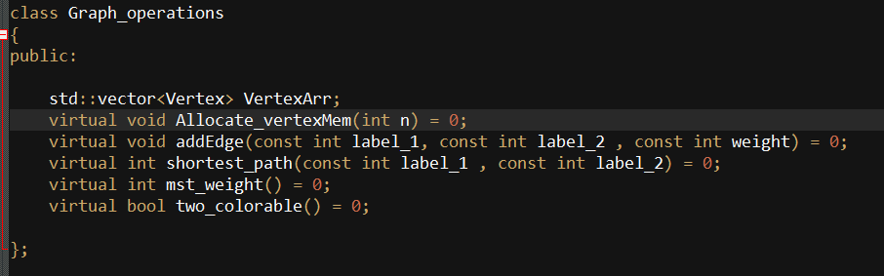
Declaration of graph

Slide 6
Function to implement
You are given a connected, undirected graph
You have to implement following functions
addEdge
shortest_path
mst_weight
two_colorable

Slide 7
addEdge
Input: three integers: the teriminals of the edge and its weight
E.g., add 0 1 4
Add a new edge between node 0 and node 1 with edge weight 4
0
4
1

Slide 8
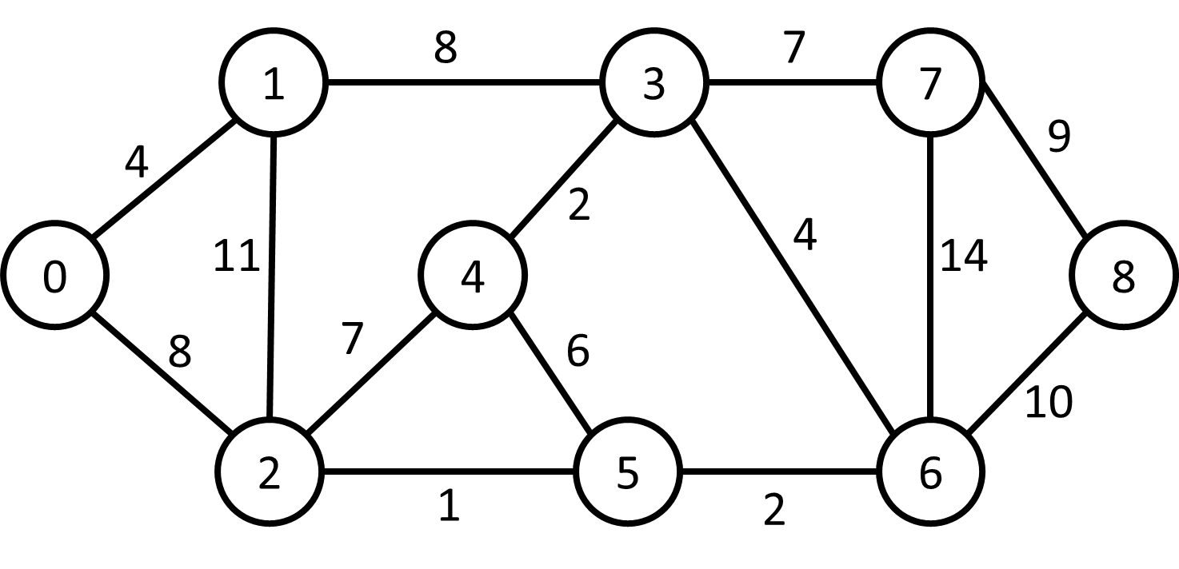
An example
add 0 1 4
add 0 2 8
add 1 2 11
add 1 3 8
add 2 4 7
add 3 4 2
add 2 5 1
add 4 5 6
add 3 6 4
add 5 6 2
add 3 7 7
add 6 7 14
add 7 8 9
add 6 8 10

Slide 9
shortest_path
Input: two integers indicating the two node ids to be compute shortest path length between
E.g. shortest_path 0 3
Output: the length of the shortest path length between two nodes
In this example
“shortest_path 0 3” outputs 12

Slide 10
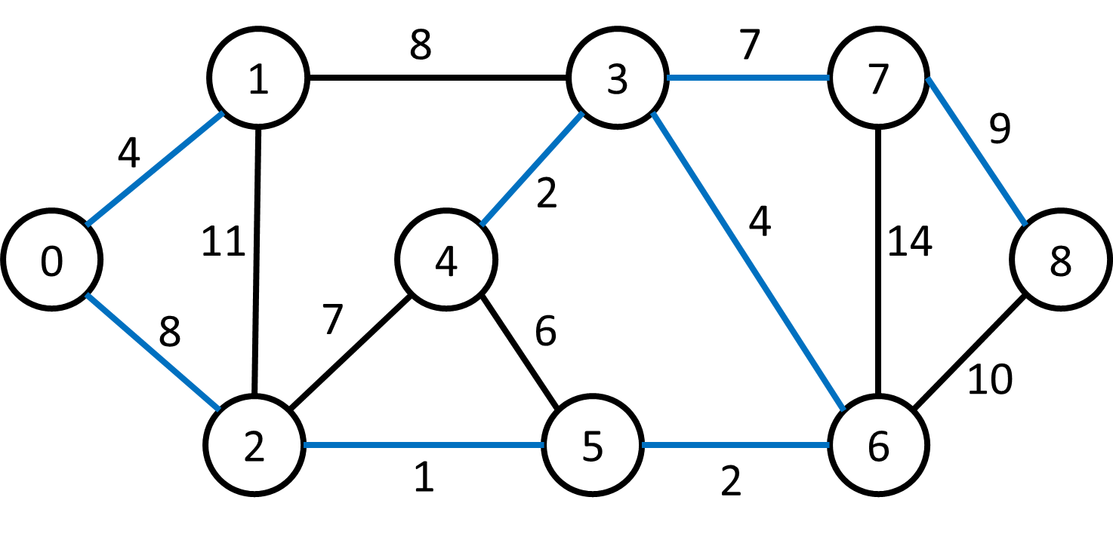
mst_weight (minimum spanning tree weight)
Takes no input
Output the sum of edge weights of the minimum spanning tree
E.g., calling “mst_weight” outputs 37

Slide 11
two_colorable
Check if a given graph is two-colorable
Definition of two-colorable
Color every vertex in a graph with two colors
Any adjacent vertices cannot be colored with the same color
If a graph can be colored with two color only, we say the graph is two colorable
If the graph is two-colorable, output two-colorable
If the graph is NOT two-colorable, output not two-colorable

Slide 12
Two colorable
Two colorable
Not two colorable

