Slide 1


Android Lecture #
3week
GPS

Slide 2

Contents
GPS
Use of GPS
Example

Slide 3

GPS

Slide 4

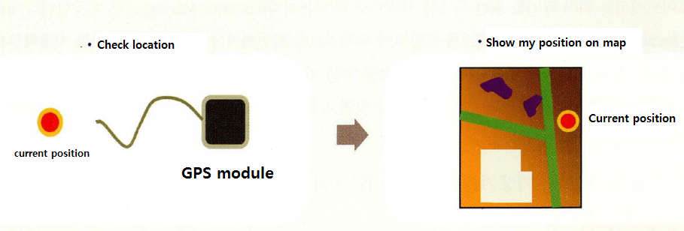
1. GPS

Slide 5
2. Use of GPS
Support LocationManager ( android.location )

Slide 6
Thank you!

