Slide 1


Towards Understanding and Fixing Upstream Merge Induced Conflicts in Divergent Forks: An Industrial Case Study
ICSE 2020
Chungha Sung | Shuvendu K. Lahiri | Mike Kaufman | Pallavi Choudhury | Chao Wang

Slide 2


Divergent fork
Original project
development
(upstream)
version N
version N+1
version N+2
fork
Independent development
or customization
(downstream)
version N’
version N’+1
version N’+2

Slide 3












Divergent fork - examples
Forked
Chromium
Chromium-based web browsers

Slide 4
Problem?
Frequent update of upstream
Security patches, feature changes
The changes need to be merged regularly for security and compatibility
Original project
development
(upstream)
version N
version N+1
version N+2
fork
Merge
Merge conflicts
Textual merge
Build break
Test failure
Independent development
(downstream)
version N’
version N’+1
version N’+2

Slide 5
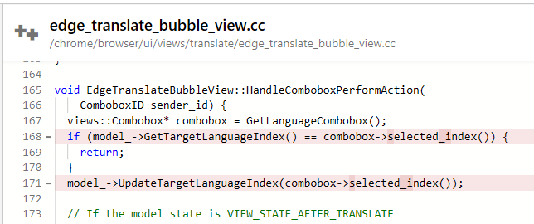
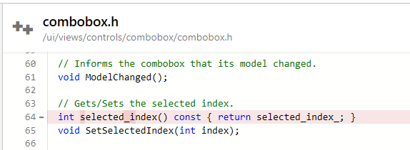
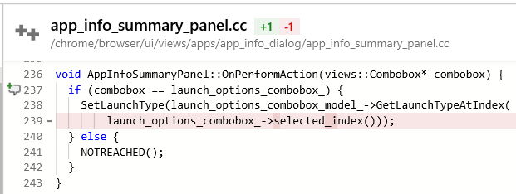

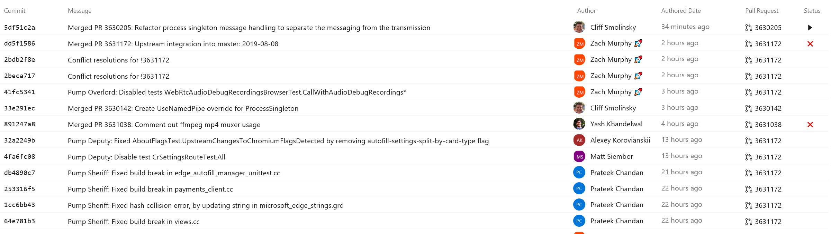
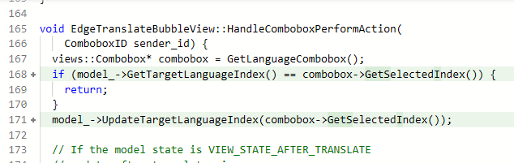
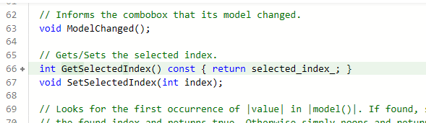
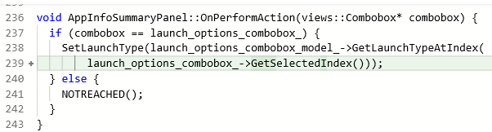
Build break file in Edge
API use change in Chromium
API def. change in Chromium
Undefined symbol
Undefined symbol
Commit history of Chromium
Build Break
Edge code fix (05/06/2019, 7abf5c10)
Chromium code update (05/02/2019, 0b079bf5)
merge
release
May
Timeline

Slide 6
Look for
Chromium changes
Update Edge
- More than 25,000 commits in Chromium for 3 months
- Necessary for up-to-date release but, a lot of engineering work
-> Chromium-based browsers are 1~8 versions behind from the recent Chromium version
Solved
Build Break
Build Break
Build Break
merge
release
May
Timeline

Slide 7

North Star: What Do We Want?
Build-break occurred!
Build break file in Edge
Root-cause in Chromium
Undefined symbol
x
Undefined symbol
Auto-fix is available: Do you want to apply auto-fix?
The root-cause of the build break
Yes
No
Yes
Auto fixed

Slide 8
Overview of the work
Contribution 1: understanding the nature of merge related conflicts in divergent forks
Study merge induced conflicts
Categorize the conflicts
Contribution 2: prototyping a tool for automatic fixes
AST-based auto-patch
Input commit pruning
Feasibility check

Slide 9
Structure of Edge development
Upstream
One cycle of merge
integration
stabilization
fork
Origin/master
(Downstream)
Each commit in upstream branch
Each commit in stabilization branch
Each commit in integration branch
Each commit in stabilization branch

Slide 10
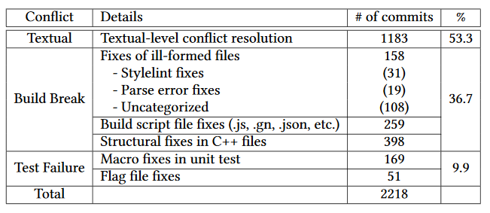
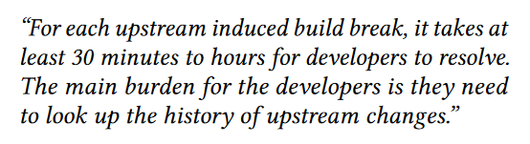
Distribution of fixes during merges
Microsoft Edge
30 cycles of merges for three months for more than 25,000 commits of Chromium
Include Statement Update
Entire Function Definition/Call Update
Function Name Update
Function Type/Specifier Update
Function Parameter/Argument Update
Function Parameter/Argument’s Type Update
Class/Namespace/Enum Reference Update
Uncategorized
Our target
- A senior manager in the Microsoft Edge development team

Slide 11
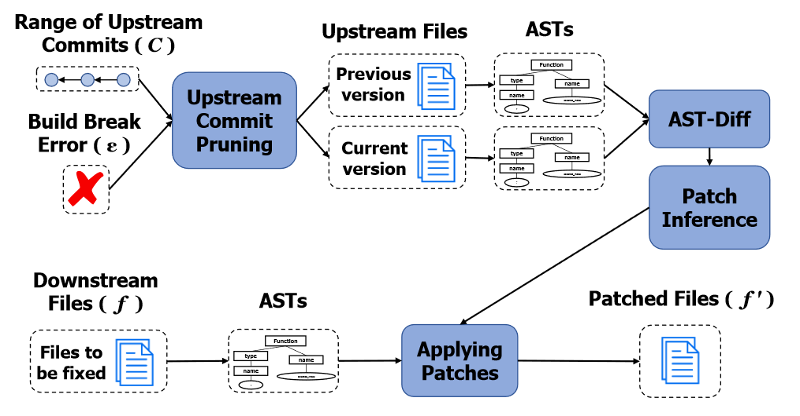
Overview of automatic patch

Slide 12
Patch inference from two upstream versions
Definition change
Use change
Function
Function
Call
Call
Definition
Change
Use
Change
type
name
type
name
name
argument_list
Diff
name
argument_list
Our inference: “Apply GetSelectedIndex for call-name with selected_index”
Diff
name
selected_index
name
GetSelectedIndex
selected_index
GetSelectedIndex
Previous AST
Current AST
int
int
Diff results: “Update selected_index to GetSelectedIndex in name”
Previous AST
Current AST
Diff results: “Update selected_index to GetSelectedIndex in name”

Slide 13
Apply pathes to downstream
Downstream AST
block
decl
call
name
argument_list
type
name
GetSelectedIndex
selected_index
Our inference: “Apply GetSelectedIndex for call-name with selected_index”

Slide 14
Overview of automatic patch
Problem: scalability
- The size of source code: > 300,000 files
Creating AST and diffing ASTs for all files are too expensive
Too many commits to consider

Slide 15
Input commit pruning
Last commit
we merged
4. Selected commit to be used as input for AST-based patch
The commit
we want to merge
Upstream
3. Find commits which updates the files
2. Find files which have the definitions
integration
stabilization
The commit where the build break occurred
fork
Origin/master
(Downstream)
1. Latest working version
Each commit in upstream branch
Each commit in stabilization branch
Each commit in integration branch
Each commit in stabilization branch

Slide 16
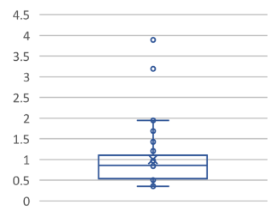
Feasibility check
Data range: Three months data (April, May, June in 2019)
Automatic fixed commit rate in average: 40%
Average fix time: 70.90 seconds
Considered classes | Fixed commit rate
Function Name Update | 67.8%
Function Type/Specifier Update | 40%
Function Parameter/Argument’s Type Update | 21.4%
Class/Namespace/Enum Reference Update | 24.5%
# of commits selected out of 1000 commits by upstream commit pruning

Slide 17
Conclusion
The first industrial case study of upstream merge induced conflicts in a divergent fork.
Categorized a class of merge conflicts and build breaks among them.
Provided an automatic patch method with input commit pruning and AST-based fix.
Encouraging feasibility results by giving an insight of divergent fork development

Slide 18
Thank You
- Please find our paper for more details!: chunghasung.org

