Slide 1

Kobe Bryant Shot Analysis and Prediction
Chunhan Li
Junyi Song
Rui Hu
Houbo Wang

Slide 2

Explore Data Analysis
Predict if shots are good

Slide 3
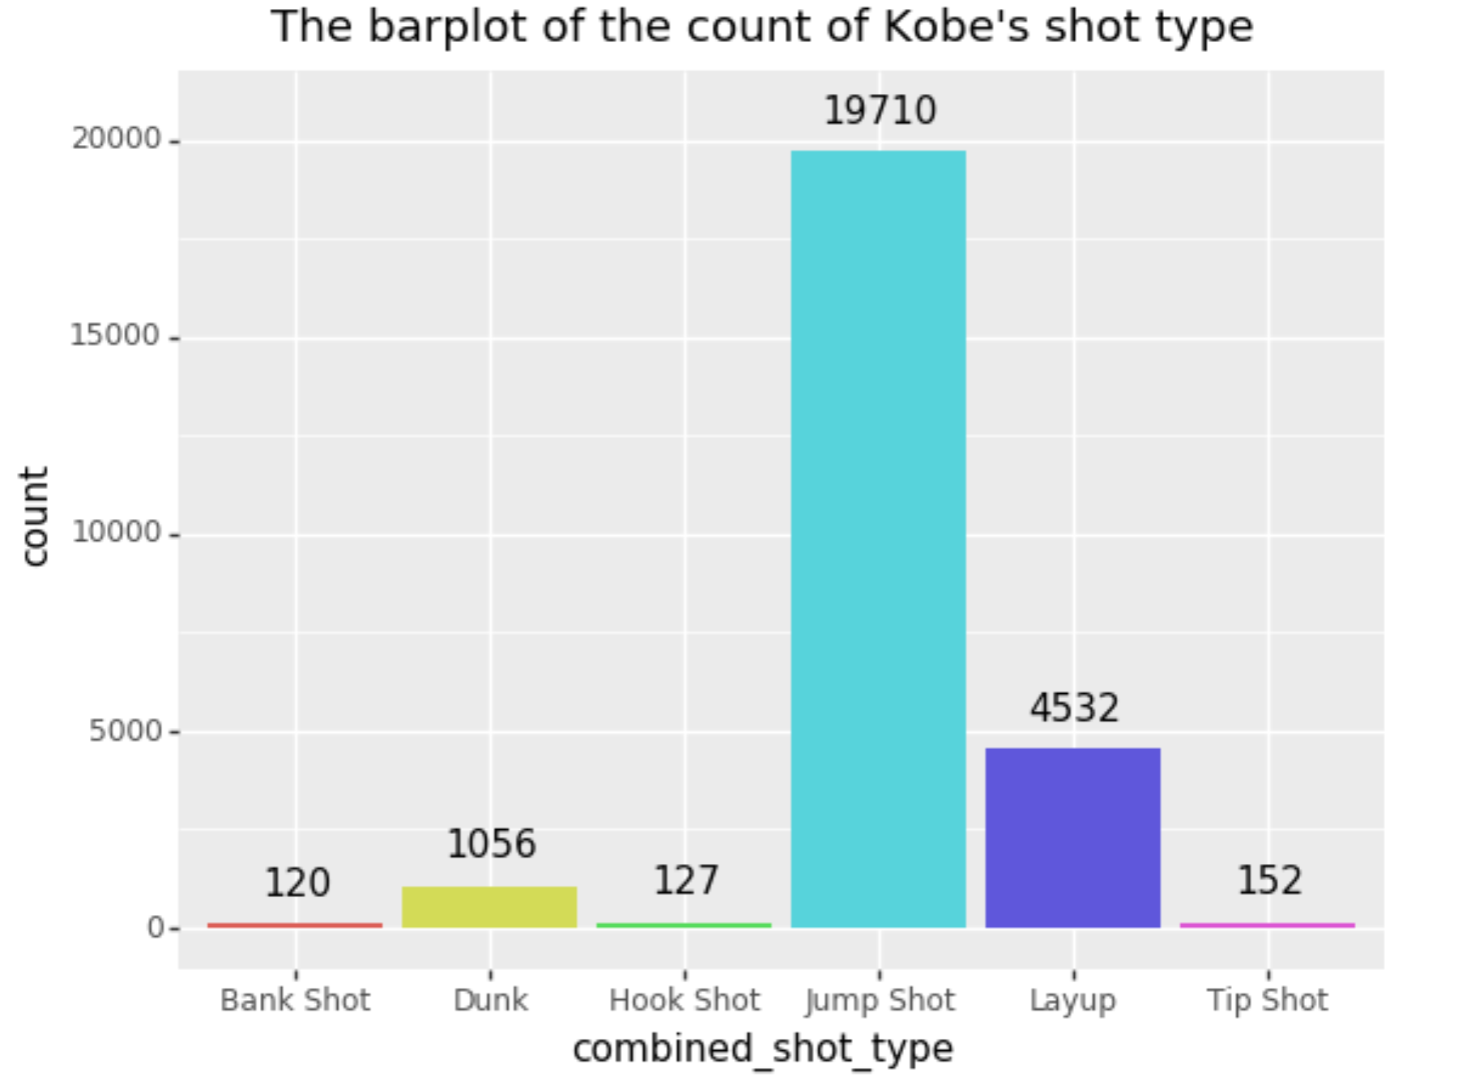
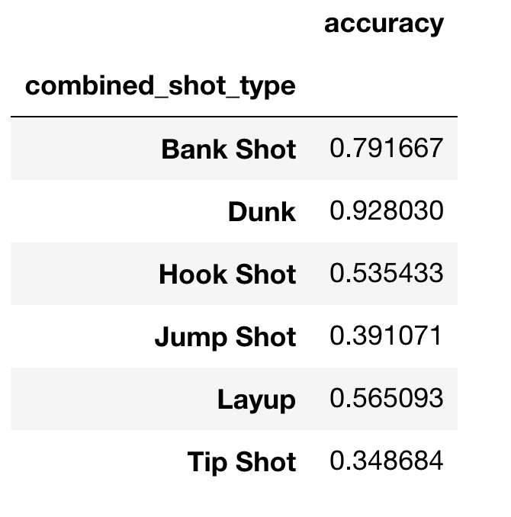
Explore Data Analysis
Accuracy vs Shot type

Slide 4
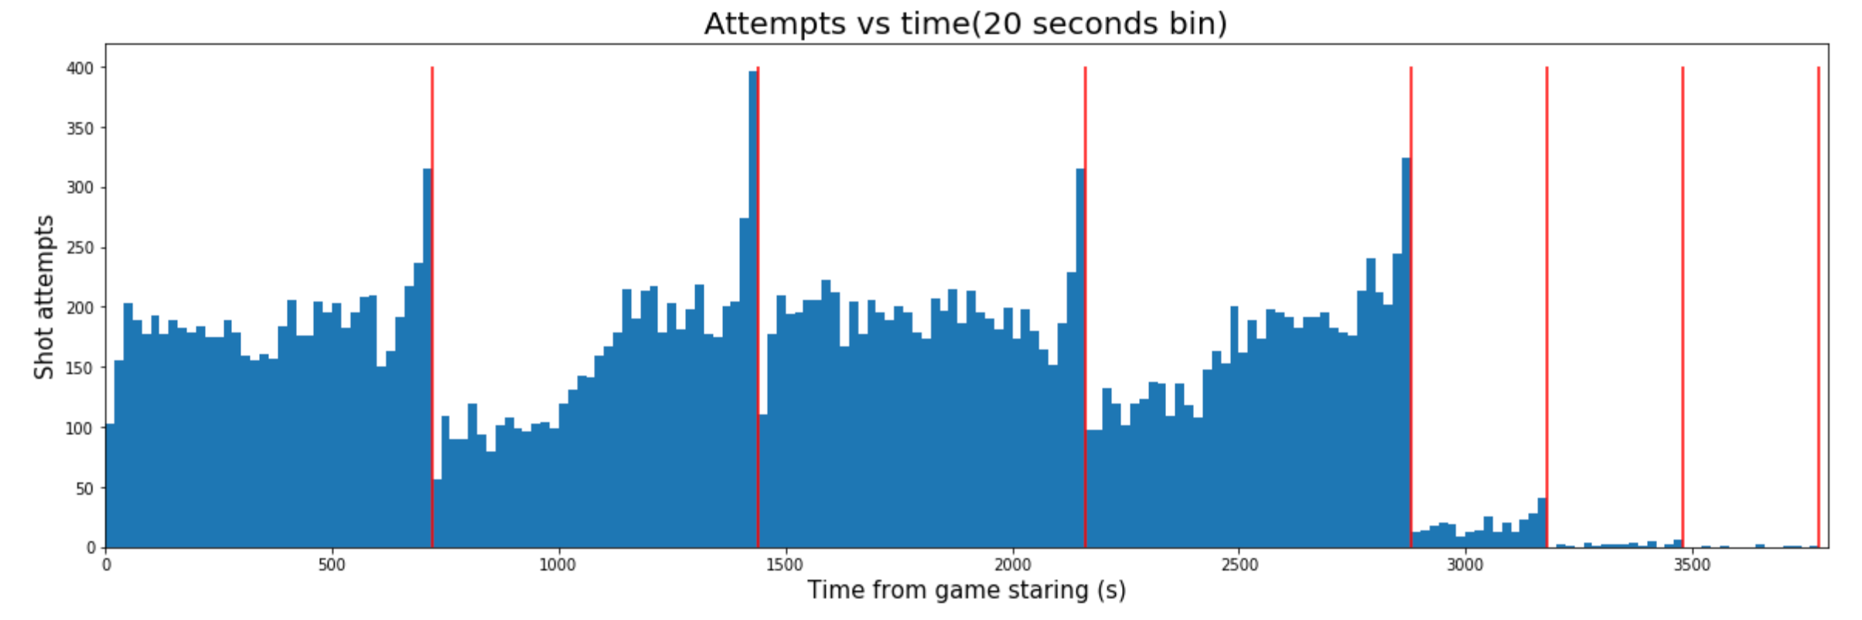
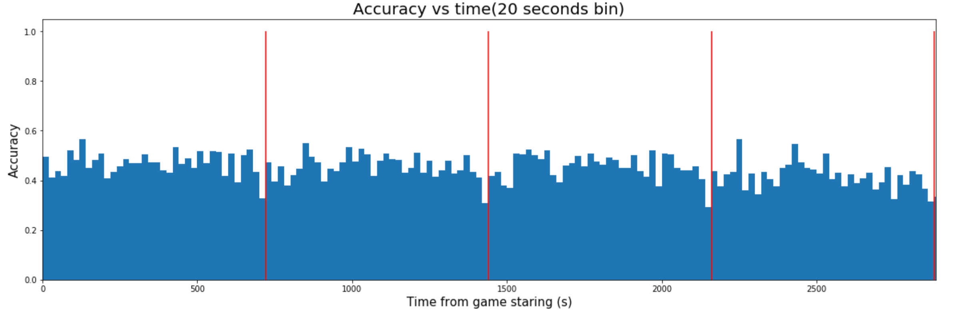
Explore Data Analysis
Accuracy vs Time

Slide 5
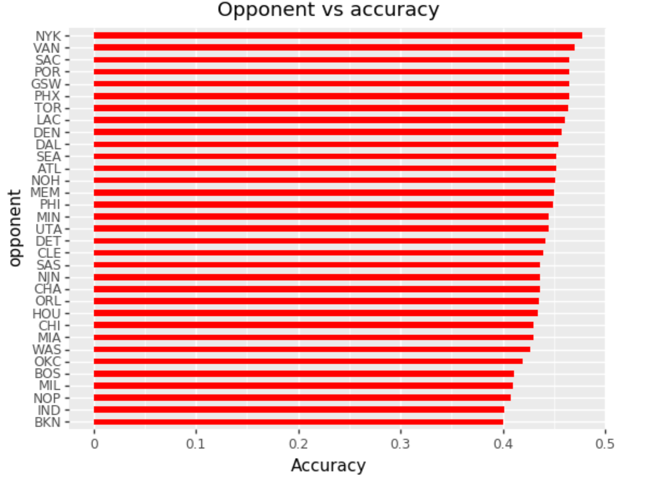
Explore Data Analysis
Accuracy vs Opponent

Slide 6
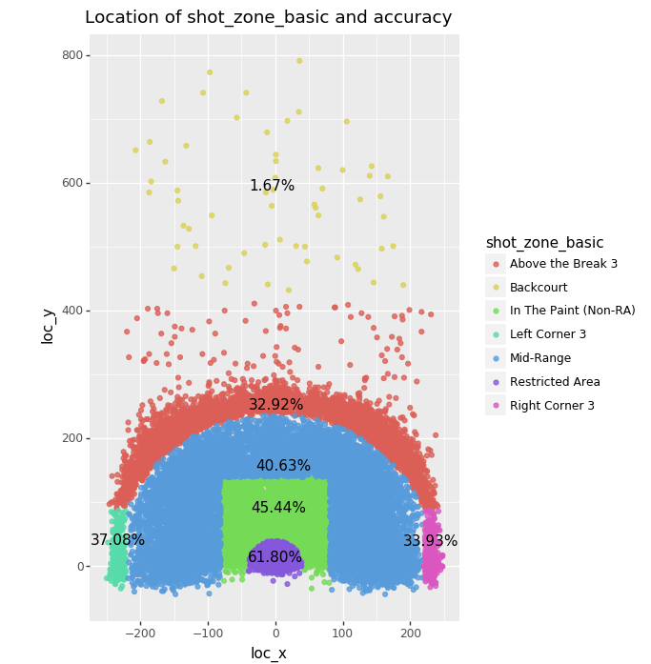
Explore Data Analysis
Accuracy
vs
Shot Zone

Slide 7
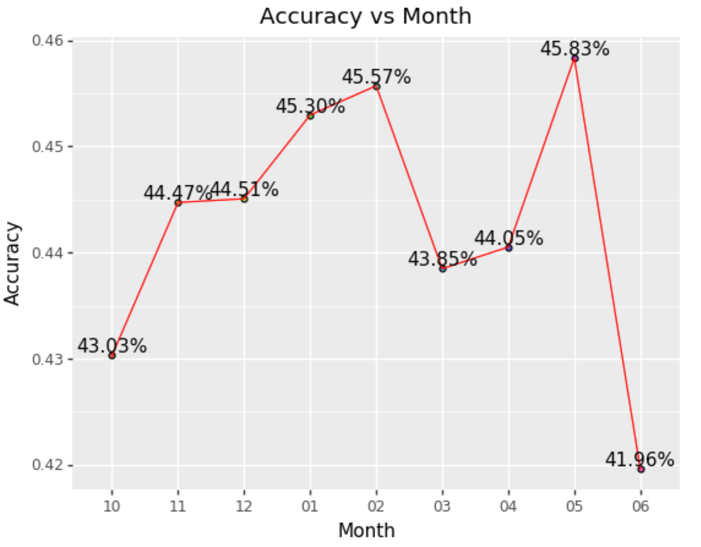
Explore Data Analysis
Accuracy vs Month

Slide 8
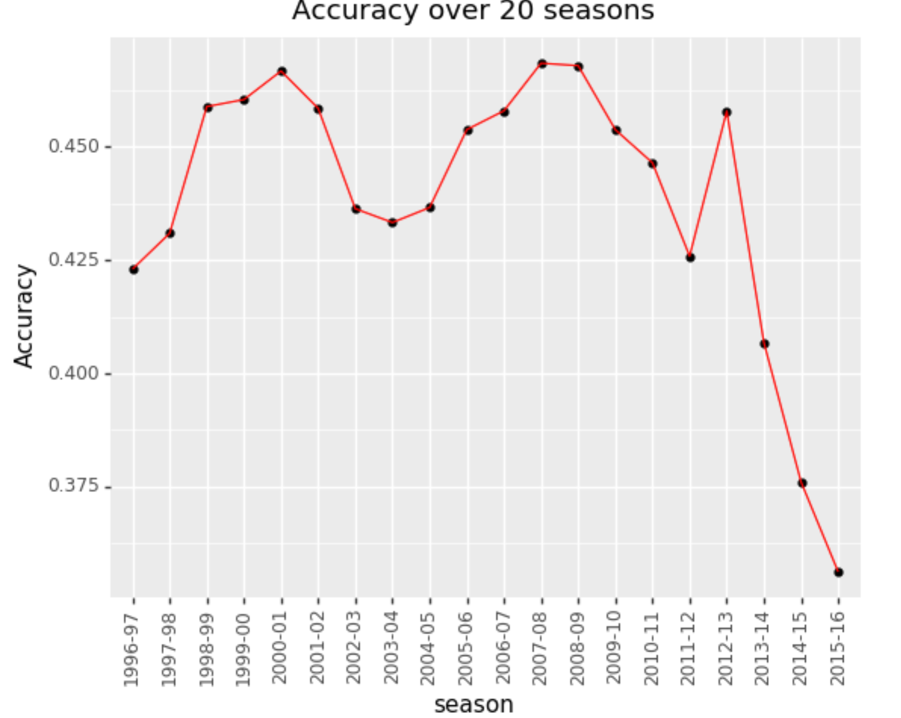
Explore Data Analysis
Accuracy vs Season

Slide 9
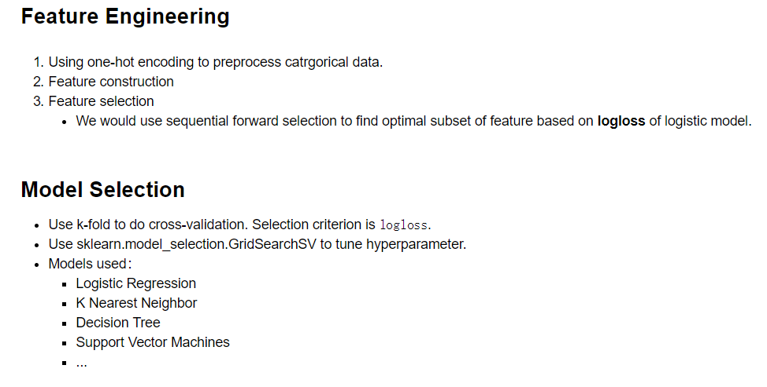
Prediction shots
Prediction

Slide 10
THANKS

