Slide 1
Extractive QA survey
Su Lixin
2017.9.21

Slide 2
QA 类型
数据集合任务介绍
论文模型结构和结果

Slide 3
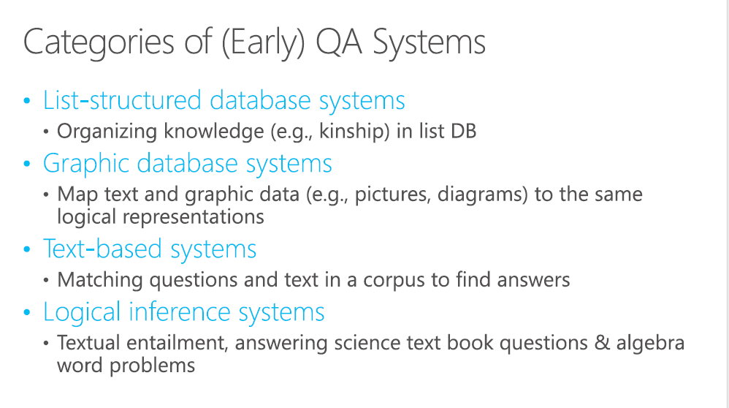
QA类型

Slide 4
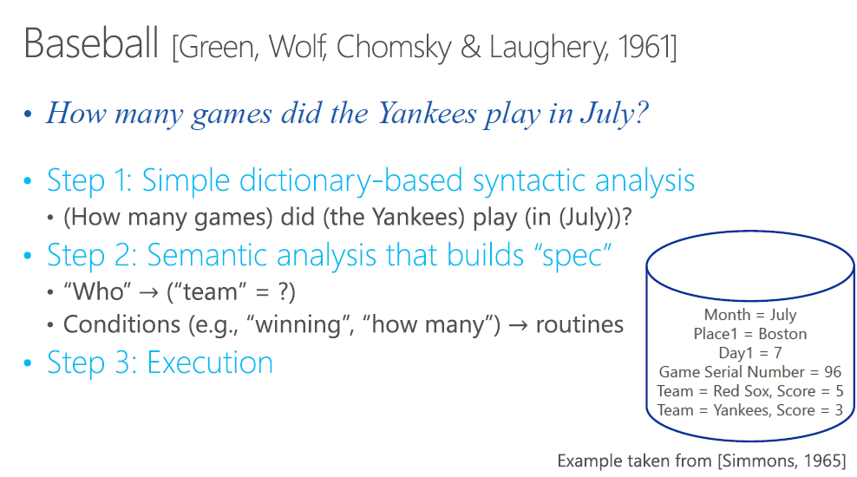
QA类型

Slide 5

QA类型

Slide 6
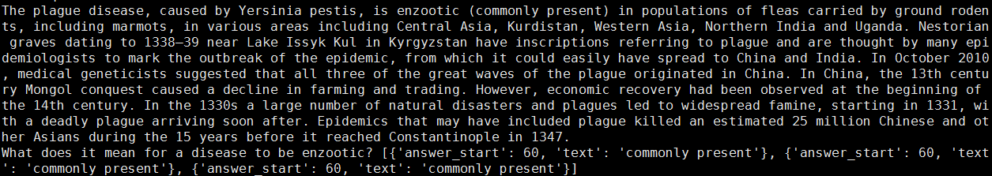
数据集合任务介绍
Stanford Question Answering Dataset (SQuAD) is a new reading comprehension dataset, consisting of questions posed by crowdworkers on a set of Wikipedia articles, where the answer to every question is a segment of text, or span, from the corresponding reading passage. With 100,000+ question-answer pairs on 500+ articles, SQuAD is significantly larger than previous reading comprehension datasets.
https://arxiv.org/pdf/1606.05250.pdf

Slide 7
数据集合任务介绍
Task： given context/paragraph/passage/document question , extract answer span(only one for squad) from context/paragraph/passage/document
Metric:
Exact match:This metric measures the percentage of predictions that match any one of the ground truth answers exactly.
(Macro-averaged) F1 score: This metric measures the average overlap between the prediction and ground truth answer. We treat the prediction and ground truth as bags of tokens, and compute their F1. We take the maximum F1 over all of the ground truth answers for a given question, and then average over all of the questions.

Slide 8




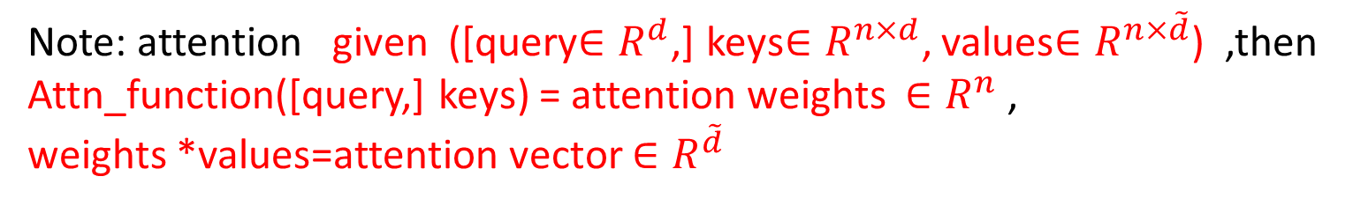
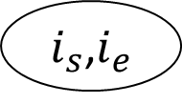



Note: attention given ([query$∈R^{d}$,] keys$∈R^{n×d}$, values$∈R^{n×\tilde{d}}$) ,then
Attn_function([query,] keys) = attention weights $∈R^{n}$ ,
weights *values=attention vector $∈R^{\tilde{d}}$
论文模型结构和结果
overview
$w_{i}^{p}$,$C_{i}^{p}$
$w_{j}^{q}$,$C_{j}^{q}$
Word emb , char (RNN/CNN) emb, word feature(POS NER)
embedding
embedding
$$\tilde{P}∈R^{n×d}$$
$$\tilde{Q}∈R^{m×d}$$
[Bi]LSTM,[Bi]GRU
encoder
encoder
$$P∈R^{n×h}$$
$$Q∈R^{m×h}$$
[Bidirection]Attetion
interaction
$$R∈R^{n×\tilde{h}}$$
Single hop, multi hop
Ptr-net, fc(normal,highway)
Answer layer
$i_{s}$,$i_{e}$

Slide 9







论文模型结构和结果
Wang S, Jiang J. Machine comprehension using match-lstm and answer pointer[J]. arXiv preprint arXiv:1608.07905, 2016.
Match-LSTM with Ans-Ptr
interaction
$$P_{i−1}$$
$$P_{i}$$
$$P_{i+1}$$
$$Q_{j−1}$$
$$Q_{j}$$
$$Q_{j+1}$$
$$α=v^{T}tanh⁡(W_{q}∗query+W_{k}∗key)$$
query
Keys, values
Attention vector
Query and Attn vector concat, then input to BiLSTM
Notes:
模型按照提交的结果的顺序叙述，基本上是按成绩由地到高在叙述

Slide 10

论文模型结构和结果
overview
answer layer
Output = Attention weights dim: n
$$α=v^{T}tanh⁡(W_{q}∗query+W_{k}∗key)$$
Hidden status
Note: in language model or NMT
Interaction vectors n
RNN
RNN
Hidden
fc
output
dim: C
Input: last output

Slide 11
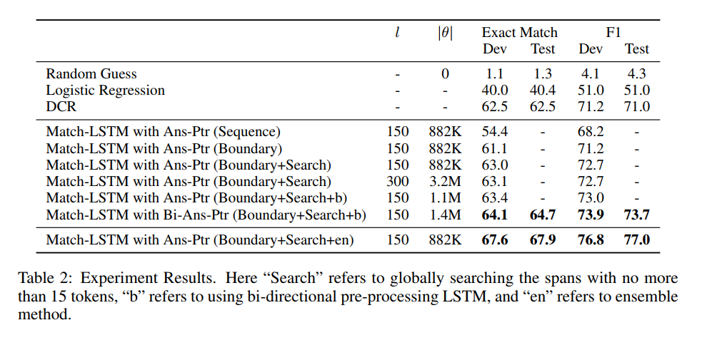
论文模型结构和结果
overview

Slide 12
论文模型结构和结果
overview
Yu Y, Zhang W, Hasan K, et al. End-to-end answer chunk extraction and ranking for reading comprehension[J]. arXiv preprint arXiv:1610.09996, 2016.
Dynamic Chunk Reader

Slide 13







论文模型结构和结果
overview
interaction
$$α={query}^{T}key$$
$$P_{i−1}$$
$$P_{i}$$
$$P_{i+1}$$
$$Q_{j−1}$$
$$Q_{j}$$
$$Q_{j+1}$$
query
Keys, values
Attention vector
Query and Attn vector concat, then input to BiGRU

Slide 14

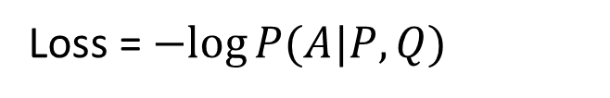

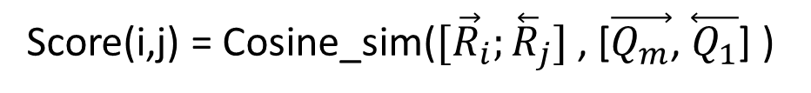
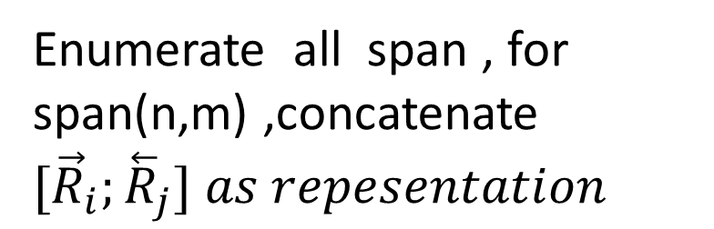

论文模型结构和结果
overview
answer layer
$$R_{i−1}$$
$$R_{i}$$
$$R_{i+1}$$
Enumerate all span , for span(n,m) ,concatenate ${[\vec{R}}_{i};{\overset{⃖}{R}}_{j}]$ $as repesentation$
Score(i,j) = Cosine_sim(${[\vec{R}}_{i};{\overset{⃖}{R}}_{j}]$ , [$\vec{Q_{m}}$, $\overset{⃖}{Q_{1}}$] )
Loss = $−log⁡P(A|P,Q)$

Slide 15
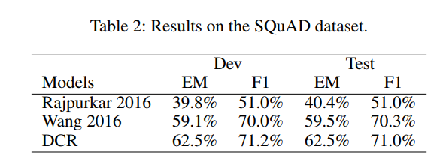
论文模型结构和结果
overview

Slide 16
论文模型结构和结果
overview
Xiong C, Zhong V, Socher R. Dynamic coattention networks for question answering[J]. arXiv preprint arXiv:1611.01604, 2016.
Dynamic Coattention Networks

Slide 17
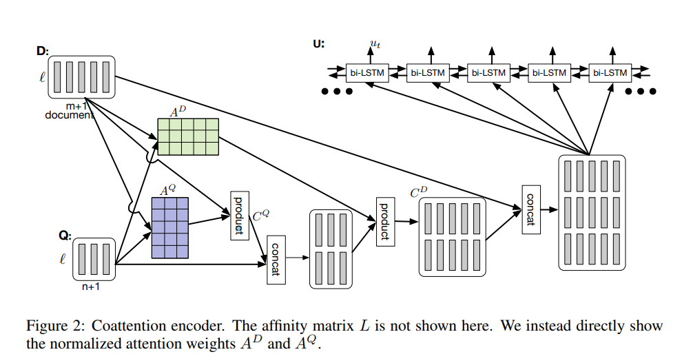
论文模型结构和结果
overview
coattention encoder

Slide 18
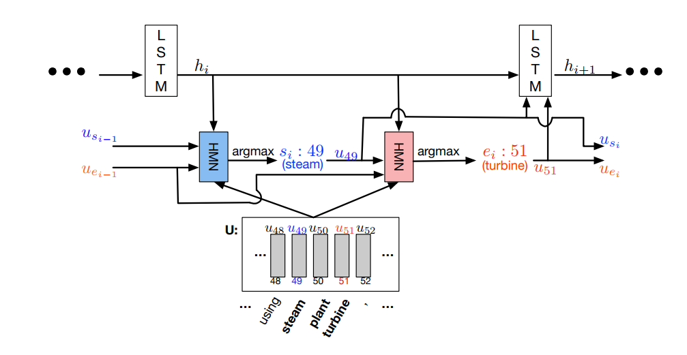
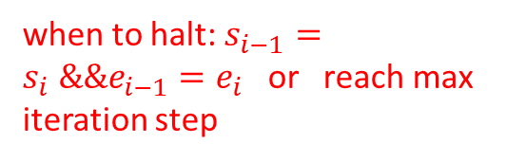
论文模型结构和结果
dynamic pointing decoder
During each iteration, the decoder updates its state taking into account the coattention encoding corresponding to current estimates of the start and end positions, and produces, via a multilayer neural network, new estimates of the start and end positions.
Last estimate start position vector
Last estimate end position vector
Interaction output length equal to length of paragraph
when to halt: $s_{i−1}=s_{i} \&\&e_{i−1}=e_{i}$ or reach max iteration step

Slide 19
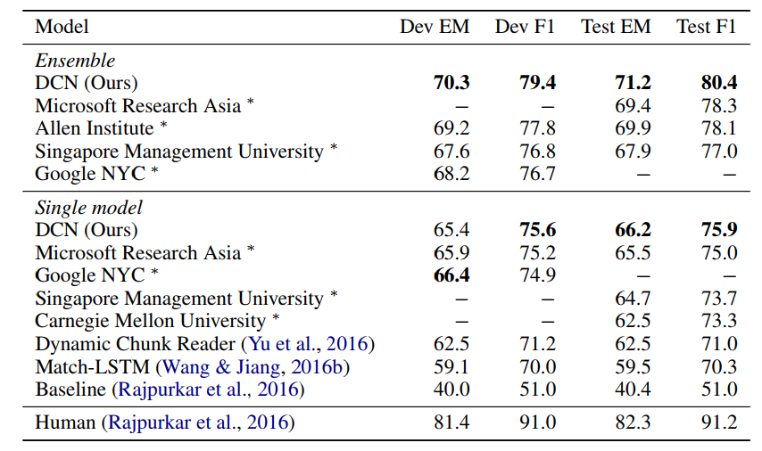
论文模型结构和结果

Slide 20
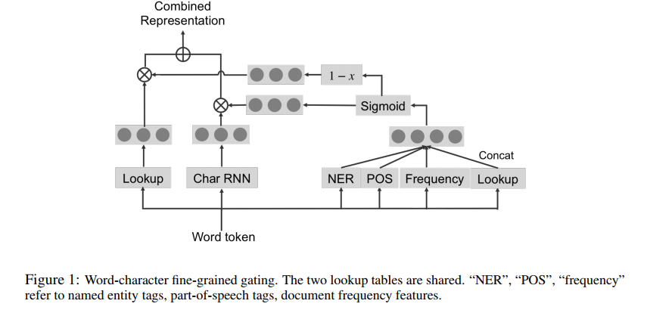
论文模型结构和结果
Yang Z, Dhingra B, Yuan Y, et al. Words or characters? fine-grained gating for reading comprehension[J]. arXiv preprint arXiv:1611.01724, 2016.
Fine-Grained Gating
embedding
gate
every dimension of embedding

Slide 21
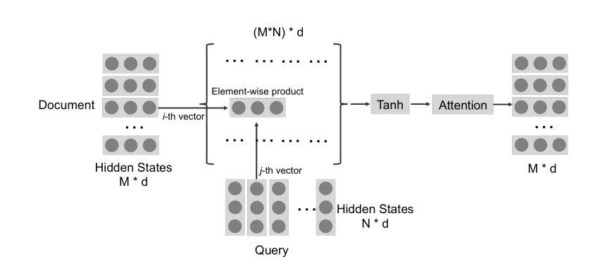
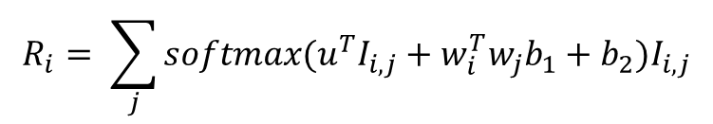

论文模型结构和结果
interaction
$$R_{i}$$
$$R_{i}= \sum_{j}{softmax(u^{T}I_{i,j}+w_{i}^{T}w_{j}b_{1}+b_{2})I_{i,j}}$$
Attention vector
key
value

Slide 22
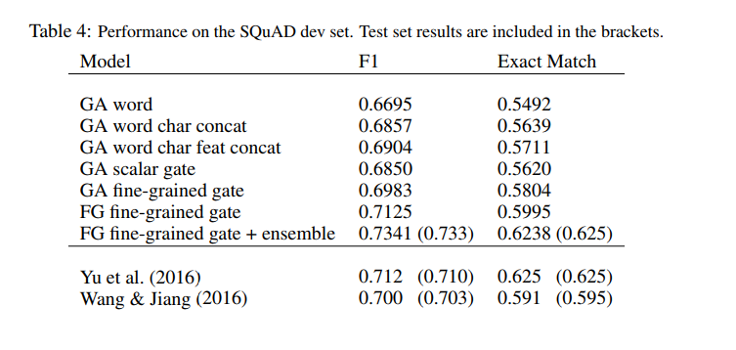
论文模型结构和结果

Slide 23
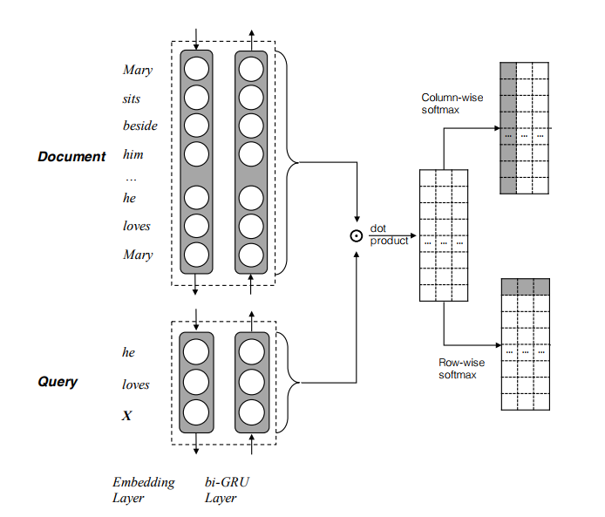

论文模型结构和结果
Seo M, Kembhavi A, Farhadi A, et al. Bidirectional attention flow for machine comprehension[J]. arXiv preprint arXiv:1611.01603, 2016.
BiDAF
max
weighted
tile
interaction
Max 产生的向量用于计算doc向量加权和，向量复制n次
将以上两个矩阵以及原始docembedding 组合产生表示，经过LSTM进行预测，其中用到乘法

Slide 24
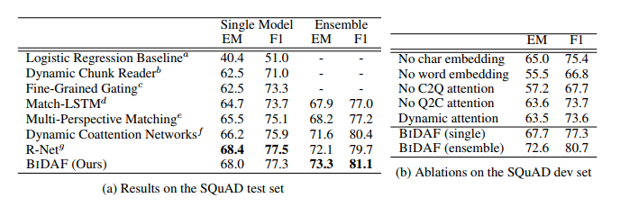
论文模型结构和结果
Match lstm attention

Slide 25
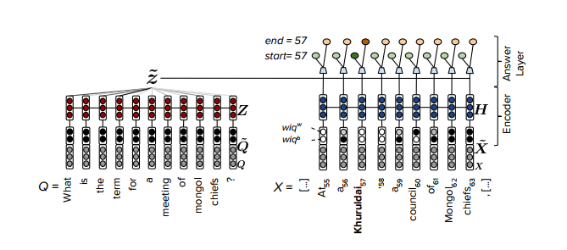
论文模型结构和结果
Weissenborn D, Wiese G, Seiffe L. Making Neural QA as Simple as Possible but not Simpler[C]//Proceedings of the 21st Conference on Computational Natural Language Learning (CoNLL 2017). 2017: 271-280.
simpleQA

Slide 26
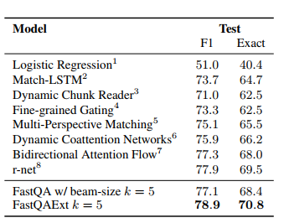
论文模型结构和结果

Slide 27

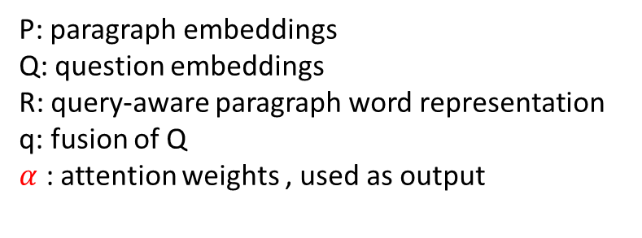

论文模型结构和结果
Chen D, Fisch A, Weston J, et al. Reading Wikipedia to Answer Open-Domain Questions[J]. arXiv preprint arXiv:1704.00051, 2017.
DrQA
P
R
P: paragraph embeddings
Q: question embeddings
R: query-aware paragraph word representation
q: fusion of Q
$α$ : attention weights , used as output
$$α$$
$$α$$
q
Q

Slide 28
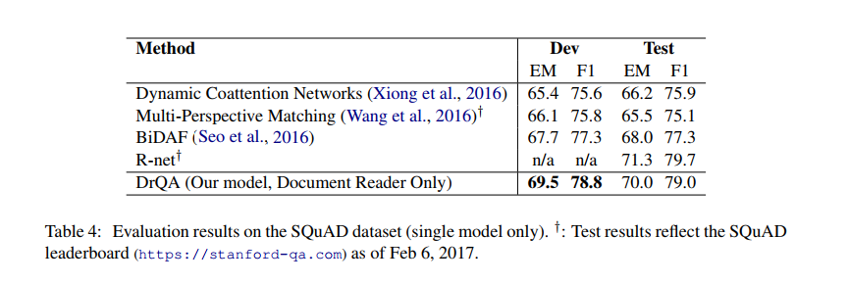
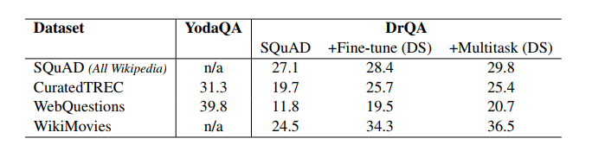
论文模型结构和结果

Slide 29
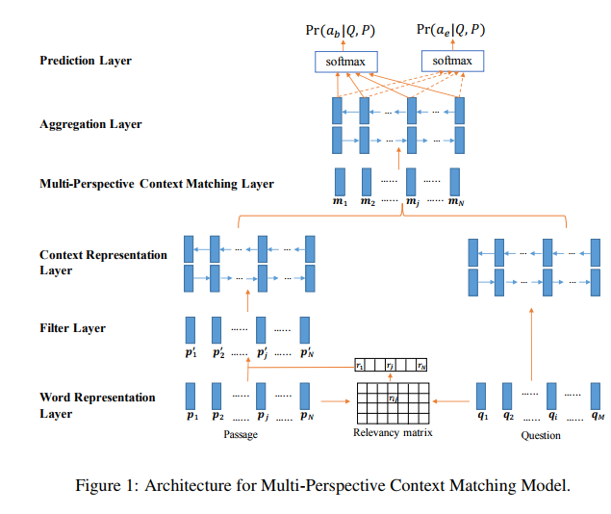



论文模型结构和结果
Wang Z, Mi H, Hamza W, et al. Multi-perspective context matching for machine comprehension[J]. arXiv preprint arXiv:1612.04211, 2016.
Multi-Perspective Matching

Slide 30
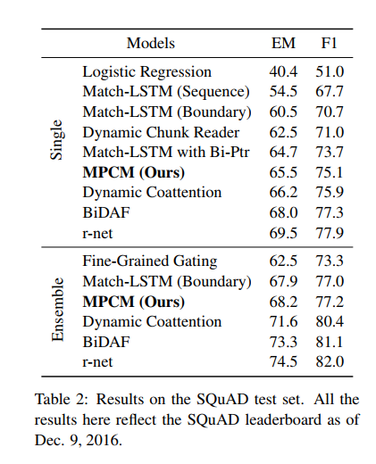
论文模型结构和结果

Slide 31
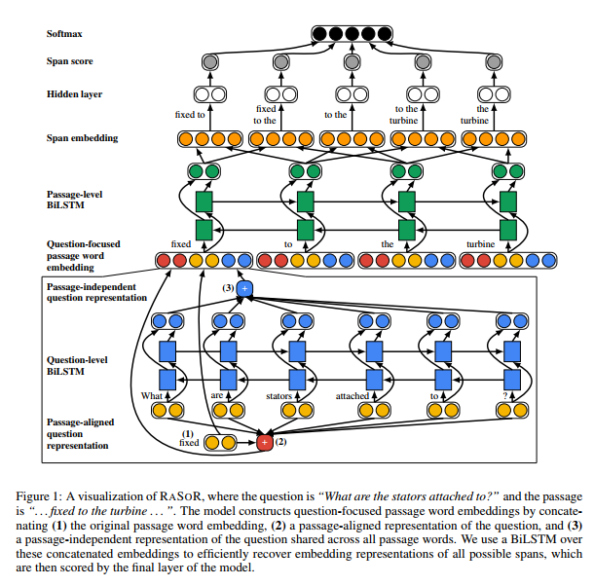
论文模型结构和结果
RaSoR
Answer layer
Similir with DCR
Notes:
Answer 层使用softmax ，span 采用启发式搜索

Slide 32
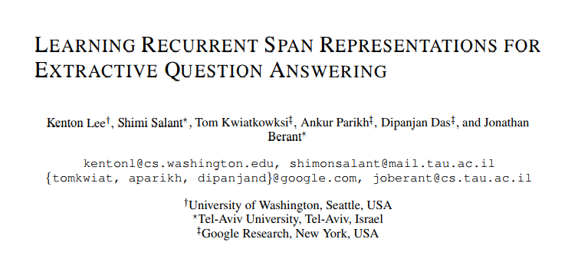
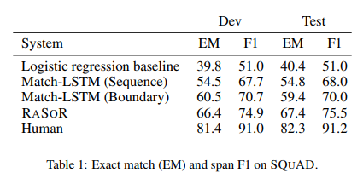
论文模型结构和结果
RaSoR
Similir with DCR
The core of the model relies on a recurrent network that enables shared computation for the shared substructure across span candidates
Notes:
Answer 层使用softmax ，span 采用启发式搜索

Slide 33





论文模型结构和结果
Highlight：
1.Gating （Accelerated convergence）
2.Use question vector to intial answer decoder（more information access）
r-net
$$c_{i}= \sum_{j}{α_{i,j}P_{j}}$$
Self attention
$$α_{i}=softmax\left(s_{i,:}\right)$$
$$s_{ij}=v^{T}tanh\left(W_{1}P_{i}+W_{2}P_{j}\right)=v^{T}tanh⁡([W_{1},W_{2}][P_{i};P_{j}])$$
$$g_{i}=sigmoid(W_{g}[P_{i};c_{i}])$$
$${\left[P_{i};c_{i}\right]= g}_{i}⨀[P_{i};c_{i}]$$
Gating
$$h_{i}=BiRNN(h_{i−1},[P_{i};c_{i}])$$

Slide 34
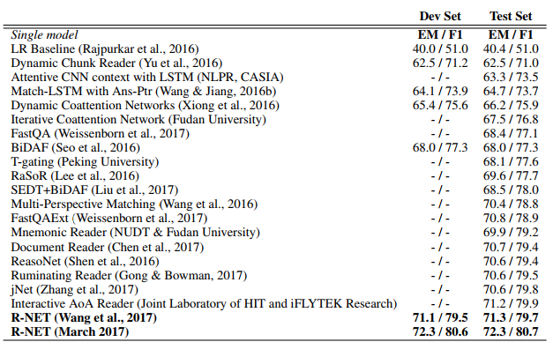

论文模型结构和结果
Note

Slide 35
论文模型结构和结果
Mnemonic Reader
Embedding layer : word + char(CNN) + binary feature question category emb -> highway
Encoding: BiLSTM
Interaction: iterative aligner
Answer layer : multihop answer pointer

Slide 36

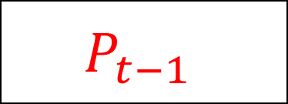
论文模型结构和结果
Mnemonic Reader
iterative aligner
interaction： Attenton + self attention
$$P_{t−1}$$
$$P_{t}$$
Q
T hops

Slide 37




论文模型结构和结果
Mnemonic Reader
Memory-based answer pointer
$$P_{s}$$
$$P_{e}$$
$$Z_{s}$$
$$Z_{e}$$
R
memory

Slide 38
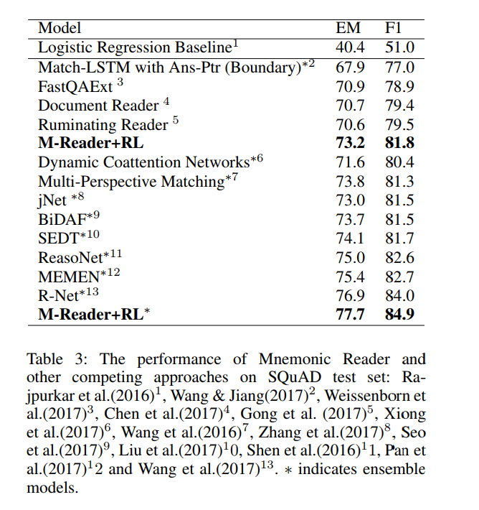
论文模型结构和结果
Mnemonic Reader

Slide 39
论文模型结构和结果
MEMEN
Embedding: word emb + char emb + POS NER emb
Encoder: BILSTM
Interaction: Memory network for Full-orientation Matching
Answer layer : pointer network

Slide 40
论文模型结构和结果
In multiple layers, the integrated hierarchical matching module M can be regarded as the of next layer after a dimensionality reduction processing. We call this memory networks of full-orientation matching.
MEMEN
Memory network for Full-orientation Matching
P
Q
q
Softmax(max(Sim_matrix,dim=1))

Slide 41
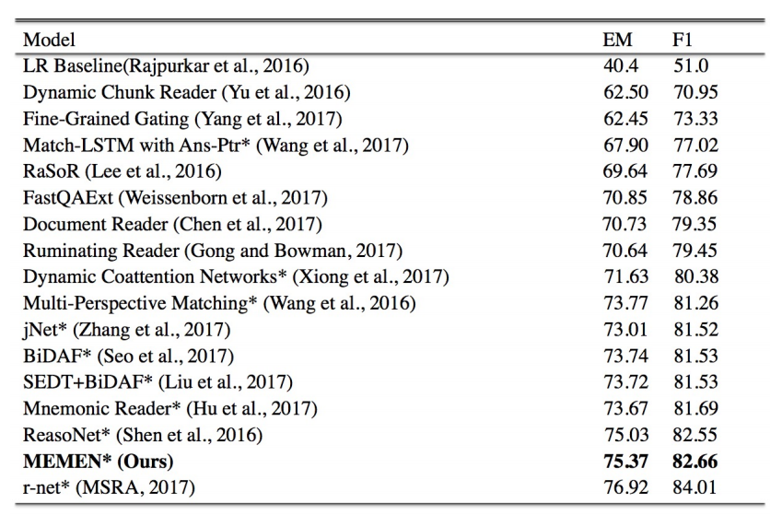
论文模型结构和结果
More interaction
Self attention

Slide 42
论文模型结构和结果
Ruminating Reader
Extension of BiDAF
Embedding: char + word -> concat-> highway
Encoder: BiLSTM
Interaction: context to query attention and query to context attention -> summarization layer(BiLSTM) -> ruminate layer -> second hop attention layer
Answer layer : same as BiDAF

Slide 43
论文模型结构和结果
Ruminating Reader
ruminate layer -> second hop attention layer
Input: summary vector s, paragraph encoding P, question encoding Q
Query ruminate :
s tile |Q| times -> S
Lowercase s,q is one column of S,Q
z = tanh(W1*s + W2*q + b)
f = sigm(W3*s + W4*q + b)
q = f*q + (1-f)z
Same for paragraph
Then start second attention

Slide 44
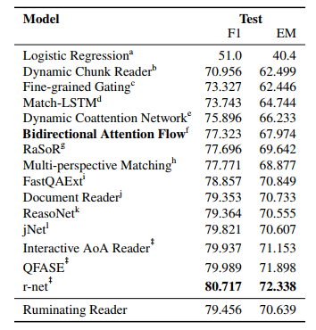
论文模型结构和结果
Ruminating Reader

Slide 45
1.Embedding layer
Word embedding （fix）
Character level embedding (CNN()/RNN)
Word feature： word(context) in question , POS(one hot , embedding), NER, Question TYPE(when how why)
2. Encoder
BiGRU
BILSTM(most)
intra attention
3.Interaction
Single/multiple
Context2query attention, query2context attention
4.Answer layer
Single/multiple hop
Pointer network(3)
Hueristic span (2)
Independent softmax(others)
总结

Slide 46
未完待续

